Slide 1
JAVA
What you learn ?
Java | Expressions
Design Patterns in JAVA | When to use Design Patterns
Singleton Pattern | Factory Pattern
Builder Pattern | Advantages of Design Pattern

Slide 2
Design Patterns in JAVA
Design patterns were first invented by Christopher Alexander in 1977. But later on four developers namely Erich Gamma, Richard Helm, John Vlissides, and Ralph Johnson wrote a book titled, “Gang of Four-Design patterns, elements of reusable object-oriented software” in the year 1995.
From then all the design patterns came to be known as “Gang of Four Design Patterns”.
Design patterns are independent of any programming languages as they are used to solve common object-oriented design problems and are not just limited to a specific programming language. So basically it’s an idea and not an implementation.
Thus using design patterns we can develop programs that are more efficient, flexible, maintainable, and reusable.

Slide 3
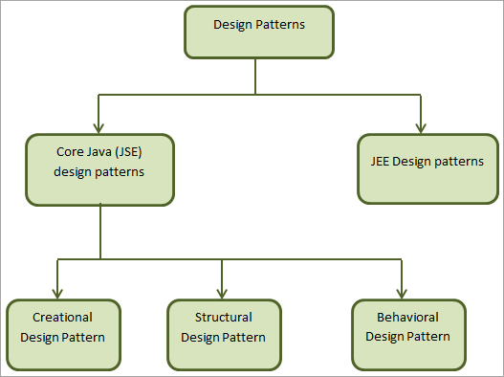
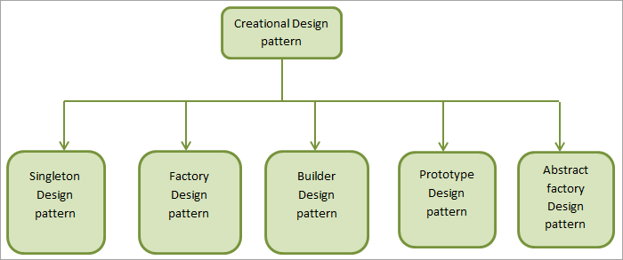
When to use Design Patterns
We usually use a design pattern during the initial Analysis and requirement phase of SDLC (Software Development Life Cycle).
Classification Of Design Patterns :

Slide 4
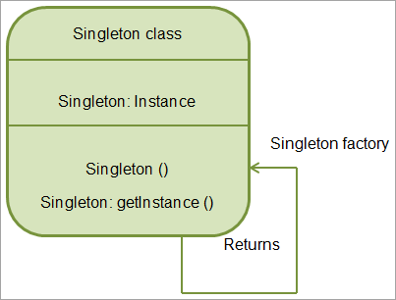
Singleton Pattern
Singleton pattern is a design pattern in which only one instance of a class is present in the Java virtual machine. A singleton pattern restricts the instantiation of a class.
java.awt.Desktop and java.lang.runtime classes
also use a singleton pattern.
Advantages:
As only one instance of the singleton class is used, we save memory.
Also, ensures reusability as the same singleton object is used again and again.

Slide 5
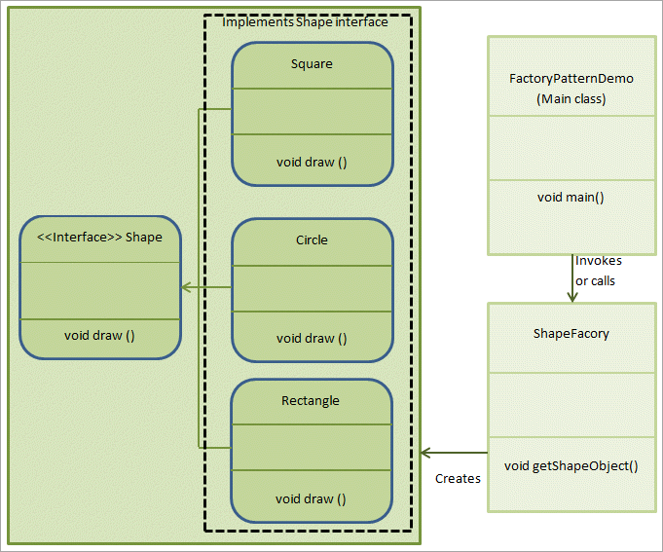
Factory Pattern
The factory pattern is also called “Factory Method pattern” or “Virtual Constructor” in Java.
In this pattern, we create an interface or an abstract class with method declarations, and then the concrete classes or subclasses implementing this interface or inheriting the class are responsible for creating instances of the class.
Advantages:
The factory pattern is a type of creational pattern and is the most commonly used pattern in Java.
By using a factory pattern we ensure that the actual creation logic is not exposed to the outside world.

Slide 6
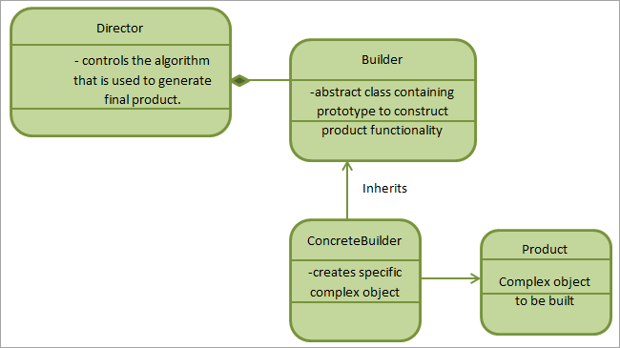
Builder Pattern
In the Builder pattern, we use a step-by-step approach to build a complex object using small, and simple objects.
So whenever we encounter an object that cannot be created in a single step, we go for a builder pattern.
Advantages:
Using the Builder pattern, we can separate the construction and representation of an object.
We also can change the internal representation of the object.
We can build complex designs like an entire delivery system using the builder pattern.

Slide 7
Advantages of Design Pattern
Design patterns are reusable and can be used by multiple projects.
We can define system architecture using design patterns.
Design patterns provide transparency to the application design.
Design patterns are already well-tested and proved so that we can use them without any worries.
Design patterns allow us to build better systems and also provide clarity on system architecture.

Slide 8
Thanks
Anirudha Gaikwad

