Slide 1
JAVA
What you learn ?
Java | Expressions
Prototype Design Pattern | Adapter Design Pattern
Composite Design Pattern | Proxy Design Pattern

Slide 2
Prototype Design Pattern
In the Prototype pattern new objects are created by cloning existing prototype objects.
With prototypes you can create customizable objects without even knowing the details of creating them.
The particular classes don't even have to be known at compile time: you can obtain a prototypical object from some data store (e.g. it could have been serialized). The classes themselves can even be loaded dynamically.
The prototype pattern makes it easy to create a huge variety of objects easily. Factory Methods and Abstract Factories don't.
You can always manufacture new prototypes on the fly!
Prototypical objects need not be jammed into an artificial object hierarchy.
Be careful about shallow copy vs. deep copy.

Slide 3
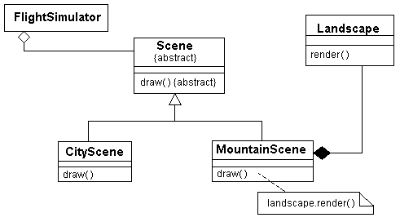
Adapter Design Pattern
In the adapter pattern you use an existing class (that doesn't quite have the right interface) in your application through a new class with the interface you need. In this example, we want to use an existing Landscape class in our flight simulator application, but it doesn't have the right interface, so we create an adapter class called MountainScene:
You can use the adapter pattern as a class adapter (the adapter is a subclass of the adaptee) or an object adapter (the adapter contains the adaptee and forwards to it).

Slide 4
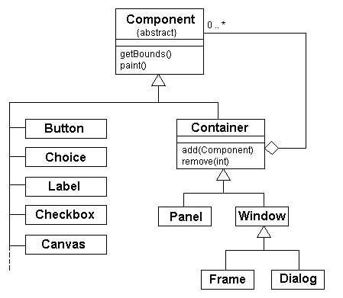
Composite Design Pattern
Use the composite pattern when you have a hierarchy of objects and you want to be able to treat groups of objects as a single object. Here is an example from the Java Core API:
Sometimes you will see an application of this pattern where any component can be a container.
Note that depending on the situation, you may or may not want the children ordered. You may or may not want a container to "own" its components, etc.

Slide 5
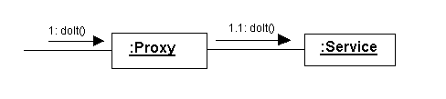
Proxy Design Pattern
A proxy is a placeholder (or surrogate) for another object. Clients access the remote object through the proxy. The proxy has the same interface as the remote object.
The client really doesn't have to know or care that the proxy is even there; the client thinks it is talking to the real object.
You can have remote proxies which are local stand-ins for objects in separate address spaces (even separate machines), virtual proxies for creating expensive objects only when needed, and protection proxies to enforce access rights on certain objects.
The so-called smart pointers (or smart references) are basically proxies.
Protection proxies are great because they decouple the security policy from the service itself.

Slide 6
Thanks
Anirudha Gaikwad

