Slide 1
JAVA
What you learn ?
Java | Expressions
Basic git commands | Git branch
Git remote | Git origin master
Git tags | Git stash
Branching strategies

Slide 2
Basic git commands
Here is a list of most essential Git commands that are used daily.
Git Config command
Git init command
Git clone command
Git add command
Git commit command
Git status command
Git push Command
Git pull command
Git Branch Command
Git Merge Command
Git log command
Git remote command

Slide 3
Basic git commands
1) Git config command
This command configures the user. The Git config command is the first and necessary command used on the Git command line. This command sets the author name and email address to be used with your commits. Git config is also used in other scenarios.
Syntax
$ git config --global user.name "abc1"
$ git config --global user.email "abc1@gmail.com"
2) Git Init command
This command is used to create a local repository.
Syntax
$ git init Demo
The init command will initialize an empty repository. See the below screenshot.

Slide 4
Basic git commands
3) Git clone command
This command is used to make a copy of a repository from an existing URL. If I want a local copy of my repository from GitHub, this command allows creating a local copy of that repository on your local directory from the repository URL.
Syntax
$ git clone URL
4) Git add command
This command is used to add one or more files to staging (Index) area.
Syntax
--To add one file
$ git add Filename
---To add more than one file
$ git add*

Slide 5
Basic git commands
5) Git commit command
Commit command is used in two scenarios. They are as follows.
Git commit -m
This command changes the head. It records or snapshots the file permanently in the version history with a message.
Syntax
$ git commit -m " Commit Message"
Git commit -a
This command commits any files added in the repository with git add and also commits any files you've changed since then.
Syntax
$ git commit -a

Slide 6
Basic git commands
6) Git status command
The status command is used to display the state of the working directory and the staging area. It allows you to see which changes have been staged, which haven't, and which files aren?t being tracked by Git.
Syntax
$ git status
7) Git push Command
It is used to upload local repository content to a remote repository. Pushing is an act of transfer commits from your local repository to a remote repo.
Git push command can be used as follows.
Git push origin master
This command sends the changes made on the master branch, to your remote repository.
Syntax
$ git push [variable name] master
Git push -all
This command pushes all the branches to the server repository.
Syntax
$ git push --all

Slide 7
Basic git commands
8) Git pull command
Pull command is used to receive data from GitHub. It fetches and merges changes on the remote server to your working directory.
Syntax
$ git pull URL
9) Git Branch Command
This command lists all the branches available in the repository.
Syntax
$ git branch
10) Git Merge Command
This command is used to merge the specified branch?s history into the current branch.
Syntax
$ git merge BranchName

Slide 8
Basic git commands
11) Git log Command
This command is used to check the commit history.
Syntax
$ git log
By default, if no argument passed, Git log shows the most recent commits first. We can limit the number of log entries displayed by passing a number as an option, such as -3 to show only the last three entries.
$ git log -3
12) Git remote Command
Git Remote command is used to connect your local repository to the remote server. This command allows you to create, view, and delete connections to other repositories. These connections are more like bookmarks rather than direct links into other repositories. This command doesn't provide real-time access to repositories.

Slide 9
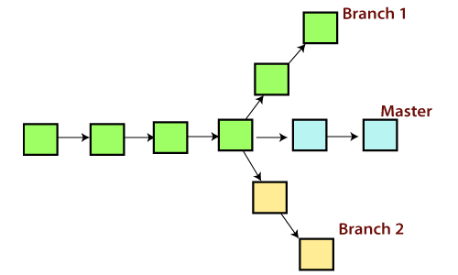
Git branch
In Git, a branch is a new/separate version of the main repository.
A branch is a version of the repository that diverges from the main working project. It is a feature available in most modern version control systems. A Git project can have more than one branch. These branches are a pointer to a snapshot of your changes.

Slide 10
Git branch
Git Master Branch
The master branch is a default branch in Git. It is instantiated when first commit made on the project. When you make the first commit, you're given a master branch to the starting commit point. When you start making a commit, then master branch pointer automatically moves forward. A repository can have only one master branch.
Master branch is the branch in which all the changes eventually get merged back. It can be called as an official working version of your project.

Slide 11
Operations on Branches
Create Branch
You can create a new branch with the help of the git branch command. This command will be used as:
Syntax:
$ git branch <branch name>
List Branch
You can List all of the available branches in your repository by using the following command.
Either we can use git branch - list or git branch command to list the available branches in the repository.
Syntax:
$ git branch --list
or
$ git branch

Slide 12
Operations on Branches
Delete Branch
You can delete the specified branch. It is a safe operation. In this command, Git prevents you from deleting the branch if it has unmerged changes. Below is the command to do this.
Syntax:
$ git branch -d<branch name>
Switch Branch
Git allows you to switch between the branches without making a commit. You can switch between two branches with the git checkout command. To switch between the branches, below command is used:
$ git checkout<branch name>
-Switch to master branch
Syntax:
$ git branch -m master

Slide 13
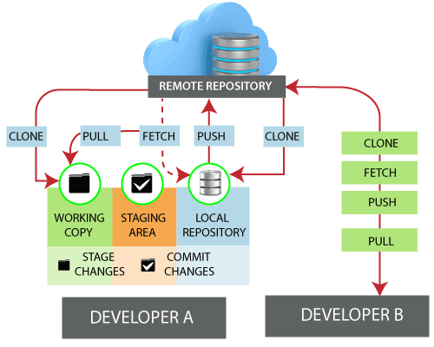
Git remote
In Git, the term remote is concerned with the remote repository. It is a shared repository that all team members use to exchange their changes. A remote repository is stored on a code hosting service like an internal server, GitHub, Subversion, and more.

Slide 14
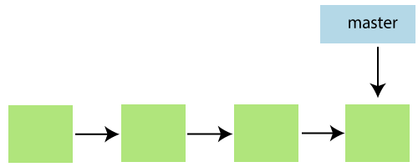
Git origin master
The term "git origin master" is used in the context of a remote repository. It is used to deal with the remote repository. The term origin comes from where repository original situated and master stands for the main branch. Let's understand both of these terms in detail.
Git Master
Master is a naming convention for Git branch. It's a default branch of Git. After cloning a project from a remote server, the resulting local repository contains only a single local branch. This branch is called a "master" branch. It means that "master" is a repository's "default" branch.

Slide 15
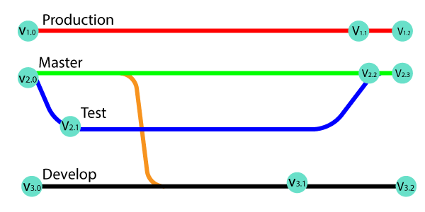
Git tags
Tags make a point as a specific point in Git history. Tags are used to mark a commit stage as relevant. We can tag a commit for future reference. Primarily, it is used to mark a project's initial point like v1.1.
Tags are much like branches, and they do not change once initiated. We can have any number of tags on a branch or different branches. The below figure demonstrates the tags on various branches.

Slide 16
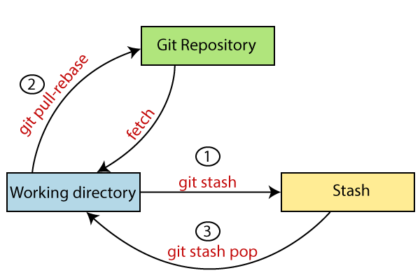
Git stash
Sometimes you want to switch the branches, but you are working on an incomplete part of your current project. You don't want to make a commit of half-done work. Git stashing allows you to do so. The git stash command enables you to switch branches without committing the current branch.
The below figure demonstrates the properties and role of stashing concerning repository and working directory.

Slide 17
Git branching strategies
Keep your branch strategy simple
Build your strategy from these three concepts:
Use feature branches for all new features and bug fixes.
Merge feature branches into the main branch using pull requests.
Keep a high quality, up-to-date main branch.
A strategy that extends these concepts and avoids contradictions will result in a version control workflow for your team that is consistent and easy to follow.

Slide 18
Thanks
Anirudha Gaikwad

