Slide 1
JAVA
What you learn ?
Java | Expressions
Variable | Method
Call by value | Call by reference

Slide 2
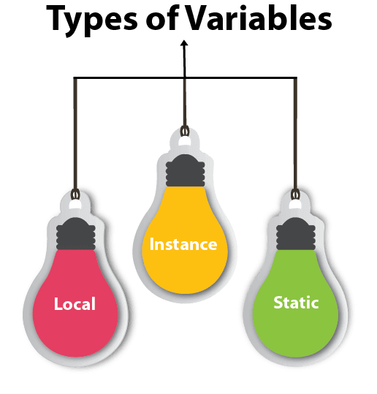
Variables
A variable is a container which holds the value while the Java program is executed. A variable is assigned with a data type. Variable is a name of memory location.
1) Local Variable
A variable declared inside the body of the method is called local variable. You can use this variable only within that method and the other methods in the class aren't even aware that the variable exists.
A local variable cannot be defined with "static" keyword.
2) Instance Variable
A variable declared inside the class but outside the body of the method, is called an instance variable. It is not declared as static.
It is called an instance variable because its value is instance-specific and is not shared among instances.
3) Static variable
A variable that is declared as static is called a static variable. It cannot be local. You can create a single copy of the static variable and share it among all the instances of the class. Memory allocation for static variables happens only once when the class is loaded in the memory.

Slide 3
Variables
class Person{
//Creating instance variables
String name;
int age;
double weight;
//The static variables must be declared as a class member in the class.
static String nationality="INDIAN"; //static variable
public static void main(String args[]){
//This is a local variable and not an instance variable
String name="Rehan";
}
}

Slide 4
Accessing instance Variables
We can access the instance variable using two ways:
Using the "this" keyword
If we want to access the instance members in the methods of the class, we can access them using the "this" keyword which referred to the current object of the class.
Example:
class Person{
int age;
String name;
Person(int age,String name){
//Accessing the instance variable using this keyword.
this.age=age;
this.name=name;
}
}
Using an object of the class
Example:
class Person{
String name;
//Method to print the name of the Person
void printName(){
System.out.println(this.name);
}
public static void main(String args[]){
//Creating an instance of the class
Person ob=new Person();
//Inistaizing the value of the instance
ob.name="Aayush";
//Calling the method of the class
ob.printName();
}
}

Slide 5
Accessing static Variables
// Method 1
// Print the static variable VariableName from class ClassName.
System.out.println(ClassName.VariableName);
// Method 2
// We can access static variables using objects as well
// ob is an object of ClassName class
// This throws a warning that can be ignored
System.out.println(ob.VariableName);

Slide 6
Accessing local Variables
Local variables exist exclusively within the function block and as discussed they cannot be used outside of it.
Even the other functions of the class are unable to access the local variables, they are unaware of their existence.
Java is known to place the local variable in the stack memory area rather than storing it in the heap memory space.
We cannot construct a static local variable since they are class-specific.

Slide 7
Methods
A method is a block of code which only runs when it is called.
You can pass data, known as parameters, into a method.
Methods are used to perform certain actions, and they are also known as functions.
Call a method-
myMethod();
write the method's name followed by two parentheses () and a semicolon;
Create a method-
public class Main {
static void myMethod() {
// code to be executed
}
}
myMethod() is the name of the method
static means that the method belongs to the Main class and not an object of the Main class.
void means that this method does not have a return value.

Slide 8
Methods
A method is a block of code which only runs when it is called.
You can pass data, known as parameters, into a method.
Methods are used to perform certain actions, and they are also known as functions.
Call a method-
methodName();
write the method's name followed by two parentheses () and a semicolon;
Generally, we can pass parameters to a method in two ways-
By value
By reference
However, Java always passes arguments by value and not by reference.
Create a method-
accessModifier returnType methodName(parameters..)
{
//logic of the function
}
Example:
public String convertToString(int number) {
String str = Integer.toString(number);
return str;
}

Slide 9
Types of Methods
Predefined methods in Java:
These are methods that are defined by Java class libraries. They are also called standard library methods or built-in methods. They can be used by directly calling them.
Example:
//sqrt() is an in-built fucntion defined in Math class
System.out.println("Square root of 289 is : " + Math.sqrt(289));
Some examples include print() in the package java.io.PrintStream, min() and max() defined in Math class etc.

Slide 10
Types of Methods
User defined methods in Java:
A method with custom logic is a user-defined method.
Further, there are some other sub-types of user-defined methods.
Static method
Instance method
Abstract method
Factory method

Slide 11
Static Method
A method in a class declared as static does not need an object of the class to invoke it. All the above built-in methods are static, so you could invoke the sqrt() method without creating an object of the Math class.
Example:
class StaticMethodDemo {
static void staticMethod() {
System.out.println("This is a static method.");
}
public static void main(String[] args) {
// No need to create object of the class StaticMethodDemo
StaticMethodDemo.staticMethod();
}
}

Slide 12
Static Method
Instance methods are attached to the objects of a class, rather than the class itself. Here, the method belongs to a class whose object must be created to call the function.
Example:
class InstanceMethodDemo {
public void instanceMethod() {
System.out.println("This is an instance method.");
}
public static void main(String[] args) {
// Create object of the class InstanceMethodDemo
InstanceMethodDemo inst = new InstanceMethodDemo();
inst.instanceMethod();
}
}

Slide 13
Abstract Method
A method without any implementation but only the method signature is called an abstract method. An abstract method can be declared in an abstract class or an interface. A regular class can implement an abstract method by extending the abstract class containing the abstract method.
Example:
abstract class Factorial {
//method declaration
public abstract int findFactorial(int n);
}

Slide 14
Factory Method
The factory method is responsible for creating and returning the objects to the client.
A factory method may accept an input that denotes the type of object that needs to be created. Factory methods belong to a certain design pattern called "Factory pattern" which is a way to dynamically return an object of a class it belongs to, at run-time based on the user's choice.
For example, if we have a program to customize the choice of condiments you can add to your coffee, you can get the object for the chosen condiment on the go when it is created.

Slide 15
Call by value
There is only call by value in java, not call by reference.
If we call a method passing a value, it is known as call by value.
The changes being done in the called method, is not affected in the calling method.
class Operation{
int data=50;
void change(int data){
data=data+100;//changes will be in the local variable only
}
public static void main(String args[]){
Operation op=new Operation();
System.out.println("before change "+op.data);
op.change(500);
System.out.println("after change "+op.data);
}
}
Output: before change 50
after change 50

Slide 16
Call by Reference
Though Java is strictly call by value when we pass the reference of the object it creates a copy of the reference and then passes it as value to the method. The copy reference also points to the same address so all the changes also reflect in the main method this is the main difference between call by value and call by reference in java.
class Ref{
int number=10;
// pass object as parameter
public static void increment(Ref pb){
pb.number = pb.number+1; // increment variable by 1
System.out.println("value in method: "+pb.number);
}
public static void main(String[] args) {
Ref pb=new Ref(); // pb is an object of class Ref
System.out.println("value before method call: "+pb.number);
increment(pb); // pass object of the class Ref
System.out.println("value after method call: "+pb.number);
}
}
Output:
value before method call: 10
value in method: 11
value after method call: 11

Slide 17
Thanks
Anirudha Gaikwad

