Slide 1
JAVA
What you learn ?
Java | Expressions
OOP concepts | Object
Class | Method
Constructor | static keyword
this keyword

Slide 2
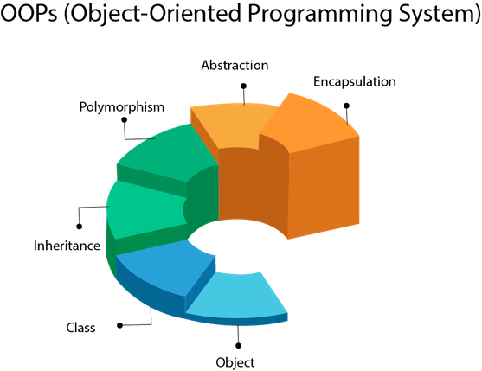
OOP concept
Object-Oriented Programming is a paradigm that provides many concepts, such as inheritance, data binding, polymorphism, etc.

Slide 3
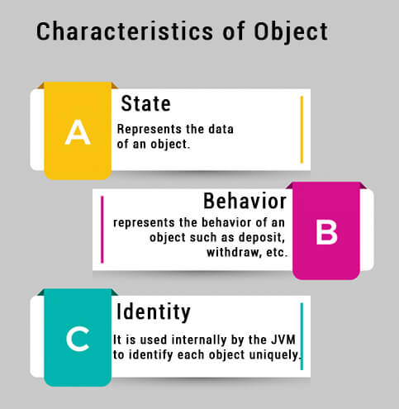
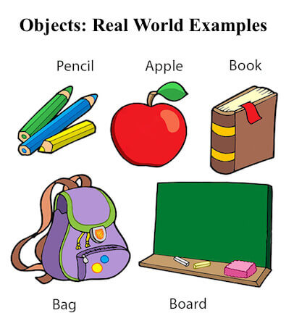
Object
An entity that has state and behavior is known as an object.
An object is an instance of a class. A class is a template or blueprint from which objects are created. So, an object is the instance(result) of a class.

Slide 4
Class
A class is a group of objects which have common properties. It is a template or blueprint from which objects are created. It is a logical entity. It can't be physical.
A class in Java can contain:
Fields
Methods
Constructors
Blocks
Nested class and interface
Syntax to declare a class:
class <class_name>{
field;
method;
}

Slide 5
Example of object and class
Object and Class Example: main outside the class
//Java Program to demonstrate having the main method in
//another class
//Creating Student class.
class Student{
int id;
String name;
}
//Creating another class TestStudent1 which contains the main method
class TestStudent1{
public static void main(String args[]){
Student s1=new Student();
System.out.println(s1.id);
System.out.println(s1.name);
}
}
Object and Class Example: main within the class
//Defining a Student class.
class Student{
//defining fields
int id;//field or data member or instance variable
String name;
//creating main method inside the Student class
public static void main(String args[]){
//Creating an object or instance
Student s1=new Student();//creating an object of Student
System.out.println(s1.id);//accessing member through reference variable
System.out.println(s1.name);
}
}

Slide 6
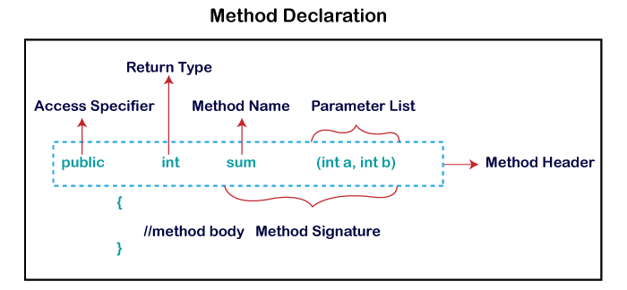
Method
A method is a block of code or collection of statements or a set of code grouped together to perform a certain task or operation. It is used to achieve the reusability of code.
Types of Method-
Predefined Method- Method that is already defined in the Java class libraries is known as predefined methods.
User-defined Method- The method written by the user or programmer is known as a user-defined method. These methods are modified according to the requirement.

Slide 7
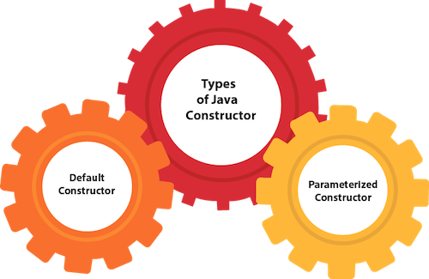
Constructor
In Java, a constructor is a block of codes similar to the method. It is called when an instance of the class is created. At the time of calling constructor, memory for the object is allocated in the memory.
Rules for creating Java constructor-
Constructor name must be the same as its class name
A Constructor must have no explicit return type
A Java constructor cannot be abstract, static, final, and synchronized

Slide 8
Example of constructor
No-arg constructor-
public class Main {
int x; // Create a class attribute
// Create a class constructor for the Main class
public Main() {
x = 5; // Set the initial value for the class attribute x
}
public static void main(String[] args) {
Main myObj = new Main(); // Create an object of class Main (This will call the constructor)
System.out.println(myObj.x); // Print the value of x
}
}
// Outputs 5
Parameterized constructor-
public class Main {
int x;
public Main(int y) {
x = y;
}
public static void main(String[] args) {
Main myObj = new Main(5);
System.out.println(myObj.x);
}
}
// Outputs 5

Slide 9
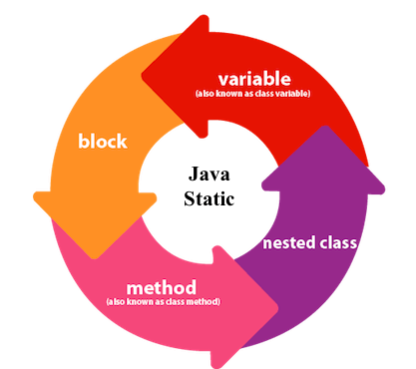
static keyword
The static keyword in Java is used for memory management mainly.

Slide 10
static keyword Example
class Test
{ static int a = m1(); // static variable
static { // static block that gets executed exactly once, when the class is first loaded.
System.out.println("Inside static block");
}
static int m1() {// static method
System.out.println("from static m1() ");
return 20;
}
// static method(main !!)
public static void main(String[] args)
{
System.out.println("Value of a : "+a);
System.out.println("from main method");
}
}
Output :
from static m1()
Inside static block
Value of a : 20
from main method

Slide 11
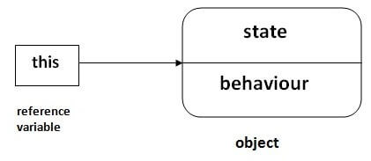
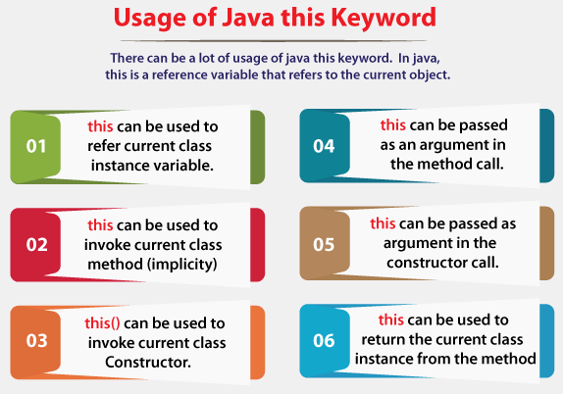
this keyword
There can be a lot of usage of Java this keyword. In Java, this is a reference variable that refers to the current object.
public class Main {
int x;
// Constructor with a parameter
public Main(int x) {
this.x = x;
}
// Call the constructor
public static void main(String[] args) {
Main myObj = new Main(5);
System.out.println("Value of x = " + myObj.x);
}
}

Slide 12
Object class in JAVA
The Object class is the parent class of all the classes in java by default. In other words, it is the topmost class of java.
Object obj=getObject();
//we don't know what object will be returned from this method
The Object class provides some common behaviors to all the objects such as object can be compared, object can be cloned, object can be notified etc.

Slide 13
equals() method in JAVA
The equals() method is defined in the Object class in Java. By default, it uses the == operator for comparison. However, equals() method can be overridden to provide custom logic to compare two objects.
When we want to compare two objects based on some logic, we need to override the equals() method in the corresponding class of those objects.
Thus equals() methods compare two entities and return true if they are logically the same. Since equals() is a method defined in the Object class thus the default implementation of the equals() method compares the object references or the memory location where the objects are stored in the heap.
Thus by default the equals() method checks the object by using the “==” operator.

Slide 14
Thanks
Anirudha Gaikwad

