Slide 1
JAVA
What you learn ?
Java | Expressions
What is inheritance? | Types of inheritance
Problem with Multiple inheritance | Aggregation

Slide 2
Inheritance
Inheritance in Java is a mechanism in which one object acquires all the properties and behaviors of a parent object.
Inheritance represents the IS-A relationship.
Why use inheritance in java
For Method Overriding (so runtime polymorphism can be achieved).
For Code Reusability.
Terms used in Inheritance:
Class: It is a template or blueprint from which objects are created.
Sub Class/Child Class: Subclass is a class which inherits the other class.
Super Class/Parent Class: Superclass is the class from where a subclass inherits the features.
Reusability: You can use the same fields and methods already defined in the previous class.

Slide 3
Inheritance
Example:
class Employee{
float salary=40000;
}
class Programmer extends Employee{
int bonus=10000;
public static void main(String args[]){
Programmer p=new Programmer();
System.out.println("Programmer salary is:"+p.salary);
System.out.println("Bonus of Programmer is:"+p.bonus);
}
}
Output:
Programmer salary is:40000.0
Bonus of programmer is:10000
Syntax-
class Subclass-name extends Superclass-name
{
//methods and fields
}
The extends keyword indicates that you are making a new class that derives from an existing class. The meaning of "extends" is to increase the functionality.

Slide 4
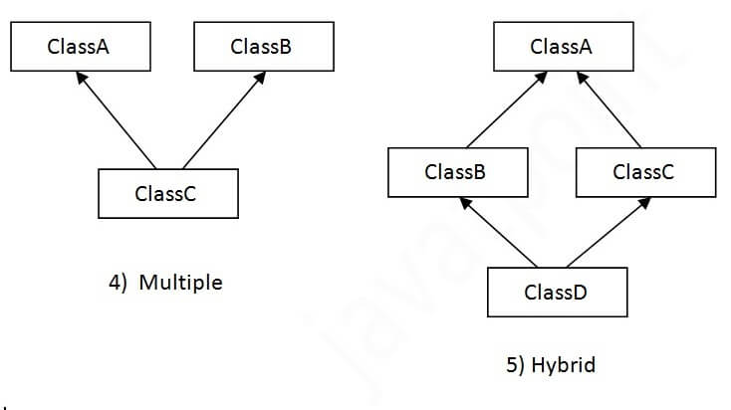
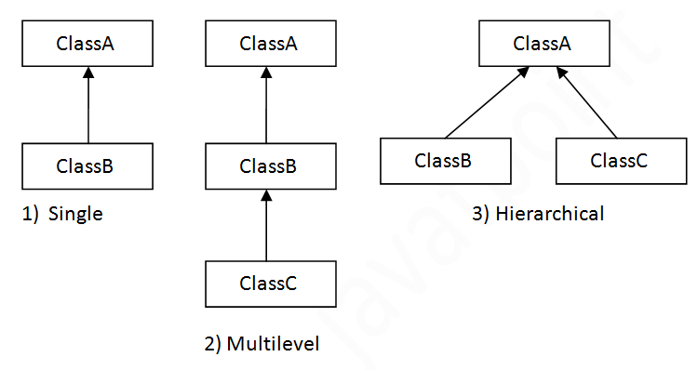
Types of inheritance
Note: Multiple inheritance is not supported in Java through class.

Slide 5
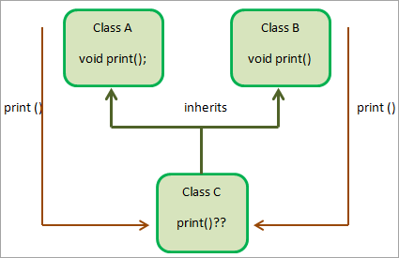
Problem with Multiple Inheritance
To reduce the complexity and simplify the language, multiple inheritance is not supported in java.
Consider a scenario where A, B, and C are three classes. The C class inherits A and B classes. If A and B classes have the same method and you call it from child class object, there will be ambiguity to call the method of A or B class.
Since compile-time errors are better than runtime errors, Java renders compile-time error if you inherit 2 classes. So whether you have same method or different, there will be compile time error.

Slide 6
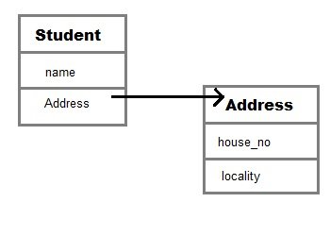
Aggregation
If a class have an entity reference, it is known as Aggregation.
Aggregation represents HAS-A relationship.
class Employee{
int id;
String name;
Address address;//Address is a class
...
}
In such case, Employee has an entity reference address, so relationship is Employee HAS-A address.

Slide 7
Thanks
Anirudha Gaikwad

