Slide 1
JAVA
What you learn ?
Java Data Types – Type Casting
Data Types | Unicode System
Type Casting | User Input

Slide 2
Data Types
A data type in programming is a classification of data that defines the type of values that a variable.
In Java, there are two categories of data types: Primitive data types and Not-Primitive(reference) data types.
Primitive data types are simple and usually small in size, and they are passed by value, which means that when they are used as parameters in a method, the method receives a copy of the value rather than a reference to the original variable.
They are built-in to the programming language

Slide 3
Data Types
Non-Primitive (Reference) data types are more complex data types that represent objects and other more complicated data structures. They are composed of smaller data types and are usually created by the programmer. Examples of reference data types in Java include String, Arrays, Classes, Interfaces, and Enumerations.
Reference data types are usually larger in size, and they are passed by reference, which means that when they are used as parameters in a method, the method receives a reference to the original variable rather than a copy of the value.

Slide 4
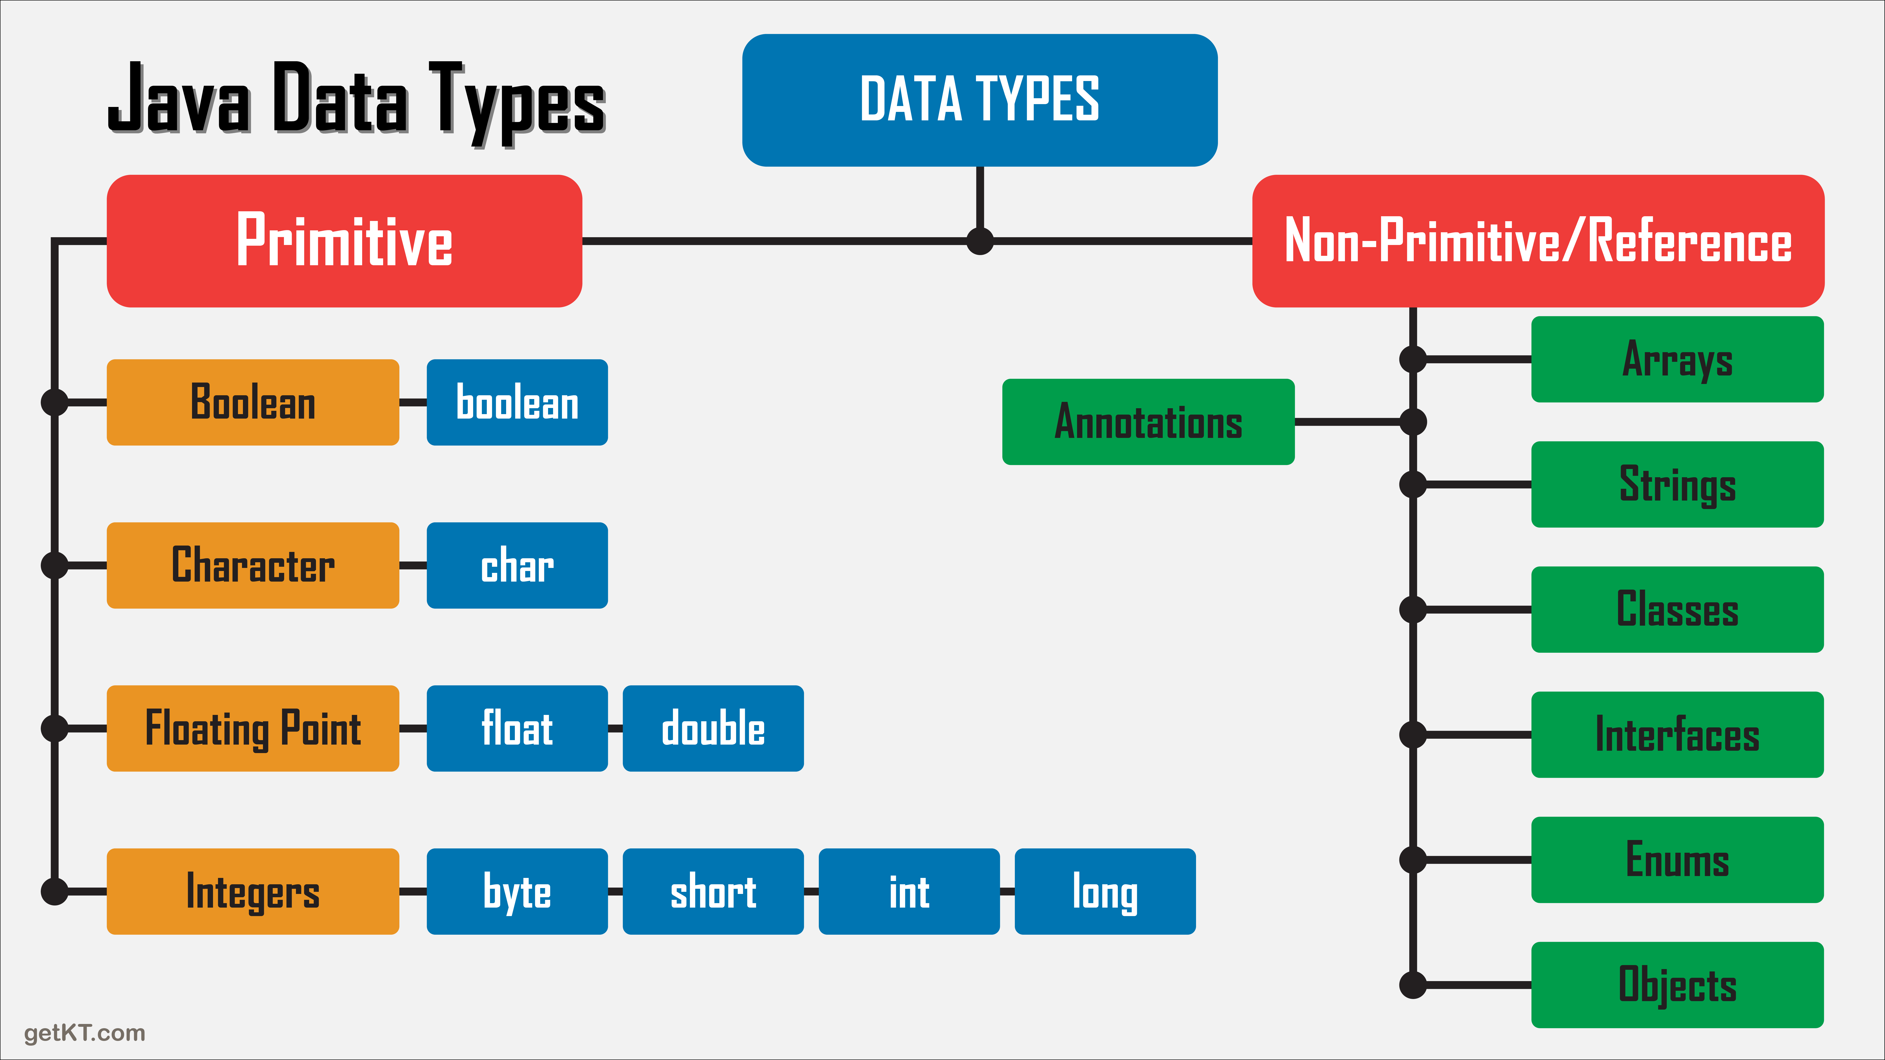
Classification of Data Types

Slide 5
Default value & size for Primitive Data Types
Data Type | Default Value | Default size
boolean | false | 1 bit
char | '\u0000' | 2 byte
byte | 0 | 1 byte
short | 0 | 2 byte
int | 0 | 4 byte
long | 0L | 8 byte
float | 0.0f | 4 byte
double | 0.0d | 8 byte

Slide 6
Important about Char Data Type
Why char uses 2 byte in Java
In Java, the char data type uses 2 bytes (16 bits) to represent a single Unicode character. This is because the Unicode character set contains a large number of characters, including non-Latin characters and special characters, that require more than 1 byte to be represented
Because the char data type uses 2 bytes per character, it allows Java to represent a wide range of characters from the Unicode character set, including characters from non-Latin scripts such as Hindi,Chinese, Japanese, and Arabic.
minimum value is '\u0000' (or 0)= NULL, and its maximum value is '\uffff' (or 65,535) = ‘?’.
https://home.unicode.org/

Slide 7
Why JAVA uses Unicode system?
Java uses the Unicode system because it provides a consistent way of representing characters from all languages, including those that require multiple bytes to represent them. The Unicode standard assigns a unique code point to every character in every language, making it possible for software developers to handle text in a variety of languages without having to worry about encoding issues.
The use of Unicode in Java is a key factor in making it a powerful and flexible language for developing applications that can work in a global environment.

Slide 8
Type Cast
Casting is process of changing one type value to another type in java
1) Implicit Type Casting(Widening Casting) :
byte-->short-->int-->long-->float-->double
Implicit type casting, also known as widening or automatic type promotion, occurs when the conversion is done automatically by the compiler. This happens when a value of a smaller data type is assigned to a variable of a larger data type.
2) Explicit Type Casting(Narrowing Casting)
double-->float-->long-->int-->short-->byte
Explicit type casting, also known as narrowing or manual type conversion, occurs when the conversion is done manually by the programmer. This happens when a value of a larger data type is assigned to a variable of a smaller data type. In this case, the programmer needs to use a type casting operator to explicitly cast the value to the desired data type

Slide 9
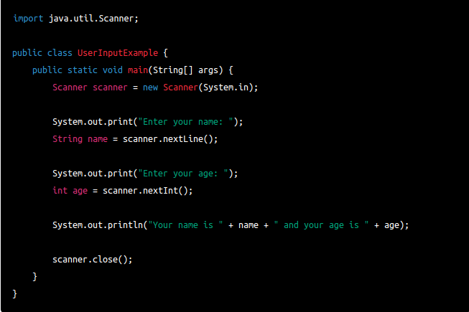
Take user input in JAVA
Java Scanner Class
In Java, you can take user input using the Scanner class, which is part of the java.util package. The Scanner class provides methods to read input from various sources, such as the keyboard or a file.

Slide 10
Take user input in JAVA
Methods of Scanner class:
Method | Description
int nextInt() | It is used to scan the next token of the input as an integer.
float nextFloat() | It is used to scan the next token of the input as a float.
double nextDouble() | It is used to scan the next token of the input as a double.
byte nextByte() | It is used to scan the next token of the input as a byte.
String nextLine() | Advances this scanner past the current line.
boolean nextBoolean() | It is used to scan the next token of the input into a boolean value.
long nextLong() | It is used to scan the next token of the input as a long.
short nextShort() | It is used to scan the next token of the input as a Short.
BigInteger nextBigInteger() | It is used to scan the next token of the input as a BigInteger.
BigDecimal nextBigDecimal() | It is used to scan the next token of the input as a BigDecimal.

Slide 11
Wrapper class in JAVA
The wrapper class in Java provides the mechanism to convert primitive into object and object into primitive.
Since J2SE 5.0, autoboxing and unboxing feature convert primitives into objects and objects into primitives automatically. The automatic conversion of primitive into an object is known as autoboxing and vice-versa unboxing.
Use of Wrapper classes in Java
Java is an object-oriented programming language, so we need to deal with objects many times like in Collections, Serialization, Synchronization, etc.
Change the value in Method: Java supports only call by value. So, if we pass a primitive value, it will not change the original value. But, if we convert the primitive value in an object, it will change the original value.
Serialization: We need to convert the objects into streams to perform the serialization. If we have a primitive value, we can convert it in objects through the wrapper classes.
Synchronization: Java synchronization works with objects in Multithreading.
java.util package: The java.util package provides the utility classes to deal with objects.
Collection Framework: Java collection framework works with objects only. All classes of the collection framework deal with objects only.

Slide 12
Wrapper class in JAVA
The eight classes of the java.lang package are known as wrapper classes in Java. The list of eight wrapper classes are given below:
Primitive Type | Wrapper class
boolean | Boolean
char | Character
byte | Byte
short | Short
int | Integer
long | Long
float | Float
double | Double
// Autoboxing- primitive to Character object conversion
char ch = 'a';
Character a = ch;
// unboxing - Character object to primitive conversion
Character ch = 'a';
char a = ch;

Slide 13
Thanks
Anirudha Gaikwad

