Slide 1


Live Project Training Python-Django Framework with Online Internship Certification
instructor: Anirudha Anil Gaikwad
Python-Django

Slide 2
What you learn ?
Python Django
What is Django | How to install Django
Virtual Environment | MVT Pattern
Django Models | Django Views
Django Templates | Django Forms
Django Admin
Python-Django

Slide 3
What is Django
Django is a high-level Python Web framework that encourages rapid development and clean, pragmatic design. Built by experienced developers, it takes care of much of the hassle of Web development, so you can focus on writing your app without needing to reinvent the wheel. It’s free and open source.
Django makes it easier to build better Web apps more quickly and with less code.
Python-Django

Slide 4
What is Django
Visit here to find out more info | https://www.djangoproject.com/
Python-Django

Slide 5
Virtual Environment
The virtual environments module provides support for creating lightweight “virtual environments” with their own site directories, optionally isolated from system site directories. Each virtual environment has its own Python binary (which matches the version of the binary that was used to create this environment) and can have its own independent set of installed Python packages in its site directories.
Python-Django

Slide 6
Install virtualenv
How Install virtualenv
~ pip install virtualenv
Open terminal and create project directory --- > eg. myproject
~ mkdir myproject
~ cd myproject
Install Virtual Environment Inside the myproject folder
~ virtualenv venv -p python3.8.5
Now before we start using it, we need to activate:
~ venv\Scripts\activate
Python-Django

Slide 7
Install Django
Install Django using following command
~ pip install Django
To start a new Django project, run the below command
~ django-admin startproject myproject
For create apps in your Django project
~ python manage.py startapp appName
Go to project directory and run server locally
~ python manage.py runserver
Python-Django

Slide 8
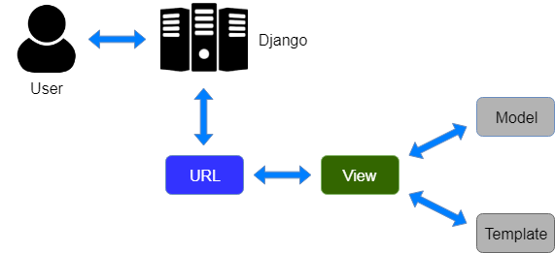
MVT Pattern
Python-Django

Slide 9
Django Templates
Being a web framework, Django needs a convenient way to generate HTML dynamically. The most common approach relies on templates. A template contains the static parts of the desired HTML output as well as some special syntax describing how dynamic content will be inserted.
Templates engines are configured with the TEMPLATES setting.
Create directory “templates” in Django Project and add
“ 'DIRS': [os.path.join(BASE_DIR, 'templates')], “in settings.py
Import os module in settings.py “ import os “
Python-Django

Slide 10
Django Views
A view function is a Python function that takes a Web request and returns a Web response. This response can be the HTML contents of a Web page, or a redirect, or a 404 error, or an XML document, or an image.
from django.http;import HttpResponse;import datetime
def current_datetime(request):
now=datetime.datetime.now()html="<html><body>It is now %s.</body></html>"%now
return HttpResponse(html)
Python-Django

Slide 11
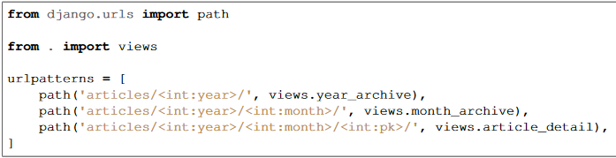
Django URLconfs
A clean, elegant URL scheme is an important detail in a high-quality Web application.
To design URLs for an app, you create a Python module called a URLconf. A table of contents for your app, it contains a mapping between URL patterns and Python callback functions. URLconfs also serve to decouple URLs from Python code
Python-Django

Slide 12
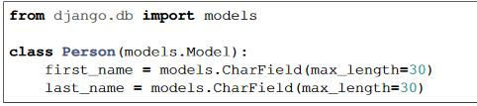
Django Models
A model is the single, definitive source of information about your data. It contains the essential fields and behaviors of the data you’re storing. Generally, each model maps to a single database table.
The basics:
Each model is a Python class that subclasses django.db.models.Model.
Each attribute of the model represents a database field.
With all of this, Django gives you an automatically-generated database-access API
Python-Django

Slide 13

Django Forms
Django provides a range of tools and libraries to help you build forms to accept input from site visitors, and then process and respond to the input.
GET and POST are the only HTTP methods to use when dealing with forms.
Python-Django

Slide 14
Django Admin
One of the most powerful parts of Django is the automatic admin interface. It reads metadata from your models toprovide a quick, model-centric interface where trusted users can manage content on your site. The admin’s recommended use is limited to an organization’s internal management tool.
It’s not intended for building your entire frontend around. The admin has many hooks for customization, but beware of trying to use those hooks exclusively. If you need to provide a more process centric interface that abstracts away the implementation details of database tables and fields, then it’s probably time to write your own views.
Python-Django

Slide 15
THANKS
Python-Django

