Slide 1


Live Project Training Python-Django Framework with Online Internship Certification
instructor: Anirudha Anil Gaikwad
Python DBMS

Slide 2
What you learn ?
Python Database Interaction
Python With RDBMS | CURD
 | Database interaction Methods
Python DBMS

Slide 3
Install the Relational DBMS
Install MySQL Community Server from https://dev.mysql.com/downloads/mysql/
Or
You can Install PostgreSQL from
https://www.postgresql.org/download/
For More Information Visit - https://www.postgresql.org/docs/
https://dev.mysql.com/doc/
Python DBMS

Slide 4
database connector
To use MySQL with our project, we will need a Python 3 database connector library compatible with Django---> install any one
~ pip install mysqlclient
~ pip install django mysqlclient
~ pip install mysql-connector-python
To use PostgreSQL with our project, we will need a Python 3 database connector library compatible with Django-
~ pip3 install psycopg2-binary
Python DBMS

Slide 5
Database interaction Methods
connect(host,user,passwd,database)
cursor()
commit()
execute(sqlquery) ---> Single Query
executescript(sqlqueries) ---> String of Query seprate by ;
executemany() ---> parameterized Query
cursor.fetchone() ----> fetch one row
cursor.fetchall() ----> fetch all row
cursor.fetchmany() ----> fetch number of row
Python DBMS

Slide 6
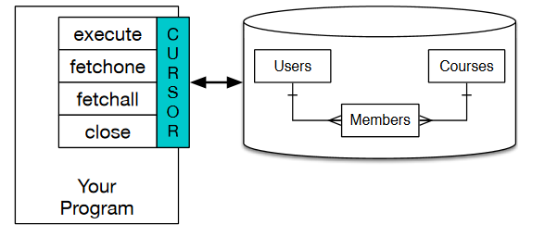
A cursor is like a file handle that we can use to perform operations on the data stored in the database
Python DBMS

Slide 7
THANKS
Python DBMS

