Slide 1


Live Project Training Python-Django Framework with Online Internship Certification
instructor: Anirudha Anil Gaikwad
Web Technology

Slide 2
What you learn ?
Web Technology - Improve your frontend development skills
What is WWW & Web Standards | Understand HTTP - HTTP request message, HTTP response message
Client & Server Architecture, Client and Server Scripting Languages | What is HTML & How to use it?
What is CSS & How to use it? | What is JavaScript & How to use it?
Types of Websites(Static and Dynamic Websites)
Web Technology

Slide 3
World Wide Web
The World Wide Web, commonly known as the Web, is an information system where documents and other web resources are identified by Uniform Resource Locators, which may be interlinked by hypertext, and are accessible over the Internet.
The resources of the WWW are transferred via the Hypertext Transfer Protocol and may be accessed by users by a software application called a web browser and are published by a software application called a web server.
Web Technology

Slide 4
Web Standards
W3C standards define an Open Web Platform for application development that has the unprecedented potential to enable developers to build rich interactive experiences.
Web Design and Applications | Web of Devices
Web Architecture | Semantic Web
XML Technology | Web of Services
Browsers and Authoring Tools
World Wide Web Consortium(W3C)
Web Technology

Slide 5
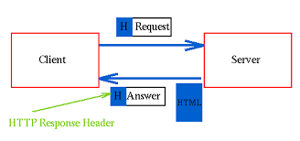
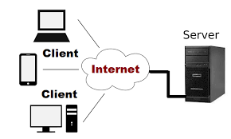
Client & Server Architecture
Web Technology

Slide 6
Client & Server Side Scripting Languages
Client Side Scripting Language | Server Side Scripting Language
HTML,CSS,JAVASCRIPT etc. | PYTHON,JAVA,PHP etc.
Web Technology

Slide 7
Understand HTTP & Messages
What is Hypertext Transfer Protocol (HTTP) ?
HTTP Messages – Request ,Response
HTTP request methods
HTTP response status codes
Web Technology

Slide 8
Frontend Technology
What we see and interact with as the visitors of a website, or as the end user of a mobile app, is considered front-end technology
there are only a few generic languages understood by all web browsers. These three main front-end coding languages are HTML, CSS and JavaScript
All other libraries and front-end engineering are built upon these three main languages, which makes them must-have skills for any front-end developer.
Web Technology

Slide 9
Introduction to HTML
HTML stands for Hyper Text Markup Language. HTML is a markup language to give structure to the content in web documents.
Like your software's are generally .exe files, text is .txt, likewise, nearly all of the content we see on the internet is stored as html files.
HTML is the basic coding format of the web. It is a simple but powerful language to show all kinds of content on the web.
Web Technology

Slide 10
Introduction to HTML
Every HTML file starts and ends with opening and closing html tag.
HTML tags are keywords (tag names) surrounded by angle brackets. An opening tag is written as <TAGNAME>, where TAGNAME is the name of the Tag and the closing tag is </TAGNAME>
HTML Tags comes in pair usually (with a few exceptions), the opening tag first and then the closing tag.
Hence the opening and closing html tags will be like <html> </html>
Web Technology

Slide 11
HTML Elements
lists some useful HTML elements, which are created using tags. They are grouped by function to help you find what you have in mind easily.
Main root | <html>
Document metadata | <head>, <link>, <meta>, <style>, <title>
Sectioning root | <body>
Content sectioning | <address>, <aside>, <footer>, <header>, <h1>, <h2>, <h3>, <h4>, <h5>, <h6>, <main>, <nav>, <section>
Text content | <div>, <hr>, <li>, <ol>, <p>, <ul>
Inline text semantics | <a>, <b>, <br>, <i>, <span>, <small>, <strong>, <sub>, <sup>
Image and multimedia | <audio>, <img>, <video>
Embedded content | <iframe>
Scripting | <script>
Table content | <table>, <tbody>, <td>, <tfoot>, <th>, <thead>, <tr>
Forms | <form>, <button>, <input>, <label>, <select>
Web Technology

Slide 12
Introduction to CSS
CSS (an abbreviation of Cascading Style Sheets) is the language that we use to style an HTML file, and tell the browser how should it render the elements on the page
CSS is a style sheet language.
CSS is among the core languages of the open web and is standardized across Web browsers according to W3C specifications
https://www.w3.org/Style/CSS/#specs
Web Technology

Slide 13
CSS Selectors
Selector helps us identify HTML elements on which a particular style has to be applied.
Selectors are of 3 types, namely,
element Selectors
id Selectors
class Selectors
Selector name | What does it select | Example
Element selector (sometimes called a tag or type selector) | All HTML elements of the specified type. | p selects <p>
ID selector | The element on the page with the specified ID. On a given HTML page, each id value should be unique. | #my-id selects <p id="my-id"> or <a id="my-id">
Class selector | The element(s) on the page with the specified class. Multiple instances of the same class can appear on a page. | .my-class selects <p class="my-class"> and <a class="my-class">
Web Technology

Slide 14
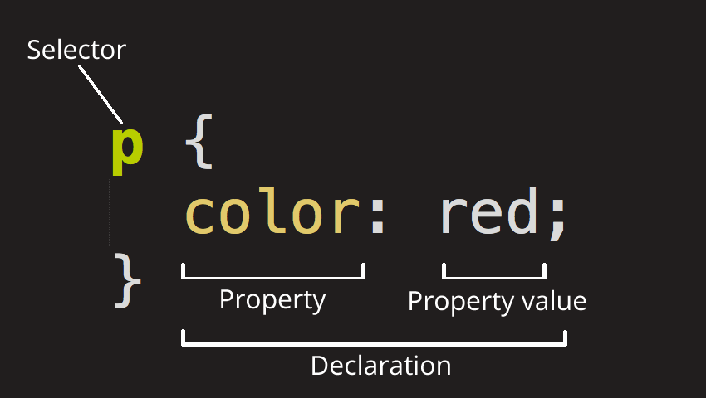
CSS Selectors
Web Technology

Slide 15
CSS Selectors
Selector
This is the HTML element name at the start of the ruleset. It defines the element(s) to be styled (in this example, <p> elements). To style a different element, change the selector.
Declaration
This is a single rule like color: red;. It specifies which of the element's properties you want to style.
Properties
These are ways in which you can style an HTML element. (In this example, color is a property of the <p> elements.) In CSS, you choose which properties you want to affect in the rule.
Property value
To the right of the property—after the colon—there is the property value. This chooses one out of many possible appearances for a given property. (For example, there are many color values in addition to red.)
Web Technology

Slide 16
CSS Syntax
Note the other important parts of the syntax:
Apart from the selector, each ruleset must be wrapped in curly braces. ({})
Within each declaration, you must use a colon (:) to separate the property from its value or values.
Within each ruleset, you must use a semicolon (;) to separate each declaration from the next one.
p {
color: red;
width: 500px;
border: 1px solid black;
}
Web Technology

Slide 17
How to use CSS in HTML
1) Internal CSS – use in HTML HEAD Tag
<style>h1 { color: magenta; text-align: center;} </style>
2) Use External CSS - link tag inside the head (between the <head> and
</head> tags)
<link href="styles/style.css" rel="stylesheet">
3) Use inline CSS with HTML Tags
<h1 style="color:blue;text-align:center;">This is a heading</h1>
Web Technology

Slide 18
Introduction to JavaScript
JavaScript is a scripting language that enables you to create dynamically updating content, control multimedia, animate images.
JavaScript is a prototype-based, multi-paradigm, single-threaded, dynamic language, supporting object-oriented, imperative, and declarative (e.g. functional programming)
JavaScript contains a standard library of objects, such as Array, Date, and Math, and a core set of language elements such as operators, control structures, and statements
Web Technology

Slide 19
Introduction to JavaScript
JavaScript is standardized at Ecma International —the European association for standardizing information and communication systems (ECMA was formerly an acronym for the European Computer Manufacturers Association) to deliver a standardized, international programming language based on JavaScript
ECMAScript standards are on yearly release cycles. This documentation refers to the latest draft version, which is currently ECMAScript 2020.
Browsers use their own JavaScript Engines to execute the JavaScript code. Some commonly used browsers are listed below:
Chrome uses a V8 engine.
Firefox uses the Spider Monkey engine.
Microsoft Edge uses the Chakra Core engine.
Safari uses the Squirrel Fish engine.
Web Technology

Slide 20
JavaScript Syntax
(function(){
"use strict";
/* Start of your code */
function greetMe(yourName) {
alert('Hello ' + yourName);
}
greetMe('World');
/* End of your code */
})();
Web Technology

Slide 21
Include JavaScript in HTML
Internal JavaScript :
<script> // JavaScript goes here </script>
External JavaScript :
<script src="script.js"></script>
Inline JavaScript :
JavaScript code living inside HTML
Web Technology

Slide 22
JavaScript language fundamentals
In JavaScript, instructions are called statements and are separated by semicolons ;
A semicolon is not necessary after a statement if it is written on its own line. But if more than one statement on a line is desired, then they must be separated by semicolons.
The source text of JavaScript script gets scanned from left to right, and is converted into a sequence of input elements which are tokens, control characters, line terminators, comments, or whitespace. (Spaces, tabs, and newline characters are considered whitespace.)
Web Technology

Slide 23
THANKS
instructor: Anirudha Anil Gaikwad
Web Technology

