Slide 1

What you learn ?
Introduction to JAVA
What is JRE,JDK,JVM | What is OOP
Java Features | Compiling & Running the Program
Examples
Introduction to JAVA

Slide 2
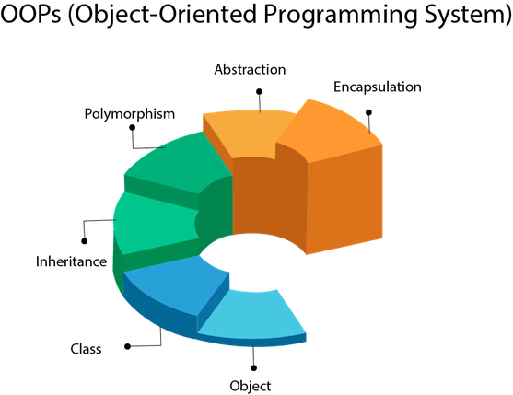
OOP
Introduction to JAVA

Slide 3
OOP
What Is an Object?
An object is a software bundle of related state and behavior. Software objects are often used to model the real-world objects that you find in everyday life. This lesson explains how state and behavior are represented within an object, introduces the concept of data encapsulation, and explains the benefits of designing your software in this manner.
What Is a Class?
A class is a blueprint or prototype from which objects are created. This section defines a class that models the state and behavior of a real-world object. It intentionally focuses on the basics, showing how even a simple class can cleanly model state and behavior.
Introduction to JAVA

Slide 4
OOP
What Is Inheritance?
Inheritance provides a powerful and natural mechanism for organizing and structuring your software. This section explains how classes inherit state and behavior from their superclasses, and explains how to derive one class from another using the simple syntax provided by the Java programming language.
What Is an Interface?
An interface is a contract between a class and the outside world. When a class implements an interface, it promises to provide the behavior published by that interface. This section defines a simple interface and explains the necessary changes for any class that implements it.
Introduction to JAVA

Slide 5
OOP
What Is Abstraction?
Abstraction is the concept of object-oriented programming that "shows" only essential attributes and "hides" unnecessary information. The main purpose of abstraction is hiding the unnecessary details from the users. Abstraction is selecting data from a larger pool to show only relevant details of the object to the user. It helps in reducing programming complexity and efforts.
What Is Encapsulation & Polymorphism?
Introduction to JAVA

Slide 6
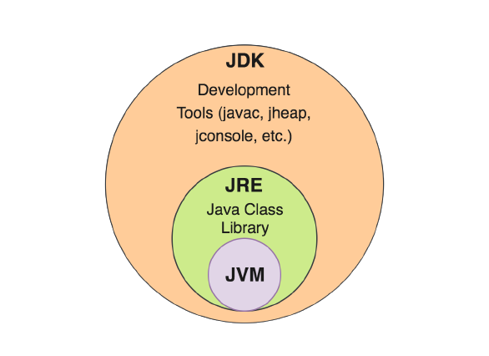
JRE-JDK-JVM
Introduction to JAVA

Slide 7
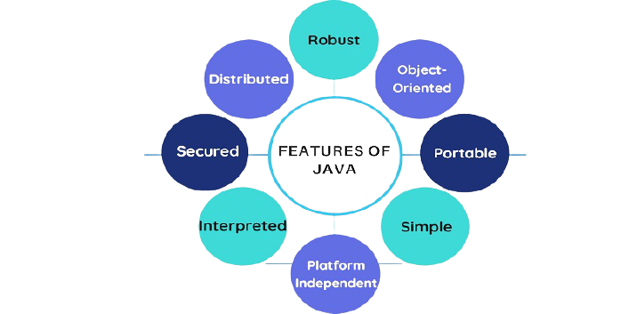
Java Features
Introduction to JAVA

Slide 8
Example Program
“First.java”
class First {
public static void main(String args[]) {
System.out.println(“Hello World”);
}
}
Introduction to JAVA

Slide 9
Compiling & Running the Program
Compiling: is the process of translating source code written in a particular programming language into computer-readable machine code that can be executed.
$ javac First.java
This command will produce a file ‘First.class’, which is used for running the program with the command ‘java’.
Running: is the process of executing program on a computer.
$ java First
Introduction to JAVA

Slide 10
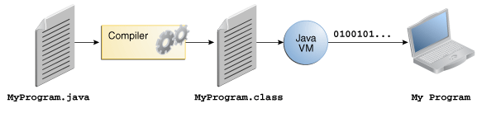
Compiling & Running the Program
Introduction to JAVA

Slide 11
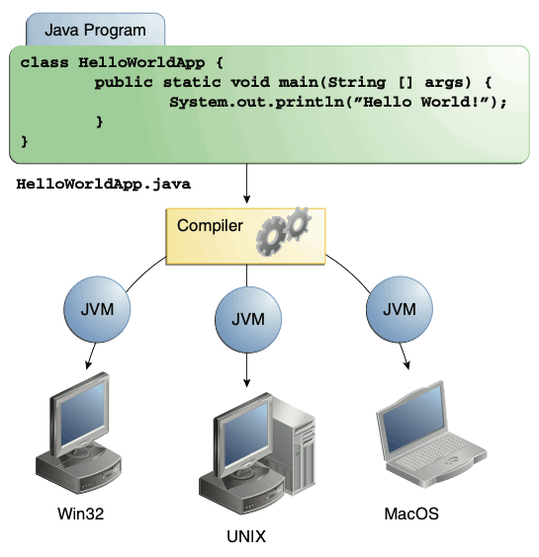
Compiling & Running the Program
Introduction to JAVA

Slide 12
About Printing on the Screen
System.out.println(“Hello World”); – outputs the string “Hello World” followed by a new line on the screen.
System.out.print(“Hello World”); - outputs the string “Hello World” on the screen. This string is not followed by a new line.
Some Escape Sequence –
\n – stands for new line character
\t – stands for tab character
Introduction to JAVA

Slide 13
THANKS
instructor: Anirudha Anil Gaikwad
https://github.com/anirudhagaikwad/Java_9Aug21.git
Introduction to JAVA

