Slide 1

Microsoft VB.Net
Instructor : Anirudha Gaikwad

Slide 2
WHAT YOU LEARN? Clicke here to more
What is VB.Net?
Why use VB.Net?
What is IDE?
Features of Visuals Studio IDE?
How to install VB.Net?

Slide 3

What is .Net?
Microsoft introduced .NET for bridging gap between interoperability between applications.
It is a Software Platform that is language-neutral (i.e. any programming language)
It is a foundation on which we can build, design, develop and deploy the applications.
It is a framework that contains more than 300+ language characteristics that have been formed as a single group, where we can use one language feature within another language. (For eg: C#, VB.Net, Java, JavaScript, etc)

Slide 4
What is VB.Net?
VB.Net known as Visual Basic .NET (VB.NET) is an object-oriented computer programming language implemented on the .NET Framework.
VB.NET is implemented by Microsoft's .NET framework.
Visual Basic 2019 (code named VB "16.0") was released with Visual Studio 2019. It is the latest version of Visual Basic focused on .NET Core.
Therefore, it has full access to all the libraries in the .Net Framework. It's also possible to run VB.NET programs on Mono, the open-source alternative to .NET, not only under Windows, but even Linux or Mac OSX.

Slide 5
Special Features of VB.NET
Modern, general purpose.
.Component oriented.
Full support for object oriented programming.
Structured error handling capabilities.
Access to .NET Framework.
Powerful unified Integrated Development Environment (IDE).
Inherent support for XML & Web Services.
Better windows applications with Windows Forms.
New Console capabilities of VB.NET.
New Web capabilities with Web Forms.
Immense power of tools & controls (including Server Controls).
Interoperatibility with other .NET complined languages.
Better database programming approach with ADO.NET.

Slide 6
Why To Use VB.Net?
VB.NET can be used to create a wide range of applications and components, including the following:
Windows console mode applications:
A console application is a computer program designed to be used via a text-only computer interface, such as a text terminal, the command-line interface of some operating systems (Unix, DOS,etc.) or the text-based interface included with most graphical user interface (GUI) operating systems, such as the Windows Console in Microsoft Windows.
Standard Windows applications:
We can build standard windows applications for our computer like Microsoft word, Microsoft PowerPoint, Microsoft Excel.

Slide 7
Windows Services:
We can even create different windows services which allow as for smooth functioning of our oprating system.
4. Windows controls and Windows control libraries :
With the help of VB.Net we can even create custom controls for our windows application.
5. Web Applications:
We can create build as well as deploy different web applications using VB.Net. Run your regular desktop applications from your browser, without even having to install them on the computer!
Web Services:
We can even create web services which nothing but software application which run on the web using VB.Net by exposing it with proper web methods.

Slide 8
What is IDE?
An integrated development environment (IDE) is a software application that provides comprehensive facilities to computer programmers for software development. An IDE normally consists of at least a source code editor, complier, debuger, and some automations tools.Click here for more
There are many ways developers work to product the different types of code they produce, which means there is also a variety of IDEs to use. Some are designed to work with one specific language, while others are cloud-based IDEs, IDEs customized for the production of mobile applications or for HTML, and also IDEs that are meant specifically for Apple or Microsoft development.
The multi-language IDEs – like Eclipse, Aptana, Komodo, NetBeans, and Geany – support multiple programming languages. (for eg: Eclipse, NetBeans, Komodo IDE, Aptana, Geany, Visual Studio.)

Slide 9
Features of Visuals Studio IDE?
Microsoft Visual Studio is an integrated development environment (IDE) from Microsoft. It is used to develop computer programs, as well as websites, web apps, web services and mobile apps.
Visual Studio supports 36 different programming languages and allows the code editor and debugger to support (to varying degrees) nearly any programming language, provided a language-specific service exists. Built-in languages include C, C++, C++/CLI, Visual Basic .NET, C#, F#, JavaScript, TypeScript, XML, XSLT, HTML, and CSS. Support for other languages such as Python, Ruby, Node.js, and M among others is available via plug-ins.
Features:
1. Code Editer:
Visual Studio (like any other IDE) includes a code editor that supports syntax highlighting and code completion using IntelliSense for variables, functions, methods, loops, and LINQ

Slide 10
queries.
2. Debugger:
Visual Studio includes a debugger that works both as a source-level debugger and as a machine-level debugger.
3. Designer:
Visual Studio includes a host of visual designers to aid in the development of applications.
These tools include:
Windows Forms Designer
WPF Designer
Web designer/development
Class designer
Data designer
Mapping designer

Slide 11
Extensibility:
Visual Studio allows developers to write extensions for Visual Studio to extend its capabilities.
Clicke here to more

Slide 12
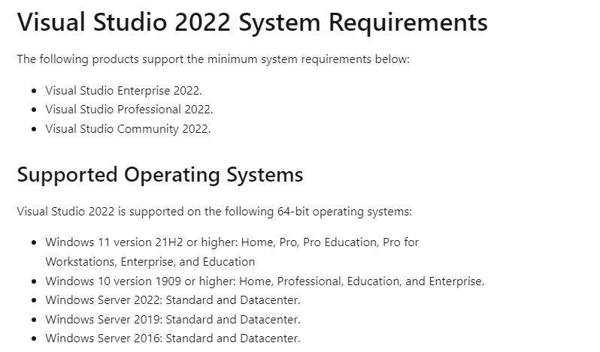
System requirements

Slide 13
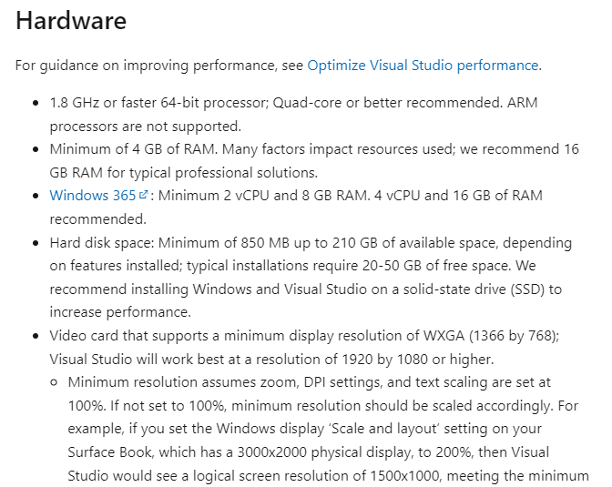

Slide 14
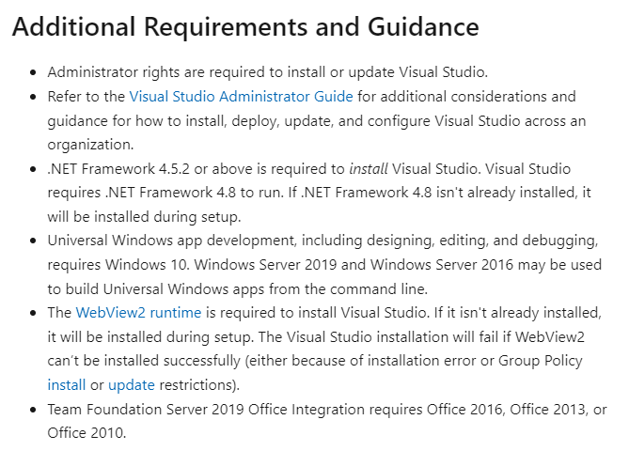

Slide 15
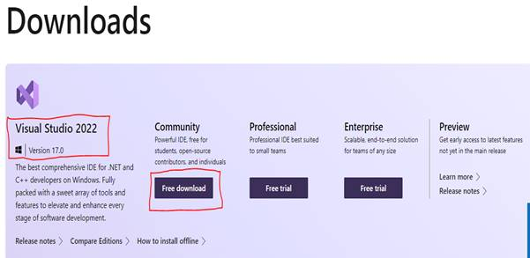
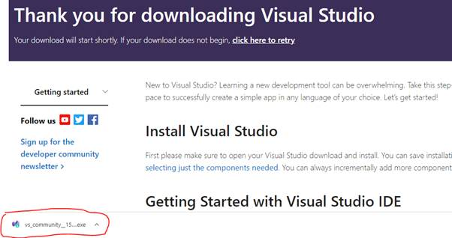
How to install VB.Net?
Step 1:
You can download and install Visual Studio 2022 version 17.0 from this.link

Slide 16
Step 2:
Click the "Download" button for downloading the VS 2022 executable file on the downloaded path.

Slide 17
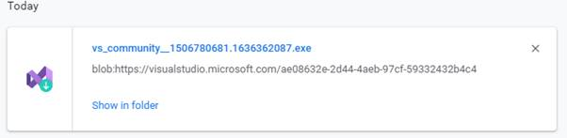

Step 3:
Open your systems download path and find the .exe file.

Slide 18
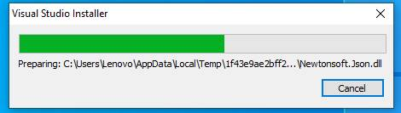
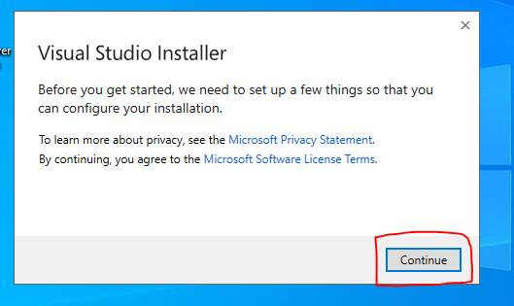
Step 4:
Double-click the .exe file, the Visual Studio installer window will open. Click "Continue".

Slide 19
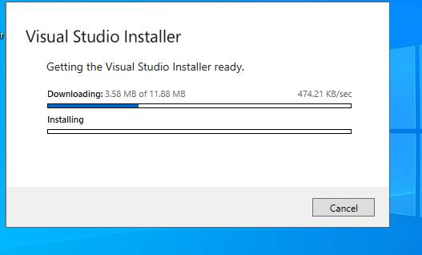
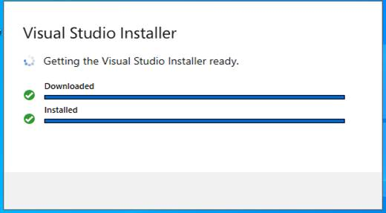
Step 5:
Downloading and installing the progress bar window will open after clicking the continue button.

Slide 20
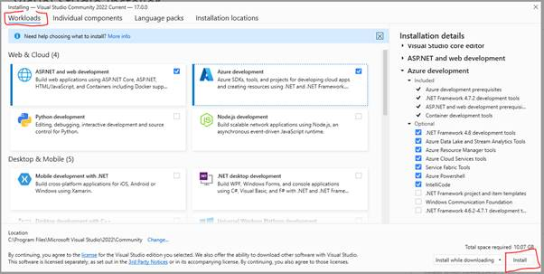
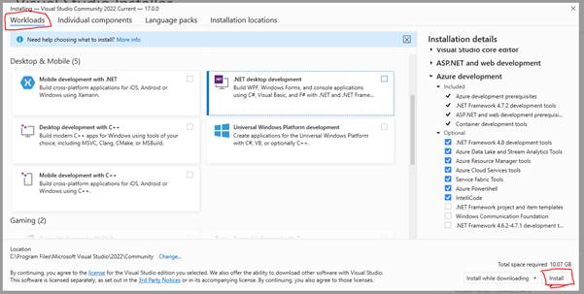
Step 6:
After completing the download and installation, then workloads will open. We need to select what are the workloads we need. Here, we selected VB.NET and web development, Azure development.

Slide 21
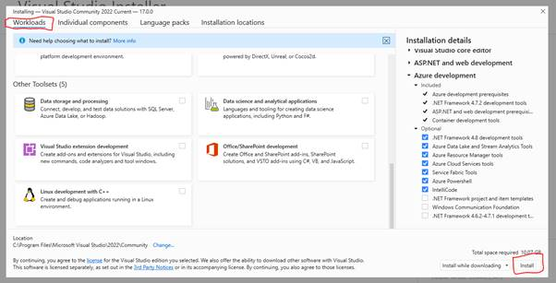
This workload will install the following packages by default.
Now, you can add or remove any optional package or individual components from the list.

Slide 22
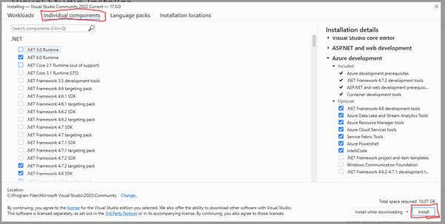
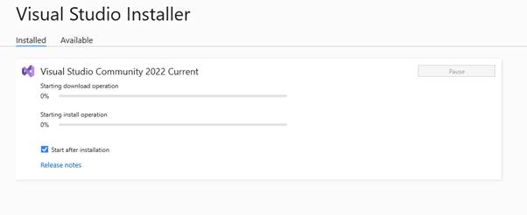
Step 7:
After selecting the desired packages, just click the “Install” button to install.

Slide 23
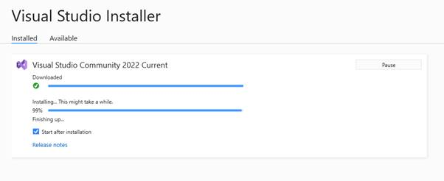
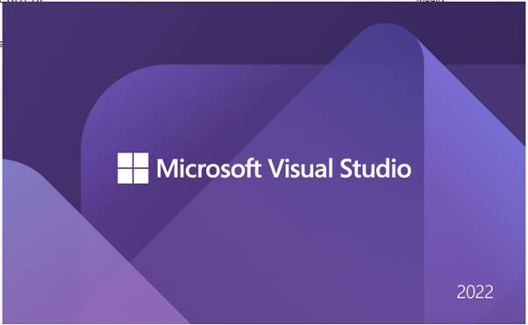
Step 8:
Once the installation is completed. Visual Studio 2022 lunched for the first time.

Slide 24
Now Visual Studio has been successfully launched. When we open Visual Studio for the first time, it takes 15-30 seconds for its initial internal setup.
Step 9:
It will load your existing Visual Studio profile. It may also ask you to login into your Microsoft account. If you don’t have a Microsoft account, you can create a new account.
The sign-in step is optional so it can be skipped. But, don’t skip this! Sign in with your Gmail / Microsoft account so that you can activate Visual Studio and get a lifetime license for Free.
If you have no account then click Not now, Maybe later.

Slide 25
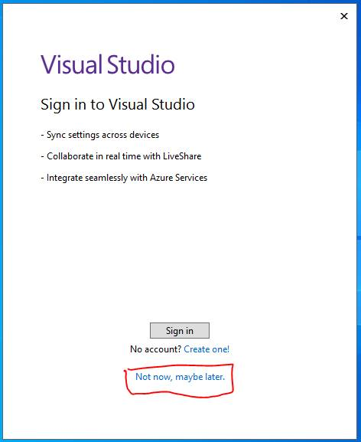
Step 10:
Once done, you will be asked to choose the Development Settings and color theme.:

Slide 26
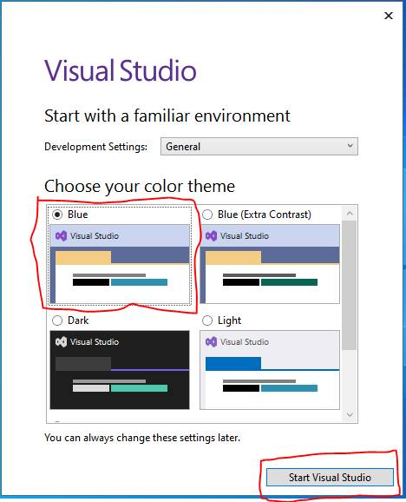
Select a color theme of your choice, here we have selected the Blue theme and by default Development Settings select General.
2. Select Start Visual Studio

Slide 27
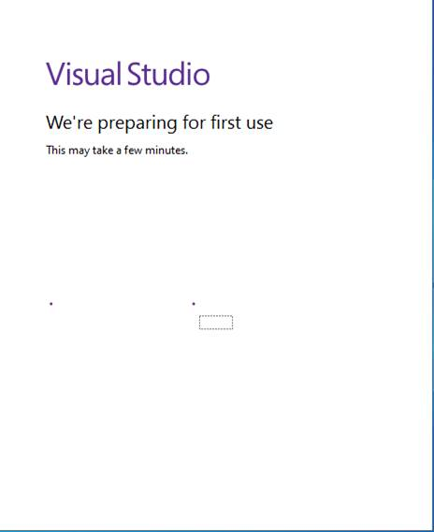
Step 11:
After selecting the required options, click on the Start Visual Studio option. We can see a newly designed landing page of Visual Studio where we see a list of recent projects. We can also clone or check out the code from GitHub and Azure DevOps. We can open a project or solution and a folder. Also, we can create a new project

Slide 28
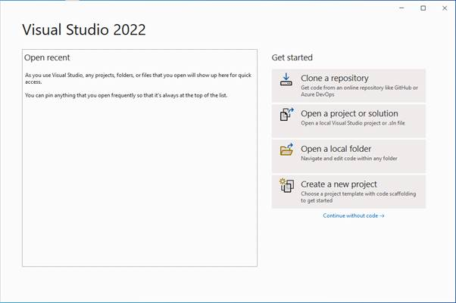
Creating Your First Project
Click on Create a new Project to create a new project.

Slide 29
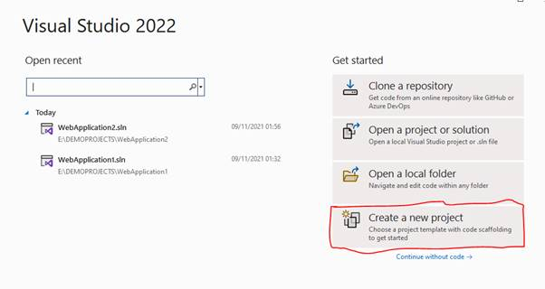
You can see various project types there. Choose “Console Application” project type for now.Select console Application and click Next.

Slide 30
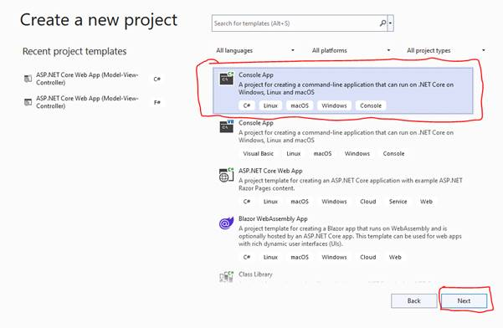
Give a valid name to your project and select a path for it. Then click Next button

Slide 31
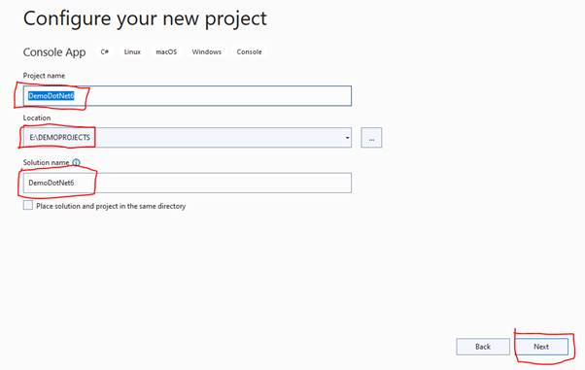
Now, choose framework .NET 6.0.Then click the create button.

Slide 32
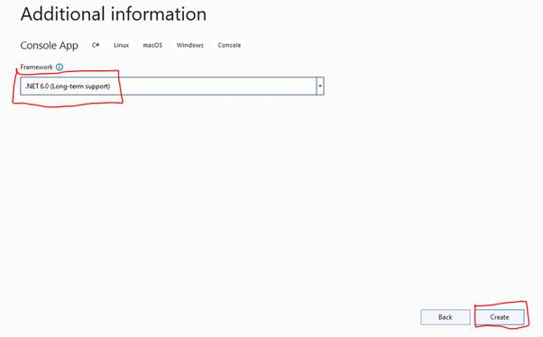
The Console application project structure is shown below,

Slide 33
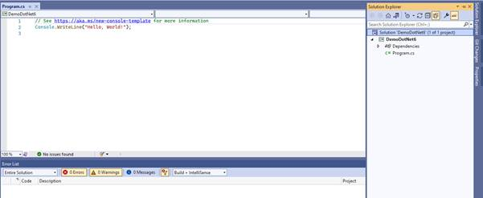
Now, build and run the application.

Slide 34
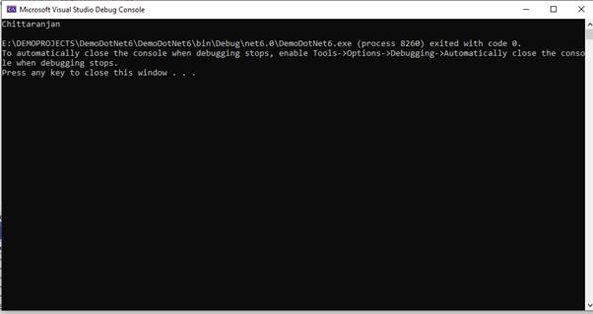
Output :

Slide 35
THANK YOU

