Slide 1


Microsoft vb.net
Instructor : Anirudha Gaikwad

Slide 2


Slide 3
What You Learn? Click Here for more
Keywords in VB.Net
What are Variables in VB.Net? Variable Declaration & Initialization and Types.
Operators, Control Statements, Looping Statements.
Functions in VB.Net.
Class, Methods and Objects in VB.Net

Slide 4
Keywords in VB.Net
Keywords are reserved words in VB whose meaning and usage is already defined by the developer.
These keywords cannot be used as an identifier in VB.NET programming such as class name, variable, function, module, etc.

Slide 5
AddHandler | AddressOf | Alias | And | AndAlso | As
Boolean | ByRef | Byte | ByVal | Call | Case
Catch | CBool | CByte | CChar | CDate | CDbl
CDec | Char | Cint | Class | CLng | CObj
Const | Continue | CSByte | CShort | CSng | CStr
CType | CUnit | CULng | CUShort | Date | Decimal
Declare | Default | Delegate | Dim | DirectCast | Do
Double | Each | Else | Elseif | End | End if
Enum | Erase | Error | Event | Exit | False
Finally | For | Friend | Function | Get | GetType
GetXML Namespace | Global | GoTO | Handles | If | Implements
Imports | In | Inherits | Integer | Interface | Is
isNot | Let | Lib | Like | Long | Loop
Me | Mod | Module | MustInherit | MustOverride | MyBase
MyClass | Namespace | Narrowing | New | Next | Not
Nothing | Not Inheritable | Not Overridable | Object | Of | On
Operator | Option | Optional | Or | OrElse | Overloads
Overridable | Overrides | ParamArray | Partial | Private | Property
Protected | Public | RaiseEvent | ReadOnly | ReDim | REM
Remove Handler | Resume | Return | SByte | Select | Set
Shadows | Shared | Short | Single | Static | Step
Stop | String | Structure | Sub | SyncLock | Then
Throw | To | True | Try | TryCast | TypeOf
UInteger | While | Widening | With | WithEvents | WhiteOnly
Xor | #Else | IsReference | TimeOfDay | Append | Auto

Slide 6
What are Variables in VB.Net?
A variable is a named, volatile memory location (i.e. RAM) which serves to store/hold data. Variables can be thought of as slots in memory which will hold data as values are input or calculated during program execution.
The values stored in variables may then be changed during program execution (i.e. they can vary). While this concept may seem new, you have seen and dealt with variables before in algebra. You have certainly seen something like:
3x + 5 = 20 x = 5
where x is the variable.
Variables must be assigned a name so they can be referenced or used. The name of a variable is what differentiates one variable from another. As mentioned, variables are assigned names in VB at the time they are declared.

Slide 7
The naming rules for variables in VB are as follows:
the name must begin with a letter, followed by 0 or more letters, numbers, and/or underscore characters
the name may not contain spaces
the name cannot be a keyword
Declaration And Initialization of the Variables :
Explicit Declaration
Implicit Declaration
Explicit Declaration :
To declare variable in this format we use “Dim” Statement
For e.g. Dim intAge As Integer
Dim intSum As Integer
Dim strFirstName As String
Dim intAge, intSum As Integer Click here for more

Slide 8
B. Implicit Declaration:
VB finds undeclared variable also. This can be achieved a variable without declaring it, but of specific data type. We can add suffix to variable name.
For e.g. Textvalue $ = “This is a string ”
Amount % =1000
Data types in VB.Net :
Data types refer to an extensive system used for declaring variables or functions of different types. The type of a variable determines how much space it occupies in storage and how the bit pattern stored is interpreted.
Following are the primary data types in VB.Net :
Integer
String
Boolean
Object Click here for more

Slide 9
Operators in VB.net :
An operator is a symbol that tells the compiler to perform specific mathematical or logical manipulations. VB.Net is rich in built-in operators and provides following types of commonly used operators
Arithmetic Operators
Comparison Operators
Logical/Bitwise Operators
Bit Shift Operators
Assignment Operators
Miscellaneous Operators

Slide 10
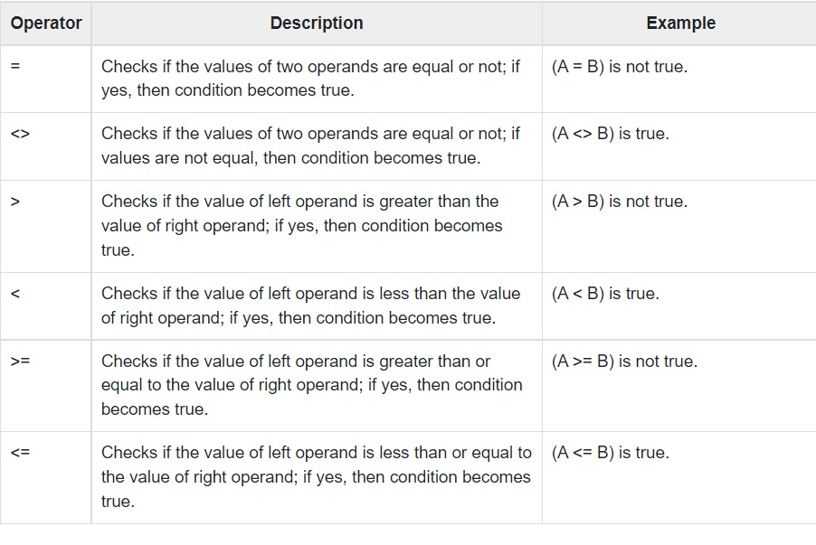
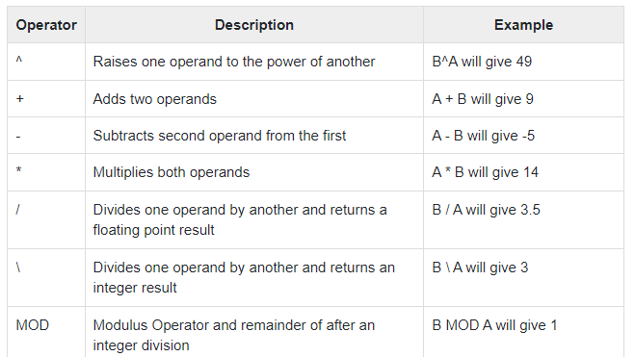
Arithmetic Operators
Comparison Operators

Slide 11
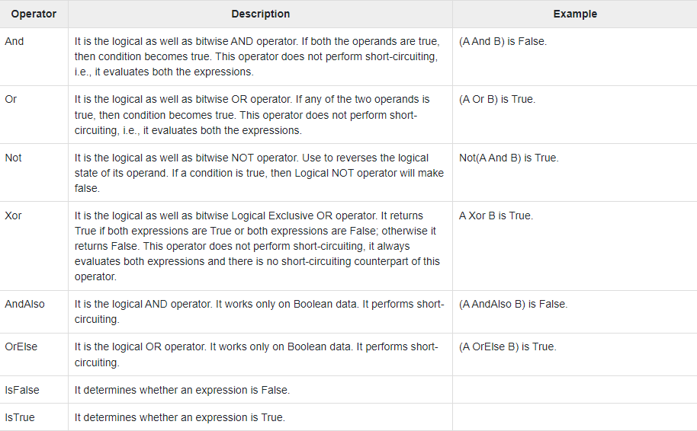
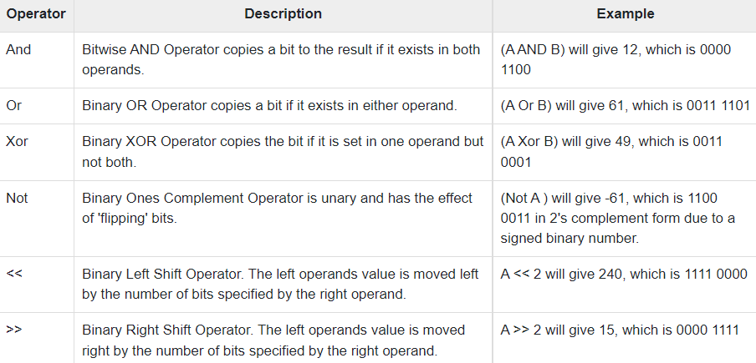
Logical/Bitwise Operators
Bit Shift Operators

Slide 12
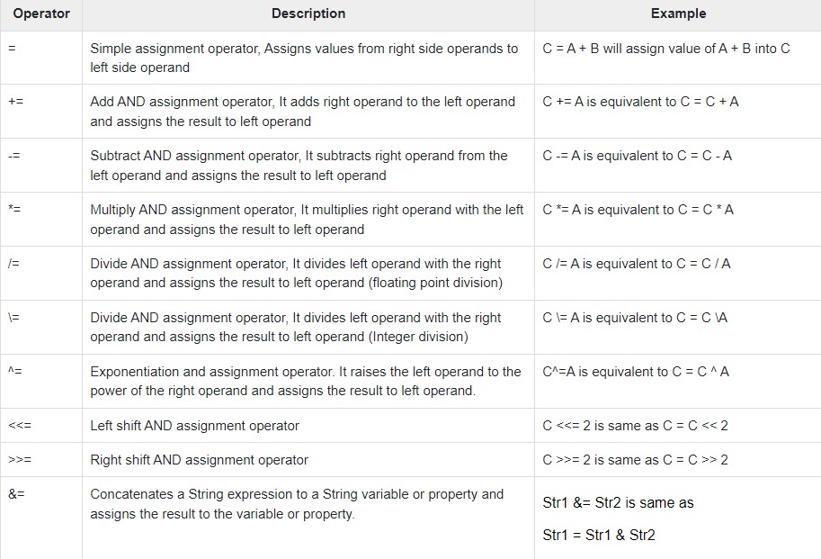
Assignment Operators

Slide 13
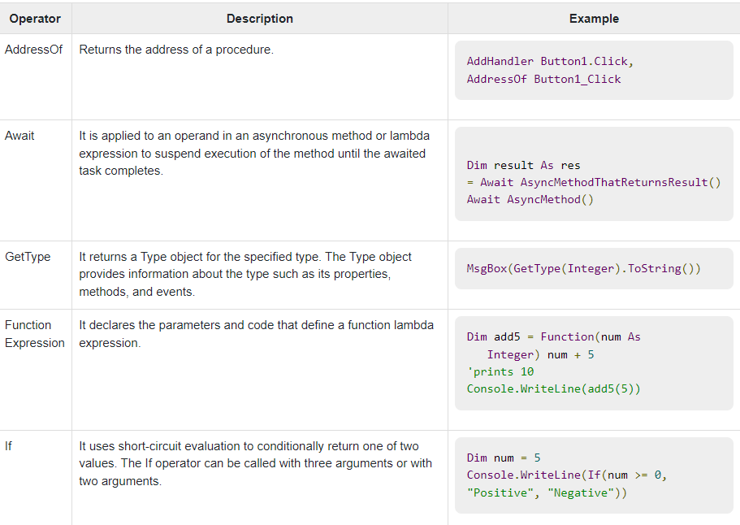
Miscellaneous Operators :

Slide 14
Decision Making Statements / Control Flow Statements :
Decision making structures require that the programmer specify one or more conditions to be evaluated or tested by the program, along with a statement or statements to be executed if the condition is determined to be true, and optionally, other statements to be executed if the condition is determined to be false.
Following are the types :
Simple if
If…Then..Else Statement
Select Case Statement

Slide 15
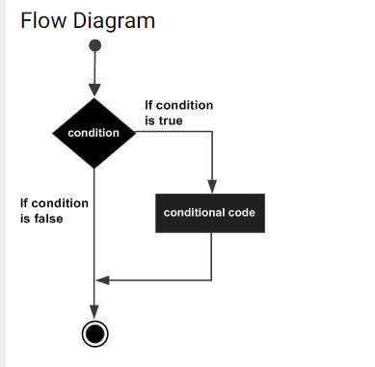
1. Simple if Statement :
It is the simplest form of control statement, frequently used in decision making and changing the control flow of the program execution.
Syntax for if-then statement is −
If (condition) Then
[Statement(s)]
End If
Where, condition is a Boolean or relational condition and Statement(s) is a simple or compound statement.

Slide 16
Example of Simple If..Then Statement :
Q) Write a program to check if the person is eligible for voting.
Code:: Output::
Module Module1 Enter the age: 22
Sub Main() You are eligible
Dim age as Integer
Console.Write(“Enter the age:”)
age = Integer.Parse(Console.ReadLine())
If age>=18 Then
Console.WriteLine(“You are eligible”)
End If
End Sub
End Module

Slide 17
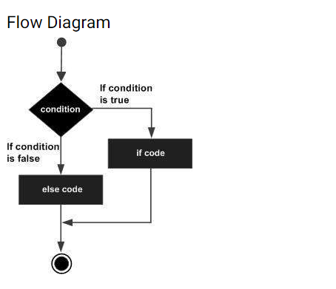
2. If…Then…Else Statement :
An If statement can be followed by an optional Else statement, which executes when the Boolean expression is false.
The syntax of an If...Then... Else statement in VB.Net is as follows −
If(condition)Then
statement(s) will execute if the condition is true
Else
statement(s) will execute if the condition is false
End If

Slide 18
Example of Simple If..Then Statement :
Q) Write a program to check if the number is even or odd.
Code:: Output::
Module Module2 Enter the age: 212
Sub Main() Given Number is odd
Dim num as Integer=0
Console.Write(“Enter the number:”)
num = Integer.Parse(Console.ReadLine())
If num Mod 2=0 Then
Console.WriteLine(“Given Number is even”)
Else
Console.WriteLine(“Given Number is odd”)
End If
End Sub
End Module

Slide 19
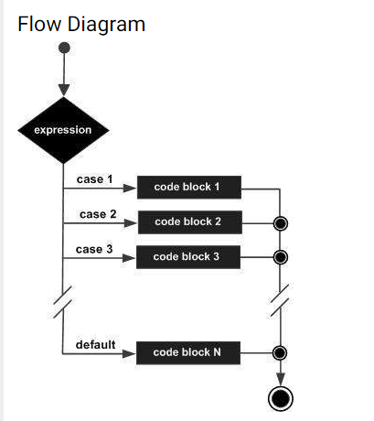
3. Select Case Statement :
A Select Case statement allows a variable to be tested for equality against a list of values. Each value is called a case, and the variable being switched on is checked for each select case.
The syntax for a Select Case statement in VB.Net is as follows −
Select Case (expression)
Case value 1
Statement 1
Case value 2
Statement 2
.
Case value n
Statement n
Case Else
Statement
End Select

Slide 20
Example of Select Case Statement :
Q) Write a menu-driven program to check if entered name is present or not
Code :: Output::
Module Module1 Enter the Name : Marry
Sub Main() Unknown name
Console.Write(“Enter the Name:”)
Dim name as String = Console.ReadLine()
Select Case name
Case “John”
Console.WtiteLine(“Hello John”)
Case “Joey”
Console.WtiteLine(“Hello Joey”)
Case “Monica”
Console.WtiteLine(“Hello Monica”)
Case Else
Console.WtiteLine(“Unknown Name”)
End Select
End Sub
End Module
Q)For Revision
Write a menu-driven program to perform Arithmetic operations (+,-,%,*) of based on choice of user input

Slide 21
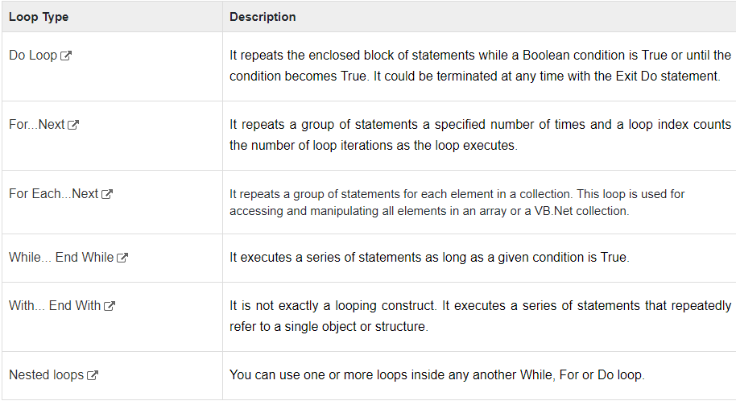
Looping Statements :
A loop statement allows us to execute a statement or group of statements multiple times and following is the general form of a loop statement in most of the programming languages −
There may be a situation when you need to execute a block of code several number of times.

Slide 22
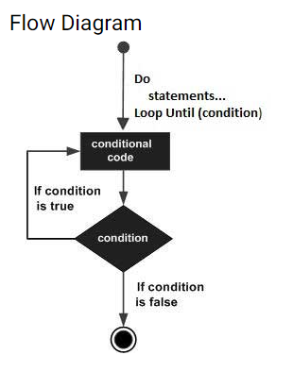
1. Do..while Loop Statement :
There may be a situation when you need to execute a block of code several number of times. The syntax for this loop construct is −
Do { While | Until } condition
[ statements ]
Loop –
or-
Do
[ statements ]
Loop { While | Until } condition

Slide 23
Example of Do..Whole Loop
Q)Write a VB.Net program to print the table of given number using Do While
Code:: Output: Enter number: 8 8 16 24 32 40 48 56 64 72 80
Module Module1
Sub Main()
Dim count As Integer = 1
Dim num As Integer = 0
Console.Write("Enter number: ")
num = Integer.Parse(Console.ReadLine())
Do Console.Write("{0} ", num * count)
count = count + 1
Loop While (count <= 10)
Console.WriteLine()
End Sub
End Module

Slide 24
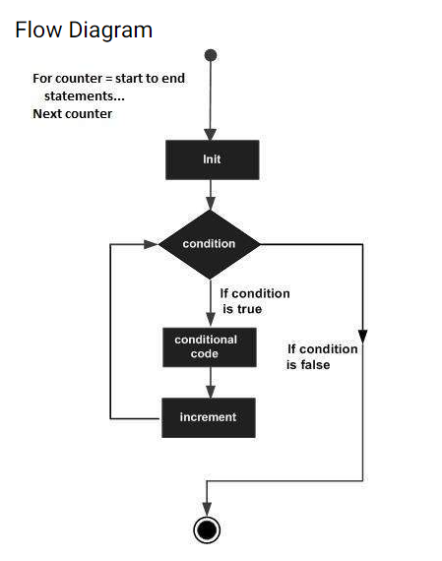
2. For…Next Looping Statements :
It repeats a group of statements a specified number of times and a loop index counts the number of loop iterations as the loop executes.
The syntax for this loop construct is −
For counter [ As datatype ] = start To end [ Step step ]
[ statements ]
Next [ counter ]

Slide 25
Example of For..Next loop
Q)Write a simple program to print the number from 1 to 10 using the For Next loop.
Code:: Output:
Imports System The number starts from 1 to 10
Module Number Number is 1
Sub Main() Number is 2
Console.Write(" The number starts from 1 to 10 ") Number is 3
For i As Integer = 1 To 10 Step 1 Number is 4
Console.WriteLine(" Number is {0} ", i) Number is 5
Next Number is 6
Console.WriteLine(" Press any key to exit... ") Number is 7
Console.ReadKey() Number is 8
End Sub Number is 9
End Module Number is 10

Slide 26
3. For Each..Next Looping Statements :
It repeats a group of statements for each element in a collection. This loop is used for accessing and manipulating all elements in an array or a VB.Net collection.
The syntax for this loop construct is −
For Each item [ As datatype ] In group
[ statements ]
Next [ element ]
For example: Output :
Module loops 1
Sub Main() 3
Dim anArray() As Integer = {1, 3, 5, 7, 9} 5
Dim arrayItem As Integer 7
For Each arrayItem In anArray 9
Console.WriteLine(arrayItem)
Next Console.ReadLine()
End Sub
End Module

Slide 27
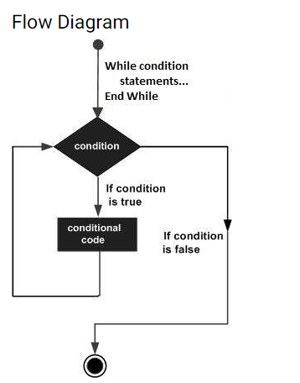
4. While…End While looping Statements :
It executes a series of statements as long as a given condition is True. The syntax for this loop construct is −
While condition
[ statements ]
[ Exit While ]
End While
For example:
Module loops
Sub Main()
Dim a As Integer = 10
While a < 20
Console.WriteLine("value of a: {0}", a)
a = a + 1
End While
Console.ReadLine()
End Sub
End Module

Slide 28
5. With….End with Looping Statements :
It is not exactly a looping construct. It executes a series of statements that repeatedly refers to a single object or structure.
The syntax for this loop construct is −
With object
[ statements ]
End With

Slide 29
Functions :
A procedure is a group of statements that together perform a task when called. After the procedure is executed, the control returns to the statement calling the procedure. VB.Net has two types of procedures −
Functions
Sub procedures or Subs
Functions return a value, whereas Subs do not return a value.
Defining a Function
The Function statement is used to declare the name, parameter and the body of a function. The syntax for the Function statement is −
[Modifiers] Function FunctionName [(ParameterList)] As ReturnType
[Statements]
End Function

Slide 30
Where,
Modifiers − specify the access level of the function; possible values are: Public, Private, Protected, Friend, Protected Friend and information regarding overloading, overriding, sharing, and shadowing.
FunctionName − indicates the name of the function
ParameterList − specifies the list of the parameters
ReturnType − specifies the data type of the variable the function returns
Example
Following code snippet shows a function FindMax that takes two integer values and returns the larger of the two.
Function FindMax(ByVal num1 As Integer, ByVal num2 As Integer) As Integer
' local variable declaration */
Dim result As Integer If (num1 > num2) Then
result = num1
Else
result = num2
End If
FindMax = result
End Function

Slide 31
Classes And Objects :
When you define a class, you define a blueprint for a data type. This doesn't actually define any data, but it does define what the class name means, that is, what an object of the class will consist of and what operations can be performed on such an object.
Objects are instances of a class. The methods and variables that constitute a class are called members of the class.
Class Definition
A class definition starts with the keyword Class followed by the class name; and the class body, ended by the End Class statement. Following is the general form of a class definition −
[ <attributelist> ] [ accessmodifier ] [ Shadows ] [ MustInherit | NotInheritable ] [ Partial ] _
Class name [ ( Of typelist ) ]
[ Inherits classname ] [ Implements interfacenames ] [ stattements ]
End Class

Slide 32
Where,
Attributelist: is a list of attributes that apply to the class. Optional.
Accessmodifier: defines the access levels of the class, it has values as - Public, Protected, Friend, Protected Friend and Private. Optional.
Shadows: indicate that the variable re-declares and hides an identically named element, or set of overloaded elements, in a base class. Optional.
MustInherit: specifies that the class can be used only as a base class and that you cannot create an object directly from it, i.e., an abstract class. Optional.
NotInheritable: specifies that the class cannot be used as a base class.
Partial: indicates a partial definition of the class.
Inherits: specifies the base class it is inheriting from.
Implements: specifies the interfaces the class is inheriting from.

Slide 33
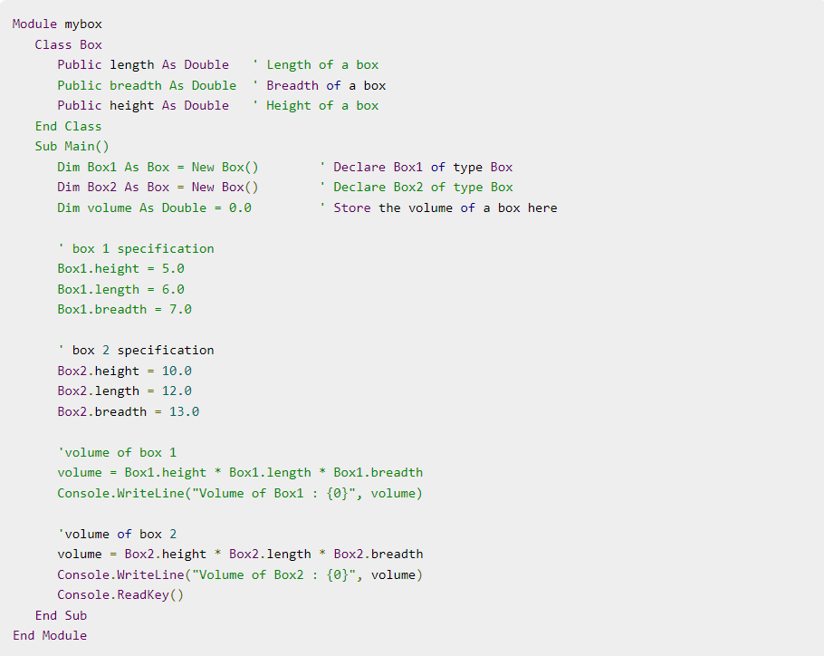

The following example demonstrates a Box class, with three data members, length, breadth and height −

Slide 34
Create an object of class :
1.Determine from which class you want to create an object, or define your own class.
For example:
Public Class Customer
Public Property AccountNumber As Integer
End Class
2. Write a Dim Statement to create a variable to which you can assign a class instance. The variable should be of the type of the desired class.
Dim nextCustomer As Customer
3. Add the New Operator keyword to initialize the variable to a new instance of the class.
Dim nextCustomer As New Customer
4.You can now access the members of the class through the object variable.
nextCustomer.AccountNumber = lastAccountNumber + 1

Slide 35
Thank You

