Slide 1

Microsoft vb.net
Instructor : Anirudha Gaikwad

Slide 2

What You Learn? Click Here for more
.Net FrameWork Components.
Compilation & Execution of .Net
System Namespaces in VB.Net

Slide 3
.NET Components
CLR (Common Language @ Runtime)
Responsible for
Debugging :
CLR sends the corresponding compiler to compile corresponding code.
Exception Handling :
How to handle runtime errors w.r.t. Error pages or Log File entry etc…..
Security :
Security is key thing for any kind of application as you code
(1) Authorized to compile /run/debug
Version Support :
Ensures that the application which implemented in lower version can be used and upgraded automatically to higher version

Slide 4
Compilation & Execution of .Net
When you compile any .NET application first instead of converting that into CPU specific
Code first it would be converted into MSIL
Either exe or dll file will be created
Then it would be sent to class loader.
There are 2 types of class loaders known a
Primordial ClassLoader: Used to load all system classes which are required to run the program.
Class Loader Objects: Used to load all custom classes which are required to run the program.
In class Loader we have JIT Compiler, converts the MSIL into CPU-specific code.
Then it would be send to execution manager, which contains queue of programs which are ready to run where we can execute the program.

Slide 5
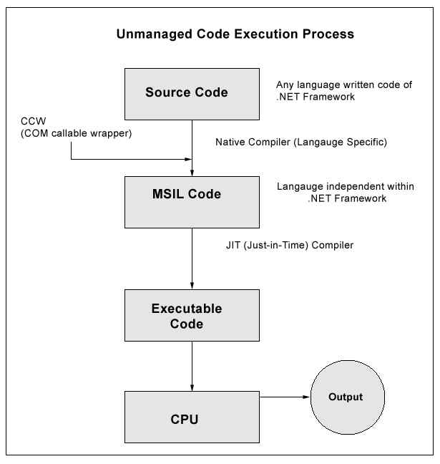
Flow chart of Execution

Slide 6
What is Namespace?
We can say that the group of code having a specific name is a “Namespace”.
In a Namespace the groups of components are somehow related to each other.
Namespaces are similar in concept to a folder in a computer file system. Like folders, namespace enable classes to have a unique name or we can say that it is a logical naming scheme for grouping related types.
Why We Need It?
We must add a reference of the Namespace object before using that object in a project.
Several references are automatically added in the project by default.
The VB.Net “Imports” keyword is used to add a reference of a namespace manually.
Ex: Import system

Slide 7
How to Create Namespace?
We can define a namespaces using the “Namespaces” keyword.
The Syntax for declaring a Namespace is :
Namespace<namespace_name>
//Classes and /or strcture and/ or enume etc.
End Namespace
Accessing Members of Namespace
We can access a member of a Namespace by using a dot(.) operator, also known as the period operator.
The members of a Namespace are the variables, procedures and classes that are defined within a Namespace .
To access the member of a namespace in desired location type the name of the namespace followed by the dot or period operator followed by the desired member of the namespace.

Slide 8
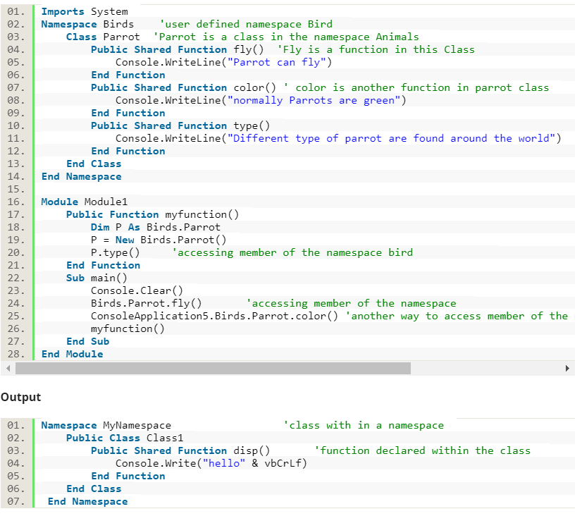
Example:
MyNamespace Classes1.disp()
//Accessing elements of the MyNamespace

Slide 9
Thank you

