Slide 1


Microsoft vb.net
Instructor : Anirudha Gaikwad

Slide 2

What You Learn? Click here for more
Input and Output Functions in VB.Net
Form Controls in VB.Net and their Properties
Sub Procedures and Examples

Slide 3
Input and Output Functions in VB.Net :
Basically the input and output are different based on the application that we are building. There are two main types applications that we build
Console Based Application
GUI or Windows Based Application
Input and Output For Console Based Applications :
A) Console.ReadLine() :
It will read the console input from the user, up until the next newline is detected (usually upon pressing the Enter or Return key). Code execution is paused in the current thread until a newline is provided. If standard input is redirected to a file, it reads a line of text from a file.
For Example : Console.Write("Enter your name:");
string name= Console.ReadLine();

Slide 4
B) Console.WriteLine():
We can store string values in string values in string objects and use these objects as parameters to the WriteLine() method. This method used to convert the value of an object to its text representation and it represents in a string. The resulting string is written to the output stream.
For Example:
string subject="Hello VB"; // subject is assigned a string
Console.WriteLine(subject);

Slide 5
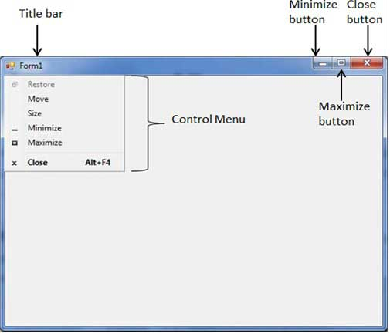
Form Controls in VB.Net :
Visual Basic Form is the container for all the controls that make up the user interface. Every window you see in a running visual basic application is a form, thus the terms form and window describe the same entity. Visual Studio creates a default form for you when you create a Windows Forms Application.
Every form will have title bar on which the form's caption is displayed and there will be buttons to close, maximize and minimize the form shown below −
If you click the icon on the top left corner, it opens the control menu, which contains the various commands to control the form like to move control from one place to another place, to maximize or minimize the form or to close the form.

Slide 6
Form Properties :
Below are the basic and most frequently used form properties. These properties can be set or read during application execution.
AcceptButton :
The button that's automatically activated when you press Enter, no matter which control has the focus at the time. Usually the OK button on a form is set as AcceptButton for a form.
CancelButton :
The button that's automatically activated when you hit the Esc key.Usually, the Cancel button on a form is set as CancelButton for a form.
ControlBox :
By default, this property is True and you can set it to False to hide the icon and disable the Control menu.
Enabled :
If True, allows the form to respond to mouse and keyboard events; if False, disables form.
HelpButton :
Determines whether a Help button should be displayed in the caption box of the form.
MinimizeBox :
By default, this property is True and you can set it to False to hide the Minimize button on the title bar.
MaximizeBox :
By default, this property is True and you can set it to False to hide the Maximize button on the title bar.

Slide 7
Above are just the most frequently used properties while creating a form. There are many more properties like
AutoScale, AutoScroll, BackColor, BorderStyle,etc. Click here for more

Slide 8
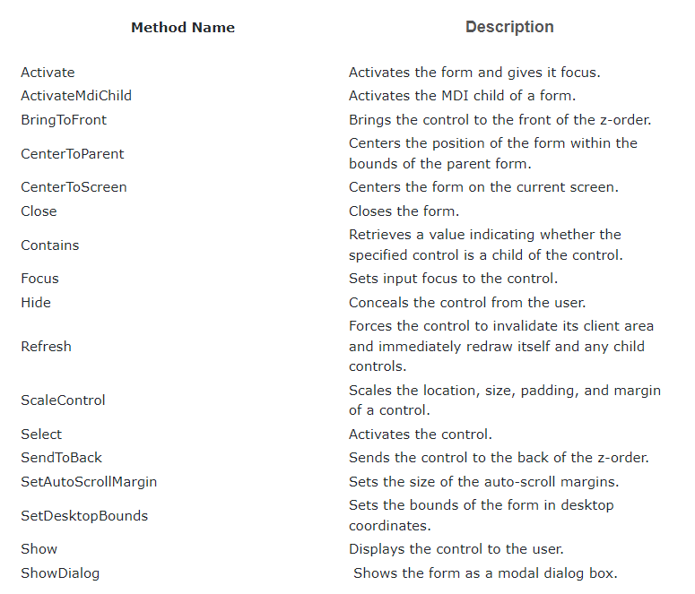
Form methods :
The following are some of the commonly used methods of the Form class.

Slide 9
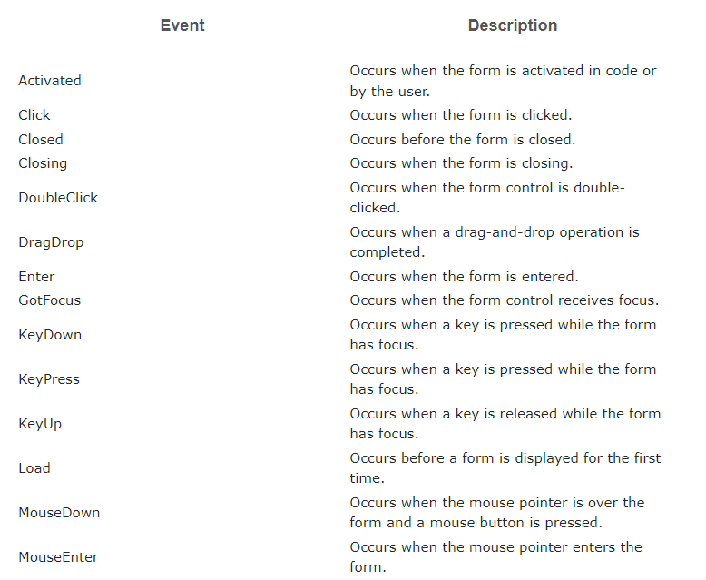
Form Events
Following table lists down various important events related to a form

Slide 10
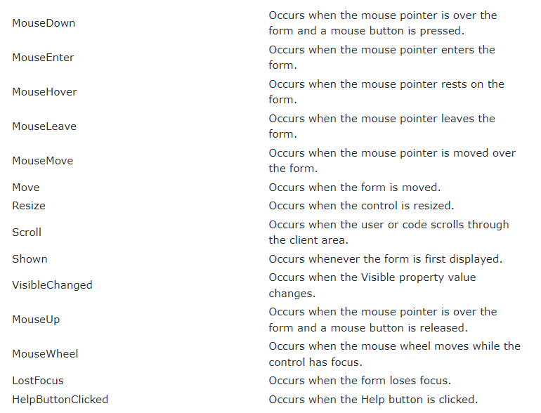

Slide 11
Some of the commonly used controls are as follows :
TextBox
Label
Button
ListBox
ComboBox
RadioButton
CheckBox
PictureBox
ProgressBar
ScrollBar
Each and Every Control has its own Properties, Methods and Events !!!

Slide 12
TextBox
Text box controls allow entering text on a form at runtime. By default, it takes a single line of text, however, you can make it accept multiple texts and even add scroll bars to it.
Properties Of TextBox | Methods Of TextBox | Events for TextBox
AcceptsReturn | AppendText | Click
FontHeight | Clear | DoubleClick
Lines | Copy | TextAlignChanged
Multiline | Cut | Click here for More
ReadOnly | Paste
Scrollbars | ResetText
TextAlign | Undo

Slide 13
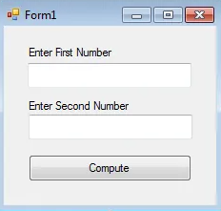
Example
Q)Write a program in vb.net that will ask the user to enter two numbers and compute the sum of that numbers.
If TextBox1.Text = "" Or IsNumeric(TextBox1.Text) = False Then
MessageBox.Show("Please enter a numeric value.")
TextBox1.Focus()
ElseIf TextBox2.Text = "" Or IsNumeric(TextBox2.Text) = False Then
MessageBox.Show("Please enter a numeric value.")
TextBox2.Focus()
Else
Dim sum As Integer = 0
sum = Val(TextBox1.Text) + Val(TextBox2.Text)
MessageBox.Show("the sum is: " & sum)
End If

Slide 14
2. Label
The Label control represents a standard Windows label. It is generally used to display some informative text on the GUI which is not changed during runtime.
Properties Of Label | Methods Of TextBox | Events Of TextBox
AutoSize | GetPreferredSize | AutoSizeChanged
BorderStyle | Refresh | Click
Font | Select | DoubleClick
FontHeight | Show | GotFocus
TabStop | ToString | LostFocus
Text |  | TextChanged
TextAlign |  | Click here for more

Slide 15
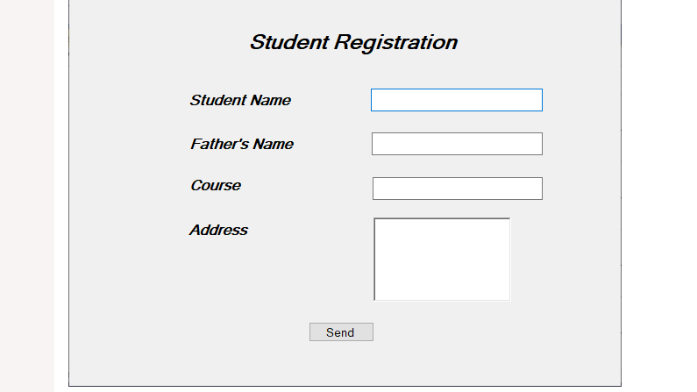
Example : Write a program to display the Label controls in VB.NET.
Public Class Label
Private Sub Label_Load(sender As Object, e As EventArgs) Handles MyBase.Load
Me.Text = "javatpoint.com" 'Set the title for a Windows Form
Label1.Text = "Student Registration"
Label1.Font = New Font("Microsoft Sans Serif", "style = Bold", "Italic", 18) ' Set Font style
Label2.Text = "Student Name"
Label2.Font = New Font("Microsoft Sans Serif", "style = Bold", "Italic", 12)
Label3.Text = "Father's Name"
Label3.Font = New Font("Microsoft Sans Serif", "style = Bold", "Italic", 12)
Label4.Text = "Course "
Label4.Font = New Font("Microsoft Sans Serif", "style = Bold", "Italic", 12)
Label5.Text = "Address"
Label5.Font = New Font("Microsoft Sans Serif", "style = Bold", "Italic", 12)
Button1.Text = "Send"
TextBox1.Text = " "
TextBox2.Text = " "
TextBox3.Text = " "
RichTextBox1.Text = " "
End Sub
End Class

Slide 16
Button
The Button control represents a standard Windows button. It is generally used to generate a Click event by providing a handler for the Click event.
Properties Of Button | Methods Of Button | Events Of Button
AutoSizeMode | GetPrederredSize | Click
BackColor | NotifyDefault | DoubleCLick
BackgroundImage | Select | GotFocus
DialogResult | ToString | TabIndexChanged
Image |  | Validated
Location |  | Click here for more
Text

Slide 17
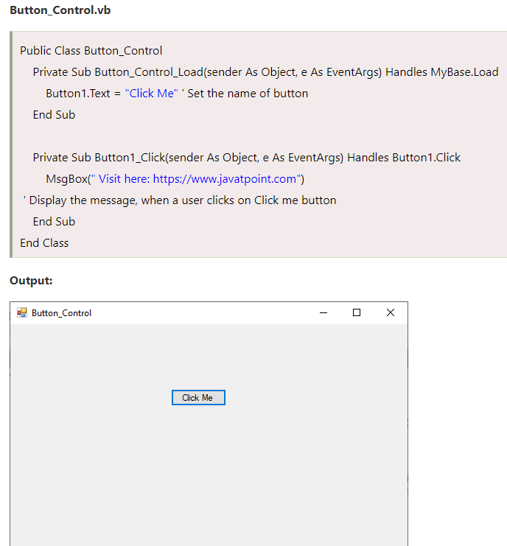

Slide 18
Radio Button
The RadioButton control is used to provide a set of mutually exclusive options. The user can select one radio button in a group.
Properties Of RadioButton | Methods Of RadioButton | Events Of RadioButton
Appearance | PerformClick | AppearenceChanged
AutoCheck |  | CheckedChanged
CheckAlign |  | Click here for more
Checked
Text
TabStop

Slide 19
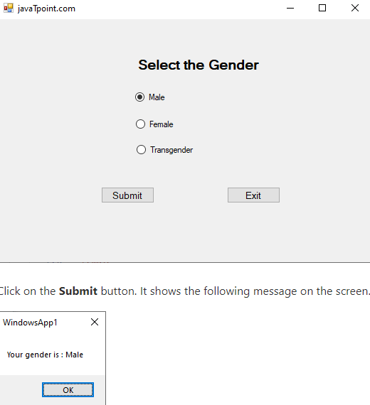
Public Class RadioBtn
Private Sub RadioBtn_Load(sender As Object, e As EventArgs) Handles MyBase.Load
Me.Text = "javaTpoint.com" ' Set the title of the form
Label1.Text = "Select the Gender"
RadioButton1.Text = "Male" ' Set the radiobutton1 and radiobutton2
RadioButton2.Text = "Female"
RadioButton3.Text = "Transgender"
Button1.Text = "Submit" ' Set the button name
Button2.Text = "Exit"
End Sub
Private Sub Button1_Click(sender As Object, e As EventArgs) Handles Button1.Click
Dim gen As String
If RadioButton1.Checked = True Then
gen = "Male"
MsgBox(" Your gender is : " & gen)
ElseIf RadioButton2.Checked = True Then
gen = "Female"
MsgBox(" Your gender is : " & gen)
Else
gen = "Transgender"
MsgBox(" You have Selected the gender : " & gen)
End If
End Sub
Private Sub Button2_Click(sender As Object, e As EventArgs) Handles Button2.Click
End 'Terminate the program
End Sub
End Class

Slide 20
Check Box
The CheckBox control allows the user to set true/false or yes/no type options. The user can select or deselect it. When a check box is selected it has the value True, and when it is cleared, it holds the value False.
Properties Of CheckBox | Methods Of CheckBox | Events Of CheckBox
Appearance | OnCheckedChanged | AppearenceChanged
AutoCheck | OnCheckStateChange | CheckedChanged
CheckAlign | OnClick | CheckStateChanged
Checked |  | Click here for more
CheckState
Text
TreeState

Slide 21
Public Class Checkbxvb
Private Sub Checkbxvb_Load(sender As Object, e As EventArgs) Handles MyBase.Load
Me.Text = "javaTpoint.com" ' Set the title name of the form
Label1.Text = "Select the fruits name"
CheckBox1.Text = "Apple"
CheckBox2.Text = "Mango"
CheckBox3.Text = "Banana"
CheckBox4.Text = "Orange"
CheckBox5.Text = "Potato"
CheckBox6.Text = "Tomato"
Button1.Text = "Submit"
Button2.Text = "Close"
End Sub
Private Sub Button1_Click(sender As Object, e As EventArgs) Handles Button1.Click
Dim fruit As String
fruit = " "
If CheckBox1.Checked = True Then
fruit = "Apple"
End If
If CheckBox2.Checked = True Then
'fruit = CheckBox2.Text
fruit = fruit & " Mango"
End If

Slide 22
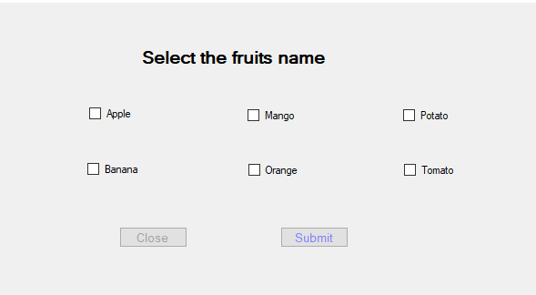
If CheckBox3.Checked = True Then
fruit = fruit & " Banana"
End If
If CheckBox4.Checked = True Then
fruit = fruit & " Orange"
End If
If CheckBox5.Checked = True Then
fruit = fruit & " Potato"
End If
If CheckBox6.Checked = True Then
fruit = fruit & " Tomato"
End If
If fruit.Length <> 0 Then
MsgBox(" Selected items " & fruit)
End If
CheckBox1.ThreeState = True
End Sub
Private Sub Button2_Click(sender As Object, e As EventArgs) Handles Button2.Click
End 'terminate the program
End Sub
End Class

Slide 23
List Box
The ListBox represents a Windows control to display a list of items to a user. A user can select an item from the list. It allows the programmer to add items at design time by using the properties window or at the runtime.
Properties Of ListBox | Methods Of ListBox | Events Of ListBox
AllowSelection | BeginUpdate | Click
BorderStyle | ClearSelected | SelectedIndexChanged
ColumnWidth | EndUpdate | Click here for more
HorizontalExtent | FindString
HorizontalScrollBar | FindStringExact
ItemHeight | GetSelected
Items | SetSelected

Slide 24

Public Class Listbx
Private Sub Listbx_Load(sender As Object, e As EventArgs) Handles MyBase.Load
' set the title of the Form.
Me.Text = “ListBoxForm"
' Add the items into the ListBox
ListBox1.Items.Add("Earth")
ListBox1.Items.Add("Mercury")
ListBox1.Items.Add("Mars")
ListBox1.Items.Add("Jupiter")
ListBox1.Items.Add("Venus")
ListBox1.Items.Add("Neptune")
ListBox1.Items.Add("Uranus")
' Set the name of the Button1 and Button2
Button1.Text = "Show"
Button2.Text = "Exit"
Label2.Text = "Select the solar system from the ListBox"
End Sub
End Class

Slide 25
Combo Box
The ComboBox control is used to display a drop-down list of various items. It is a combination of a text box in which the user enters an item and a drop-down list from which the user selects an item.
Properties Of Combo Box | Methods Of Combo Box | Events Of Combo Box
AllowSelection | BeginUpdate | DropDown
AutoCompleteCustomSource | EndUpdate | DropDownClosed
AutoCompleteMode | FindString | DropDownStyleChanged
AutoCompleteSource | FindStringExact | SelectedIndexChanged
DataManager | SelectAll | SelectionChangeCommitted
DropDownHeight |  | Click here for more
DropDownStyle

Slide 26
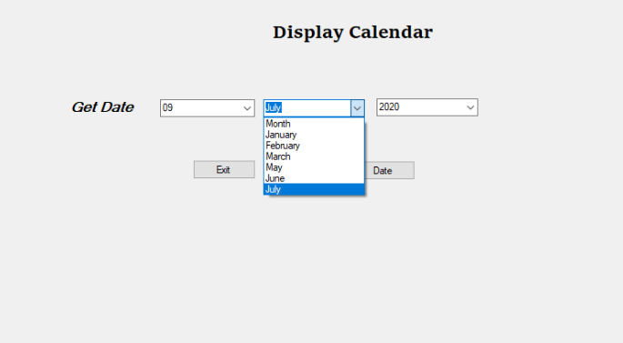
Q)Write a program to display the Calendar in the VB.Net Windows Form.
Public Class ComboBox_Control
Dim DT As Integer
Dim MM As String
Dim YY As Integer
Private Sub ComboBox_Control_Load(sender As Object, e As EventArgs) Handles MyBase.Load
Me.Text = "JavaTpoint.com"
Label1.Text = "Display Calendar"
Label2.Text = "Get Date"
Button1.Text = "Date"
Button2.Text = "Exit"
ComboBox1.Items.Add("Date")
ComboBox1.Items.Add("01")
ComboBox1.Items.Add("02")
ComboBox1.Items.Add("03")
ComboBox1.Items.Add("04")
ComboBox1.Items.Add("05")
ComboBox1.Items.Add("06")
ComboBox1.Items.Add("07")
ComboBox1.Items.Add("08")
ComboBox1.Items.Add("09")
ComboBox2.Items.Add("Month")
ComboBox2.Items.Add("January")
ComboBox2.Items.Add("February")
ComboBox2.Items.Add("March")
ComboBox2.Items.Add("May")

Slide 27
ComboBox2.Items.Add("June")
ComboBox2.Items.Add("July")
ComboBox3.Items.Add("Year")
ComboBox3.Items.Add("2016")
ComboBox3.Items.Add("2017")
ComboBox3.Items.Add("2018")
ComboBox3.Items.Add("2019")
ComboBox3.Items.Add("2020")
End Sub
Private Sub Button1_Click(sender As Object, e As EventArgs) Handles Button1.Click
DT = ComboBox1.Text
MM = ComboBox2.Text
YY = ComboBox3.Text
MsgBox("Month " & MM + vbCrLf + "Year " & YY)
End Sub
Private Sub Button2_Click(sender As Object, e As EventArgs) Handles Button2.Click
End
End Sub
End Class

Slide 28
Picture Box
The PictureBox control is used for displaying images on the form. The Image property of the control allows you to set an image both at design time or at run time.
Properties Of Picture Box | Methods Of Picture Box | Events Of Picture Box
AllowDrop | CancelAsync | CausesValidationChanged
ErrorImage | Load | Click
Image | LoadAsync | Enter
ImageLocation | ToString | FontChnaged
InitialLocation |  | KeyPress
SizeMode |  | KeyDown
Text |  | Click here for more

Slide 29
Public Class Picturebx
Private Sub Button1_Click(sender As Object, e As EventArgs) Handles Button1.Click
'Dim Str As String = "C:\Users\AMIT YADAV\Desktop\"
PictureBox1.Image = Image.FromFile("C:\Users\AMIT YADAV\Desktop\jtp2.png")
PictureBox1.SizeMode = PictureBoxSizeMode.StretchImage
PictureBox1.Height = 250
PictureBox1.Width = 400
Label1.Visible = False
End Sub
Private Sub Picturebx_Load(sender As Object, e As EventArgs) Handles MyBase.Load
Me.Text = "javaTpoint.com" 'Set the title name for the form
Button1.Text = "Show"
Label1.Text = "Click to display the image"
Label1.ForeColor = ForeColor.Green
End Sub
End Class

Slide 30
Thank you

