Slide 1

Microsoft vb.net
Instructor : Anirudha Gaikwad

Slide 2

What You Learn? Click Here for more
Overloading, Overriding and Shadowing
Exception Handling

Slide 3
Method Overriding:
In visual basic, Method Overriding means override a base class method in the derived class by creating a method with the same name and signatures to perform a different task.
The Method Overriding in visual basic can be achieved by using Overridable & Overrides keywords along with the inheritance principle.
The base class method which we want to override in the derived class that needs to be defined with an Overridable keyword and we need to use Overrides keyword in derived class while defining the method with the same name and parameters then only we can override the base class method in the derived class.
In visual basic, the Method Overriding is also called as run time polymorphism or late binding. Following is the code of implementing a method overriding in a visual basic programming language.

Slide 4
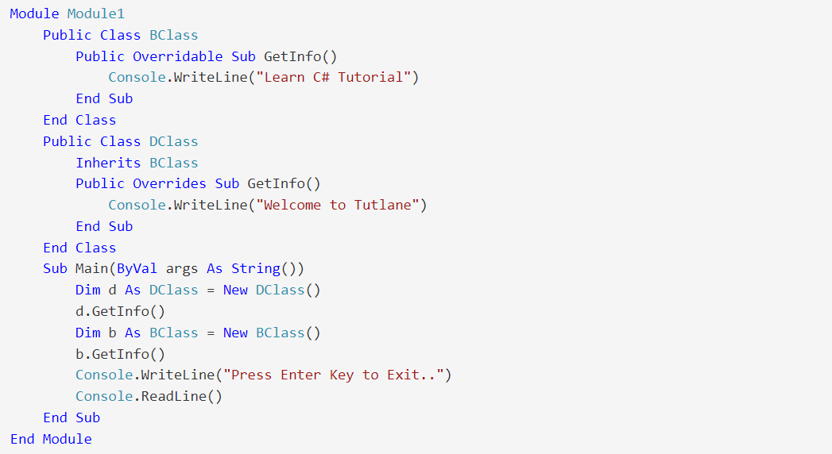
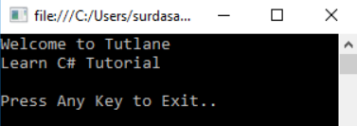
Example:
Output:

Slide 5
Method Overloading:
In visual basic, Method Overloading means defining multiple methods with the same name but with different parameters.
By using Method Overloading, we can perform different tasks with the same method name by passing different parameters.
Suppose, if we want to overload a method in visual basic, we need to define another method with the same name but with different signatures. In visual basic, the Method Overloading is also called as compile time polymorphism or early binding.

Slide 6
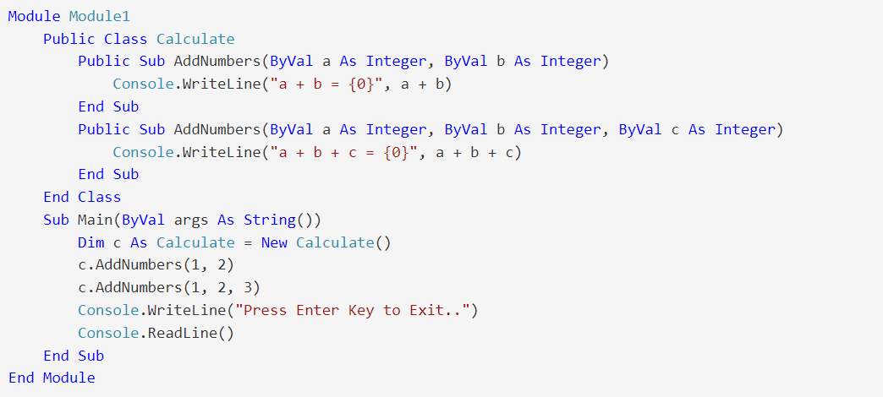
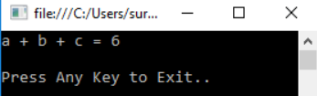
Example:
Output:

Slide 7
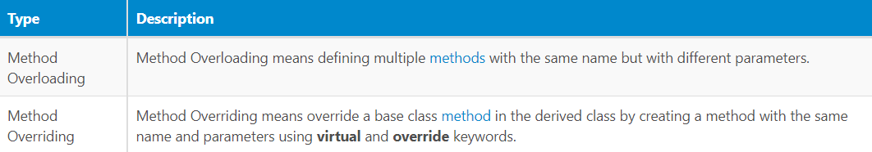
The following are the difference between method overloading and method overriding in a visual basic programming language.
Visual Basic Overloading vs Overriding

Slide 8
Shadows:
Specifies that a declared programming element redeclares and hides an identically named element, or set of overloaded elements, in a base class.
The main purpose of shadowing (which is also known as hiding by name) is to preserve the definition of your class members. The base class might undergo a change that creates an element with the same name as one you have already defined. If this happens, the Shadows modifier forces references through your class to be resolved to the member you defined, instead of to the new base class element.
Both shadowing and overriding redefine an inherited element, but there are significant differences between the two approaches. For more information, see Shadowing in Visual Basic.

Slide 9
Rules:
Declaration Context: You can use Shadows only at class level. This means the declaration context for a Shadows element must be a class, and cannot be a source file, namespace, interface, module, structure, or procedure.
You can declare only one shadowing element in a single declaration statement.
Combined Modifiers: You cannot specify Shadows together with Overloads, Overrides, or Static in the same declaration.
Element Types: You can shadow any kind of declared element with any other kind. If you shadow a property or procedure with another property or procedure, the parameters and the return type do not have to match those in the base class property or procedure.
Accessing: The shadowed element in the base class is normally unavailable from within the derived class that shadows it. However, the following considerations apply.

Slide 10
If the shadowing element is not accessible from the code referring to it, the reference is resolved to the shadowed element. For example, if a Private element shadows a base class element, code that does not have permission to access the Private element accesses the base class element instead.
If you shadow an element, you can still access the shadowed element through an object declared with the type of the base class. You can also access it through MyBase.
The Shadows modifier can be used in these contexts:
Class Statement
Const Statement
Declare Statement
Delegate Statement
Dim Statement
Enum Statement
Event Statement
Function Statement
Interface Statement
Property Statement
Structure Statement
Sub Statement

Slide 11
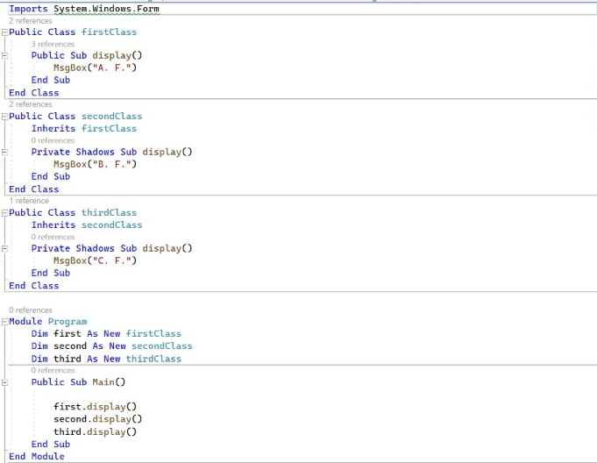
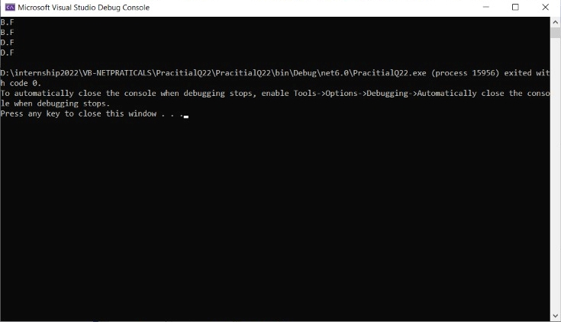
Examples:
Output:

Slide 12
Exception Handling:
An exception is a problem that arises during the execution of a program. An exception is a response to an exceptional circumstance that arises while a program is running, such as an attempt to divide by zero.
Exceptions provide a way to transfer control from one part of a program to another. VB.Net exception handling is built upon four keywords - Try, Catch, Finally and Throw.
Try : A Try block identifies a block of code for which particular exceptions will be activated. It's followed by one or more Catch blocks.
Catch : A program catches an exception with an exception handler at the place in a program where you want to handle the problem. The Catch keyword indicates the catching of an exception.

Slide 13
3. Finally: The Finally block is used to execute a given set of statements, whether an exception is thrown or not thrown. For example, if you open a file, it must be closed whether an exception is raised or not.
Throw: A program throws an exception when a problem shows up. This is done using a Throw keyword.
Syntax:
Assuming a block will raise an exception, a method catches an exception using a combination of the Try and Catch keywords. A Try/Catch block is placed around the code that might generate an exception. Code within a Try/Catch block is referred to as protected code, and the syntax for using Try/Catch looks like the following −

Slide 14
Try
[ tryStatements ]
[ Exit Try ]
[ Catch [ exception [ As type ] ] [ When expression ]
[ catchStatements ]
[ Exit Try ] ]
[ Catch ... ]
[ Finally
[ finallyStatements ] ]
End Try
You can list down multiple catch statements to catch different type of exceptions in case your try block raises more than one exception in different situations.

Slide 15
Exception Classes in .Net Framework:
In the .Net Framework, exceptions are represented by classes. The exception classes in .Net Framework are mainly directly or indirectly derived from the System.Exception class. Some of the exception classes derived from the System.Exception class are the System.ApplicationException and System.SystemException classes.
The System.ApplicationException class supports exceptions generated by application programs. So the exceptions defined by the programmers should derive from this class.
The System.SystemException class is the base class for all predefined system exception.

Slide 16
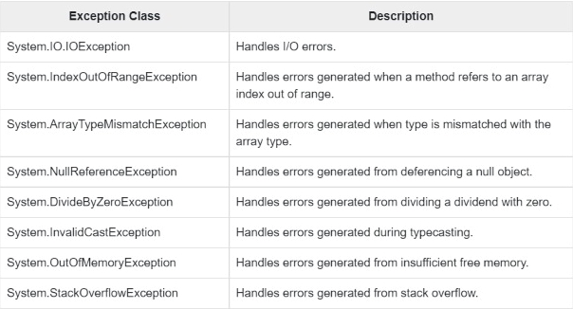
The following table provides some of the predefined exception classes derived from the Sytem.
SystemException class

Slide 17
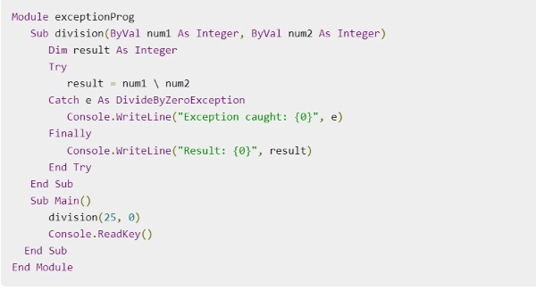
Examples:
VB.Net provides a structured solution to the exception handling problems in the form of try and catch blocks. Using these blocks the core program statements are separated from the error-handling statements.
These error handling blocks are implemented using the Try, Catch and Finally keywords.

Slide 18

Output:
Creating User-Defined Exceptions:
You can also define your own exception. User-defined exception classes are derived from the ApplicationException class.

Slide 19
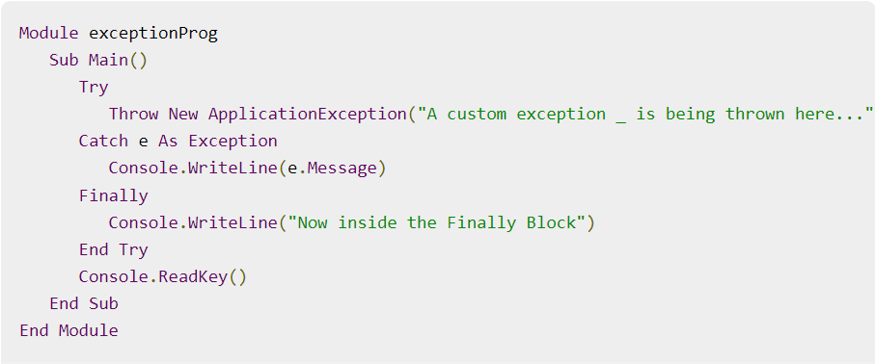
Output:
Throwing Objects:
You can throw an object if it is either directly or indirectly derived from the System.Exception class.
You can use a throw statement in the catch block to throw the present object as
Throw [ expression ]
Example:

Slide 20

Output:

Slide 21
Thank you

