Slide 1

Microsoft vb.net
Instructor : Anirudha Gaikwad

Slide 2

What You Learn? Click Here for more
Architecture Of ADO. Net
Accessing Data With Server Explorer
Data Providers
Connections, Data Reader, Data Adapters and Dataset

Slide 3
What is ADO.Net?
The full-form of ado.net is ActiveX Data Object.
ADO.net is the data-access technology that enables applications to connect to data stores and manipulate data contained in them in various ways.
It is based on the .NET framework and it is highly integrated with the rest of the framework class library.
Ado.net is a collection of classes, interfaces, structures, enumerated type that mange data access from the relational data stores within the .net framework.

Slide 4
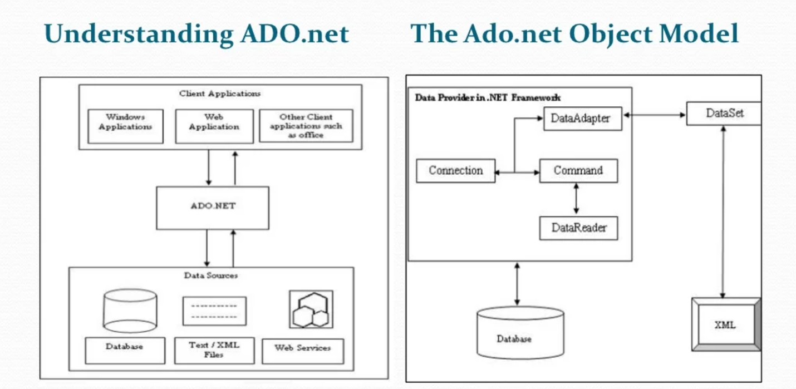
Architecture Of ADO. Net

Slide 5
Working with Ado.net
Many of web application development, in many of the developers data situations involves opening data store, making request for specific data, and then populating the table in then browser with the data.
To address the above situations Ado.net support the following classes:
1)DataSet
2)DataReader
Working with Ado.net Namespaces
The six core Ado.net namespaces:
1)System.Data
2)System.Data.Common
3)System.Data.OleDb
4)System.Data.Odbc
5)System.Data.SqlClient
6)System.Data.SqlTypes

Slide 6
The classes from the above namespaces are categorized as follow:
Disconnected: These Class provides basic structure of Ado.net includes Data Table, etc. The object of this class are capable of storing data without any dependency on specific data provide.
Shared: Set of base classes for data provide and shared amount all dataprovide. Includes DataSet, DataRow, DataTables, Constraint, etc.
Data Provide: These classes are meant to work with different datasoures. Performs all database management operations a specific database. E.g.SqlClient data provide works only with SQL Server Database.

Slide 7
Type of Architecture:
ADO.NET is both Connection-oriented as well as Disconnection oriented
Connected: Forward-only, Read-only, mode. Application issues query then reads back results and DataReader object. processes them.
2. Disconnected: Application issues query then retrieve and stores results for processing Minimizes time connected to database DataSet object.

Slide 8
Data Provider:- (Connected Environment)
A data provider is used for connecting to a database, retrieving data, storing the data in a dataset, reading the retrieved data, and updating the database.
Connection:-This component is used to establish a connection with a data source such as database.
Command:-This component is used to retrieve, insert, delete, or modify data in a data source.
DataReader:-This component is used to retrieve data from a data source in a read-only and forward-only mode.
DataAdapter:-This component is used to transfer data to and from database. A DataReader retrieves data from a database into a dataset.

Slide 9
Data Set:- (Disconnected Environment)
The data set is a memory-based relational representation of data.
DataTableCollection:-It contains all table retrieved from the data source.
DataRelation Collection:-It contains relationships and links between table in a dataset.
Data Table:-It represent a table in the data table collection of a dataset.
DataRowCollection:-It contains all the rows in a data table.
DataColoumn Collection:-It contains all the column in a data table.

Slide 10
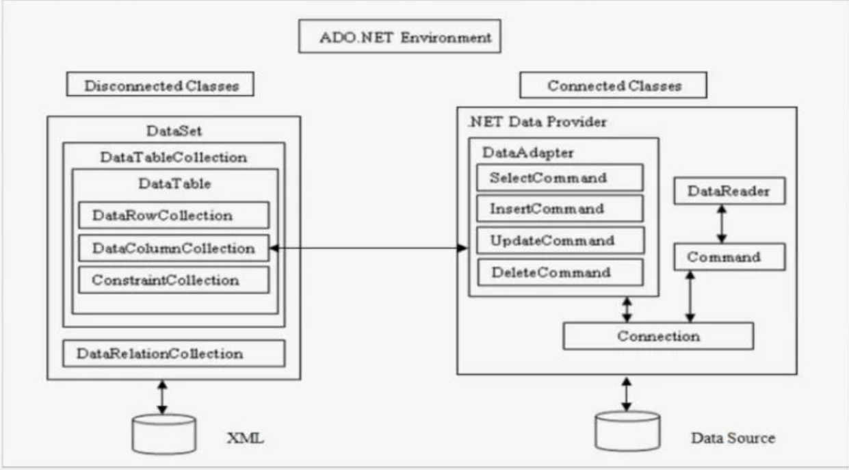
ADO. Net Environment:

Slide 11
Data Reader
A data reader(SqlDataReader, etc.,) is a simple and fastest way of selecting some data from a data source but also least capable.
You can't directly instantiate a data reader object. An instance is returned from appropriate Command object after having called ExecuteReader() method.
This data reader is forward-only, read-only connected cursor. You can only travel the records in one direction. Database connection used is kept open until the data reader has been closed.
The DataReader object requires a live connection to the database. So when you are done with DataReader object, be sure to call close(). If not connection stays alive.
When DataReader object is closed (via an explicit call to close) or the object being garbage collected, the underlying connection(con) may also be closed depending on which of the ExecuteReader() methods is called.

Slide 12
If you call ExecuteReader() and pass CommandBehaviour
Close Connection you can force the connection to be closed when reader closed.
For Data Reader object you have the following methods:
Read():Reads record by record in the data reader.
Close():Closes the SqlDataReader connection
Dispose():Disposes the data Reader object.
Some of the important properties of Data Reader object are:
Connection: Gets the SqlConnection associated with theSqlDataReader.
HasRows: Gets the value that indicates whether the SqlDataReader contains one or more rows.
IsClosed: Retrieves a boolean value that indicates whether the specified SqlDataReader instance has been closed.

Slide 13
Data Adapter
The Data Adapter classes (Eg: SqlDataAdapter,..) bridge the gap between the disconnected DataTable objects and the physical data source.
The SqlDataAdapter provides two-way data transfer mechanisms:
It is capable of executing a SELECT statement on a data source and transferring the result set into a Data Table object.
It is also capable of executing the standard INSERT, UPDATE and DELETE statements and extracting the input data from the DataTable object.
The commonly used properties of SqlDataAdapter class are:
Select Command: Gets or sets an object of type SqlCommand. This command is automatically executed to fill a Data Table with the result set.
Insert Command: Gets or sets an object of type SqlCommand.
Update Command: Gets or sets an object of type SqlCommand.

Slide 14
Delete Command: Gets or sets an object of type SqlCommand.
This SqlDataAdapter class also provide a method called Fill().
Calling the Fill() method automatically execute the command provided by the Select Command property and retrieve the result set and copies it to DataTable.
Using Parameter:
If you requires SQL Statements that required you to configure using parameters then you need to instantiate Parameter (i.e., SqlParameter,...) object and providing it with necessary information such as name, value, type, size, direction, etc.,
The following are properties of the SqlParameter class:
ParameterName, SqlDbType, Size, Direction, SourceColoumn, value

Slide 15
for e.g.:
SqlCommand myCmd = new SqlCommand(); myCmd.commandText = "SELECT * FROM CUSTOMERS WHERE CITY=@CITY";
sqlParameter parmCity = new SqlParameter();
parmCity.ParameterName="@CITY";
parmCity.SqlDbType-SqlDbType.varchar;
parmCity.Direction=Parameter Direction.input;
parmCity. Value="Ahmedabad"
mycmd.Parameter.Add(parmCity);

Slide 16
DataSet
The DataSet class has been designed as an offline container of data.
Data held within the DataSet is not necessary to come from database. It can be recorded from database. It can be recorded from CSV file, XML source, etc.
A DataSet class contains a set of Data Table classes and links between tables.
for e.g.:
foreach(DataRow row in ds. Tables["Customers"].rows);
Console.WriteLine("{0} and {1}", row[o],row[1]);
Each Data Table class consists DataColoumn, Data Row, Constraints and ExtendedProperties classes.
.csv=Comma Separated Values

Slide 17
Here DataColoumn object defines the properties of a coloumn within Data Table. These properties includes data type (Int32, Char, DateTime, etc.,), read-only. You can also assign a name for coloumn.
for e.g.:
DataColoumn
customer ID=newDataColoumn("CustomerID", typeof (int));
customerID.AllowDBNull=false;customerID.ReadOnly=false;
customerID.AutoIncrement=true;customerID. Unique=true;
The actual data within a table is accessed via a DataRow object. One of the interesting aspect of DataRow is that it is versioned.
This permits you to receive various values for a given coloumn in a particular row.

Slide 18
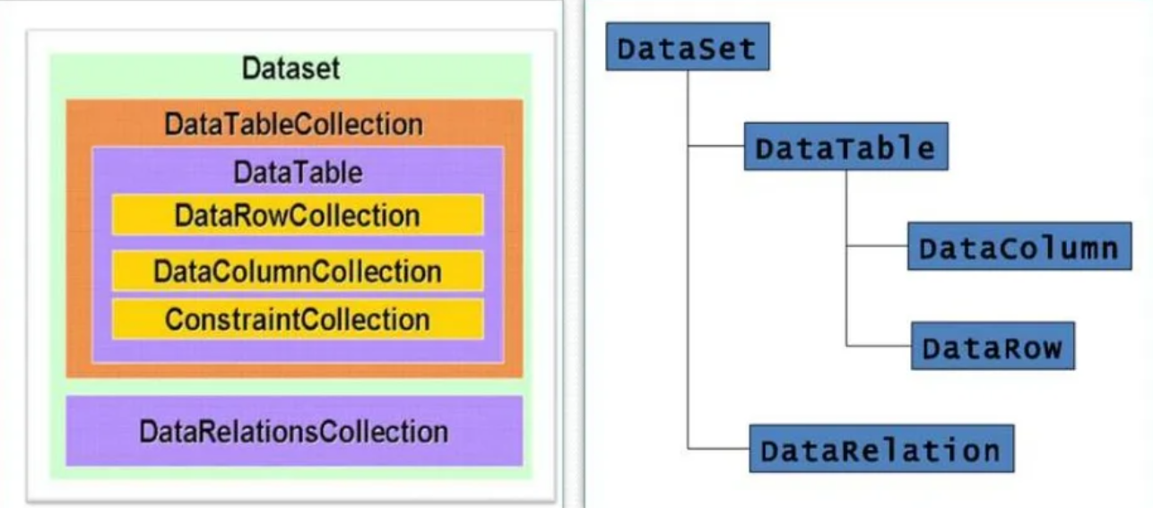

Slide 19
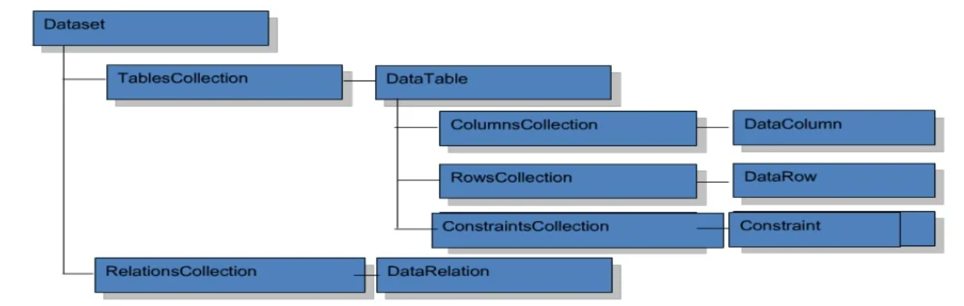
DataSet Architecture:
You can create DataSet in any one of the following methods:
Using Server Explorer
Using DataAdapter
Programmatically
Using Xml

Slide 20
for e.g.:
SqlConnection con = new SqlConnection(...);
SqlCommand cmd = new SqlCommand(...);
SqlDataAdapter da = new SqlDataAdapter (cmd, con);
DataSet ds = new DataSet();da.Fill(ds, "MyTable");
The DataAdapter class is used to place the data in a DataSet class.
This Adapter class issues the SQL clause and fills a table within the DataSet.
for e.g. :
SqlDataAdapter da = new SqlDataAdapter(strCmd, con);
DataSet ds = new DataSet();
da.Fill(ds, "Customers"); //Populating DataSet with DataAdapter.

Slide 21
The DataSet class has been designed to establish relationships between data tables with ease.
At present you can apply the ForeignKeyConstraint and Unique Constraint on a columns in a DataSet.
You can also set Update & Delete constraints on a columns that have constraint relationships.

Slide 22
Data Providers Classes
In .NET framework data provide is used for connecting to database, executing commands are retrieving results. By default the following data provides are included in .NET framework:
Data Provider for SQL Server
Data Provider for OLEDB
Data Provider for ODBC
Data Provider for Oracle
In.NET to access the data set of classes defined in the namespaces System.Data and other namespaces defined within this namespaces.
Each data provider contains the following objects:
Connection (for e.g. : Sqlconnection, Oracleconnection, Odbcconnection, etc.)
Command, CommandBuilder (for e.g. : Sqlconnection, SqlConnectionBuilder, etc.)
DataAdapter (for e.g.: SqlDataAdapter, etc.)
DataReader (for e.g. : SqlDataReader, etc)

Slide 23
Parameter (for e.g.: SqlParameter, etc)
Transaction (e.g.: SqlTransaction, etc)
Each Provider use different namespaces. Their namespaces are in respective:
System.Data.SqlClient
System.Data.Oledb
System.Data.Odbc
System.Data. Oracle Client
In addition to above namespaces few more important namespaces in ADO.NET are:
System.Data
System.Data.Comman
System.Data.SqlTypes

Slide 24
Classes in Data Providers
Each data provider supports the fallowing types of core objects to communicate with database.
The Connection object provides connectivity to a data source.
The Command object enable access to database commands to return data, modify data, run stored procedures, and send or retrieve parameter information.
The DataReader provides a high performance stream of the data from the data source.
Finally, the DataAdapter provides the bridge between the DataSet object and the data source.
The DataAdapter uses Command objects to execute SQL commands at the data source to both load the DataSet with data, and renconcile change made to the data in the data in the DataSet back to the data source.

Slide 25
Connection Object
The different Connection classes are in different data provider models.
for e.g.: SqlConnection, OleDbConnection, Oracle Connection, etc.
The properties of SqlConnection class are:
ConnectionString, DataSource, Database, State.
In above properties DataSource, Database, State are read-only mode.
You can pass necessary connection string information to the SqlConnection in a string format or store in "web.config" file..
You can store database connection parameters in configuration file under <ConnectionString> section.
Here you can specify name of connection, connection string parameter and provider for this connection.

Slide 26
for e.g. usage of SqlConnection:
SqlConnection con = new SqlConnection("Data Source=FARZADFWADIA-PC;Initial Catalog=Farzad Wadia; Integrated Security=True");
con.Open();//Use connection object.
con.Close(); //you need to call this explicitly, because .net doesn't implicitly release the connection when they fall out of scope.

Slide 27
Command Object
In Ado.net a command is a string of the containing SQL statements that is to be issued to the database. It can also be a stored procedure or the name of the table which return all columns and rows.
A Command can be constructed by using the instance of SqlCommand.
for e.g.:
SqlCommand cmd = new SqlCommand("Select * from Employee", con);
After building the command object you need to execute with any one of themethods
ExecuteNonQuery(): Executes the command but doesn't return any output. Only it will return no of rows effected.
ExecuteReader(): Executes the command and returns a type SqlDataReader.

Slide 28
ExecuteRow(): Executes the command and returns SqlRecord. (Single row)
ExecuteScalar(): Executes the command and returns a single values.
ExecuteXmlReader(): Executes the command and returns XmlReader.

Slide 29
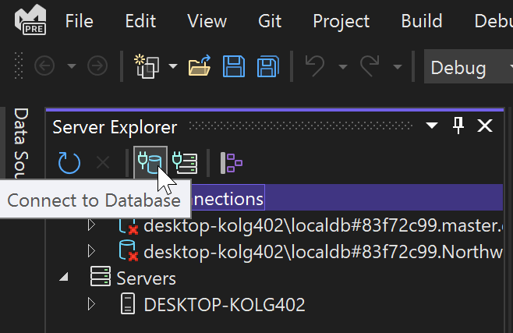
Accessing Data With Server Explorer
To create a connection to the database, click the Add Connection icon in Server Explorer, or right-click in Server Explorer on the Data Connections node and select Add Connection. From here, you can also connect to a database on another server, a SharePoint service, or an Azure service.

Slide 30
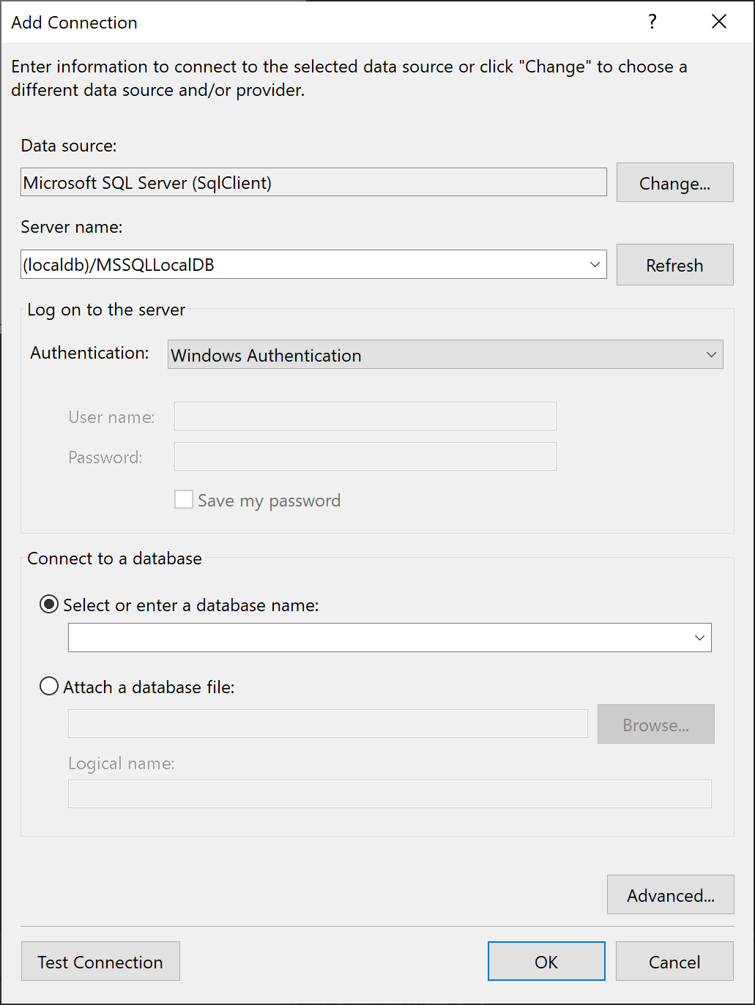
This brings up the Add Connection dialog box. Here, we have entered the name of the SQL Server LocalDB instance, (localdb)\MSSqlLocalDB, which is usually installed with Visual Studio.

Slide 31
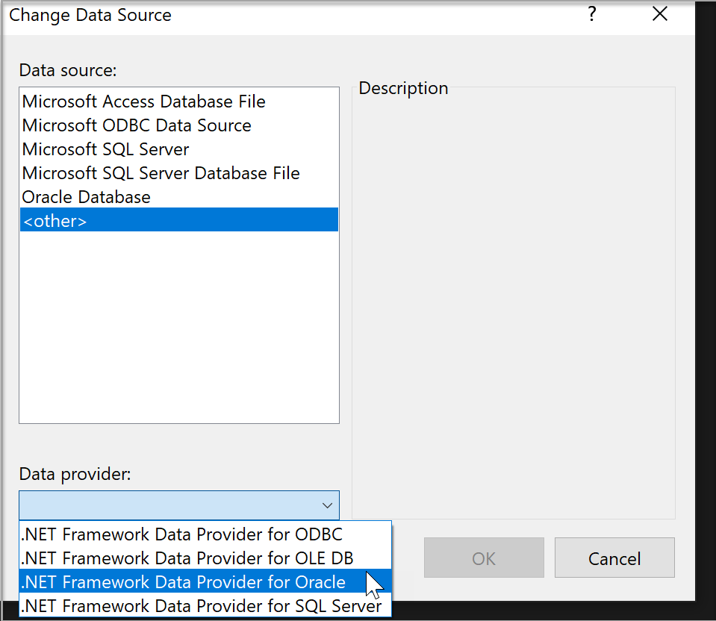
Change the provider
If the data source is not what you want, click the Change button to choose a new data source and/or a new ADO.NET data provider. The new provider might ask for your credentials, depending on how you configured it.

Slide 32
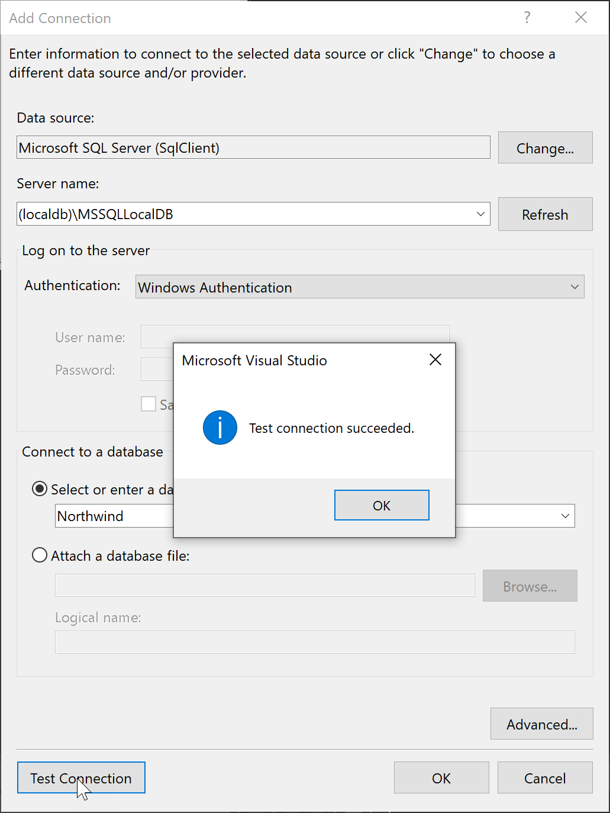
Test the connection
After you have chosen the data source, click Test Connection. If it doesn't succeed, you will need to troubleshoot based on the vendor's documentation.

Slide 33
Thank you

