Slide 1

Microsoft vb.net
Instructor : Anirudha Gaikwad

Slide 2

What You Learn?
CRUD Operation using VB.Net

Slide 3
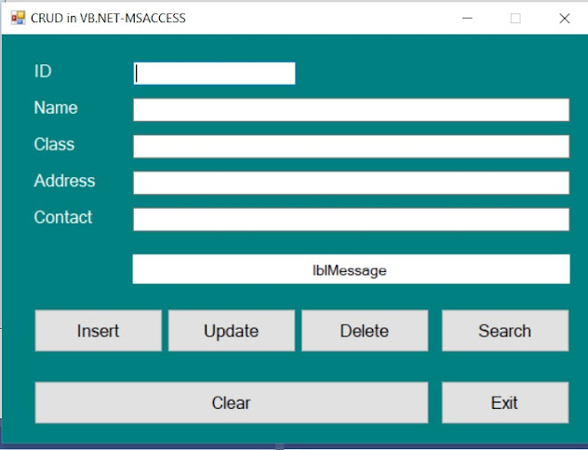
CRUD Operation:
To create a VB.Net project about CRUD in VB.Net and Microsoft Access, first of all you have to design an interface of the form with six labels, five text boxes and six buttons on this form as shown in the image.

Slide 4
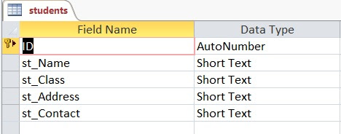
Next change the Text property of the labels as Id, Name, Class, Address, Contact and lblMessage and the name property of the textboxes to txtId, txtName, txtClas, txtAddress and txtContact.
Next, change the name property of the buttons as btnInsert, btnUpdate, btnDelete, btnSearch, btnClear and btnExit respectively.
Before you start typing the VB.Net code on the different buttons which you placed on the form of CRUD in VB.Net and Microsoft Access project first of all you have to create a database in the Microsoft Access with the name of students and also you need to create a table with the name of students with fields as shown below.

Slide 5
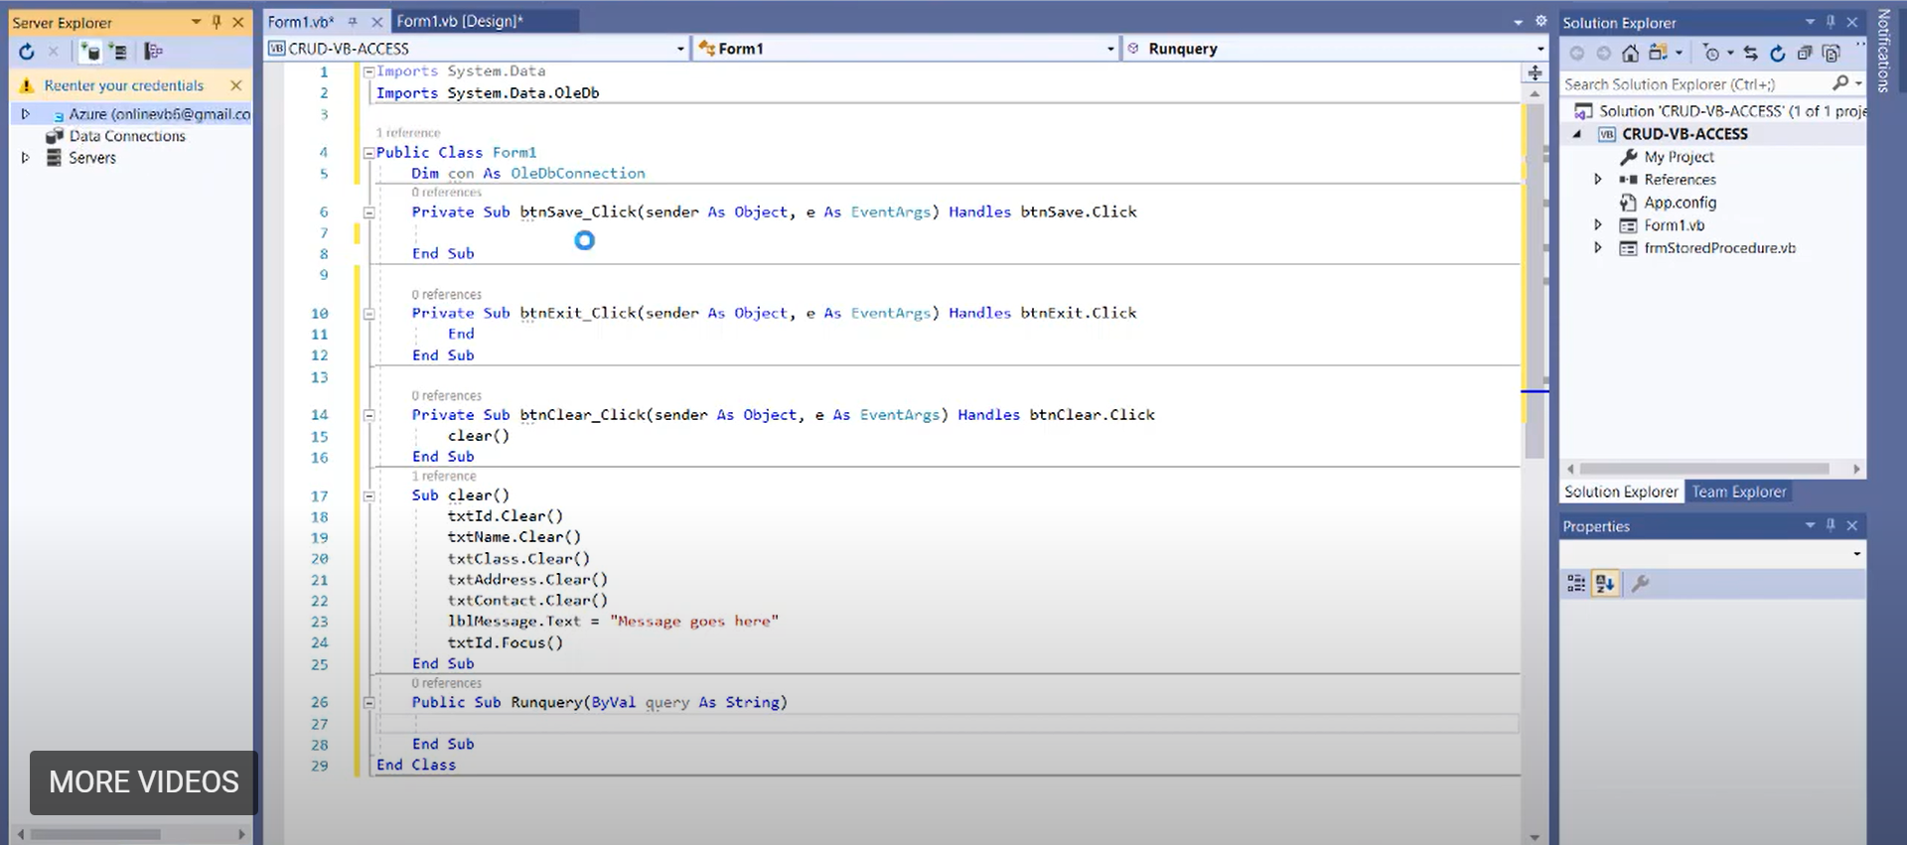
Now, moving on to the coding part we will be having a class named “Form1” as mentioned in above fig. Inside the class, we will be having 3 sub procedures namely btnSave_Click, btnExit_Click, btnClear_Click

Slide 6
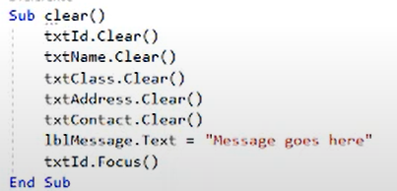
Inside the exit sub procedure, we will just add the “End” keyword which basically tells the server to end or exit whenever the user clicks on the “Exit” button
Inside the clear sub procedure, we will be having a self-defined sub procedure named “clear()”
Which basically clears all the data Form1 whenever the user clicks the “Clear” button
Now, we will look into the actual CRUD Operation wherein we will see Insert Operation, Update Operation, Delete Operation and Search Operation respectively.
In order to achieve the above-mentioned operation we will be having 4 sub procedures namely
btnInsert_Click, btnDelete_Click, btnUpdate_Click, btnSearch_Click

Slide 7
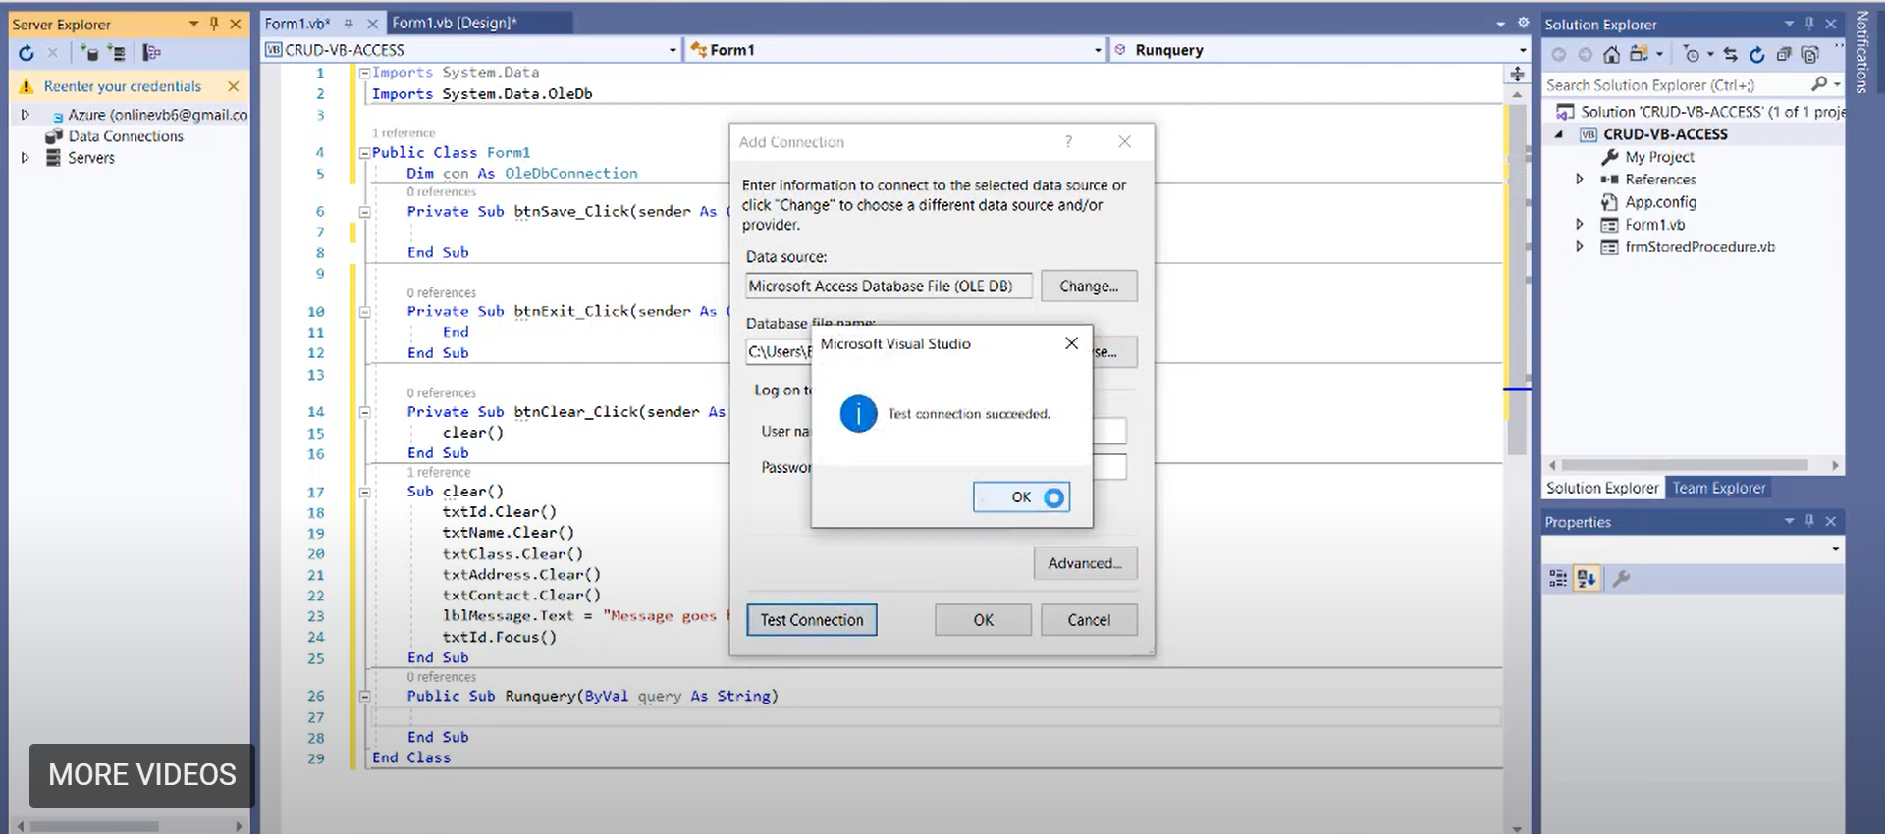
Before, moving on we need to make a connection between our database fille and Form1 After the connection your screen should look like the below…..
After successful connection to the database in Add connection tab→go to Advanced→In the provide section copy the URL to your clipboard

Slide 8
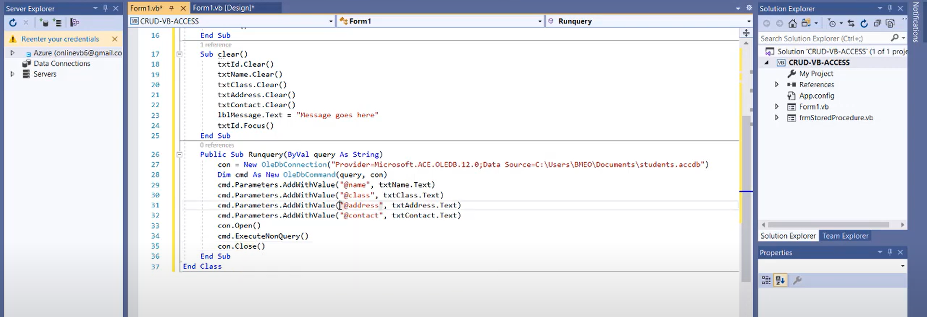
Here, we have created Runquery() sub procedure which basically holds the connection to our database i.e. whenever any CRUD Operation takes place we see are data in the database.
Now, paste the URL that you have copied in the “con” variable as shown in the above function

Slide 9
Code:
Imports System.Data
Imports System.Data.OleDb
Public Class Form1
Dim con As OleDbConnection
Private Sub btnClear_Click(sender As Object, e As EventArgs) Handles btnClear.Click
clear()
End Sub
Sub clear()
txtID.Clear()
txtName.Clear()
txtClass.Clear()
txtAddress.Clear()
txtContact.Clear()
lblMessage.Text = ""
txtID.Focus()
End Sub
Private Sub btnExit_Click(sender As Object, e As EventArgs) Handles btnExit.Click
End
End Sub

Slide 10
Public Sub RunQuery(ByVal query As String)
'con = New OleDbConnection("Provider=Microsoft.ACE.OLEDB.12.0;Data Source=C:\Users\BMEO\Documents\Visual Studio 2019\Projects\CRUD-VB-Access\CRUD-VB-Access\bin\Debug\students.accdb")
'con = New OleDbConnection("Provider=Microsoft.ACE.OLEDB.12.0;Data Source=Application.StartupPath & \students.accdb")
con = New OleDbConnection("provider = Microsoft.ACE.OLEDB.12.0;Data Source=C:\Users\BMEO\Documents\students.accdb")
Dim cmd As New OleDbCommand(query, con)
cmd.Parameters.AddWithValue("@name", txtName.Text)
cmd.Parameters.AddWithValue("@stclass", txtClass.Text)
cmd.Parameters.AddWithValue("@address", txtAddress.Text)
cmd.Parameters.AddWithValue("@contact", txtContact.Text)
cmd.Parameters.AddWithValue("@id", txtID.Text)
con.Open()
cmd.ExecuteNonQuery()
con.Close()
End Sub
Private Sub btnInsert_Click(sender As Object, e As EventArgs) Handles btnInsert.Click
Dim insertQuery As String = "insert into students (st_Name,st_Class,st_Address,st_Contact) VALUES(@name,@stclass,@address,@contact)"
RunQuery(insertQuery)
lblMessage.Text = "Record inserted successfully"
End Sub

Slide 11
Private Sub btnDelete_Click(sender As Object, e As EventArgs) Handles btnDelete.Click
Dim deleteQuery As String = "delete from students where ID=@id"
RunQuery(deleteQuery)
lblMessage.Text = "Record Deleted successfully"
End Sub
Private Sub btnUpdate_Click(sender As Object, e As EventArgs) Handles btnUpdate.Click
Dim updatequery As String = "update students set st_Name=@name,st_Class=@stclass,st_Address=@address,st_Contact=@contact where ID=@id"
RunQuery(updatequery)
lblMessage.Text = "Record Updated successfully"
End Sub
Private Sub btnSearch_Click(sender As Object, e As EventArgs) Handles btnSearch.Click
con = New OleDbConnection("provider = Microsoft.ACE.OLEDB.12.0;Data Source=C:\Users\BMEO\Documents\students.accdb")
Dim searchQuery As String = "select * from students where ID=@id"
Dim cmd As New OleDbCommand(searchQuery, con)
cmd.Parameters.AddWithValue("@id", txtID.Text)
Dim da As New OleDbDataAdapter(cmd)
Dim table As New DataTable
da.Fill(table)

Slide 12
If table.Rows.Count > 0 Then
txtName.Text = table.Rows(0)(1).ToString
txtClass.Text = table.Rows(0)(2).ToString
txtAddress.Text = table.Rows(0)(3).ToString
txtContact.Text = table.Rows(0)(4).ToString
lblMessage.Text = "Record found"
Else
clear()
lblMessage.Text = "Record not found"
End If
End Sub
End Class

Slide 13
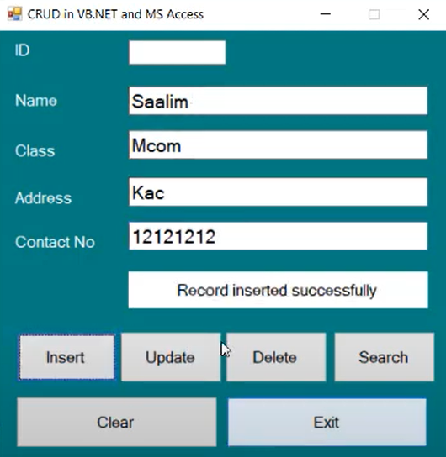
1. Inserting following data into database through Form1

Slide 14
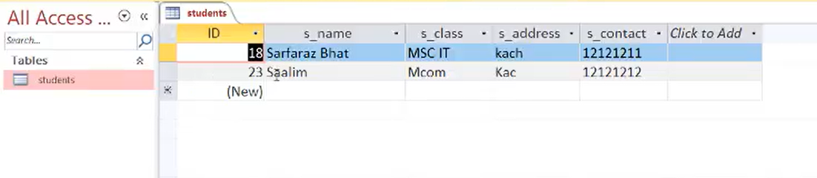
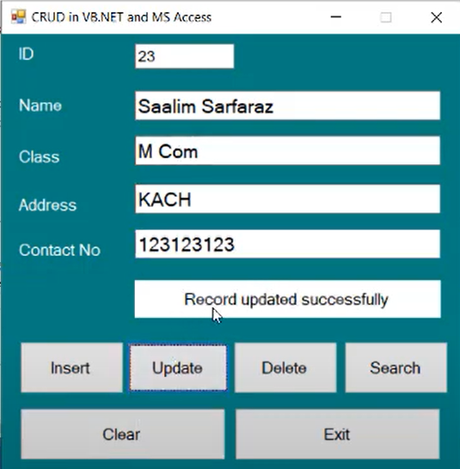
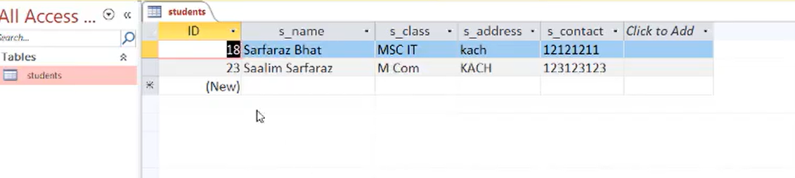
2. Updating the previous data (here we have updated the contact column)
Before
After

Slide 15
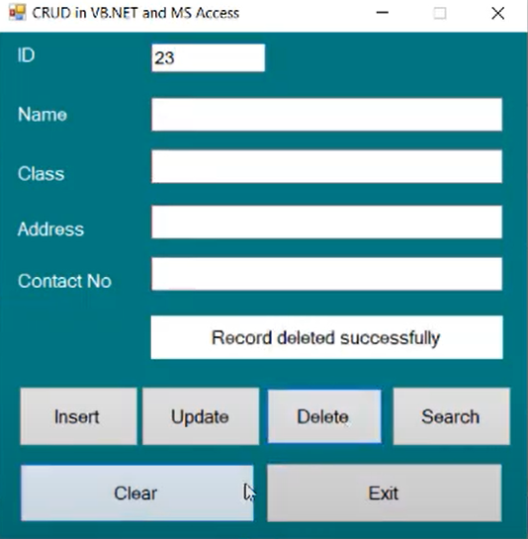
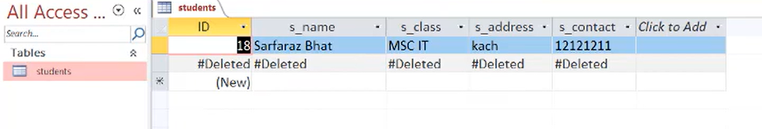
3. Deleting the element by ID
After Deleting the Id 23

Slide 16
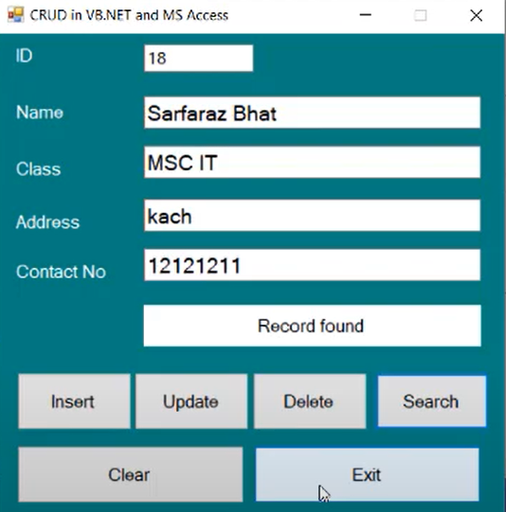
4. Searching the element by ID:

Slide 17
Thank you

