Slide 1

Microsoft vb.net
Instructor : Anirudha Gaikwad

Slide 2

What You Learn? Click here for more
How to Create a SQL Database in VB.Net using VS
Create and configure datasets in Visual Studio
Connect to data in an Access database

Slide 3
How to Create a SQL Database in VB.Net using VS :
We can use Visual Studio to create and update a local database file in SQL Server Express LocalDB.
We can also create a database by executing Transact-SQL statements in the SQL Server Object Explorer tool window in Visual Studio.
In this topic, we'll create an .mdf file and add tables and keys by using the Table Designer.
Prerequisites
We'll need the .NET desktop development and Data storage and processing workloads installed in Visual Studio.
To install them, open Visual Studio Installer and choose Modify (or More > Modify) next to the version of Visual Studio you want to modify.

Slide 4
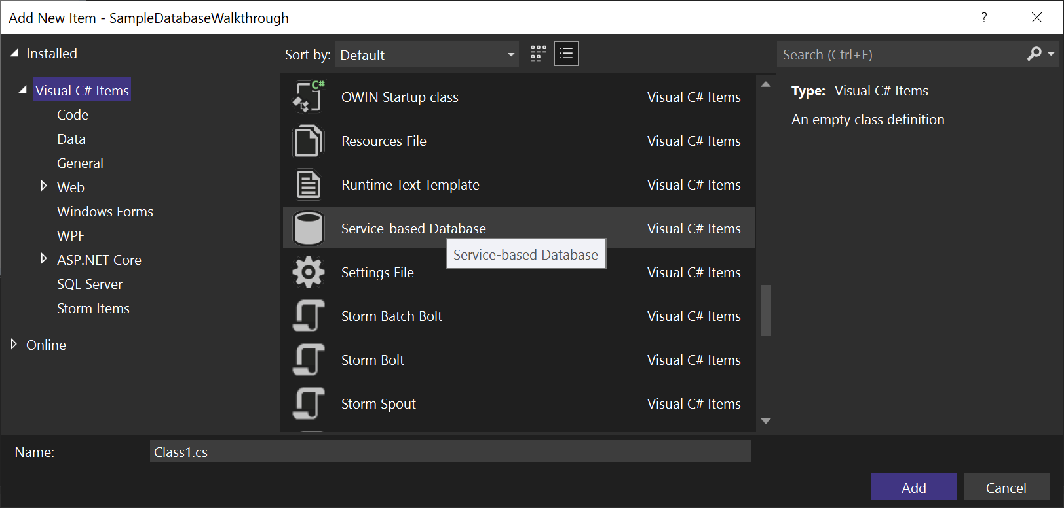
Create a project and a local database file
Create a new Windows Forms App (.NET Framework) project and name it SampleDatabaseWalkthrough.
On the menu bar, select Project > Add New Item.
In the list of item templates, scroll down and select Service-based Database.
Name the database SampleDatabase, and then click Add.

Slide 5
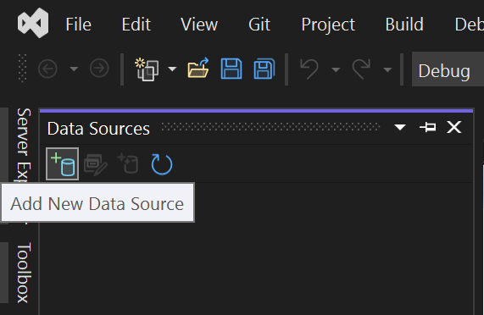
Add a data source
If the Data Sources window isn't open, open it by pressing Shift+Alt+D or selecting View > Other Windows > Data Sources on the menu bar.
In the Data Sources window, select Add New Data Source.

Slide 6
The Data Source Configuration Wizard opens.
On the Choose a Data Source Type page, choose Database and then choose Next.
On the Choose a Database Model page, choose Next to accept the default (Dataset).
On the Choose Your Data Connection page, select the SampleDatabase.mdf file in the drop-down list, and then choose Next.
On the Save the Connection String to the Application Configuration File page, choose Next.
On the Choose your Database Objects page, you'll see a message that says the database doesn't contain any objects. Choose Finish.

Slide 7
View properties of the data connection
We can view the connection string for the SampleDatabase.mdf file by opening the Properties window of the data connection:
Select View > SQL Server Object Explorer to open the SQL Server Object Explorer window. Expand (localdb)\MSSQLLocalDB > Databases, and then right-click on SampleDatabase.mdf and select Properties.
Alternatively, you can select View > Server Explorer, if that window isn't already open. Open the Properties window by expanding the Data Connections node, right-clicking on SampleDatabase.mdf, and then selecting Properties.
Note ::
If you can't expand the Data Connections node, or the SampleDatabase.mdf connection is not listed, select the Connect to Database button in the Server Explorer toolbar. In the Add Connection dialog box, make sure that Microsoft SQL Server Database File is selected under Data source, and then browse to and select the SampleDatabase.mdf file. Finish adding the connection by selecting OK.

Slide 8
Create tables and keys by using Table Designer
In this section, you'll create two tables, a primary key in each table, and a few rows of sample data. You'll also create a foreign key to specify how records in one table correspond to records in the other table.
Create the Customers table
1. In Server Explorer, expand the Data Connections node, and then expand the SampleDatabase.mdf node.
If you can't expand the Data Connections node, or the SampleDatabase.mdf connection is not listed, select the Connect to Database button in the Server Explorer toolbar. In the Add Connection dialog box, make sure that Microsoft SQL Server Database File is selected under Data source, and then browse to and select the SampleDatabase.mdf file. Finish adding the connection by selecting OK.
2. Right-click on Tables and select Add New Table.
The Table Designer opens and shows a grid with one default row, which represents a single column in the table that you're creating. By adding rows to the grid, you'll add columns in the table.

Slide 9
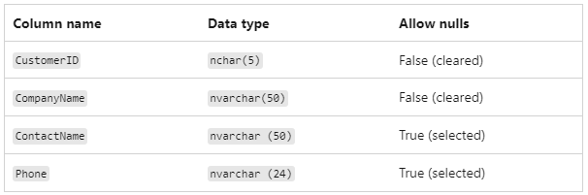
3. In the grid, add a row for each of the following entries:
4. Right-click on the CustomerID row, and then select Set Primary Key.
5. Right-click on the default row (Id), and then select Delete.
6. Name the Customers table by updating the first line in the script pane to match the following sample:
CREATE TABLE [dbo].[Customers]
7. Add an index constraint to the Customers table. Add a comma at the end of the Phone line, then add the following sample before the closing parenthesis:
CONSTRAINT [PK_Customers] PRIMARY KEY ([CustomerID])

Slide 10
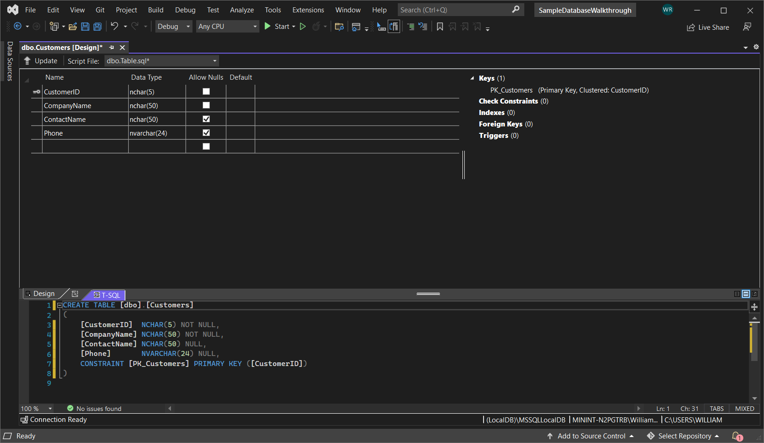
You should see something like this

Slide 11
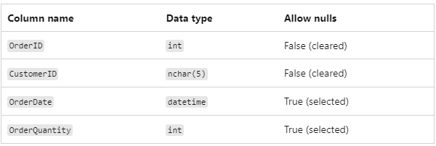
8. In the upper-left corner of Table Designer, select Update, or press Shift+Alt+U.
9. In the Preview Database Updates dialog box, select Update Database.
The Customers table is created in the local database file.
Create the Orders table
1. Add another table, and then add a row for each entry in the following table:

Slide 12
Set OrderID as the primary key, and then delete the default row.
3. Name the Orders table by updating the first line in the script pane to match the following sample: CREATE TABLE [dbo].[Orders]
4. Add an index constraint to the Customers table. Add a comma at the end of the OrderQuantity line, then add the following sample before the closing parenthesis: CONSTRAINT [PK_Orders] PRIMARY KEY ([OrderId])
5. In the upper-left corner of the Table Designer, select Update, or press Shift+Alt+U..
6. In the Preview Database Updates dialog box, select Update Database.
The Orders table is created in the local database file. If you expand the Tables node in Server Explorer, you see the two tables:

Slide 13
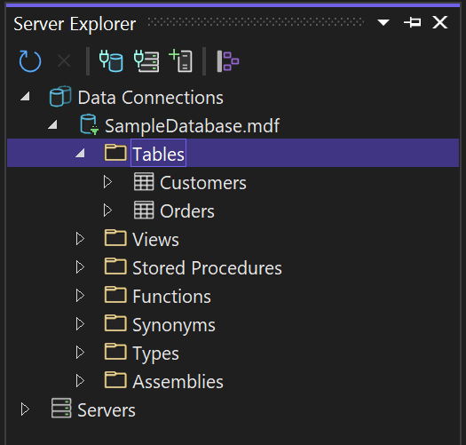
If you don’t see it, hit the Refresh button in the toolbar

Slide 14
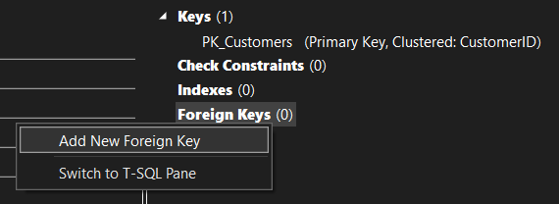
Create a foreign key
1. In the context pane on the right side of the Table Designer grid for the Orders table, right-click on Foreign Keys and select Add New Foreign Key.

Slide 15
4. In the text box that appears, replace the text ToTable with Customers.
5. In the T-SQL pane, update the last line to match the following sample:
CONSTRAINT [FK_Orders_Customers] FOREIGN KEY ([CustomerID]) REFERENCES [Customers]([CustomerID])
6. In the upper-left corner of the Table Designer, select Update (Shift+Alt+U).
7. In the Preview Database Updates dialog box, select Update Database.
The foreign key is created.

Slide 16
Add data into the tables :
In Server Explorer or SQL Server Object Explorer, expand the node for the sample database.
Open the shortcut menu for the Tables node, select Refresh, and then expand the Tables node.
Open the shortcut menu for the Customers table, and then select Show Table Data or View Data.
Add whatever data you want for some customers.
You can specify any five characters you want as the customer IDs, but choose at least one that you can remember for use later in this procedure.
Open the shortcut menu for the Orders table, and then select Show Table Data or View Data.
Add data for some orders. As you enter each row, it is saved in the database.
Congratulations! You now know how to create tables, link them with a foreign key, and add data.

Slide 17
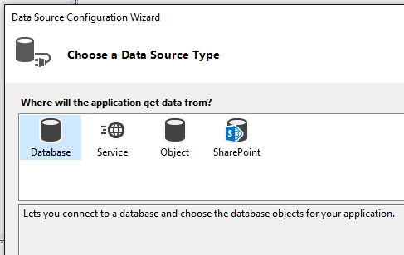
Create and configure datasets in Visual Studio
A dataset is a set of objects that store data from a database in memory and support change tracking to enable create, read, update, and delete (CRUD) operations on that data without the need to be always connected to the database.
Create a new dataset by using the Data Source Configuration Wizard:
Open your project in Visual Studio, and then choose Project > Add New Data Source to start the Data Source Configuration Wizard.
Choose the type of data source to which you'll be connecting.

Slide 18
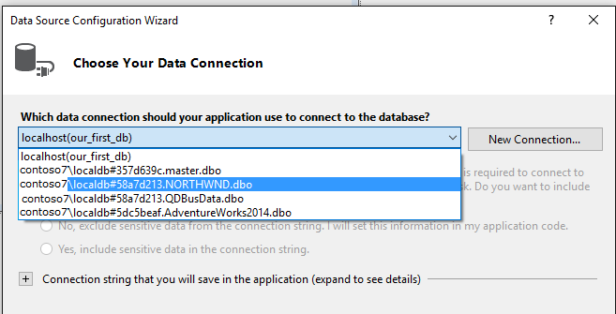
Choose the database or databases that will be the data source for your dataset.
Choose the tables (or individual columns), stored procedures, functions, and views from the database that you want to be represented in the dataset.

Slide 19
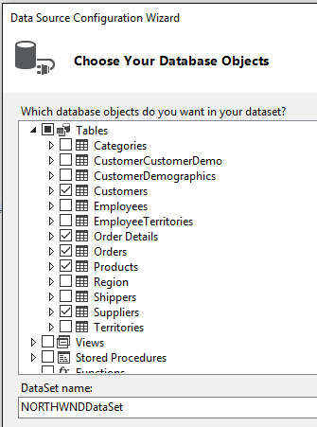
Click Finish.
The dataset appears as a node in Solution Explorer.

Slide 20
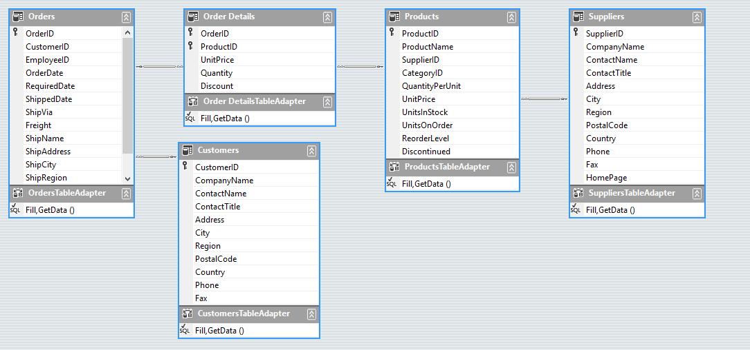
Click the dataset node in Solution Explorer to open the dataset in the DataSet Designer. Each table in the dataset has an associated TableAdapter object, which is represented at the bottom.

Slide 21
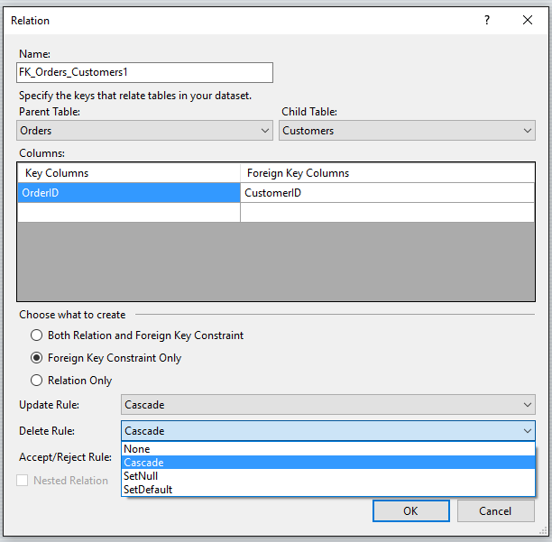
Click the lines to bring up the Relation dialog, where you can change the behavior of hierarchical updates. For more information, see Relationships in datasets and Hierarchical update.

Slide 22
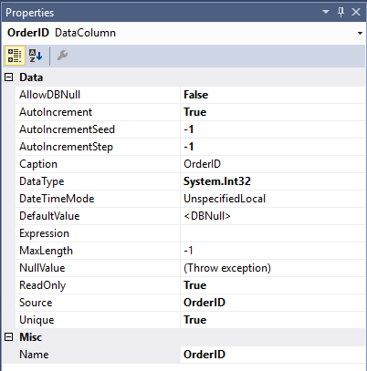
Click a table, table adapter, or column name in a table to see its properties in the Properties window. You can modify some of the values here. Just remember that you are modifying the dataset, not the source database.

Slide 23
Connect to data in an Access database
We can connect to an Access database (either an .mdb file or an .accdb file) by using Visual Studio. After you define the connection, the data appears in the Data Sources window. From there, you can drag tables or views onto your design surface.
Prerequisites
To use these procedures, you need a Windows Forms or WPF project and either an Access database (.accdb file) or an Access 2000-2003 database (.mdb file). Follow the procedure that corresponds to your file type.

Slide 24
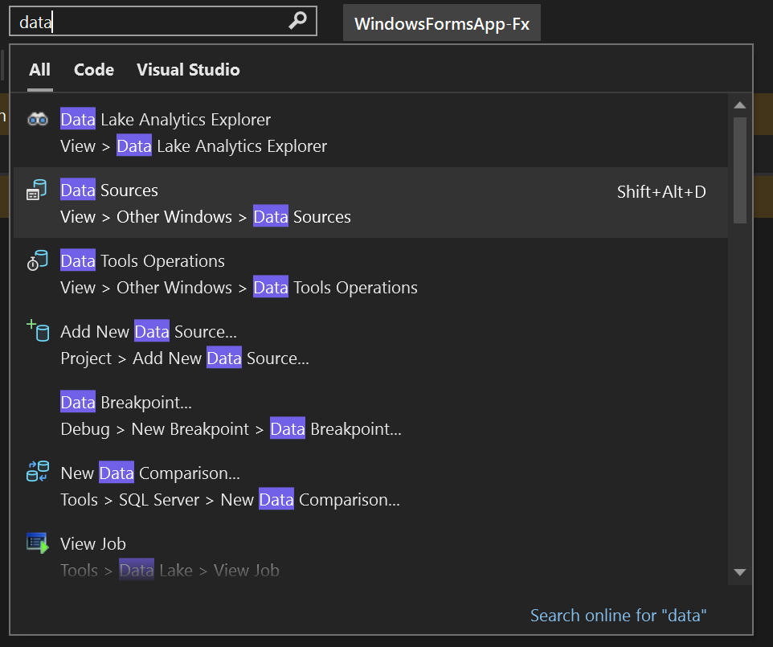
Create a dataset for an .accdb file
Connect to databases created with Microsoft 365, Access 2016, Access 2013, Access 2010, or Access 2007 by using the following procedure.
Open a Windows Forms or WPF application project in Visual Studio.
To open the Data Sources window, press Ctrl+Q, enter "data" in the search box, and choose Data Sources window. Or on the View menu, select Other Windows > Data Sources. Or on the keyboard, press Shift+Alt+D.

Slide 25
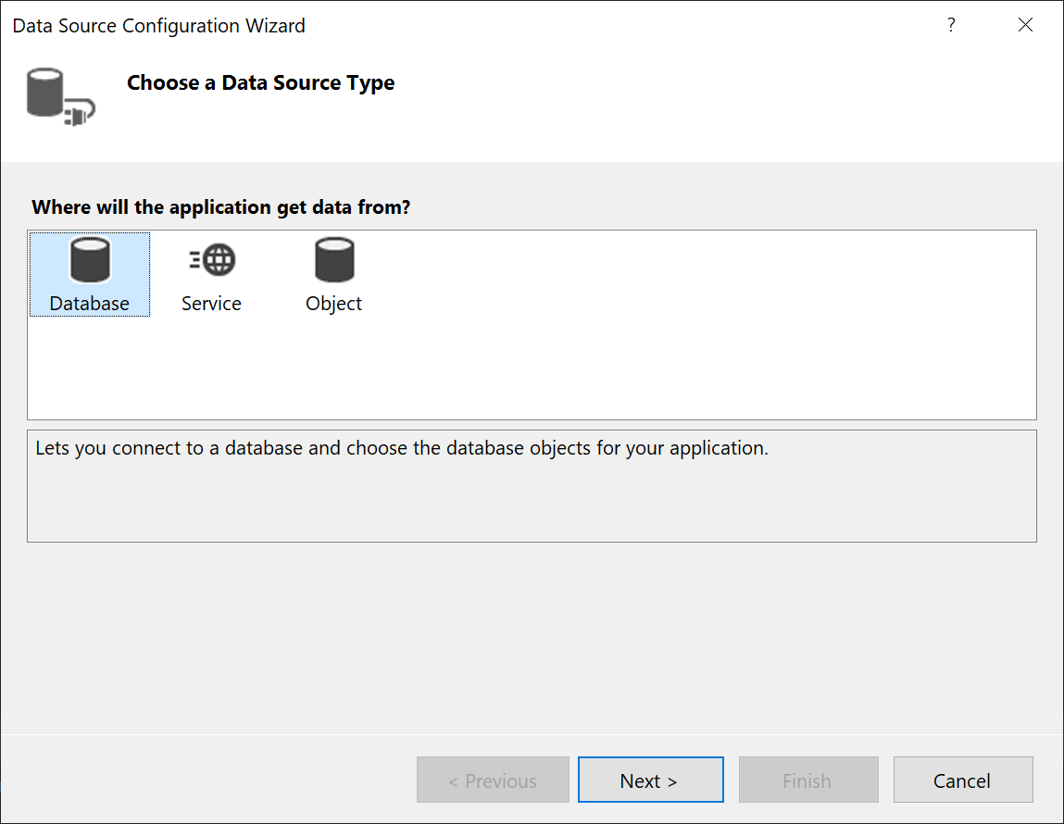
In the Data Sources window, click Add New Data Source.
The Data Source Configuration Wizard opens.

Slide 26
Select Database on the Choose a Data Source Type page, and then select Next.
Select Dataset on the Choose a Database Model page, and then select Next.

Slide 27
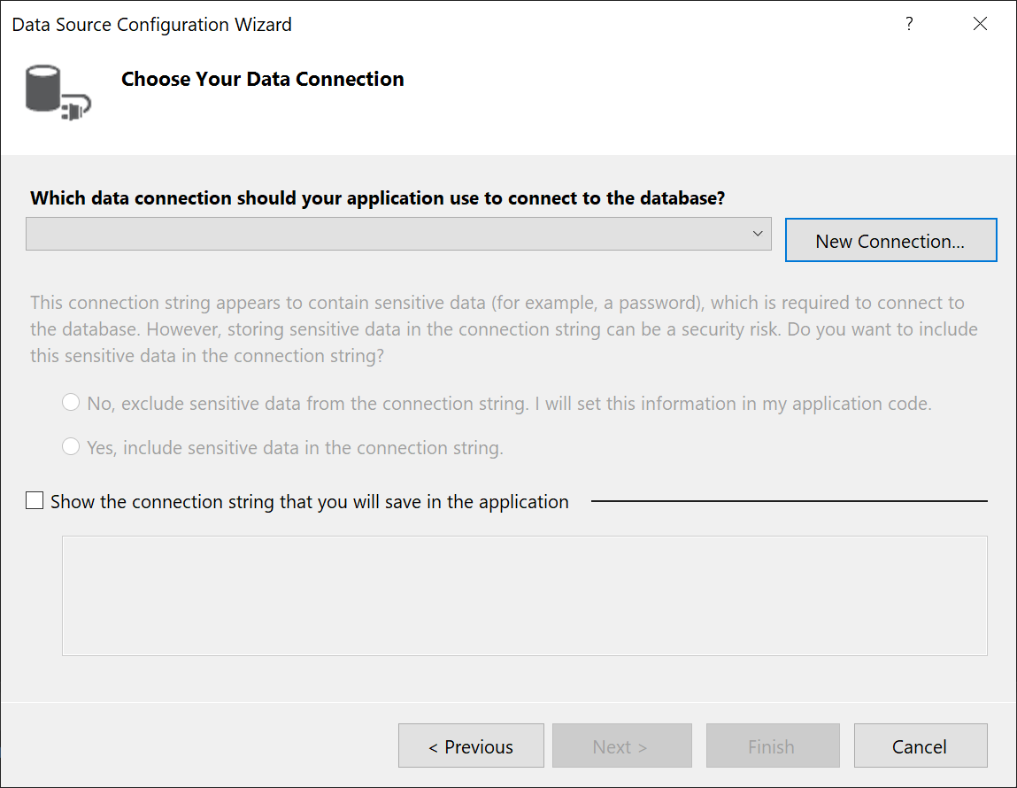
On the Choose your Data Connection page, select New Connection to configure a new data connection.

Slide 28
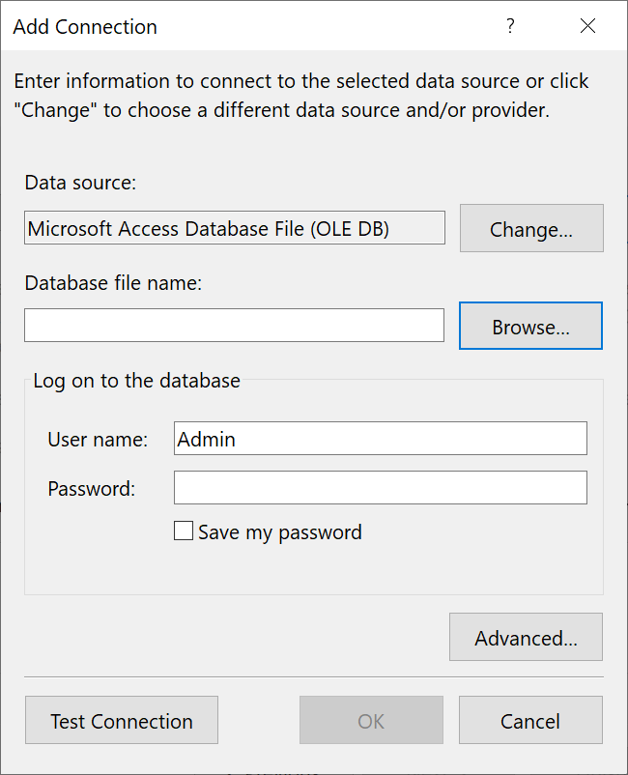
The Add Connection dialog box opens.

Slide 29
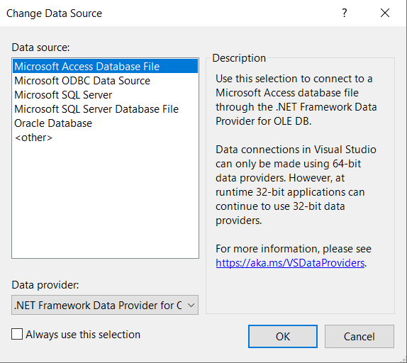
If Data source is not set to Microsoft Access Database File, select the Change button.
The Change Data Source dialog box opens. In the list of data sources, choose Microsoft Access Database File. The option .NET Framework Data Provider for OLE DB is already preselected. Choose OK.

Slide 30
Choose Browse next to Database file name, and then navigate to your .accdb file and choose Open.
Enter a user name and password (if necessary), and then choose OK.
Select Next on the Choose your Data Connection page.
You may get a dialog box telling you the data file is not in your current project. Select Yes or No.
Select Next on the Save connection string to the Application Configuration file page.

Slide 31
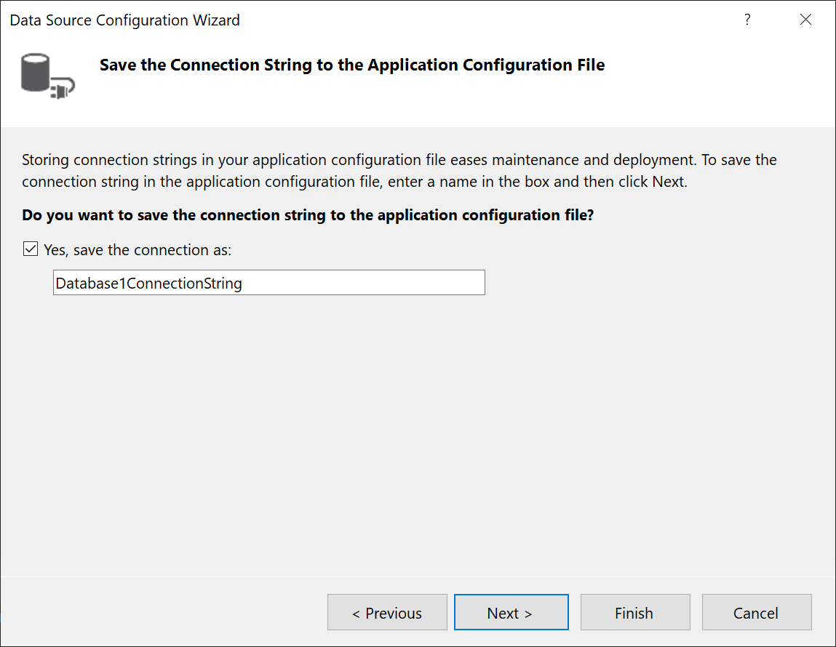

Slide 32
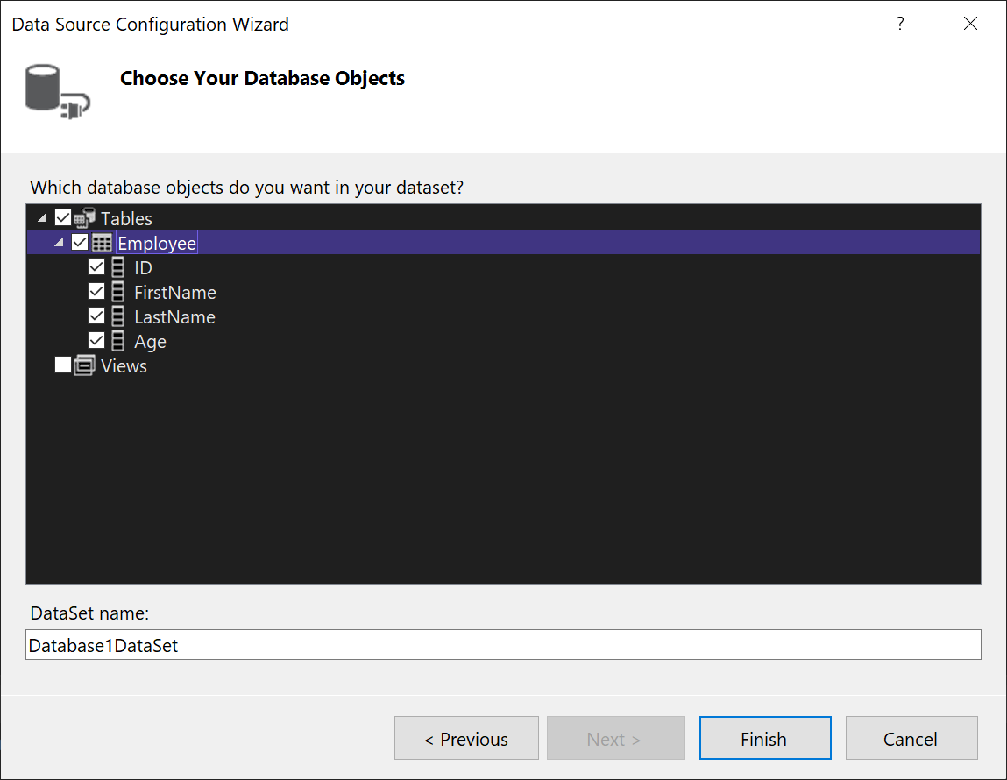
Expand the Tables node on the Choose your Database Objects page.

Slide 33
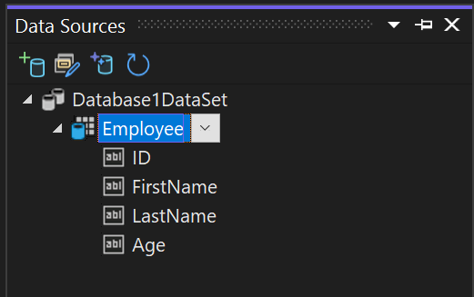
Select the tables or views you want to include in your dataset, and then select Finish.
The dataset is added to your project, and the tables and views appear in the Data Sources window.

Slide 34
Thank you

