Slide 1

Microsoft vb.net
Instructor : Anirudha Gaikwad

Slide 2

What You Learn?
Regex using VB.Net

Slide 3
Regular Expression(Regex):
In visual basic, regular expression (regex) is a pattern and it is useful to parse and validate whether the given input text is matching the defined pattern (such as an email address) or not.
Generally, the key part to process the text with regular expressions is regular expression engine and it is represented by Regex class in visual basic.
The Regex class is available with System.Text.RegularExpressions namespace. To validate the given input text using regular expressions, the Regex class will expect the following two items of information.
The regular expression pattern to identity in the text.
The input text to parse for the regular expression pattern.

Slide 4
Regular Expression
A Regular Expression (RegEx) is a sequence of characters that defines a search pattern.
A pattern defined using RegEx can be used to match against a string.
Expression | String | Matched?
^a...s$ | abs | No match
 | alias | Match
 | abyss | Match
 | Alias | No match
 | An abacus | No match
The pattern is: any five letter string starting with ‘a’ and ending with ‘s’

Slide 5
MetaCharacters
Metacharacters are characters that are interpreted in a special way by a RegEx engine. Here's a list of metacharacters:
[] . ^ $ * + ? {} () \ |
[] - Square brackets
Square brackets specifies a set of characters you wish to match
Expression | String | Matched?
[abc] | a | 1 match
 | ac | 2 matches
 | Hey Juderr | No match
 | abc de caty | 5 matches

Slide 6
[] - Square brackets
[abc] will match if the string you are trying to match contains any of the a, b or c.
You can also specify a range of characters using - inside square brackets.
[a-e] is the same as [abcde].
[1-4] is the same as [1234].
[0-39] is the same as [01239].
You can complement (invert) the character set by using caret ^ symbol at the start of a square-bracket.
[^abc] means any character except a or b or c.
[^0-9] means any non-digit character.

Slide 7
. Period
A period matches any single character (except newline '\n').
Expression | String | Matched?
.. | a | No match
 | ac | 1 match
 | acd | 1 match
 | acde | 2 matches (contains 4 characters)

Slide 8
^ Caret
The caret symbol ^ is used to check if a string starts with a certain character.
Expression | String | Matched?
^a | a | 1 match
 | abc | 1 match
 | bac | No match
^ab | abc | 1 match
 | acb | No match (starts with a but not followed by b)

Slide 9
$ Dollar
The dollar symbol $ is used to check if a string ends with a certain character.
Expression | String | Matched?
a$ | a | 1 match
 | formula | 1 match
 | cab | No match

Slide 10
* Star
The star symbol * matches zero or more occurrences of the pattern left to it.
Expression | String | Matched?
ma*n | mn | 1 match
 | man | 1 match
 | maaan | 1 match
 | main | No match (a is not followed by n)
 | woman | 1 match

Slide 11
+ Plus
The plus symbol + matches one or more occurrences of the pattern left to it.
Expression | String | Matched?
ma+n | mn | No match (no a character)
 | man | 1 match
 | maaan | 1 match
 | main | No match (a is not followed by n)
 | woman | 1 match

Slide 12
? Question Mark
The question mark symbol ? matches zero or one occurrence of the pattern left to it.
Expression | String | Matched?
ma?n | mn | 1 match
 | man | 1 match
 | maaan | No match (more than one a character)
 | main | No match (a is not followed by n)
 | woman | 1 match

Slide 13
{} Braces
Consider this code: {n,m}. This means at least n, and at most m repetitions of the pattern left to it.
Expression | String | Matched?
a{2,3} | abc dat | No match
 | abc daat | 1 match (at daat)
 | aabc daaat | 2 matches (at aabc and daaat)
 | aabc daaaat | 2 matches (at aabc and daaaat)
Expression | String | Matched?
[0-9]{2,4} | ab123csde | 1 match (match at ab123csde)
 | 12 and 345673 | 3 matches (12, 3456, 73)
 | 1 and 2 | No match

Slide 14
| Alternation
Vertical bar | is used for alternation (or operator).
Expression | String | Matched?
a|b | cde | No match
 | ade | 1 match (match at ade)
 | acdbea | 3 matches (at acdbea)
Here, a|b match any string that contains either a or b

Slide 15
() Group
Parentheses () is used to group sub-patterns. For example, (a|b|c)xz match any string that matches either a or b or c followed by xz
Expression | String | Matched?
(a|b|c)xz | ab xz | No match
 | abxz | 1 match (match at abxz)
 | axz cabxz | 2 matches (at axzbc cabxz)

Slide 16
\ Backslash
Backlash \ is used to escape various characters including all metacharacters. For example,
\$a match if a string contains $ followed by a. Here, $ is not interpreted by a RegEx engine in a special way.
If you are unsure if a character has special meaning or not, you can put \ in front of it. This makes sure the character is not treated in a special way.
\A - Matches if the specified characters are at the start of a string.
\b - Matches if the specified characters are at the beginning or end of a word.
\B - Opposite of \b. Matches if the specified characters are not at the beginning or end
of a word.
\d - Matches any decimal digit. Equivalent to [0-9]

Slide 17
\ Backslash
\D - Matches any non-decimal digit. Equivalent to [^0-9]
\s - Matches where a string contains any whitespace character. Equivalent to [ \t\n\r\f\v].
\S - Matches where a string contains any non-whitespace character. Equivalent to
[^ \t\n\r\f\v].
\w - Matches any alphanumeric character (digits and alphabets). Equivalent to
[a-zA-Z0-9_]. By the way, underscore _ is also considered an alphanumeric character.
\W - Matches any non-alphanumeric character. Equivalent to [^a-zA-Z0-9_]
\Z - Matches if the specified characters are at the end of a string.

Slide 18
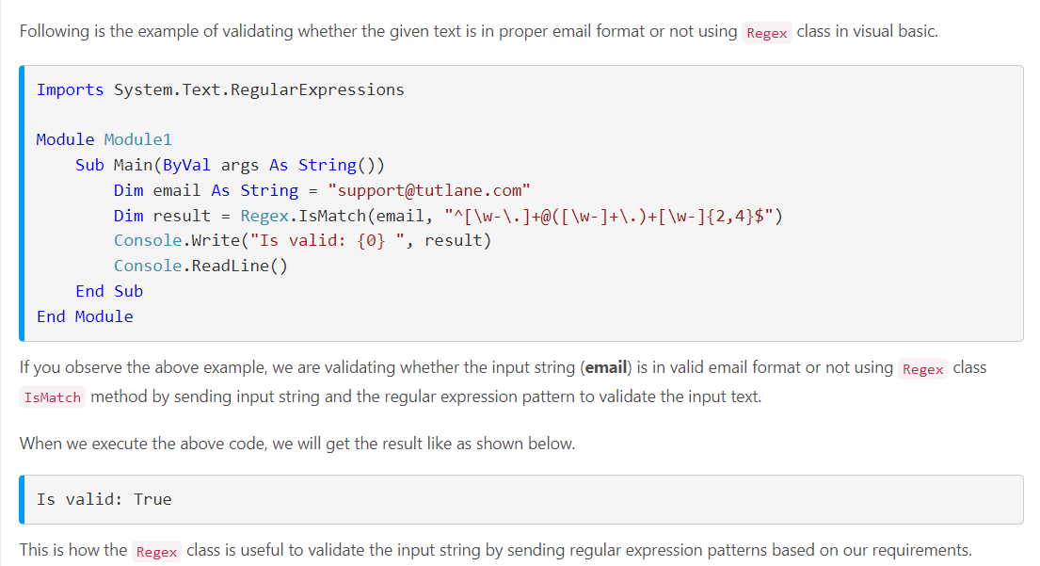
Visual Basic Regex Example:

Slide 19
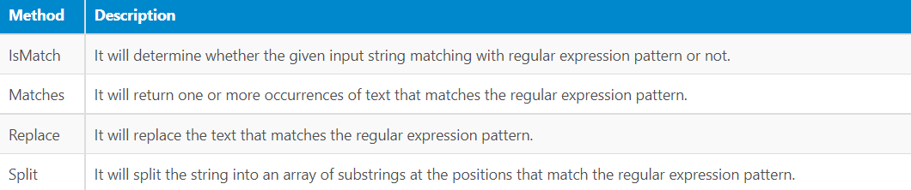
Visual Basic Regex Class Methods

Slide 20
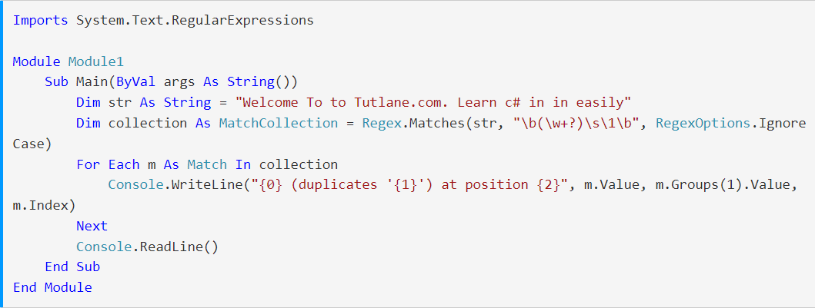
Visual Basic Regex Find Duplicate Words Example
Output:

Slide 21
Thank you

