Slide 1

Microsoft vb.net
Instructor : Anirudh Gaikwad

Slide 2

What You Learn? Click here for more
Create VB.Net app in VS Code

Slide 3
How to create an app in VS
Create a console app
Create a Windows Forms Application
Create a console app
We'll use Visual Studio to create a simple Visual Basic application, a console app. A console app takes input and displays output in a command-line window, also known as a console.
Prerequisites :
If you haven't already installed Visual Studio, go to the Visual Studio downloads page to install it for free.
Create a Project :
First, you'll create a Visual Basic app project. The default project template includes all the files you'll need for a runnable app.
1.Open Visual Studio.
2.On the start window, choose Create a new project.

Slide 4
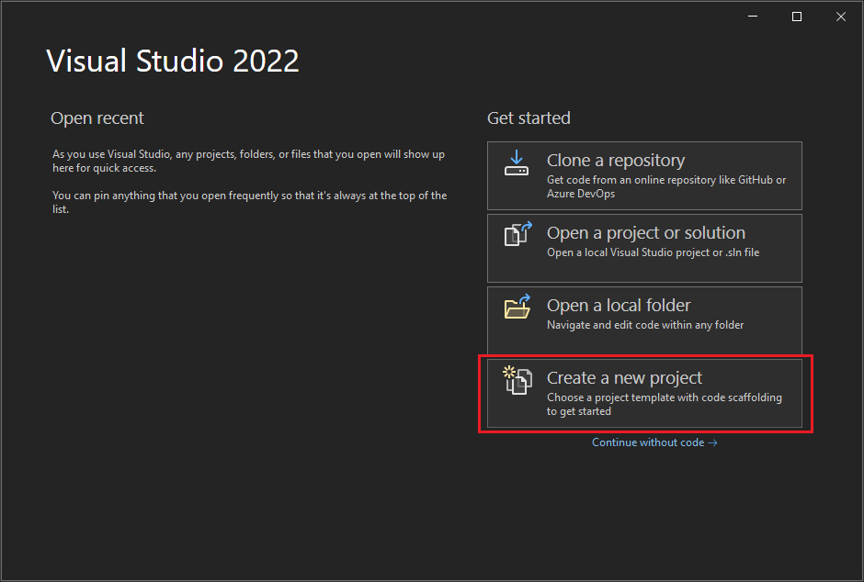

Slide 5
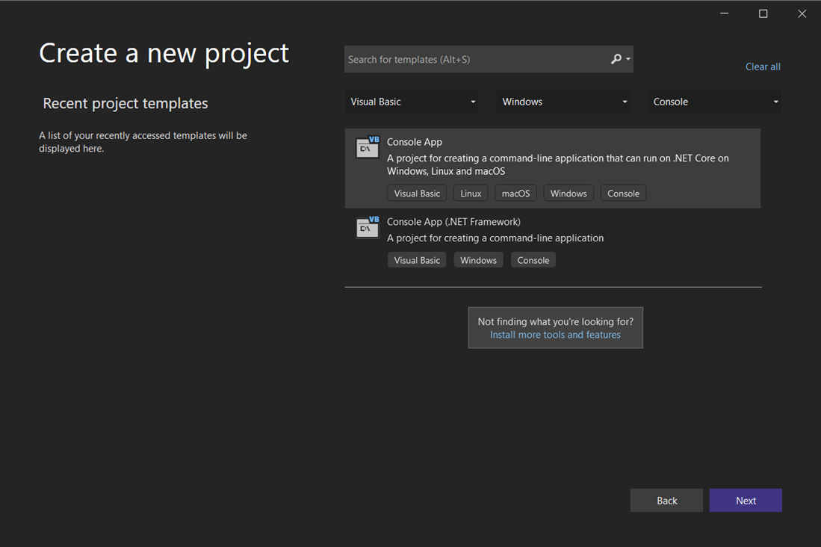
3. In the Create a new project window, choose Visual Basic from the Language list. Next, choose Windows from the Platform list and Console from the Project types list.
After you apply these language, platform, and project type filters, choose the Console App template, and then choose Next.

Slide 6
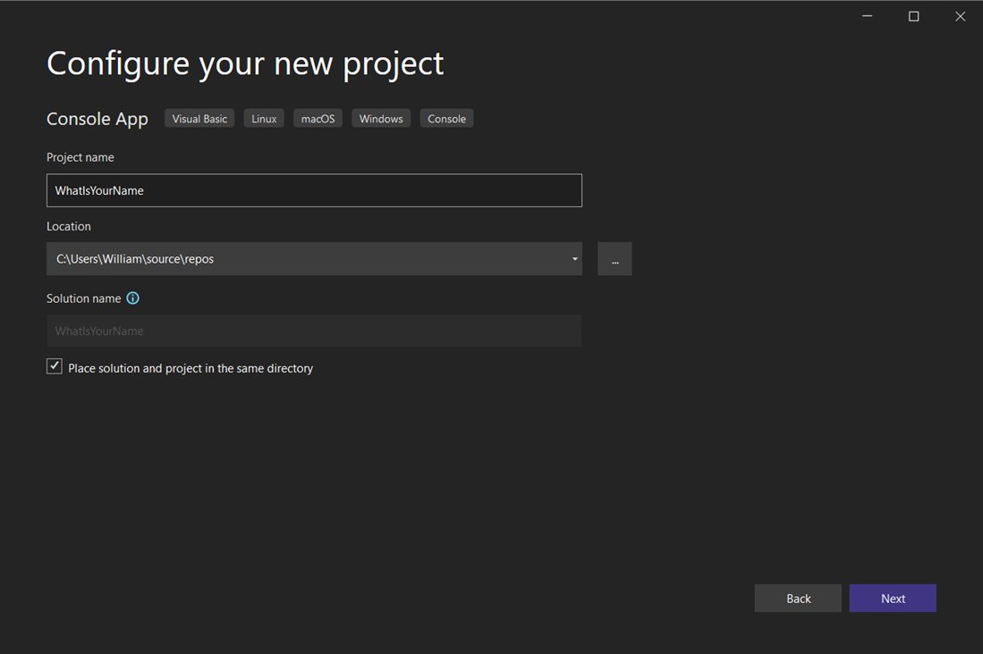
4. In the Configure your new project window, enter WhatIsYourName in the Project name box. Then, choose Next.

Slide 7
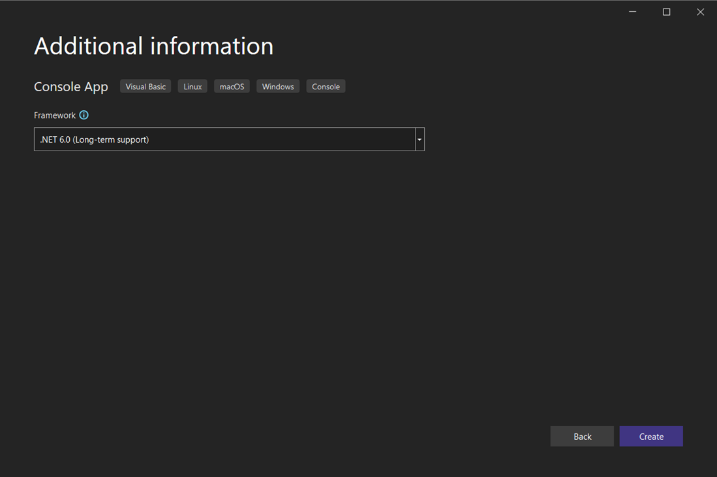
5. In the Additional information window, .NET 6.0 (Long-term support) should already be selected for your target framework. If not, select .NET 6.0 (Long-term support). Then, choose Create.

Slide 8
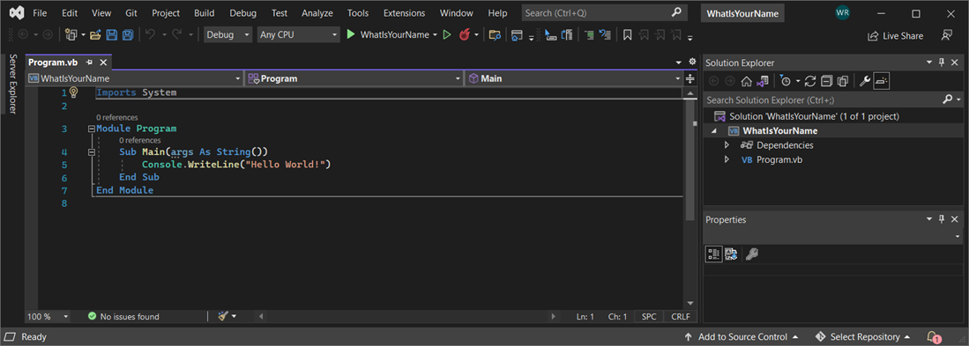
Run the app
After you select your Visual Basic project template and name your project, Visual Studio creates a Program.vb file. The default code calls the WriteLine method to display the literal string "Hello World!" in the console window.
There are two ways to run this code, inside Visual Studio in debug mode, and from your computer as a regular standalone app.
Run the app in debug mode

Slide 9
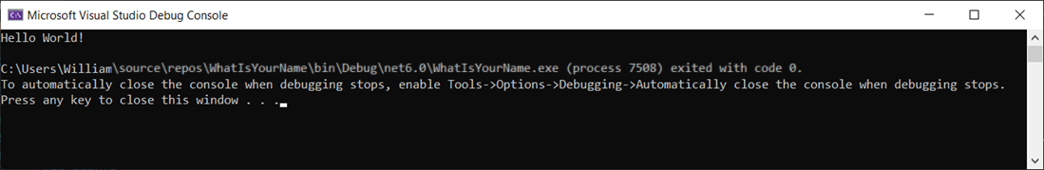
1. Select the WhatIsYourName button or press F5 to run the default code in Debug mode.
2. When the app runs in the Microsoft Visual Studio Debug Console, "Hello World!" displays. Press any key to close the debug console window and end the app:

Slide 10
Run the app as a standalone
To see the output outside of Visual Studio, in a system console window, build and run the executable (.exe file).
In the Build menu, choose Build Solution.
In Solution Explorer, right-click on WhatIsYourName and choose Open File in File Explorer.
In File Explorer, navigate to the bin\Debug\core6.0 directory and run WhatIsYourName.exe.
The Main procedure terminates after its single statement executes and the console window closes immediately. To keep the console visible until the user presses a key, see the next section.

Slide 11
Create a Windows Forms app with Visual Basic
you'll create a Visual Basic application that has a Windows Forms user interface. The Visual Studio integrated development environment (IDE) includes all the tools you need to create a Windows Forms app.
Create a project
Create a Visual Basic application project. The project type comes with all the template files you'll need, before you've even added anything.
Open Visual Studio.
On the start window, choose Create a new project.

Slide 12
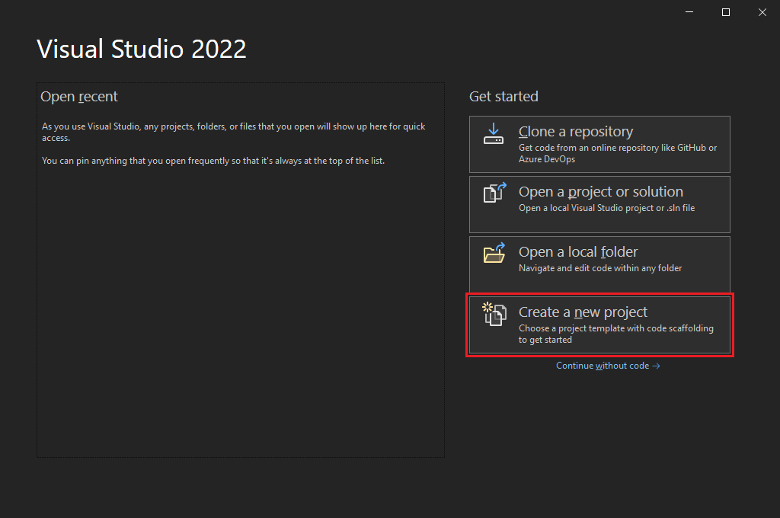

Slide 13
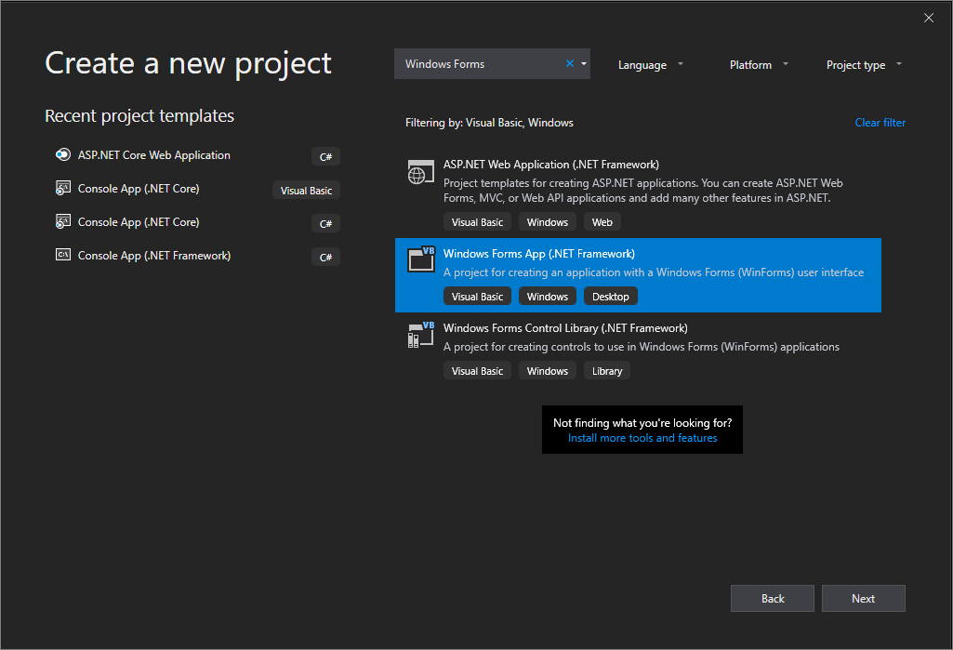
3. On the Create a new project window, select the Windows Forms App (.NET Framework) template for Visual Basic.
You can refine your search to quickly get to the template you want. For example, enter Windows Forms App in the search box. Next, select Visual Basic from the Language list, and then Windows from the Platform list.

Slide 14
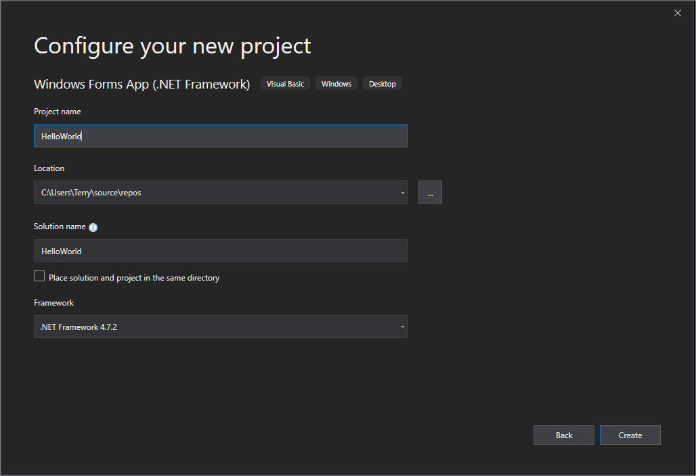
4. In the Configure your new project window, enter HelloWorld as the Project name. Then, select Create.

Slide 15
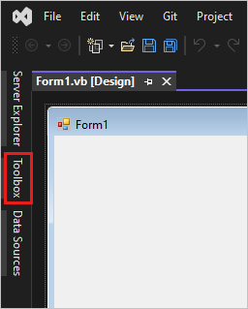
Add a button to the form
1. On the left side of the Visual Studio IDE, select the Toolbox tab. If you don't see it, select View > Toolbox from the menu bar or Ctrl+Alt+X.

Slide 16
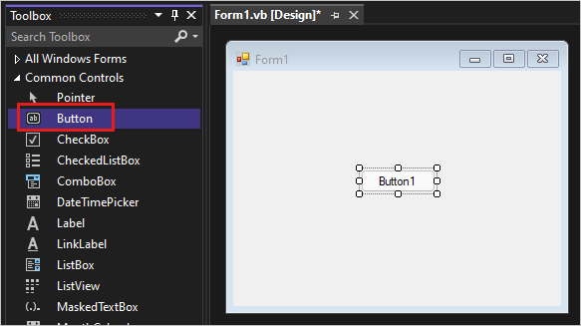
2. Select the Button control and then drag it onto the form.
3. In the Appearance section of the Properties window, for Text, type Click this, and then press Enter.

Slide 17
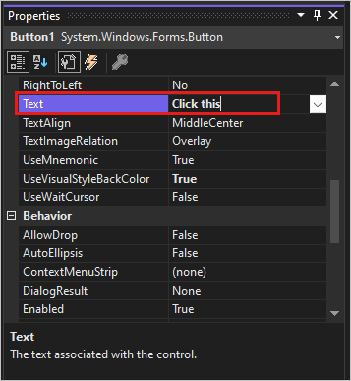
If you don't see the Properties window, you can open it from the menu bar. Select View > Properties Window or press F4.

Slide 18
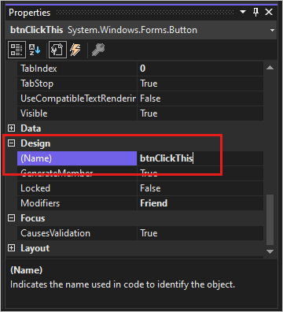
4. In the Design section of the Properties window, change the name from Button1 to btnClickThis, and then press Enter.

Slide 19
Thank you

