Slide 1
Database
What you learn ?
Database
What is Database | Purpose of Database
What is a Database Model | Types of database models
Things you do with RDBMS | Relational Database Terminology
Introduction to SQL

Slide 2
What is Database
A database is a storing system that collects organized data, to make some works easier like searching, structure, and extend.
In web development, most databases use the relational database management system (RDBMS) to organize data and programming in SQL. Some databases, however, don't follow the former mechanism to organized data, which called NoSQL.
Some famous server-side RDBMS are MySQL(or MariaDB which is a fork of it), SQL Server, PostgreSQL,and Oracle Database.
On the other hand, some famous NoSQL examples are MongoDB, Cassandra, Firebase and Redis.

Slide 3
Purpose of Database
Databases are structured to facilitate the storage, retrieval, modification, and deletion of data in conjunction with various data-processing operations.
Businesses can use databases in various ways. It helps them to arrange information about their customers and clients. Also, it can include information about product inventory.
It helps to monitor sales, expenses, and other financial information.

Slide 4
What is a Database Model
A database model shows the logical structure of a database, including the relationships and constraints that determine how data can be stored and accessed.
Individual database models are designed based on the rules and concepts of whichever broader data model the designers adopt.

Slide 5
Types of database models
There are many kinds of data models. Some of the most common ones include:
Hierarchical database model
Relational model
Network model
Object-oriented database model
No-SQL database model

Slide 6
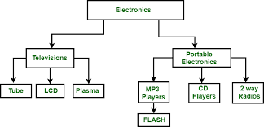
Types of database models
Hierarchical database model
The hierarchical model organizes data into a tree-like structure, where each record has a single parent or root.

Slide 7
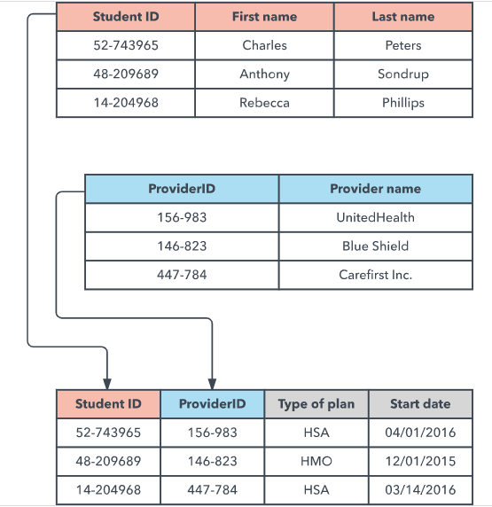
Types of database models
Relational database model
The relational model sorts data into tables, also known as relations, each of which consists of columns and rows.

Slide 8
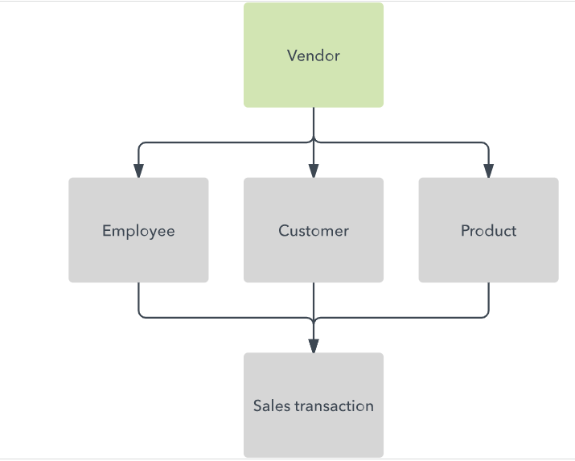
Types of database models
Network database model
It builds on the hierarchical model by allowing many-to-many relationships between linked records, implying multiple parent records. Based on mathematical set theory.

Slide 9
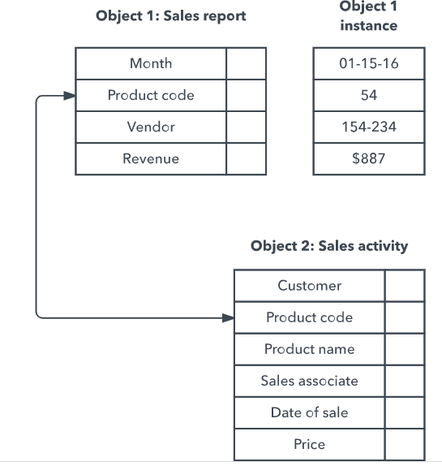
Types of database models
Object-oriented database model
This model defines a database as a collection of objects, or reusable software elements, with associated features and methods.

Slide 10
Types of database models
NoSQL database model
In addition to the object database model, other non-SQL models have emerged in contrast to the relational model:
The graph database model, which is even more flexible than a network model, allowing any node to connect with any other.
The multivalue model, which breaks from the relational model by allowing attributes to contain a list of data rather than a single data point.
The document model, which is designed for storing and managing documents or semi-structured data, rather than atomic data.

Slide 11
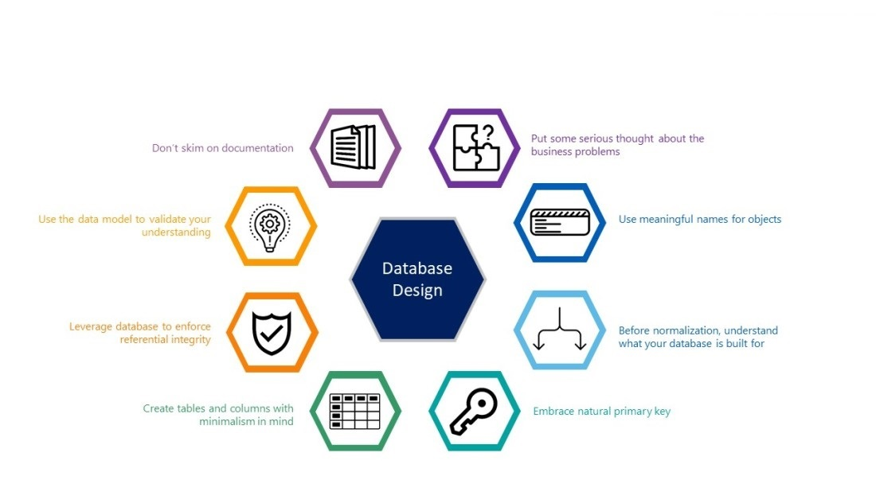
Things you do with RDBMS

Slide 12
Relational Database Terminology
Database
A database is a named collection of tables. (see table). A database can also contain views, indexes, sequences, data types, operators, and functions.
Command
A command is a string that you send to the server in hopes of having the server do something useful. Some people use the word statement to mean command.
Query
A query is a type of command that retrieves data from the server.
Normalization
Is the process of organizing data into a related table, it also eliminates redundancy and increases the integrity which improves performance of the query.

Slide 13
Relational Database Terminology
Column (field, attribute)
A column is the smallest unit of storage in a relational database. A column represents one piece of information about an object. Every column has a name and a data type. Columns are grouped into rows, and rows are grouped into tables.
Row (record, tuple)
A row is a collection of column values. Every row in a table has the same shape (in other words, every row is composed of the same set of columns). If you are trying to model a real-world application, a row represents a real-world object. For example, if you are running an auto dealership, you might have a vehicles table. Each row in the vehicles table represents a car (or truck, or motorcycle, and so on). The kinds of information that you store are the same for all vehicles (that is, every car has a color, a vehicle ID, an engine, and so on).

Slide 14
Relational Database Terminology
Client
A client is an application that makes requests of the Database server.
Client applications provide a user interface and can be written in many languages.
Eg. MySQL Workbench,PhpMyAdmin
Server
The MySQL,Oracle,PostgreSQL database server is a program that services commands coming from client applications.
The Database server has no user interface?you can't talk to the server directly, you must use a client application.

Slide 15
Relational Database Terminology
foreign key
A foreign key is a column or a set of columns in a table whose values correspond to the values of the primary key in another table.
primary key
A primary key is a column or a group of columns in a table that uniquely identifies the rows in that table.
Views
Views are virtual tables. They are only a structure, and contain no data. Their purpose is to allow a user to see a subset of the actual data. A view can consist of a subset of one table

Slide 16
Introduction to SQL Getting Started with MySQL
SQL Used for?
Now that we understand what is SQL and how does it work, let’s try to see what SQL can do.
This programming language has various uses for data analysts & data science professionals. It is particularly helpful because it can:
Execute queries against a database
Retrieve data from a database
Insert records into a database
Update records in a database
Delete records from a database
Create new databases, or new tables in a database
Create stored procedures & views in a database
Set permissions on tables, procedures, and views

Slide 17
SQL Data Types important points
Not all data types are supported by every relational database vendor. For example, Oracle database doesn’t support DATETIME and MySQL doesn’t support CLOB data type. So while designing database schema and writing SQL queries, make sure to check if the data types are supported or not.
Data types listed here doesn’t include all the data types, these are the most popularly used data types. Some relational database vendors have their own data types that might be not listed here. For example, Microsoft SQL Server has money and smallmoney data types but since it’s not supported by other popular database vendors.
Every relational database vendor has its own maximum size limit for different data types, you don’t need to remember the limit. Idea is to have the knowledge of what data type to be used in a specific scenario

Slide 18
SQL Command
SQL defines following ways to manipulate data stored in an RDBMS.
DDL: Data Definition Language
DML: Data Manipulation Language
TCL: Transaction Control Language
DCL: Data Control Language
DQL: Data Query Language

Slide 19
Thanks
Instructor: Anirudha Anil Gaikwad
https://github.com/anirudhagaikwad

