Slide 1

“Full Stack Development Using Bootstrap & Python Django Framework”
During 22 –27 March, 2021
Sponsored by
Under TEQIP-III Program Organized By
Dr. Babasaheb Ambedkar Technological
University, Lonere
N.K. Orchid College of Engg. & Tech., Solapur.
Anirudha Anil Gaikwad
HTML Template & UI-KIT

Slide 2

What you learn ?
HTML Template & UI-KIT
What is WWW & Web Standards | Understand HTTP request message, HTTP response message
HTTP response status codes | Understand what is HTML Template & UI-KIT?
Develop Static Website | Understand Static Hosting Environments
Host Website on Github/Firebase
HTML Template & UI-KIT

Slide 3
World Wide Web
The World Wide Web, commonly known as the Web, is an information system where documents and other web resources are identified by Uniform Resource Locators, which may be interlinked by hypertext, and are accessible over the Internet.
The resources of the WWW are transferred via the Hypertext Transfer Protocol and may be accessed by users by a software application called a web browser and are published by a software application called a web server.
HTML Template & UI-KIT

Slide 4
Web Standards
W3C standards define an Open Web Platform for application development that has the unprecedented potential to enable developers to build rich interactive experiences.
Web Design and Applications | Web of Devices
Web Architecture | Semantic Web
XML Technology | Web of Services
Browsers and Authoring Tools
World Wide Web Consortium(W3C)
HTML Template & UI-KIT

Slide 5
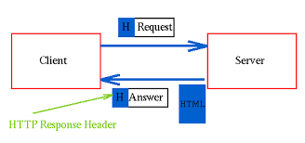
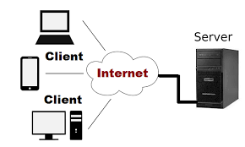
Client & Server Architecture
HTML Template & UI-KIT

Slide 6
Understand HTTP Messages
HTTP Messages – Request ,Response
HTTP request methods
HTTP response status codes
Informational responses (100–199) | Successful responses (200–299)
Redirects (300–399) | Client errors (400–499)
Server errors (500–599)
HTML Template & UI-KIT

Slide 7
Frontend Technology
What we see and interact with as the visitors of a website, or as the end user of a mobile app, is considered front-end technology
there are only a few generic languages understood by all web browsers. These three main front-end coding languages are HTML, CSS and JavaScript
All other libraries and front-end engineering are built upon these three main languages, which makes them must-have skills for any front-end developer.
HTML Template & UI-KIT

Slide 8
THANKS
instructor: Anirudha Anil Gaikwad
Web Technology

