Slide 1
Database
What you learn ?
Database
What is Database | Purpose of Database
What is a Database Model | Types of database models
Things you do with RDBMS | Relational Database Terminology
Introduction to SQL Getting Started with MySQL

Slide 2
What is Database
A database is a storing system that collects organized data, to make some works easier like searching, structure, and extend.
In web development, most databases use the relational database management system (RDBMS) to organize data and programming in SQL. Some databases, however, don't follow the former mechanism to organized data, which called NoSQL.
Some famous server-side RDBMS are MySQL(or MariaDB which is a fork of it), SQL Server, PostgreSQL,and Oracle Database.
On the other hand, some famous NoSQL examples are MongoDB, Cassandra, Firebase and Redis.

Slide 3
Purpose of Database
Databases are structured to facilitate the storage, retrieval, modification, and deletion of data in conjunction with various data-processing operations.
Businesses can use databases in various ways. It helps them to arrange information about their customers and clients. Also, it can include information about product inventory.
It helps to monitor sales, expenses, and other financial information.

Slide 4
What is a Database Model
A database model shows the logical structure of a database, including the relationships and constraints that determine how data can be stored and accessed.
Individual database models are designed based on the rules and concepts of whichever broader data model the designers adopt.

Slide 5
Types of database models
There are many kinds of data models. Some of the most common ones include:
Hierarchical database model
Relational model
Network model
Object-oriented database model
No-SQL database model

Slide 6
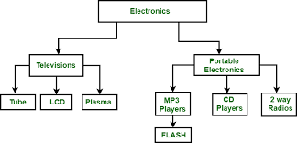
Types of database models
Hierarchical database model
The hierarchical model organizes data into a tree-like structure, where each record has a single parent or root.

Slide 7
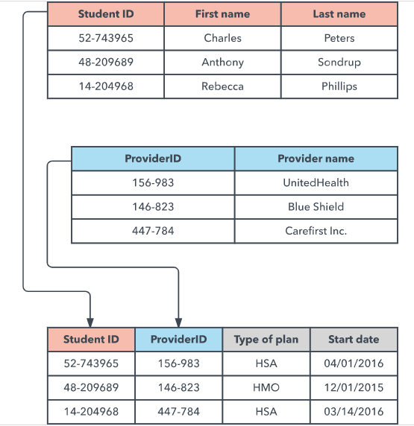
Types of database models
Relational database model
The relational model sorts data into tables, also known as relations, each of which consists of columns and rows.

Slide 8
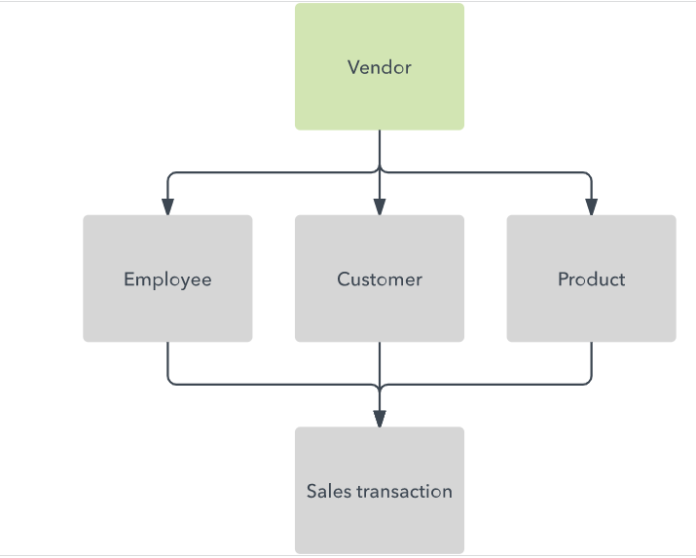
Types of database models
Network database model
It builds on the hierarchical model by allowing many-to-many relationships between linked records, implying multiple parent records. Based on mathematical set theory.

Slide 9
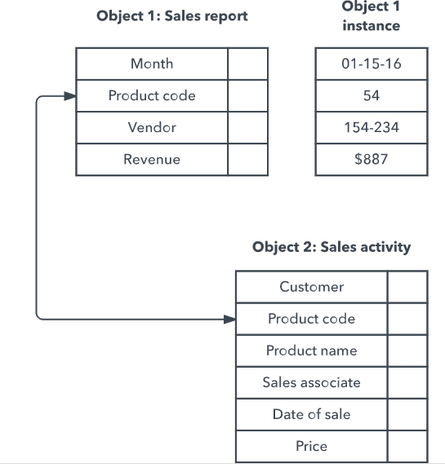
Types of database models
Object-oriented database model
This model defines a database as a collection of objects, or reusable software elements, with associated features and methods.

Slide 10
Types of database models
NoSQL database model
In addition to the object database model, other non-SQL models have emerged in contrast to the relational model:
The graph database model, which is even more flexible than a network model, allowing any node to connect with any other.
The multivalue model, which breaks from the relational model by allowing attributes to contain a list of data rather than a single data point.
The document model, which is designed for storing and managing documents or semi-structured data, rather than atomic data.

Slide 11
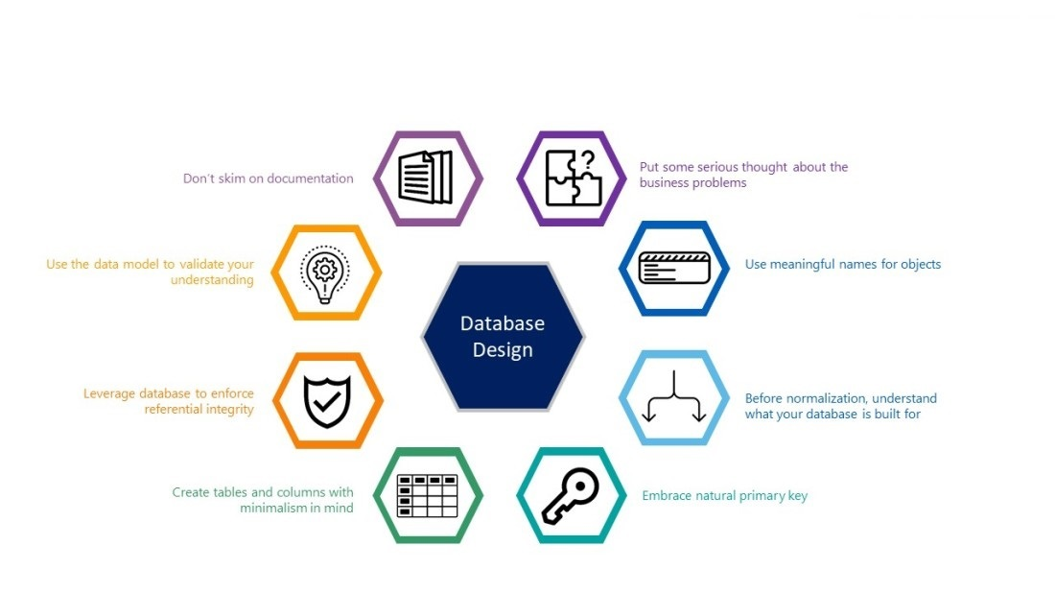
Things you do with RDBMS

Slide 12
Relational Database Terminology
Database
A database is a named collection of tables. (see table). A database can also contain views, indexes, sequences, data types, operators, and functions.
Command
A command is a string that you send to the server in hopes of having the server do something useful. Some people use the word statement to mean command.
Query
A query is a type of command that retrieves data from the server.
Normalization
Is the process of organizing data into a related table, it also eliminates redundancy and increases the integrity which improves performance of the query.

Slide 13
Relational Database Terminology
Column (field, attribute)
A column is the smallest unit of storage in a relational database. A column represents one piece of information about an object. Every column has a name and a data type. Columns are grouped into rows, and rows are grouped into tables.
Row (record, tuple)
A row is a collection of column values. Every row in a table has the same shape (in other words, every row is composed of the same set of columns). If you are trying to model a real-world application, a row represents a real-world object. For example, if you are running an auto dealership, you might have a vehicles table. Each row in the vehicles table represents a car (or truck, or motorcycle, and so on). The kinds of information that you store are the same for all vehicles (that is, every car has a color, a vehicle ID, an engine, and so on).

Slide 14
Relational Database Terminology
Client
A client is an application that makes requests of the Database server.
Client applications provide a user interface and can be written in many languages.
Eg. MySQL Workbench,PhpMyAdmin
Server
The MySQL,Oracle,PostgreSQL database server is a program that services commands coming from client applications.
The Database server has no user interface?you can't talk to the server directly, you must use a client application.

Slide 15
Relational Database Terminology
foreign key
A foreign key is a column or a set of columns in a table whose values correspond to the values of the primary key in another table.
primary key
A primary key is a column or a group of columns in a table that uniquely identifies the rows in that table.
Views
Views are virtual tables. They are only a structure, and contain no data. Their purpose is to allow a user to see a subset of the actual data. A view can consist of a subset of one table

Slide 16
Introduction to SQL Getting Started with MySQL
SQL is the most common language for extracting and organising data that is stored in a relational database,SQL is the language of databases. It facilitates retrieving specific information from databases that are further used for analysis.
There are different versions and frameworks for SQL, the most commonly used is MySQL. MySQL is an open-source solution that helps facilitate SQL’s role in managing back-end data for web applications. Companies such as Facebook, Instagram, WhatsApp, etc. all use SQL for back-end data storage and data processing solutions.
When an SQL query is written & run (or parsed), it is processed by a query optimiser. The query reaches SQL server, where it compiles in three phases; Parsing, Binding and Optimisation.
Parsing – A process to check the syntax
Binding – A process to check the query semantics
Optimisation – A process to generate the query execution plan
SQL stands for Structured Query Language

Slide 17
Introduction to SQL Getting Started with MySQL
SQL Used for?
Now that we understand what is SQL and how does it work, let’s try to see what SQL can do.
This programming language has various uses for data analysts & data science professionals. It is particularly helpful because it can:
Execute queries against a database
Retrieve data from a database
Insert records into a database
Update records in a database
Delete records from a database
Create new databases, or new tables in a database
Create stored procedures & views in a database
Set permissions on tables, procedures, and views

Slide 18
MySQL Overview
https://dev.mysql.com/doc/refman/8.0/en/what-is-mysql.html
What is MySQL?
MySQL, the most popular Open Source SQL database management system, is developed, distributed, and supported by Oracle Corporation.
MySQL is a database management system.
MySQL databases are relational.
MySQL software is Open Source.
The MySQL Database Server is very fast, reliable, scalable, and easy to use
MySQL Server works in client/server or embedded systems.
https://dev.mysql.com/doc/refman/8.0/en/features.html

Slide 19
Installation of the MySQL server
How to Get MySQL
Check downloads page at https://dev.mysql.com/downloads/ for information about the current version of MySQL and for downloading instructions.
https://dev.mysql.com/doc/refman/8.0/en/installation-layouts.html
Installation Requirements
MySQL Installer requires Microsoft .NET Framework 4.5.2 or later. If this version is not installed on the host computer, you can download it by visiting the Microsoft website.

Slide 20
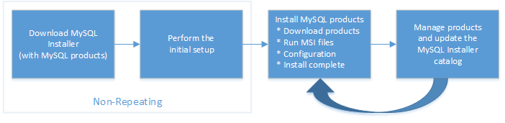
Installation of the MySQL server
MySQL Installer Process
https://dev.mysql.com/doc/refman/8.0/en/mysql-installer-setup.html

Slide 21
MySQL Overview
https://dev.mysql.com/doc/refman/8.0/en/what-is-mysql.html
What is MySQL?
MySQL, the most popular Open Source SQL database management system, is developed, distributed, and supported by Oracle Corporation.
MySQL is a database management system.
MySQL databases are relational.
MySQL software is Open Source.
The MySQL Database Server is very fast, reliable, scalable, and easy to use
MySQL Server works in client/server or embedded systems.

Slide 22
MySQL Overview
https://dev.mysql.com/doc/refman/8.0/en/what-is-mysql.html
What is MySQL?
MySQL, the most popular Open Source SQL database management system, is developed, distributed, and supported by Oracle Corporation.
MySQL is a database management system.
MySQL databases are relational.
MySQL software is Open Source.
The MySQL Database Server is very fast, reliable, scalable, and easy to use
MySQL Server works in client/server or embedded systems.

Slide 23
MySQL client
https://www.mysql.com/products/workbench/
MySQL Workbench
MySQL Workbench is a unified visual tool for database architects, developers, and DBAs. MySQL Workbench provides data modeling, SQL development, and comprehensive administration tools for server configuration, user administration, backup, and much more. MySQL Workbench is available on Windows, Linux and Mac OS X.
PhpMyAdmin
phpMyAdmin is a free software tool written in PHP, intended to handle the administration of MySQL over the Web.
phpMyAdmin supports a wide range of operations on MySQL and MariaDB
https://www.phpmyadmin.net/

Slide 24
Thanks
Instructor: Anirudha Anil Gaikwad
https://github.com/anirudhagaikwad

