Slide 1

PreTrender
Application to predict the future of trend patterns.

Slide 2
Concept
‘History repeats Itself’
Prediction is an abstract thought but computation is the closest we can get to the future.
Any entity with a web presence is predictable.
Entity’s trend is proportional to people’s perception of it expressed in the form of comments, blogs and tweets.

Slide 3
Overview
Pretrender is a mobile based application .
The user can input any topic with a web presence.
It generates entity’s trending score on any date in the future.
The basis of prediction is entity’s past trend pattern expressed as a function of sentiment score evaluated using tweets.

Slide 4
Components
Interactive Session
Tweet Fetching
Sentiment Evaluation
Graph and Data constriction
Prediction
Application

Slide 5
Interactive Session
Application just a simple Interface.
Server takes in input via UDP connection.
Session remains active till the end of computation.
Application can be made faster only by increasing processing speed of server.

Slide 6
Fetching
Uses authentication keys to fetch real time tweets about queried entity.
For purpose of sample computation we take 50 tweets per day over last two months.
Tweets are then filtered for language, hyperlinks and repetitions.
Twitter, Query and Queryresult.

Slide 7
Filtering Using Regex
"RT|@.*?\\s|(?:^|[\\W])((ht|f)tp(s?):\\/\\/|www\\.)"
+ "(([\\w\\-]+\\.){1,}?([\\w\\-.~]+\\/?)*"
+ "[\\p{Alnum}.,%_=?&#\\-+()\\[\\]\\*$~@!:/{};']*)"

Slide 8
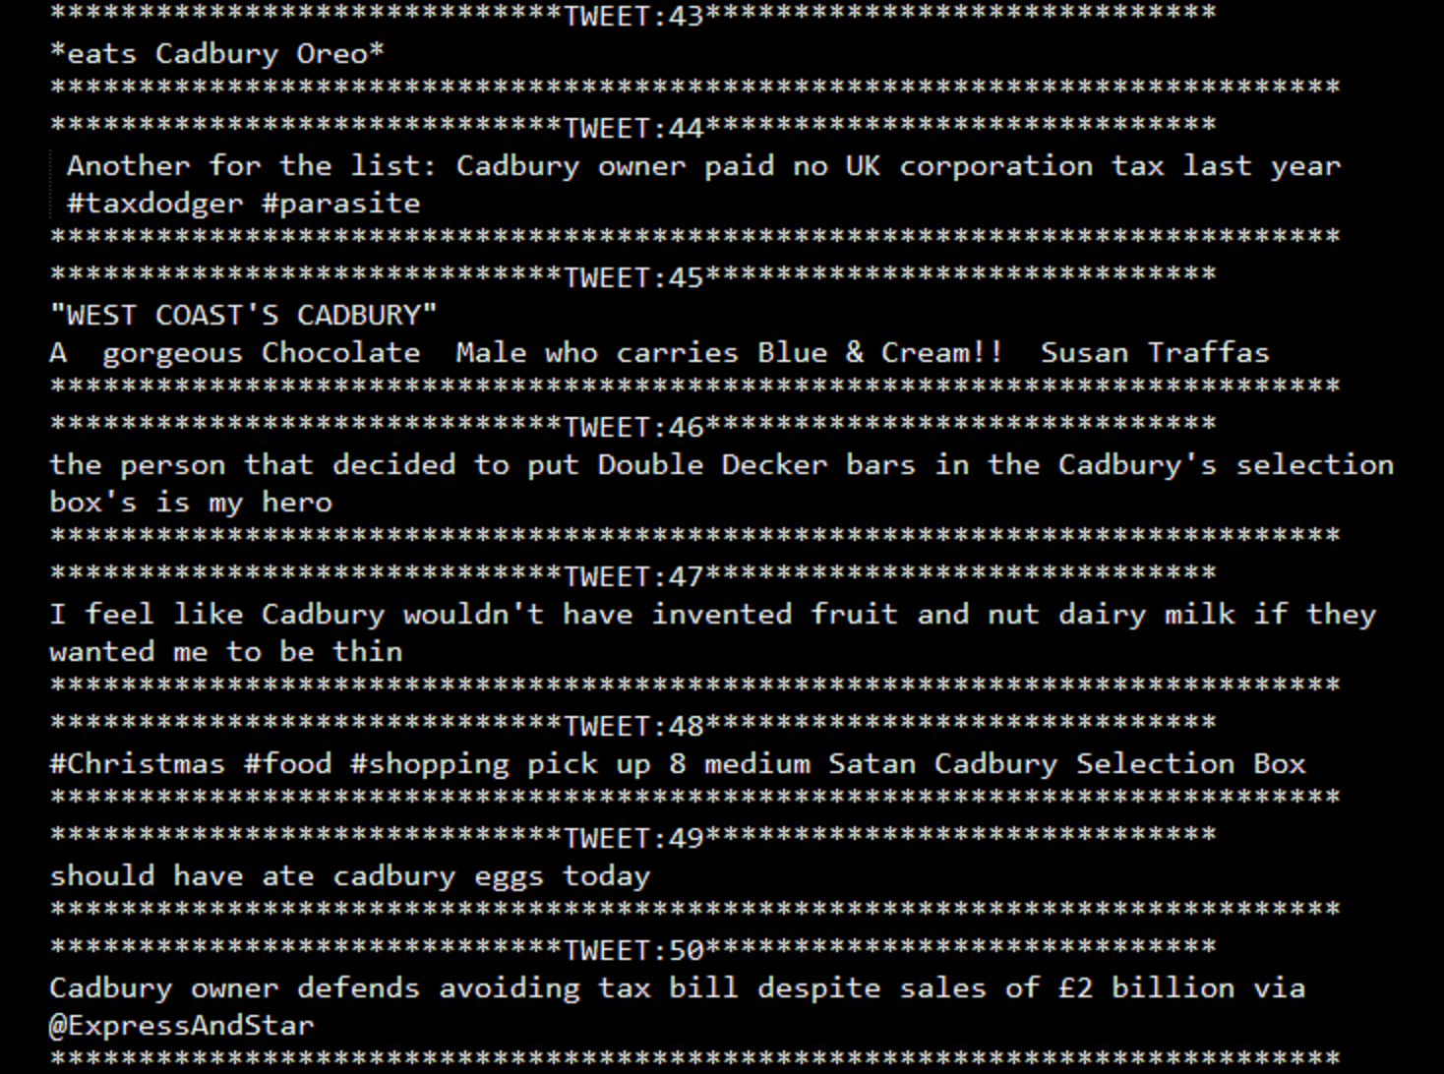

Slide 9
Sentiment Evaluation
Stanford Core-NLP Sentiment library.
Annotation, tokenization, parsing and calculation.
Sarcasm Removal

Slide 10
Sarcasm
I have a computer, a playstation & pizza delivery. Why the hell should I leave the house?
-Negative by Stanford Core NLP
I’ve found Lord. He was behind the sofa the whole time.
-Positive by Stanford Core NLP

Slide 11
Graph and Data Constriction
A total of around 2000 sentiments are constricted to 60 values, per day a sentiment.
Exponential Weight Moving Average.
Plotting of graph using swing and canvas java classes.

Slide 12
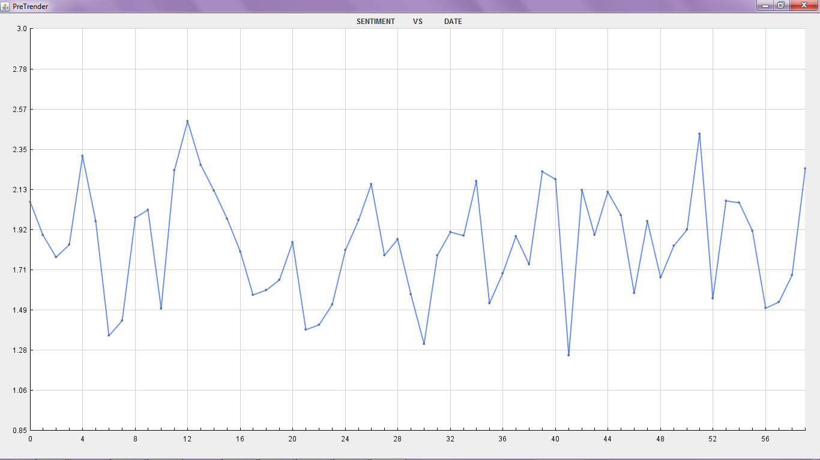

Slide 13
Prediction
Langrange’s interpolation to make the graph continuous.
Graph divided into smaller fragments to get slopes.
Extrapolation using slope comparison.

Slide 14
Application
Application is just an abstract interface.
Loading time proportional to server speed.
Multithreading used to run UI and keep session active.
Server can handle multiple requests using one thread for each client.

Slide 15
Demo
Real time
Log Files
Application

Slide 16
Scope
Lagrange’s Interpolation
Processing Speed
Anomalous graph
Language filtering

