Slide 1
Work report 7th – 11th June
Anirudha Kulkarni

Slide 2
To do
How to model this problem?
What algorithms can be applied to solve it?
Analysing those algorithms
What is Simplex algorithm?
How to model current data
Collecting distance between districts using API
Modelling the graph

Slide 3
How to model?
Network model
Transportation problem

Slide 4
Network Model
Convert multiple source multiple sink problem to single source single sink problem which can be solved with linear programming
To solve this kind of problem, we simply add a new “super-source” s and a new “super-sink” t.
Create arcs from super source to all sources with cost = 0 and capacity = maximum supply possible from corresponding source.
Create arcs from all sinks to super sink with cost = 0 and capacity = demand for corresponding sink.

Slide 5
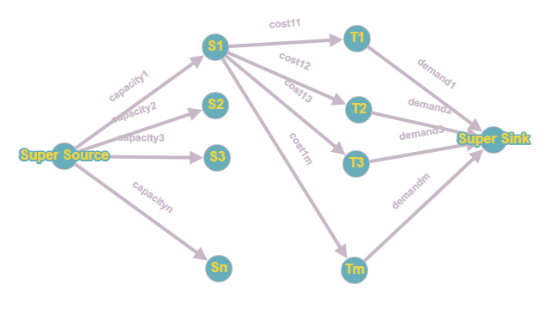

Slide 6
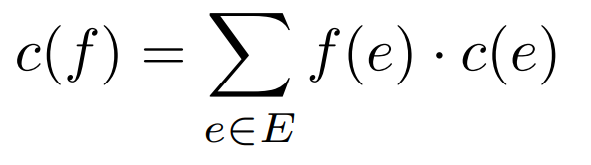
Network Model
Cost = 0 in super sources ensures all sources are used.
Cost of flow is defined as
Hence problem reduces to maximum flow with smallest cost possible
Integrality theorem
network_flow.pdf (duke.edu)
lecture27.pdf (illinois.edu)

Slide 7
Network Model
Flow in edge <= capacity of edge
Except for super source and super sink:
Net in flow of a node = net outflow
Cost function:
Parameters:
Monetary cost = base cost + flow dependent cost
Time cost?
Due to Demand of sink node?

Slide 8
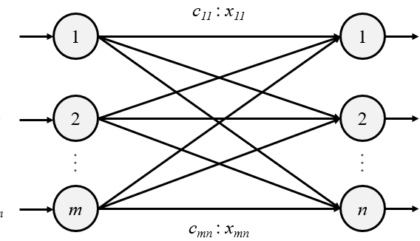
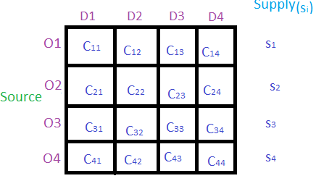
Transportation problem
Minimize cost such that:
F11+F12+ … + F1n <= S1
F21+F22+ … + F2n <= S2
F31+F32+ … + F3n <= S3
Fm1+Fm2+ … + Fmn <= Sm
F11+F21+ … + Fn1 >= D1
F12+F22+ … + Fn2 >= D2
F13+F23+ … + Fn3 >= D3
F1m+F2m+ … + Fnm >= Dm
Module 4: Transportation Problem (acsce.edu.in)
Operations Research with R — Transportation Problem | by Roberto Salazar | Towards Data Science

Slide 9
How to solve
Solving Network model:
Cycle cancelling
Shortest augmenting path for unit capacity graphs
Capacity scaling s12-minCostFlowAlg.pdf (mit.edu)
Hungarian Algorithm Minimum Cost Maximum Flow Tutorials & Notes | Algorithms | HackerEarth
Extension of Edmonds-Karp Minimum-cost flow - Successive shortest path algorithm - Competitive Programming Algorithms (cp-algorithms.com)

Slide 10
How to solve?
Linear Programming:
NorthWest Corner Cell Method.
Least Call Cell Method.
Vogel’s Approximation Method (VAM).

Slide 11
Code
[DONE]Randomly create data with required conditions – select a state, select randomly some cities as source with total sum equal to given sum, give random requirement to all districts, get distance between all sources and sinks
Model the data:
Network model
Write Algorithm
Optimize it

Slide 12
What is Simplex algorithm

