Slide 1
Work report 27th – 2th July

Slide 2
successive_shortest_path_nonnegative_weights
Challenge (huihoo.com)
pgrouting/src/costFlow at 31838b3b68bda559a0613838adfaafa23d8a653f · pgRouting/pgrouting (github.com)
GTL/bgl_adaptor_test.cc at c20d49d66a421a9826d3f485f74a524d414ab1cc · mbrt/GTL (github.com)

Slide 3
Minimum-cost flow - Successive shortest path algorithm - Competitive Programming Algorithms (cp-algorithms.com)
Maximum flow - Ford-Fulkerson and Edmonds-Karp - Competitive Programming Algorithms (cp-algorithms.com)

Slide 4
Boost Prototype
BGL – boost graph library - Steep learning curve
Similar performance for small graphs
Slower than python
500 sources and 500 sinks :
280.86 seconds vs 60 seconds for Python
C program should work significantly faster than python

Slide 5
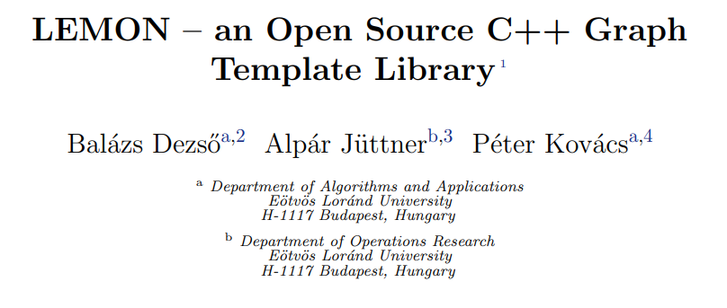
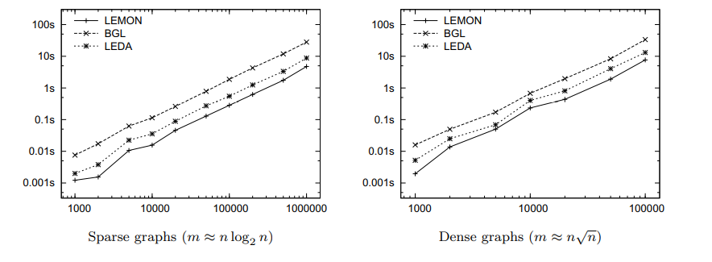
Performance analysis of BGL
Boost Graph Library is highly inefficient
LEDA – commercial library for network analysis performs better than BGL
LEMON – open-source library performs better than both

Slide 6
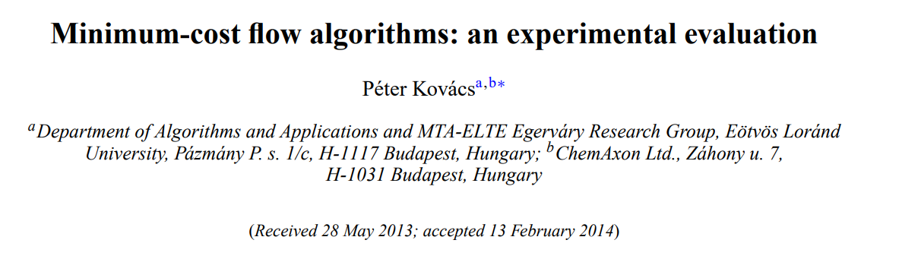
Other options for MCMF
Minimum-cost flow algorithms: an experimental evaluation: Optimization Methods and Software: Vol 30, No 1 (tandfonline.com)
Performed Similar analysis on all algorithms available for MCMF
Then came up with Own implementation

Slide 7
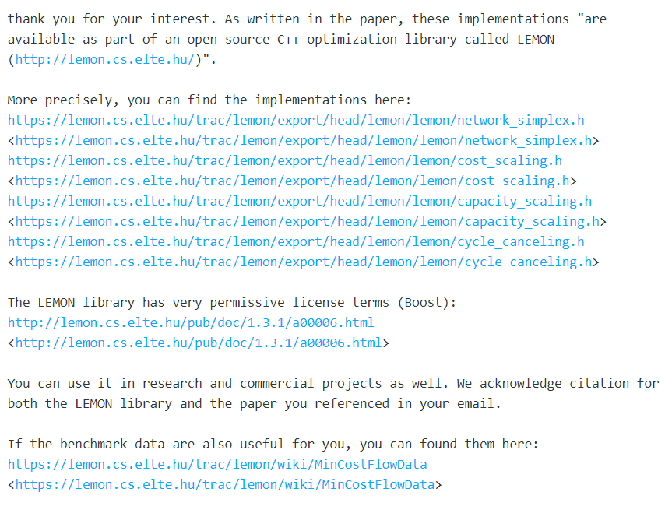
LEMON Library
Library for Efficient Modeling and Optimization in Networks.
Compactible with Boost
4 Different Algorithms for MCMF
More efficient than BGL

Slide 8
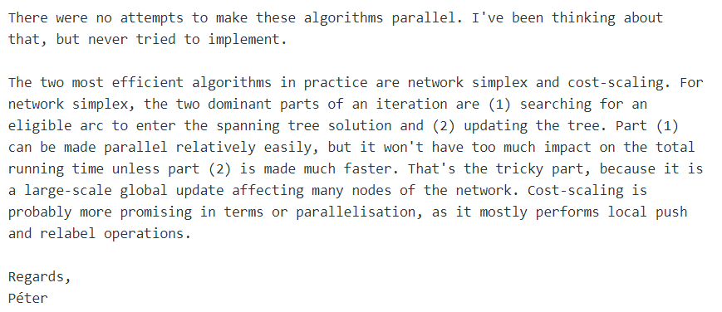
Scope
Make LEMON lib algorithms parallel

Slide 9
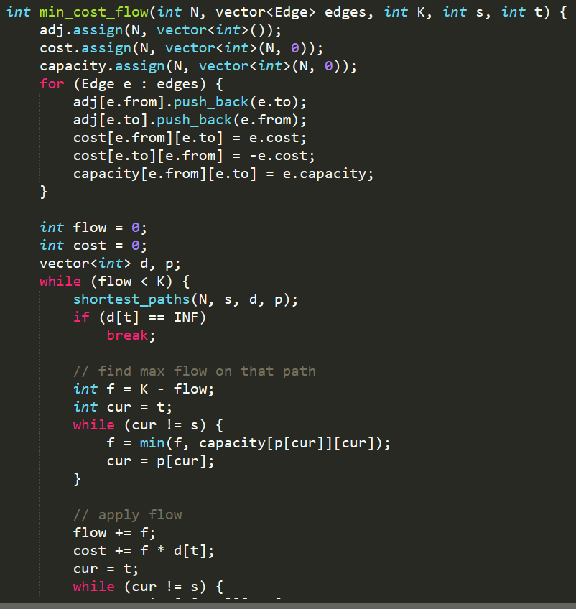
Own Implementation
Created a basic Algorithm
Segmentation error

Slide 10
SSH
How to keep a process running after logging off from ssh?
Using tmux to create a new session?
How to install a library?
Using conda to create virtual environment?
Installing from source in ‘anirudha/home’?

