Slide 1
Work report 14th – 19th June
Anirudha Kulkarni

Slide 2
To do
Non linear Programming
What is Simplex algorithm? Modelling the graph
Analysing those algorithms
Start coding of a model – network flow algorithm
Design own algorithm inspired by linear programming

Slide 3
What is Non Linear Programming
Maximize f(x1,x2,…,xn) subject to :
G1(x1,x2,..,xn)<b1
G2(x1,x2,..,xn)<b2
.
.
.
Linear programming is when f and g are linear program
AMP-Chapter-13.pdf (mit.edu)

Slide 4
Simplex Algorithm
Notes:
Find solution of system of linear equations and find the best solution
Introduce slack variables to make it system of linear equations
Both problems are equivalent
Basic solutions – all intersection points – solution with any n variables = 0
Basic feasible solution – if a basic solution – solution with all parameters=0 corresponding to initial system corresponds to a point in feasible region of LP only 4 in case of 2 variables 2 contraints
Optimal value of objective function must exist at basic feasible solutions
Ch06_1-2_Simplex_Method.pdf (wsu.edu)

Slide 5
Simplex Algorithm
Basic variables: non zero variables = n-m
Non Basic variables: which are zero = n

Slide 6
Simplex Algorithm
Steps:
1.

Slide 7
Simplex Algorithm on nonlinear programming
ijcsmv4n3_15.pdf (ripublication.com)
AMP-Chapter-13.pdf (mit.edu)

Slide 8
Network Model
Convert multiple source multiple sink problem to single source single sink problem which can be solved with linear programming
To solve this kind of problem, we simply add a new “super-source” s and a new “super-sink” t.
Create arcs from super source to all sources with cost = 0 and capacity = maximum supply possible from corresponding source.
Create arcs from all sinks to super sink with cost = 0 and capacity = demand for corresponding sink.

Slide 9
Network Model
Flow in edge <= capacity of edge
Except for super source and super sink:
Net in flow of a node = net outflow
Cost function:
Parameters:
Monetary cost = base cost + flow dependent cost
Time cost?
Due to Demand of sink node?

Slide 10
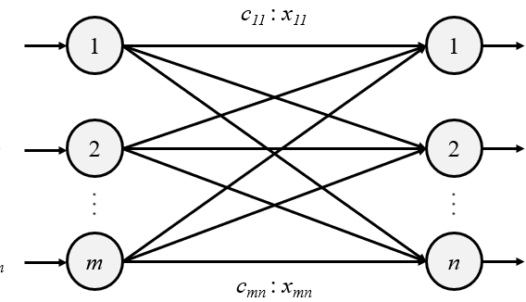
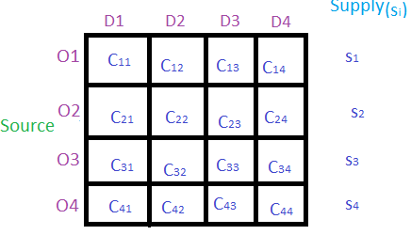
Transportation problem
Minimize cost such that:
F11+F12+ … + F1n <= S1
F21+F22+ … + F2n <= S2
F31+F32+ … + F3n <= S3
Fm1+Fm2+ … + Fmn <= Sm
F11+F21+ … + Fn1 >= D1
F12+F22+ … + Fn2 >= D2
F13+F23+ … + Fn3 >= D3
F1m+F2m+ … + Fnm >= Dm
Module 4: Transportation Problem (acsce.edu.in)
Operations Research with R — Transportation Problem | by Roberto Salazar | Towards Data Science

Slide 11
How to solve
Solving Network model:
Cycle cancelling
Shortest augmenting path for unit capacity graphs
Capacity scaling s12-minCostFlowAlg.pdf (mit.edu)
Hungarian Algorithm Minimum Cost Maximum Flow Tutorials & Notes | Algorithms | HackerEarth
Extension of Edmonds-Karp Minimum-cost flow - Successive shortest path algorithm - Competitive Programming Algorithms (cp-algorithms.com)

Slide 12
How to solve?
Linear Programming:
NorthWest Corner Cell Method.
Least Call Cell Method.
Vogel’s Approximation Method (VAM).

Slide 13
Code
[DONE]Randomly create data with required conditions – select a state, select randomly some cities as source with total sum equal to given sum, give random requirement to all districts, get distance between all sources and sinks
Model the data:
Network model
Write Algorithm
Optimize it

Slide 14
What is Simplex algorithm

