Slide 1
CODVO.AI Take-Home Assignment Predictive Equipment Failure Industrial Pump Fleet - Remaining Useful Life (RUL) Prediction

Slide 2
First, The Big Picture — What Are We Building?
The Problem: Industrial Pump Failures
Factories run pumps 24/7 — unexpected breakdown = production stop, costly repairs, safety risk
Reactive maintenance (fix when broken) → risky & expensive
Preventive maintenance (replace on schedule) → wasteful, healthy pumps replaced unnecessarily
Predictive Maintenance → use sensor data to predict failure before it happens
The Solution: Predict Remaining Useful Life (RUL)
RUL = cycles/hours left before a machine is likely to fail
Sensors tracked: temperature, vibration, pressure, and more
Model trained on 80 pumps — learns the sensor patterns that appear before failure
Output: "This pump will fail in ~47 cycles" → maintenance scheduled at exactly the right time

Slide 3
Problem Framing & Architecture Decision
Option | Approach | Decision
A — RUL Regression | Predict exact cycles remaining (e.g. 47) | ✅ Chosen
B — Failure-Window Classification | Yes/No: will it fail within N cycles? | ❌ Doesn't say when
C — Survival / Hazard Model | Probabilistic time-to-failure curve | ❌ Only 72 failures — too few
D — Custom Alternative | Any justified novel approach | ❌ Nothing superior found
Problem Framing: What Are We Predicting?
Given a pump's sensor history, how many operating cycles remain before the next failure — early enough to raise a work order?
Four Options Evaluated
Why RUL Regression Wins
Outputs a continuous number every cycle → tells planners exactly how much time they have
Answers "when will it fail?" not just "will it fail?"
Directly actionable for scheduling maintenance windows

Slide 4
Piecewise-Linear RUL — The Key Design Decision
A pump with 350 cycles left and one with 200 cycles left look identical on sensors — both are perfectly healthy. The model has nothing to learn from this difference.
The Fix: Cap RUL at RUL_MAX
RUL label = min(actual remaining cycles, RUL_MAX)
Why This Works
✅ Model only trains on the degradation window (last 100–150 cycles) — where sensors actually change
✅ Removes uninformative early-life data → signal-to-noise ratio improves dramatically
✅ Honest output: "This pump has 45 cycles left" vs trying to distinguish 350 from 200 (impossible from sensor data)
✅ Standard practice in PHM (Prognostics and Health Management) literature — validated on NASA C-MAPSS benchmark
PHM = Prognostics and Health Management — the engineering field for predicting equipment failure
Why Piecewise-Linear RUL? (The Most Important Design Decision)
🔑 Piecewise-Linear RUL Formula
RUL label = min(actual remaining cycles, RUL_MAX) If a pump has 350 cycles left → label = RUL_MAX (e.g. 120) If a pump has 80 cycles left → label = 80 If a pump has 20 cycles left → label = 20 Everything before the degradation window is just labelled RUL_MAX — we say 'we don't know exactly how many cycles remain, but it's beyond our predictable window.’
Signal-to-Noise Ratio in ML: The ratio of meaningful pattern to random variation in training data. High noise = the model learns garbage. Piecewise-linear RUL reduces noise by removing the uninformative early-life data from the regression target.

Slide 5
Data Understanding & EDA Findings
The Dataset at a Glance
File Name | What It Contains | Key Numbers
train.csv | The main training data. One row per pump per operating cycle. Contains all sensor readings. | ~16,600 rows across 80 pumps. 20 sensor columns. Readings taken every hour (hourly sampling).
train_units.csv | One summary row per pump. Records whether the pump eventually failed. | 72 pumps reached failure (event=1). 8 pumps were still healthy when monitoring stopped (event=0, these are censored).
sample_test_input.csv | Example of what new pump data looks like at inference time (when we use the trained model on a real pump). | Same sensor columns, 2 pumps shown, no failure label — because failure hasn't happened yet.

Slide 6
Data Understanding & EDA Findings
EDA — 5 Steps to Understand the Data Before Building the Model
EDA (Exploratory Data Analysis) = "Get to know your data thoroughly before trusting it to a machine"
Phase 1 — Is the data clean? 🧹
Are all columns present and in the right format?
Any fake "missing value" codes like −999 hiding in the data?
Do cycle numbers run 1, 2, 3… without any gaps?
Any duplicate rows from a data pipeline glitch?
Phase 2 — Which sensors actually matter? 📡
20 sensors — but some are dead, some are pure noise, some are useful
Rank each sensor by how consistently it changes as the pump approaches failure
Tool used: Spearman Correlation — "does this sensor reliably move as the pump degrades?"
Phase 3 — What does failure look like across the fleet? 📉
Align all 72 failed pumps to their failure point and overlay them
Reveals: "on average, sensors start behaving differently ~120 cycles before failure"
This is how we chose the RUL_MAX cap
Phase 4 — Can we safely ignore the 8 pumps that never failed? ❓
Test: do their sensor readings look statistically identical to the failed pumps at the same life stage?
Tool: Mann-Whitney U Test — if p > 0.05, yes → safe to exclude them from training
Phase 5 — Is the pump running hard or easy? ⚙️
Same pump, different speeds = different sensor readings — not degradation
Cluster the data into operating modes (low speed / high speed)
Normalise within each mode so the model compares apples to apples

Slide 7
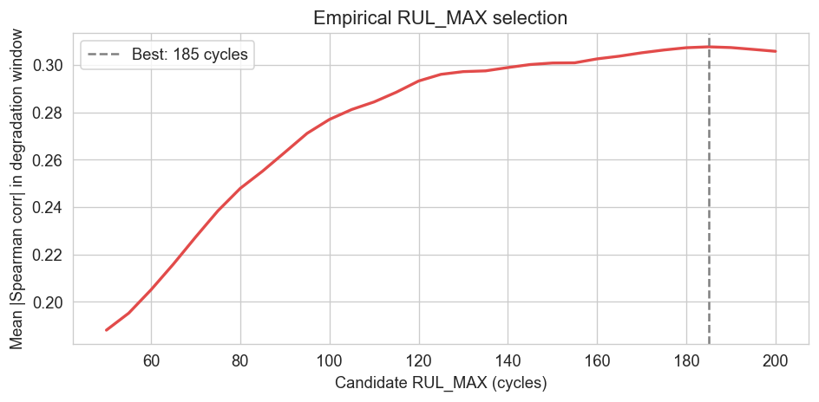
The Key EDA Finding: Automatic RUL_MAX Selection
Selected RUL_MAX = 185 cyclesInterpretation: sensor signals start diverging from healthy baselinewithin the last 185 cycles before failure.

Slide 8
Label Engineering — Handling Censoring
Label Calculation Examples
RUL label = min(max_cycle − current_cycle, RUL_MAX)
Example:
Pump lives 280 cycles total. RUL_MAX = 120.
At cycle 100: RUL = min(280-100, 120) = min(180, 120) = 120
At cycle 200: RUL = min(280-200, 120) = min(80, 120) = 80
At cycle 260: RUL = min(280-260, 120) = min(20, 120) = 20
At cycle 279: RUL = min(280-279, 120) = min(1, 120) = 1

Slide 9
Feature Engineering — Physics-Informed
Category 1 — Rolling Statistics (480 features from 4 windows × 6 statistics)
For each of the 20 sensor channels, the model computes statistics over a rolling window of recent cycles. Four window sizes are used (e.g., 5 cycles, 10 cycles, 30 cycles, 60 cycles) and six statistics per window:
Mean (average value over the window)
Standard deviation (how much the values vary — increasing std suggests growing instability)
Minimum and Maximum (captures extreme events)
Skewness (whether the distribution is lopsided — a sign of non-normal behaviour)
Rate of change (how fast the average is moving)
Category 2 — OLS Slope and Curvature (120 features from 3 windows)
OLS stands for Ordinary Least Squares — the classic method for fitting a straight line through a set of data points. Here, a straight line is fitted through the sensor readings in the last N cycles. The slope of that line tells you: 'Is this sensor trending upward? How fast?' The curvature (from a quadratic fit) tells you: 'Is the trend accelerating?' An accelerating degradation trend is a much more urgent signal than a slow steady drift.

Slide 10
Feature Engineering — Physics-Informed
Category 3 — EWMA Level and Deviation (120 features from 3 alphas)
EWMA stands for Exponentially Weighted Moving Average. Unlike a simple rolling average where all past readings are weighted equally, EWMA gives more weight to recent readings and less weight to older ones. The 'alpha' parameter controls how quickly old data is forgotten. A small alpha = long memory (slow to react). A large alpha = short memory (reacts quickly to new readings). By computing EWMA at three different alpha values, the model captures both long-term drift and short-term spikes.
Category 4 — Baseline Z-Score (40 features — the most important category)
This is the most clever feature. The problem with raw sensor readings is that every pump is slightly different from the factory — manufacturing variation. Pump A might have a natural vibration of 2.3 units when healthy; Pump B might have 3.1 units healthy. If you just look at the raw reading, 3.1 looks more alarming, but it's perfectly normal for Pump B.
The baseline z-score solves this. For each pump, the team computes the mean and standard deviation of each sensor over the first 20 cycles of that pump's life (when it's brand new and definitely healthy). The z-score is then:
Category 5 — Cross-Sensor Interactions (~10 features)
Some degradation patterns only show up in the relationship between two sensors, not in either sensor individually. For example, pump efficiency = output flow / input power. A pump can degrade while maintaining normal flow (because the motor works harder) — so individual sensors look fine but efficiency drops. Cross-sensor features capture these relationships.

Slide 11
Feature Selection: Reducing 790 Candidates to 150
After building all ~790 candidate features, a two-step selection process reduces them to the 150 most informative:
Step 1 and 2 — XGBoost Gain Importance
A quick XGBoost model is trained on all 790 features. XGBoost tracks 'gain' for each feature — how much that feature improved the model's predictions each time it was used in a decision split. The top 150 features by gain are kept.
Step 3 — SHAP Beeswarm Validation
SHAP stands for SHapley Additive exPlanations. It's a game theory-based technique that calculates, for each prediction, exactly how much each feature contributed to pushing the prediction above or below the average. A beeswarm plot shows every training example as a dot — you can see whether high z-score (red dots) always pushes RUL down (meaning: high z-score = more degraded = less life remaining). If the direction makes physical sense, the feature is validated.
📖 Concept: Feature Importance by Gain XGBoost Gain Importance: Every time a feature is used to split the data in a decision tree, the improvement in prediction accuracy is recorded as the 'gain' for that feature. Summing all gains across all trees gives a total importance score. High-gain features are the most useful predictors.

Slide 12
Model Architecture — Why Not Deep Learning?

