Slide 1
Chem 456 1/12/2026
About the course, Computational Biochemistry and Drug Design
Definitions
Course overview
Online resources
Introductions
Instructor
Yourself (by 1/21)
High-performance computing
Linux
Motivation
Basic commands
Exercise 0: Basic Linux + Treasure Hunt

Slide 2
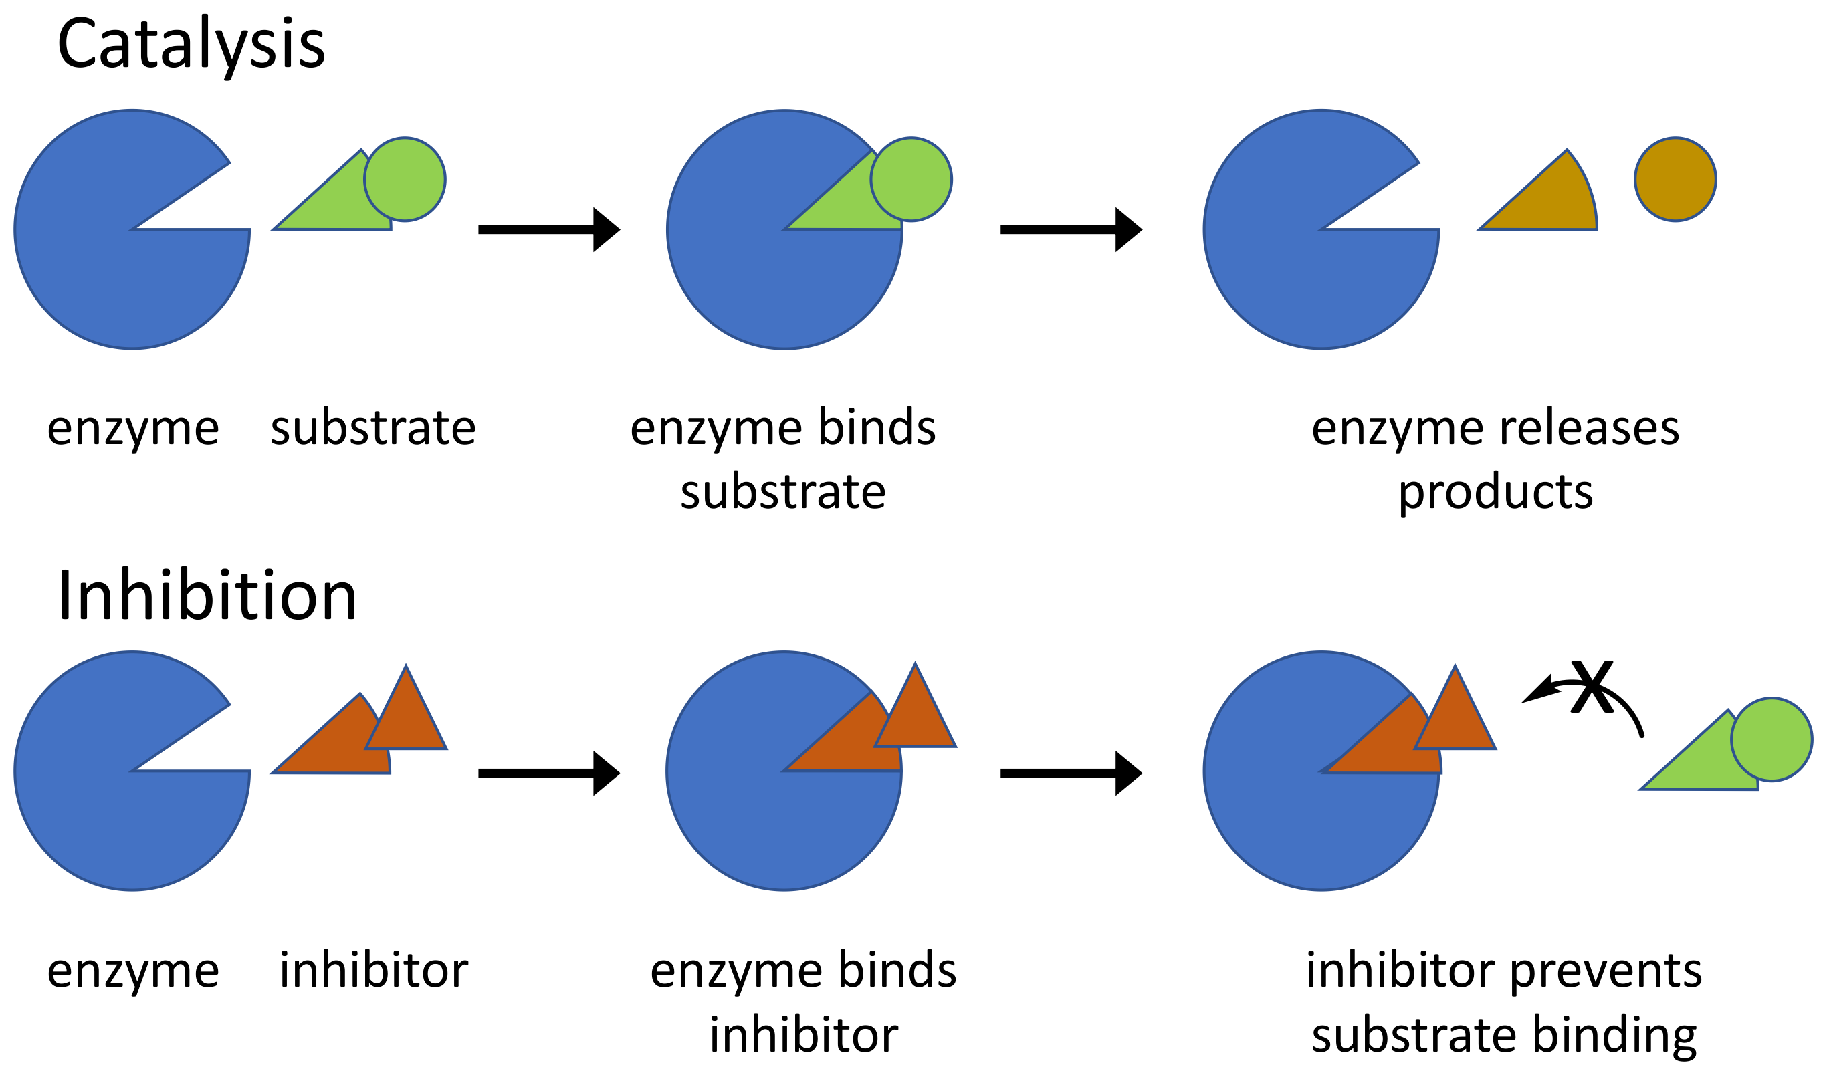
Computational Biochemistry and Drug Design
Biochemistry – the study of chemical processes related to living organisms.
Drug design – the inventive process of finding new medications based on the knowledge of a biological target.
Nowadays, computers are widely used in both.
Some biochemical processes. CCA-SA4.0

Slide 3
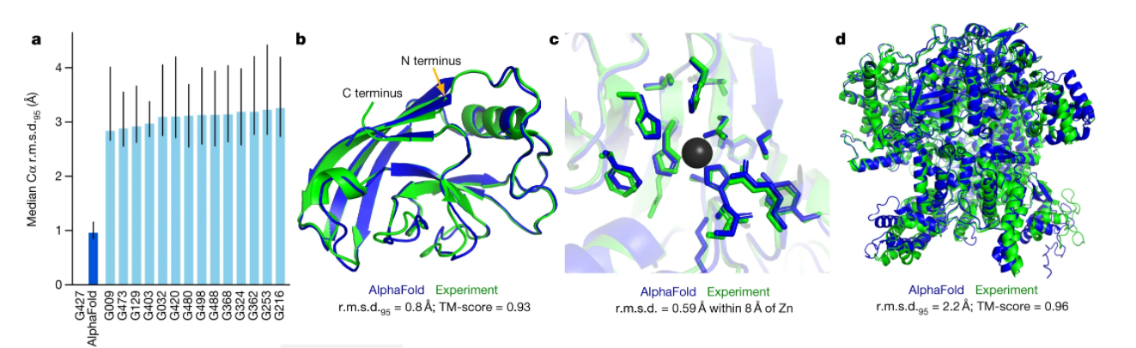
What will this course cover?
Informatics – the use of data-centric approaches to solve complex problems. Includes artificial intelligence.
Energy, focusing on types and applications of potential energy models
Molecular dynamics simulations
evaluating stability of structural elements and networks
investigating how motion leads to conformational populations and relates with function
AlphaFold protein structure prediction (Nature 596, 583–589 (2021) CCA-SA4.0) was awarded the 2024 Nobel Prize in Chemistry

Slide 4


Some tools we’ll learn to use
AlphaFold
Informatics-based structure prediction
Less track record for complexes
Molecular docking
Physics-based structure prediction
Rank (large) virtual libraries to prioritize molecules to test
Enhanced sampling methods
Explore conformations more quickly
Obtain reproducible and converged results
Free energy methods
Compare interactions between (closely analogous) molecules
Rank (small) virtual libraries more rigorously
Many possibilities
Few choices

Slide 5
Milestones related to Chem 456
Molecular modeling workshop
I attended a workshop at the start of my Ph.D., helping me get off to a quick start
Chem 456 first taught
Chem 456 begins in a computer lab and moves online due to the pandemic
Colombia workshop
I worked with four students to run a workshop in Colombia, migrating labs to Google Colab
Nobel Prize in Chemistry Awarded for “computational protein design” and “protein structure prediction”, related to this class
🧑‍🏫
🏛️
💻
🌐
📍
💡
🏅
☁️
2004
2017
2020
2021M
2022S
2022F
2024F
2024F
Programs launched
Illinois Tech launches degree programs in medicinal and computational chemistry
Online workshop + Chem 456
I organized an online workshop and ran a small session of Chem 456, running labs on a virtual machine
Patent + startup outcome
I taught Chem 456 and a student project ultimately led to a patent and a startup company
ACCESS-CI migration
I taught Chem 456 and migrated some labs to ACCESS-CI

Slide 6
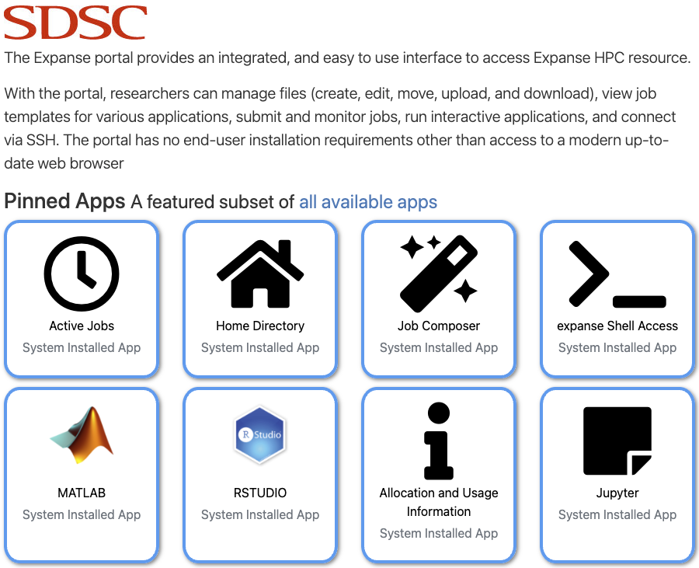
Online Resources
The course website includes the
Syllabus
Resources tab, with links to previous classes and other sites
Schedule, with links to class notes and exercises
Description of Assignments and Grading
The San Diego Supercomputer Center (SDSC) Expanse User Portal
requires an account from the Advanced Cyberinfrastructure Coordination Ecosystem: Services & Support (ACCESS-CI) program
can be accessed through modern laptop/desktop computers (e.g. classroom desktops) using a modern browser
allows you to
upload and download files
access the shell to set up environments/submit batch jobs and run interactive Jupyter notebooks
is where you will work on exercises and projects
will use an educational allocation from ACCESS-CI. If needed, graduate students can obtain their own allocation.
Canvas is where you will
submit assignments, except for large files
post information in discussions visible to the class
Notes:
Review syllabus in class

Slide 7
Introductions

Slide 8
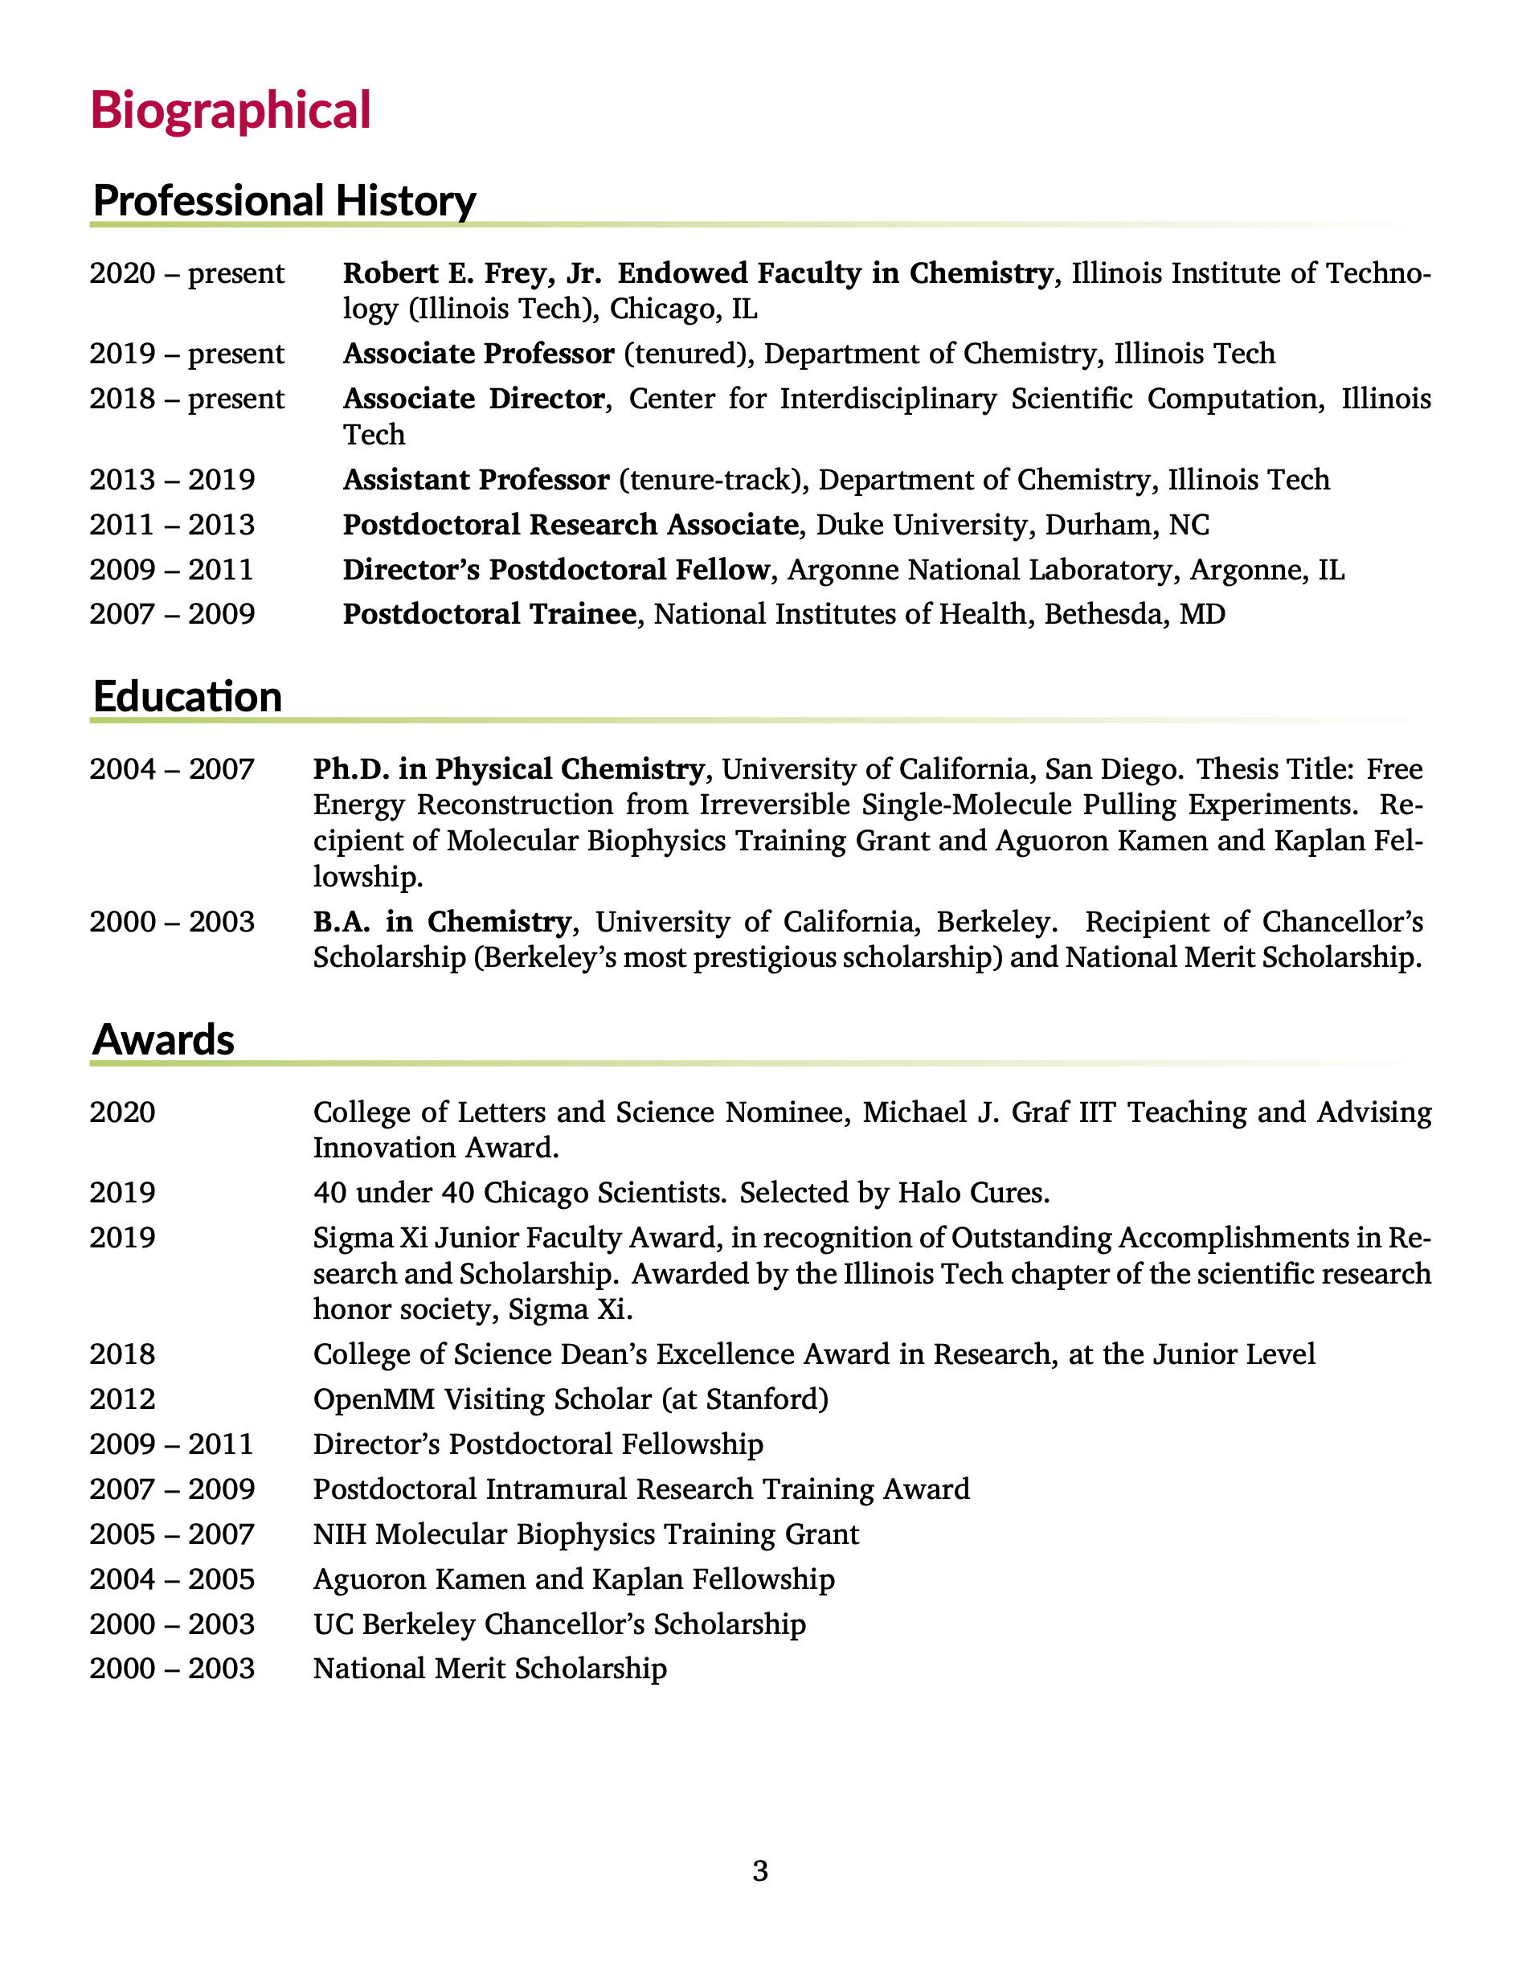
About me: work
Coauthored 61 peer-reviewed journal articles
Cited over 1700 times with an h-index of 23, according to Google scholar.
Current research in computational chemistry
Developing methods related to structure-based drug design
predicting binding affinities and ligand efficacy
simulating biological macromolecules
Involved in antibiotic drug discovery
Research has been funded by NIH, NSF, and Illinois
Full curriculum vitae: https://ccbatiit.github.io/downloads/DavidMinh_CV.pdf

Slide 9
About me: beyond work
Outside of work, I like to
exercise, especially CrossFit, swimming, and biking.
play sports, especially basketball, tennis, and table tennis.
listen to podcasts and sometimes audiobooks. Some of my favorite podcasts are Planet Money and Hidden Brain.
play board games, especially chess.
play music, especially guitar. I also can play bass and piano.
read news and sometimes books.
travel. I’ve been to 6 continents.
I am
Australian-born and American-raised by Vietnamese parents of Vietnamese and Chinese descent
married, with 2 children
Christian, c.f. my profile on Meet the Prof
incredibly blessed!

Slide 10
Introduce yourself
Before class on 1/21, fill out this survey under Participation on Canvas
What is your full name? What do you like to be called?
Which degree program are you in?
What is one things that you hope to learn in this class?
How will this help you achieve your goals?
Share something interesting about yourself

Slide 11
High performance computing

Slide 12
High Performance Computing (HPC) Systems
User Workstation (Laptop/Desktop)
HPC System / Cluster, e.g. SDSC Expanse
SSH / Web portal
Login Node
Head Node
submit
Why use HPC?
User workstations not powerful enough for many computational biochemistry and drug design calculations
You may want to use your workstation for something else, move it, or turn it off
Typical workflow: open Web portal → connect to login node → submit to Slurm on head node → compute on worker nodes → write/read to shared storage → retrieve results
Shared Storage
dispatches jobs
Worker Nodes (Compute Nodes)
Worker 1
Worker 2
Worker 3
/home/<user>/
(backed up)
/expanse/lustre/scratch
(not backed up)
Worker 5
Worker 6
Worker 7
/scratch is erased at job end.

Slide 13
The SDSC Expanse User Portal
Logging into the User Portal requires an ACCESS-CI account
In this class we will mostly
manage jobs (close when done)
upload and download files
access the shell to set up environments, submit jobs, and run interactive Jupyter notebooks
Notes:
Review syllabus in class

Slide 14
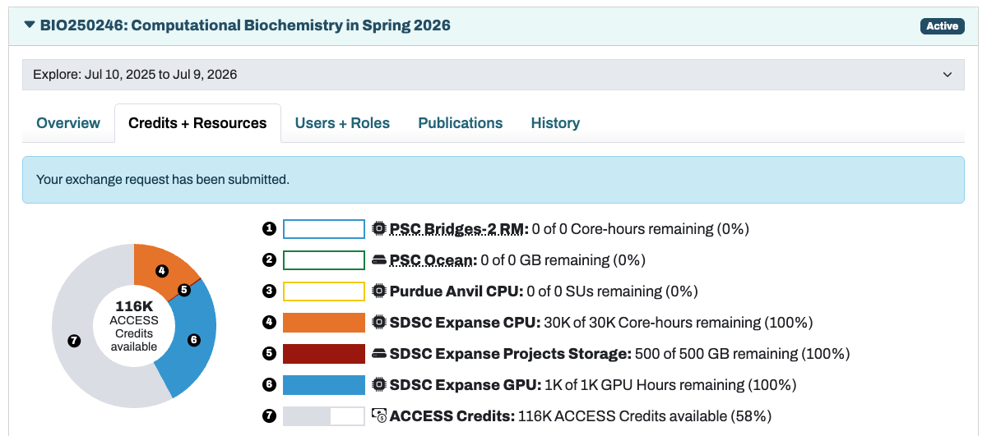
ACCESS Allocations
System for distributing ACCESS computing resources
Class (not individual students) has one allocation
Graduate students / PhD scientists can be PIs on additional ACCESS allocations
Allocation in ACCESS Credits that can be exchanged for resources, mostly CPU, GPU, and Storage
c.f. https://allocations.access-ci.org/

Slide 15
Basic Linux

Slide 16
Why Linux?
Linux is a practical “work environment” for doing computational science — especially when you move beyond small, local runs and start using HPC
Open source + customizability for specialized hardware and workloads
Cost-effective clustering with commodity nodes
Strong job scheduling + cluster management ecosystem
First-class support for parallel computing standards (MPI)
Operational reliability for long-running, multi-user systems
We will use the Linux terminal to
Manage files and environments on ACCESS-CI HPC resources
Start up interactive course notebooks
Submit & monitor longer calculations as batch jobs

Slide 17

The Shell (bash)
Core Shell Commands
Commands like 'pwd', 'ls', and 'cd' enable navigation and file listing in the shell environment.
File Operations
'mkdir', 'cp', 'mv', and 'rm' manage directories and files.
We will practice basic commands and file operations in Exercise 0.
Advanced Shell Features (Optional)
Redirection and piping allow chaining commands and controlling input/output streams efficiently.
Help and Automation
Commands like 'man' and '--help' assist users; shell scripts automate batch jobs on HPC clusters.
Notes:
The shell, commonly bash on HPC systems, is a command interpreter that reads user input and executes programs. It is the backbone of Linux interaction, enabling navigation, file manipulation, and execution of scripts. Key commands include 'pwd' to print the current directory, 'ls' to list files, and 'cd' to change directories. File operations such as 'mkdir' for creating directories, 'cp' for copying files, 'mv' for moving or renaming, and 'rm' for deletion are fundamental. Beginners should use 'rm -i' to avoid accidental deletions. Advanced shell features include redirection and piping, which allow chaining commands and managing input/output streams efficiently. For help, commands like 'man <command>' or '<command> --help' provide detailed usage instructions. Understanding the shell is critical because batch job scripts, which automate computations on HPC clusters, are essentially shell scripts executed non-interactively.

Slide 18

Filesystems and Paths
Hierarchical Directory Structure
Linux uses a root-based hierarchical directory tree to organize files with absolute and relative paths.
Storage Areas in HPC
HPC environments offer home directories, project spaces, and scratch spaces for different data storage needs.
Disk Space and Usage Commands
Commands like 'df -h' and 'du -sh *' help users monitor disk space and directory sizes efficiently.
File Permissions and Data Management
Understanding permissions and data locations is vital to avoid data loss and maintain storage policy compliance.
Notes:
Linux organizes storage as a hierarchical directory tree starting at the root '/'. Paths can be absolute, beginning with '/', or relative, starting from the current directory. HPC environments typically provide multiple storage areas: home directories for configuration files, project spaces for collaborative work, and scratch spaces for temporary high-speed storage. Commands like 'df -h' display available disk space, while 'du -sh *' shows the size of items in the current directory. Understanding paths and storage types is essential for efficient data management and avoiding accidental data loss. Permissions also play a role in file accessibility, and users must be aware of where their data resides to optimize performance and comply with storage policies.

Slide 19
Absolute vs. Relative Paths
Absolute path = exact address
Starts at the root: /
Works from anywhere (independent of your current folder)
Example: /home/$USER/chem456/project1/data/input.csv
Analogy: an exact street address
Shortcut: ~/ is your home directory
Relative path = directions from here
Starts from your current directory (pwd)
Shorter, but depends on where you are
Example: data/input.csv (when you’re in ~/chem456/project1)
Analogy: “across the street from Pritzker Science Center”
Shortcut: ../ is the parent directory
Notes:
Tip: Use relative paths inside a project; use absolute paths in scripts that may run from anywhere.

Slide 20

Permissions
Linux File Permissions
Permissions indicate who can read, write, or execute files, shown as symbols like '-rwxr-x---'.
Permission Modification
Use commands like 'chmod +x script.sh' to change file permissions and make scripts executable.
Security and Collaboration
Proper permission management prevents unauthorized access and supports group-based collaboration in HPC environments.
Common Permission Errors
Misconfigured permissions can cause errors like 'Permission denied,' disrupting workflows and operations.
Notes:
Linux permissions determine who can read, write, or execute a file. They are displayed using 'ls -l', which shows attributes like '-rwxr-x---', indicating permissions for the user, group, and others. 'r' stands for read, 'w' for write, and 'x' for execute. To make a script executable, use 'chmod +x script.sh'. Proper permission management ensures security and prevents unauthorized modifications. In HPC environments, permissions also affect collaborative workflows, as shared directories often rely on group-based access. Misconfigured permissions can lead to errors such as 'Permission denied,' so understanding and managing them is crucial for smooth operations.

Slide 21
Exercise 0: Basic Linux + Treasure Hunt

Slide 22
Homework
By Tuesday 1/13 at noon, sign up for an ACCESS account and submit your username on Canvas. This will give ACCESS and I time to add you to the class allocation by Wednesday’s class.
By next Wednesday 1/21 at 8:30am,
Fill out the Introduce Yourself survey under Participation on Canvas. This counts as two participation points.
Complete Exercise 0.
By next Friday 1/23 at 8:30am, complete Exercise 1.

