Slide 1
2/4/2026 Scientific Literature
Comments on
Quiz: make sure to understand foundational material
Exercise 3
Confirm MOR:Gα instability
Carry over to Exercise 4
Biological target presentation and report
Searching the scientific literature
Biochemistry-related databases
Search strategies
Accessing articles
Zotero
Library and Resources and Citation Management (Guest workshop by Sean Murphy)

Slide 2
Biochemistry-related databases
Scientific Literature
Google/Google Scholar
Web of Science
PubMed
Others: https://guides.library.iit.edu/c.php?g=474723&p=3248565
GPCR Database: https://gpcrdb.org/
“GPCRdb, GproteinDb, ArrestinDb and Biased Signaling Atlas cover related aspects of signal transduction while serving dedicated research communities and use cases.”
PubChem: https://pubchem.ncbi.nlm.nih.gov/
Includes biological activity of many chemical entities
Chemicals often identified by SMILES strings

Slide 3
Search strategies
Consider alternative names, e.g. coronavirus main protease (MPro) and 3c-like (3cl) protease and nonstructural protein 5 (NSP5)
Proteins from different species are usually similar
Look at citations
cited by an article of interested
that cite the article of interest
A research group will often work on similar proteins

Slide 4
Accessing articles
Free
Open access - article is free online. Usually requires larger author payment
Recent articles on NIH-funded research is freely available online at PubMed Central (PMC)
Preprint servers, e.g. bioarXiv - free, but may not be peer reviewed
Sometimes available from authors on their websites or upon request
Paywall
IIT subscribes to a selection of scientific journals, which can be accessed
in the library
online from campus
via a proxy server or VPN
Interlibrary loan (MyILL) can be used to request nearly any article, but requires a lead time

Slide 5
Zotero
Open source and free
Available online and as an application
Automatically organizes manuscript files & notes
Allows sharing with others via group libraries
Creates bibliographies
linked with MS Word and Google Docs
exportable to BibTeX

Slide 6
Library Resources and Citation Management
CHEM 456 - Computational Biochem
Sean Murphy | he/him/his
Head of Systems and Open Infrastructure – Galvin Library
Liaison Librarian - Chemistry, Biology, Physics, Food Science
smurphy13@illinoistech.edu
Notes:
Head of Access Services at the Galvin Library
Liaison Areas
Food Science and Nutrition, Physics, Chemistry, Biology
Background - Masters in Applied Molecular Biology

Slide 7
How do you find information?
Notes:
Ask the class to raise their hand if:
You’ve searched for info using Google
You were skeptical of something you read and looked for a different source
You’ve read an academic journal article
You’ve searched a database for journal articles
You’ve searched a database for patents or product information
You’ve ever been frustrated when you couldn’t find the info you needed

Slide 8
Learning Objectives
Finding Full-Text Articles
Database Searching
Tracking the Literature
Evaluating and Citing Sources
Library Resources
Notes:
Your assignments touch on a variety of topics
Ideal Gas equations
Thermodynamic cycles
Phase diagrams
There won’t be a single, best place to find info across all these disciplines
Give you tools and strategies to know where to look and how to find info

Slide 9
Finding Sources
Notes:
You’ll do most of your research online, though some articles are published in physical volumes

Slide 10
Popular Sources vs Scholarly Sources
Popular Sources are written for a general audience
They may be intended to inform, entertain, or persuade
Scholarly Sources are written for an academic audience
They are intended to contribute to a disciplinary discourse
Peer Review
Notes:
How do you evaluate whether a source is popular or scholarly?
Where it was published
Who wrote it
Who is the audience
What was the purpose of writing the source
What kind of review does it undergo

Slide 11
Scholarly Articles
Published In:
Uploaded To:
Journals
PNAS, Nature
Repositories
Arxiv
Collected in:
Databases
ProQuest, Academic Search Complete
Subscription Packages
American Chemical Society, IEEE
Searchable Using:
Library Catalog
Search Engines
Google Scholar
Citation Index
Web of Science

Slide 12
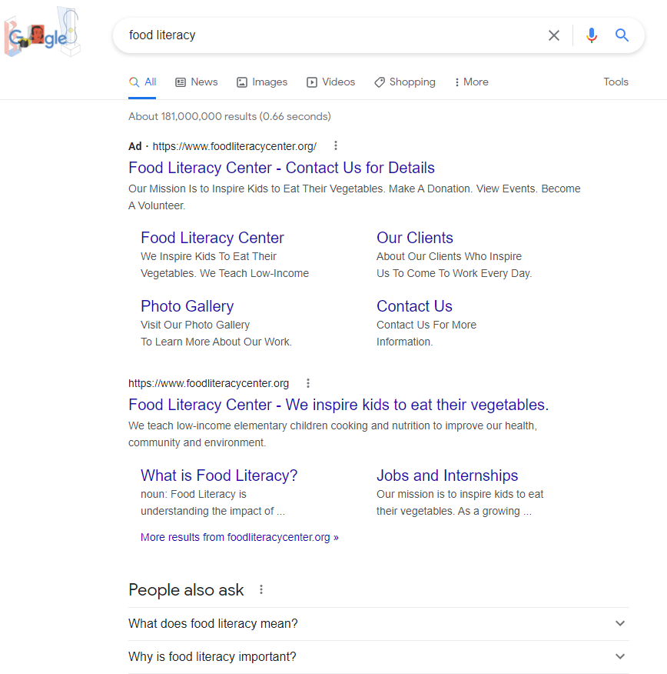
Searching Using Google
Algorithms and “Natural Language Processing”
Notes:
Search engine indexing
Algorithm-based
Advertising
“Natural Language Processing”
Don’t get me wrong - Google is great for learning about most things

Slide 13
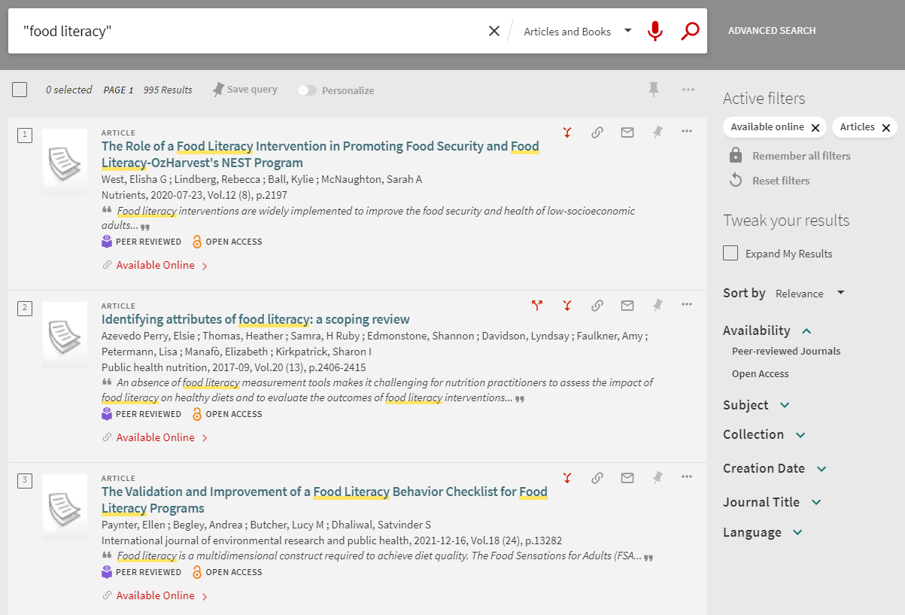
Catalogs/Databases
Keywords and Filters
Notes:
Select keywords as search terms
Be accurate (spelling)
Boolean operators
Controlled Vocabulary

Slide 14
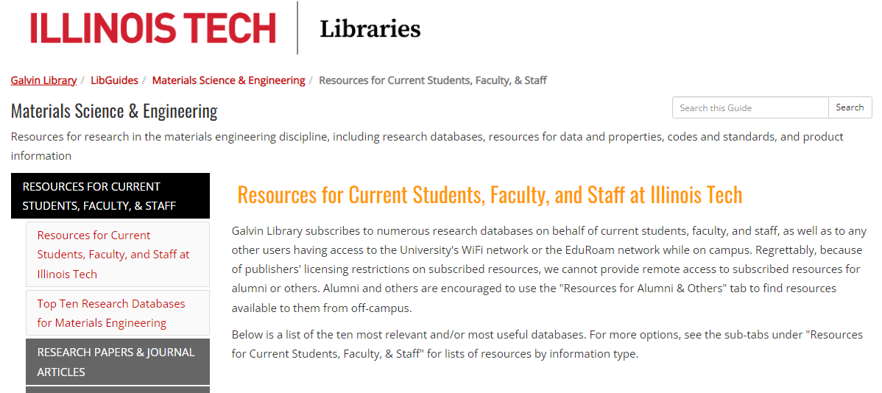
LibGuides
Discipline-specific, curated guides
Compiled by Librarians
Databases
Patent and Product Information
Tips and Tricks
Research Help
Chemistry
Chemical Engineering
Research Tips
Notes:
Librarians create LibGuides to gather relevant sources and information on various subjects

Slide 15
library.iit.edu
Notes:
Demonstrate the following:
Catalog
ILL
A-Z Database List
FAQ
LibGuides

Slide 16
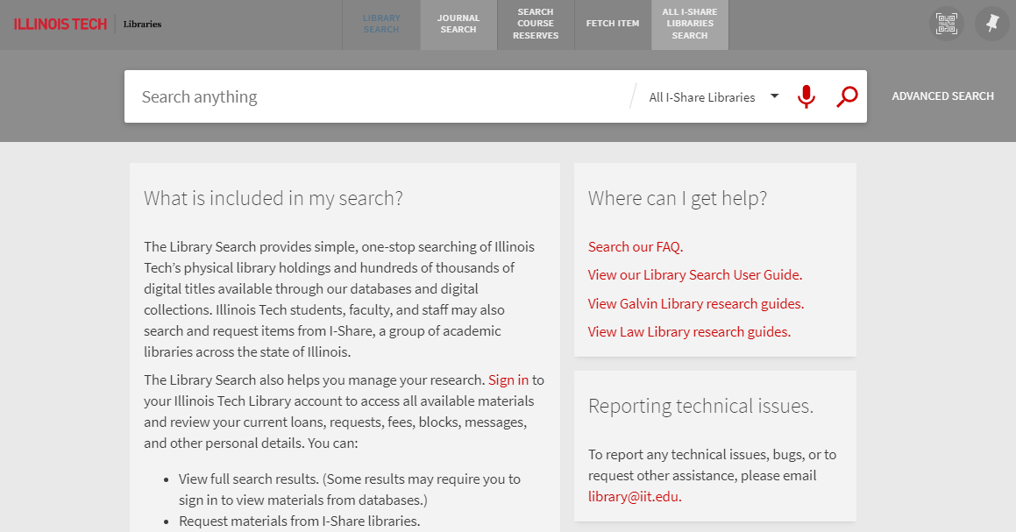
Library Catalog
Sign in with HawkID
Searches all library subscriptions
Will show articles, books, databases, etc. in search results
Great starting point
Notes:
Search expressions
Filtering results
Full text
Peer Reviewed label
Citation generators
Permalinks
Favorites
Search expression: electrocatalysts AND alcohol AND "carbon dioxide" AND spectroscopy
Demonstrate the search expression
Show Full Text limiter/filter

Slide 17
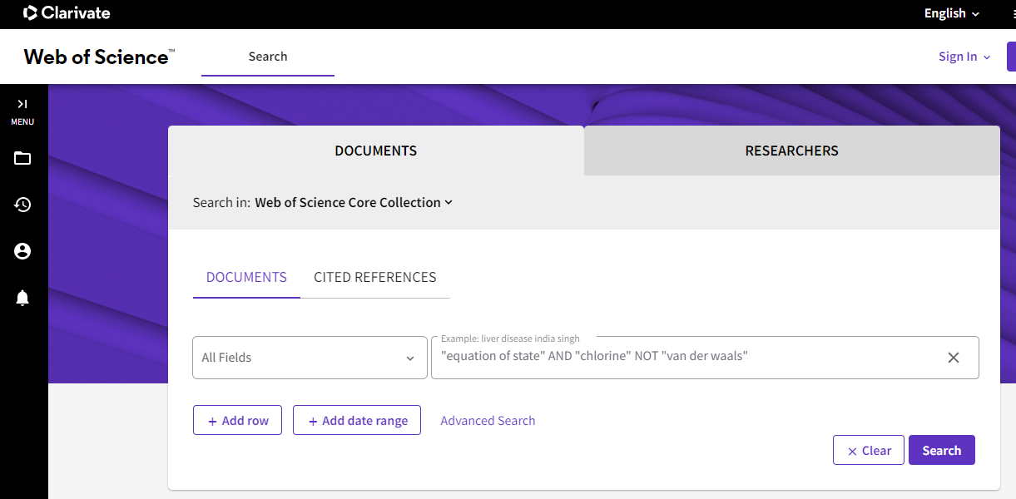
Web of Science
Citation Index
Full Text not necessarily available
Powerful citation tools
Notes:
Search expression: electrocatalysts AND alcohol AND "carbon dioxide" AND spectroscopy
Demonstrate the search expression
Citation Tracking
Full Text button

Slide 18
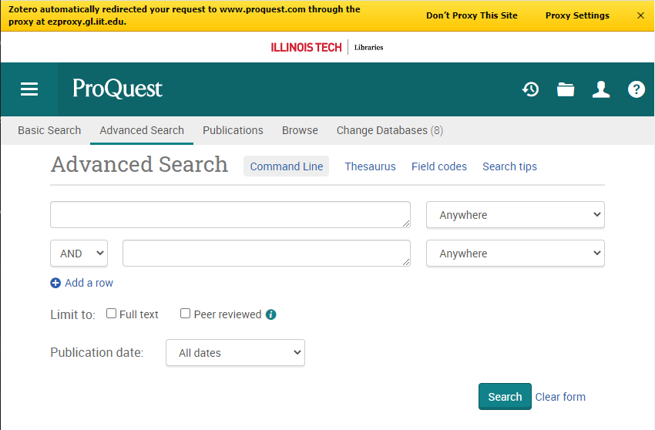
Proquest SciTech
Boolean Searching
Limits and Filters
Full Text
“Find Full Text” - Library Catalog
Notes:
Search expression: electrocatalysts AND alcohol AND "carbon dioxide" AND spectroscopy
Demonstrate the search expression
Subject heading filters
Publication date filters
Find full text

Slide 19
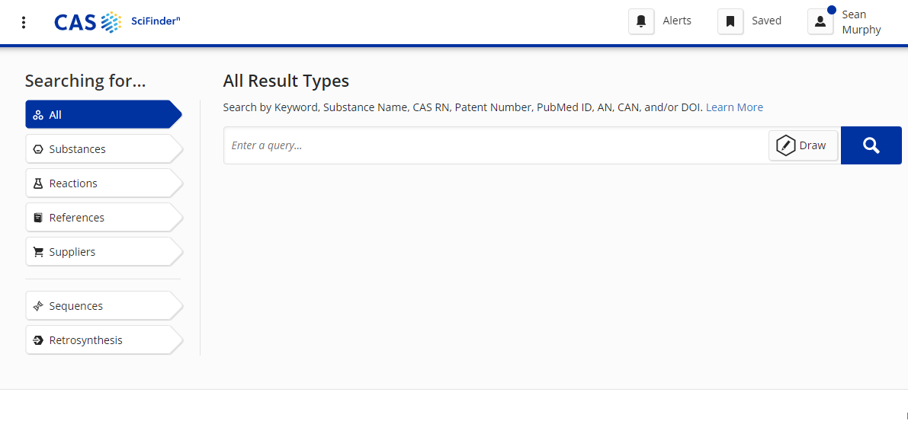
SciFinder
Requires Additional Signup
Chemical Structure and Properties Database
Reference citations for property data
Notes:
Search expression: “phase diagram” AND “argon”
Demonstrate the search expression
Show references list

Slide 20
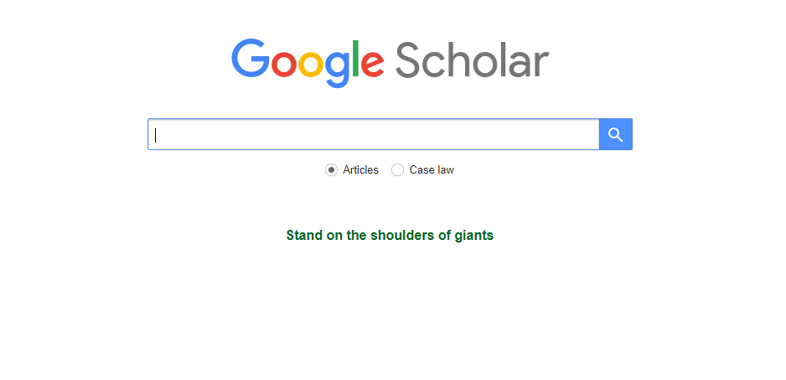
Google Scholar
Broad scope, search-engine style interface
Can be linked with IIT holdings
Good for when you know exactly what you’re looking for
Notes:
Search expression: electrocatalysts AND alcohol AND "carbon dioxide" AND spectroscopy
Demonstrate the search expression
Show “Find full text @ IIT”

Slide 21
Citing Sources
Notes:
When you write a research paper, you will be building on the work of others throughout history
It’s very important to acknowledge the work of others for a variety of reasons

Slide 22
Why Cite?
Give Credit
Demonstrate a scholarly discourse
Support your claims with evidence
Direct readers to original sources
Avoid plagiarism
Notes:
To give credit to those who performed the work
To demonstrate that scholarship is an ongoing, collaborative discourse
To provide supporting evidence for the claims you make in your own paper
To direct your readers to the original sources of information you’re building upon
To avoid plagiarism

Slide 23
Plagiarism
Using someone else’s words, ideas, or work as your own without giving due credit to the original author
Notes:
Using someone else’s words, ideas, or work as your own without giving due credit to the original author.
It’s essentially fraud; it can also be viewed as stealing.

Slide 24
How do you give credit?
In-Text Citations
Attributing a sentence, quote, or idea to a particular reference within the body of your text
Full Reference
A citation that’s formatted and included at the end of your paper in a bibliography or works cited section

Slide 25
Illinois Tech Code of Academic Honesty
“The misrepresentation of any work submitted for credit or otherwise as the product of a student’s sole independent effort, such as using the ideas of others without attribution and other forms of plagiarism[...],” Illinois Tech Code of Academic Honesty, section I.A
Penalties for violating the Code of Academic Honesty can include:
Grade reductions
Expulsion from a course or the university

Slide 26
When in doubt…..
Just Cite!

Slide 27
Citation Styles
APA (American Psychological Association) - Sciences
MLA (Modern Language Association) - Humanities
Chicago Manual of Style
Perdue OWL - Online Writing Lab

Slide 28
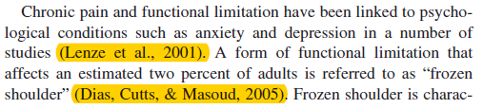
In-text citation
Examples from a scholarly article:
Church, D., & Nelms, J. (2016). Pain, range of motion, and psychological symptoms in a population with frozen shoulder: A randomized controlled dismantling study of clinical EFT (emotional freedom techniques). Archives of Scientific Psychology, 4(1), 38-48. doi:10.1037/arc0000028

Slide 29
Scalabrin, G., Bettio, L., Marchi, P., & Stringari, P. (2007). A fundamental equation of state for Sulfur Hexafluoride (SF6) in extended equation of state format. Journal of Physical and Chemical Reference Data, 36(2), 617–662. https://doi.org/10.1063/1.2716004
Notes:
Citation in APA 7th Edition format.
The year is in parentheses directly after the authors.
The title is in sentence case (only the first word is capitalized)
The DOI is a static URL for the paper, and it’s helpful to include it.

Slide 30
Bibliography
Located at the end of papers
How can readers find the cited resource?
“Bibliographic Information”
More information on sources cited in-text
Notes:
Located at the end of papers
Gives readers all the information they need to track down the cited resource
“Bibliographic Information”
In-text citations should also appear in bibliographies
Also known as References (APA) and Works Cited (MLA)

Slide 31
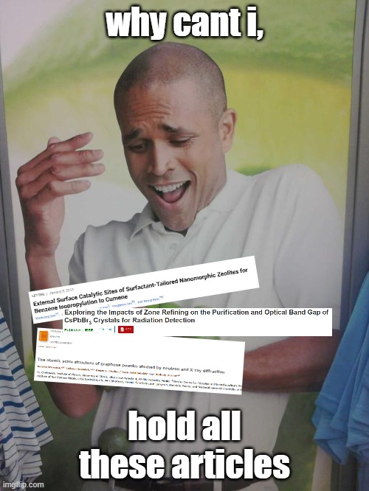
Citation Problems
How can I keep track of all my PDFs and keep them organized?
How can I find the right article to cite in my own work?
Writing citations and bibliographies is tedious and boring
One Solution: Zotero

Slide 32
Zotero
Open-Source Citation Management Platform
https://guides.library.iit.edu/zotero
Galvin Library Zotero LibGuide
Notes:
Using someone else’s words, ideas, or work as your own without giving due credit to the original author.
It’s essentially fraud; it can also be viewed as stealing.

Slide 33
Metadata
"Data whose purpose is to describe and give information about other data." - OED
Data about data
Metadata about articles, books, etc:
Title
Author
Journal
Publication Year
Volume, Issue, Page Number
Keywords
Topics
Abstracts
Metadata can be used to automatically build citations
Zotero is great for this
Institutional Affiliations
Web Links
Unique Identifiers (ID Numbers)
DOIs or Persistent Links
Notes:
Located at the end of papers
Gives readers all the information they need to track down the cited resource
“Bibliographic Information”
In-text citations should also appear in bibliographies
Also known as References (APA) and Works Cited (MLA)

Slide 34
ZoteroBib
www.zbib.org
Simple citation construction using a web link
Builds citations using metadata in various citation styles
Notes:
Using someone else’s words, ideas, or work as your own without giving due credit to the original author.
It’s essentially fraud; it can also be viewed as stealing.

Slide 35
Zotero
Full Citation Management
www.zotero.org
Cloud version (Zotero Web Library)
Standalone application
Browser Extension
Word Extension
Notes:
Using someone else’s words, ideas, or work as your own without giving due credit to the original author.
It’s essentially fraud; it can also be viewed as stealing.

Slide 36
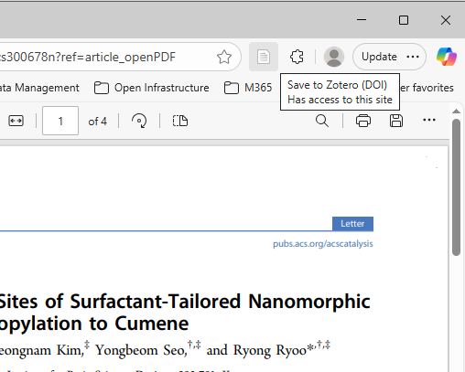
Zotero Web Library
Sign up for a free Zotero account
Download Zotero Connector for your browser
Make the extension visible in your toolbar
Find articles online
Galvin Library catalog
Google Scholar
Save both PDFs and metadata to Zotero Web Library
300 MB free space, Upgradeable at cost
Notes:
Located at the end of papers
Gives readers all the information they need to track down the cited resource
“Bibliographic Information”
In-text citations should also appear in bibliographies
Also known as References (APA) and Works Cited (MLA)

Slide 37

Zotero Desktop
Install on your computer
Uses computer storage for PDFs, but can sync with Zotero Web Library
More robust tools and options
Required to use the Microsoft Word extension
(Zotero | www.zotero.org)
Notes:
Located at the end of papers
Gives readers all the information they need to track down the cited resource
“Bibliographic Information”
In-text citations should also appear in bibliographies
Also known as References (APA) and Works Cited (MLA)

Slide 38
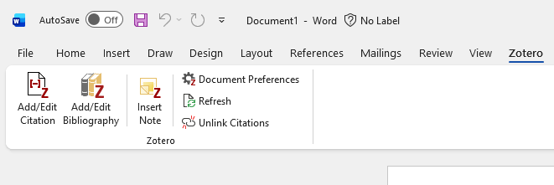
Zotero Plugin for Microsoft Word
Easily add citations from your Zotero library
In-Text
Bibliography
Desktop version of Word Only
Installs alongside Zotero Desktop
Zotero Desktop and Word must be open at the same time
Notes:
Located at the end of papers
Gives readers all the information they need to track down the cited resource
“Bibliographic Information”
In-text citations should also appear in bibliographies
Also known as References (APA) and Works Cited (MLA)

Slide 39
Still can’t find what you need?
The library can help!
Research Help
Reference Desk
Research Appointments
Interlibrary Loan
Worldwide Article Access

Slide 40
Sean Murphy
Head of Systems and Open Infrastructure
smurphy13@illinoistech.edu
Research Appointments
Main Library Desk

