Slide 1
Object detection under rainy conditions
A review on State-of-the-Art techniques

Slide 2
Introduction
Visual data plays a critical role in achieving self-driving capabilities in autonomous vehicles
Deep learning techniques are employed for object detection and classification
Challenges today:
Hard to train on video\image which is distorted by rain or other bad weather conditions
Lack of training data for commonly occurring weather conditions

Slide 3
Deep learning based methods for object detection
There are broadly two types of object detection architectures that are available today that show promising results for object detection and classification on visual data taken during clear weather
Faster R-CNN
YOLO

Slide 4
Faster R-CNN
The input image is fed to a feature extractor to produce a feature map.
Then this feature map is used to predict the regions in the image that could potentially contain objects of interest.
Overlapping regions are filtered out and the remaining feature vectors are fed to two fully connected layers: one predicts the offset values for bounding box and the other predicts the class probability

Slide 5
YOLO
YOLO network predicts the object of interest and the class probability directly from a full image in one evaluation.
The image is broken down into grids and each cell is responsible from detection objects. It also predicts the class probabilities within each grid.
To weed out the potentially wrongly classifies probabilities, a threshold is used

Slide 6
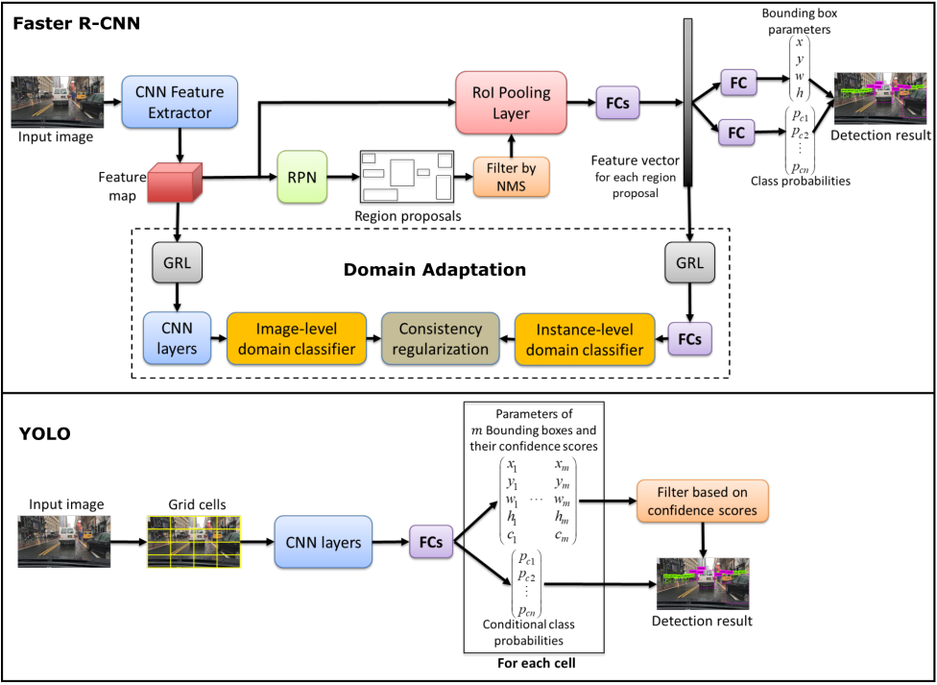

Slide 7
Image de-raining algorithms
There are well known image detaining algorithms whose goal is to remove the distortion created by the rain drops on the image while still maintaining the visual details in the image.
Some of the algorithms are discussed in the following slides

Slide 8
Deep Detail Network (DDN)
Convolutional neural network is used, ResNet.
First the difference between the rainy image clear image is predicted
The difference is used to remove rain from the image

Slide 9
Attentive Generative Adversarial Network (DeRaindrop)
In this method, a generative adversarial network (GAN) with visual attention is employed to learn raindrop areas and their surroundings.
The first part of the generative network, known as the Attentive-Recurrent Network (ARN), produces an attention map to guide the next stage of the framework. ARN includes ResNet, a Long ShortTerm Memory (LSTM), and CNN layers.
The second stage, which is known as Contextual Autoencoder, operates on the attention map and hence it focuses on the raindrop areas
The architecture also includes a discriminative network, which assesses the generated rain-free images to verify that they are similar to real ones that have been used during the training process.

Slide 10
Progressive Image Deraining Network (PReNet)
Recursively remove raindrops from the image, at each iteration certain amount of raindrop is removed from the image
The architecture contains several blocks of ResNet, CNN layer that operates on the original image and current output image and another CNN layer to generate the output image.
A recurrent layer is appended to exploit dependencies features across iterations

Slide 11
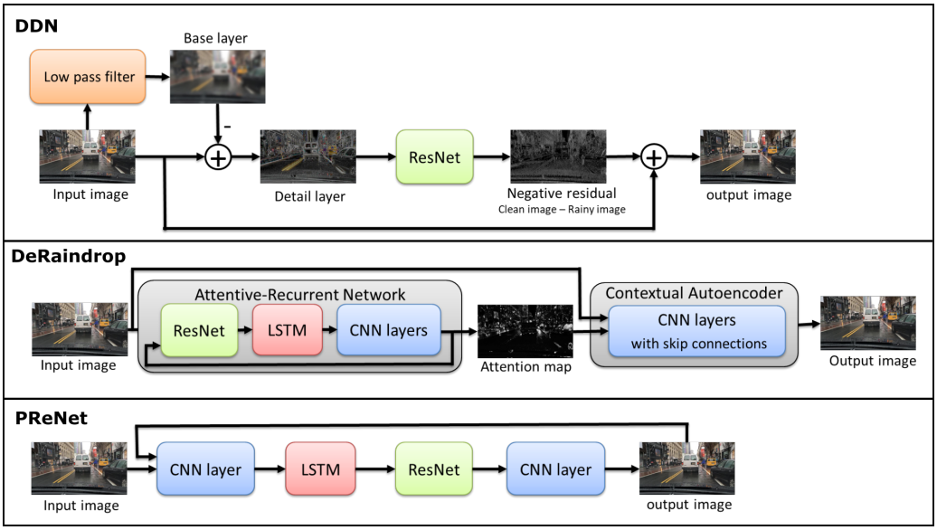

Slide 12
Alternate training approaches for deep learning based object detection
Unsupervised image-to-image translation: In this technique, image is translated from one domain to another while maintaining the visual content. GANs have proven to be effective in the area of image translation
Domain adaptation: This technique employs a adversarial training strategy to learn robust features that are domain-invariant. In other words, it makes the distribution of features extracted from images in the two domain indistinguishable

Slide 13
Reference
https://arxiv.org/pdf/2006.16471.pdf

