Slide 1
RAILWAY RESERVATION SYSTEM
Submitted To- Prof. O P Vyas
Dr. Ranjana Vyas
By- Group 28
IIT2013034
IIT2013038
IIT2013061
IIT2013117
TA- Anand Kumar Singh Ravindra Kumar Soni

Slide 2
INTRODUCTION
Group-28
This project is aimed to create a project based on reservation of railway tickets using Database Management System.
This system is basically concerned with the reservation and cancellation of tickets for the railway passengers. The need of this system arises as India has the largest railway network in the world and handling it manually is a tough job. By computerising it we will be able to overcome many of its limitations and can make the system more efficient.

Slide 3
FUNCTIONALITIES OF THE PROJECT
Group-28
Key Features:
Reserves and cancels seats of passengers.
Contains information about trains.
Contains details about passengers.
Contains details of reservation fees, any concessions etc.
Will make entries for reservations, cancelled tickets and wait-listed tickets.
Generates tickets in PDF format for users.
Will tell the current PNR status.

Slide 4
FUNCTIONS OF USER
Group-28
Train Enquiry
Book Ticket
Payment
Check PNR Status
Cancel Ticket
Login & Logout

Slide 5
FUNCTIONS OF ADMIN
Group-28
Add & Remove Train
Add & Remove User
Book Ticket
Cancel Ticket
Get Passenger List
Login and Logout

Slide 6
ER Diagram

Slide 7
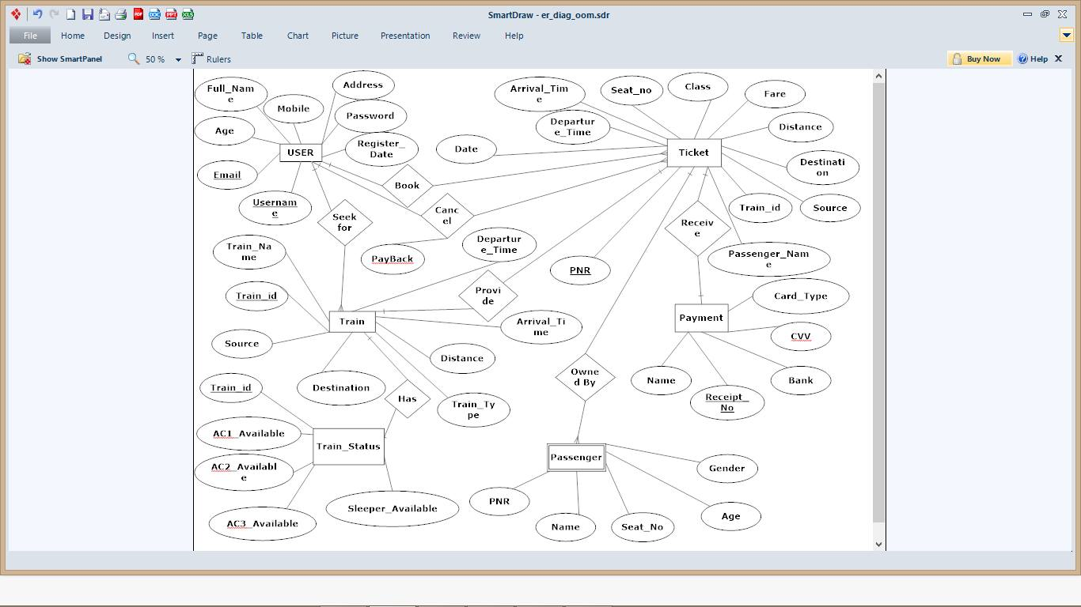

Slide 8
Entity- USER
Group-28
Attribute | Data Type | Constraints
Full_Name | varchar(30) | Not null
Age | int | Not null
Email_id | Varchar(20) | Primary Key (Composite)
Mobile | Varchar(12) | Not null
Address | Varchar(50) | Not null
Password | Varchar(20) | Not null
Register_date | Date | Not null
Username | Varchar(20) | Primary key (Composite)

Slide 9
Entity- TRAIN
Group-28
Attributes | Data type | Constrains
Train_Name | Varchar(30) | Not null
Train_id | Varchar(20) | Primary Key, Foreign Key
Source | Varchar(20) | Not null
Destination | Varchar(20) | Not null
Train_type | Varchar(20) | Not null
Distance | Int | Not Null
Arrival_time | time | Not null
Departure_time | time | Not null

Slide 10
Entity- TRAIN_STATUS
Group-28
Attribute | Data type | Constraints
Train_id | Varchar(20) | Primary Key
AC1_Available | Int | Not Null
AC2_Available | Int | Not Null
AC3_Available | Int | Not Null
Sleeper_Available | Int | Not Null

Slide 11
Entity- TICKET
Group-28
Attributes | Data type | Constraints
Date | date | Not null
PNR | Varchar(10) | Primary Key
Passenger_Name | Varchar(20) | Not null
Train_ID | Varchar(20) | Not Null
Source | Varchar(20) | Not null
Destination | Varchar(20) | Not null
Distance | Int | Not null
Fare | Int | Not null
Class | Varchar(20) | Not null
Seat_no | Int | Not null
Arrival_time | Time | Not null
Departure_time | Time | Not null

Slide 12
Entity- PAYMENT
Group-28
Attributes | Data type | Constraints
Name | Varchar(20) | Not null
Receipt_no | Varchar(20) | Primary Key
Bank | Varchar(20) | Not null
CVV | Varchar(3) | Not null
Card_Type | Varchar(20) | Not Null

Slide 13
Entity- PASSENGER
Group-28
Attributes | Data type | Constraints
PNR | Varchar(10) | Not null
Name | Varchar(20) | Not Null
Seat_no | Int | Not Null
Age | int | Not Null
Gender | Varchar(6) | Not Null

Slide 14
EXTRACTED ATTRIBUTES
Group-28
Primary Key (Entity) | Composite Key (Entity) | Foreign Key (Entity)
Train_id (TRAIN) | Email_id, Username (USER) | Train_id (TRAIN)
PNR (TICKET)
Receipt-no(PAYMENT)
Train_id (TRAIN_STATUS)

Slide 15
EXTRACTED ENTITIES
Group-28
Strong Entity | Weak Entity
USER | PASSENGER
TICKET
TRAIN
PAYMENT
TRAIN_STATUS

Slide 16
IIT2013034 – Praneel Rathore (9026090651)
IIT2013038 – Himanshu Tuteja (8176027474)
IIT2013061 – Aayush Garg (8176027480)
IIT2013117 – Anirudh Gupta (9453131334)

