Slide 1



INDIA SOLAR POWER GENERATION ANALYSIS
PROJECT MEMBER PROJECT GUIDE
BAIRAVI E (22ADR013) Dr. KALAIVANI K S
ANIRUDH G V(22ADR006) ASSOCIATE PROFESSOR
KABILAN C (22ADR045)

Slide 2
DATA DESCRIPTION
Description : This dataset was collected from two solar power plants in India over a period of 34 days. It includes two main components for each plant: power generation data and sensor data. Power generation metrics were captured at the inverter level, which means each inverter was responsible for collecting data from multiple lines of solar panels. On the other hand, environmental sensor data was collected at the plant level using an optimally positioned sensor array.
Source: data.world
Key features: Date, Time, Ambient temperature, Power generated, separate plant id, each module temperature
Purpose: By combining these two datasets, we can get a comprehensive view of how environmental conditions affect solar power production.

Slide 3
DATA PREPROCESSING
DATA EXTRACTION
(from Excel)
Data transformed for the SOURCE_KEY (like labelling the source key to human understandable way using python)
Data Is Combined
Both Plants data are combined to Perform easier analysis

Slide 4
DATA ANALYSIS
Split the data and time separately
Find the thermal differences.
Analyze how ambient temperature affects module temperature.
Find peak irradiation times.
Calculate average, max, and min temperatures..
Calculate average, max, and min irradiation values.
Compare different plants (using PLANT_ID) to see which has higher ambient temperatures.
Compare different plants (using PLANT_ID) to see which has higher irradiation levels.
Calculate cumulative irradiation values over periods to assess overall energy potential.
Find the relationship between the two dataset.
Compare the total yield generated by two different plants.
Compare and contrast the thermal differences between the two solar plants.
Compare the AC_POWER generated by two plants.
Finding the adverse effect of the temperature difference to the power generation.

Slide 5
How does the thermal difference affects the irradiation level?
What is the average of the daily yield in both plants?
What is the average of the Irradiation yield in both plants?
What is the total AC and DC Power Generated in both plants?
What is the Power Efficiency of both power plants?

Slide 6
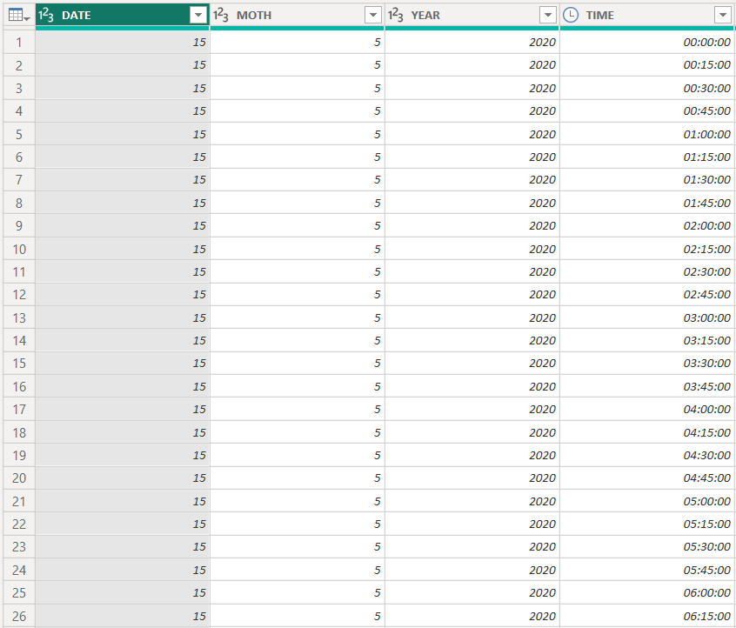
Split the data and time separately
INFERENCE:
The date and time has been splitted successfully.

Slide 7
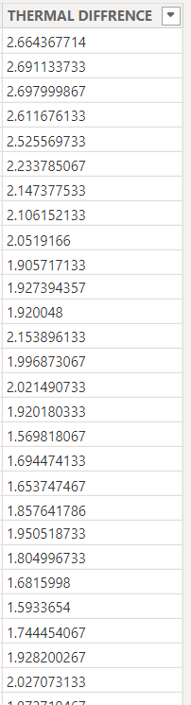
2. Find the thermal differences
INFERENCE:
Thermal difference has been found
Thermal difference=(Ambient temp - Module temp)

Slide 8
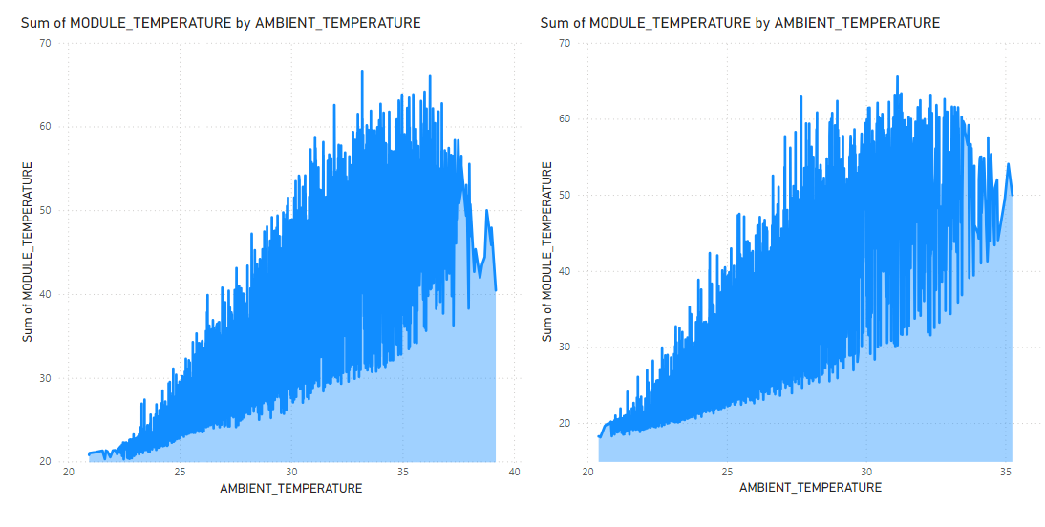
3. Analyze how ambient temperature affects module temperature.
INFERENCE:
Module temperature increases with respect to ambient temperature

Slide 9
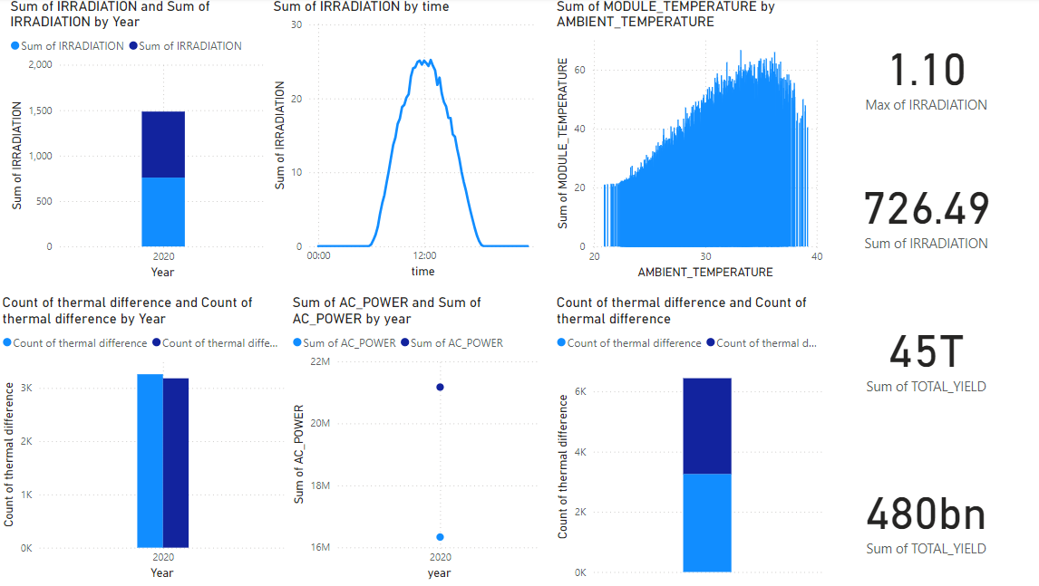
4. Find peak irradiation times.
INFERENCE:
The peak irradiation is at 12.00 pm

Slide 10
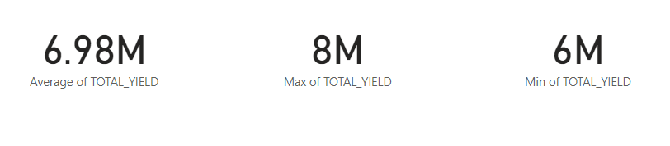
5. Calculate average, max, and min temperatures.
INFERENCE:
Average: 6.98 M Maximum: 8 M Minimum: 6 M

Slide 11
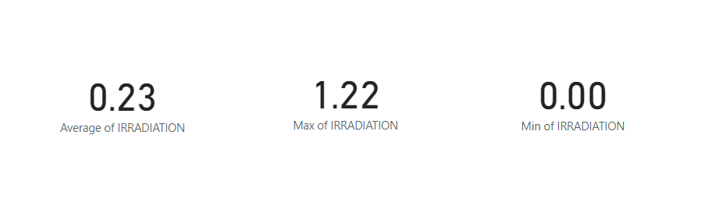
6. Calculate average, max, and min irradiation values.
INFERENCE:
Average: 0.23 Maximum: 1.22 Minimum: 0

Slide 12
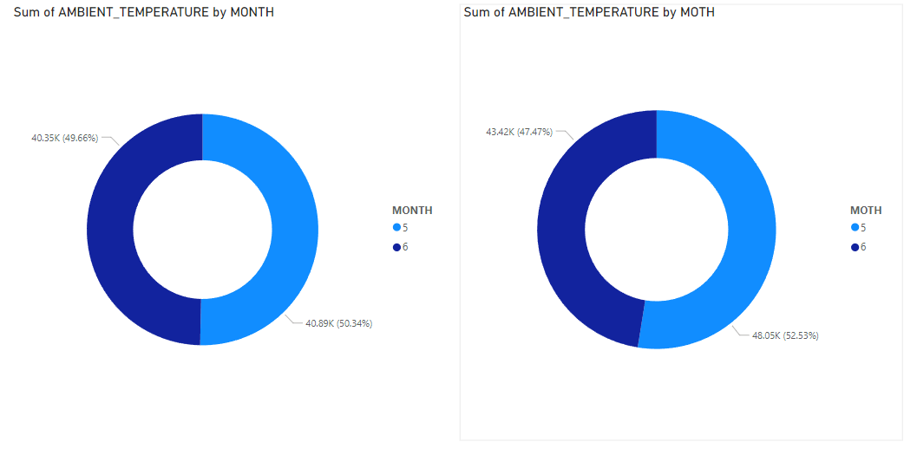
7. Compare different plants (using PLANT_ID) to see which has higher ambient temperatures.
INFERENCE:
Plant ID 4136001 has acquired highest ambient temperature

Slide 13
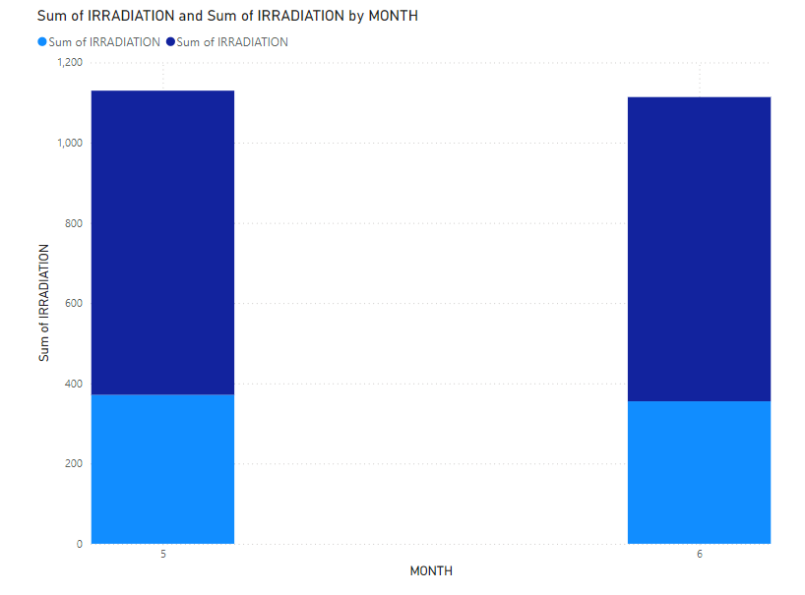
8. Compare different plants (using PLANT_ID) to see which has higher irradiation levels.
INFERENCE:
The PLANT ID 4135001 has higher irradiation level

Slide 14
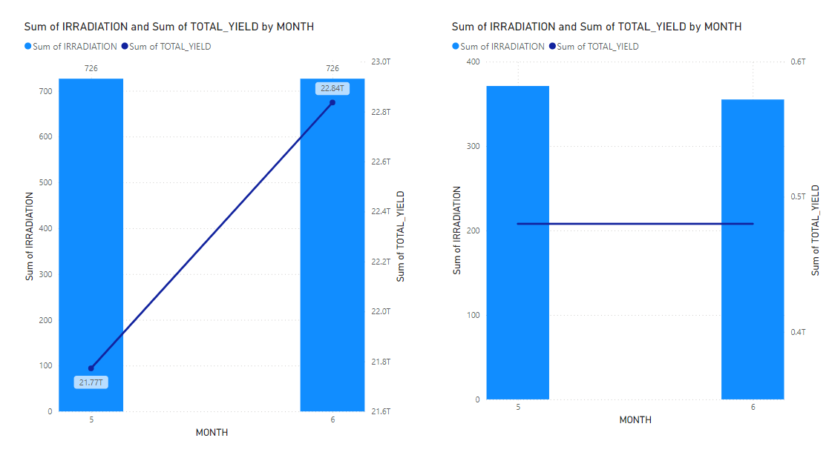
9. Calculate cumulative irradiation values over periods to assess overall energy potential.
INFERENCE:
PLANT ID 4135001: The total yield increases over time
PLANT ID 4136001: The total yield remains same over the time

Slide 15
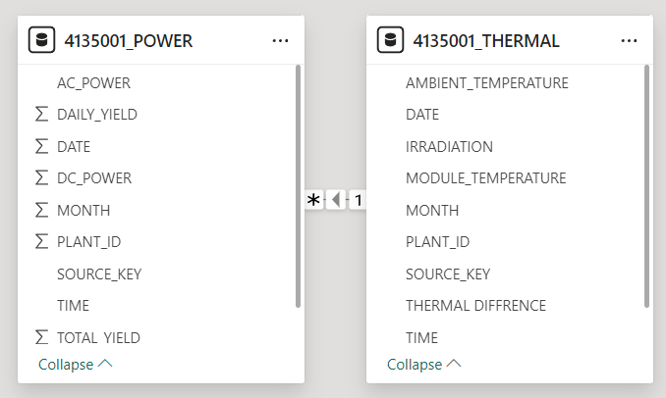
10. Find the relationship between the two dataset.
INFERENCE:
The AC power attribute has many to one relationship to the thermal difference attribute.

Slide 16
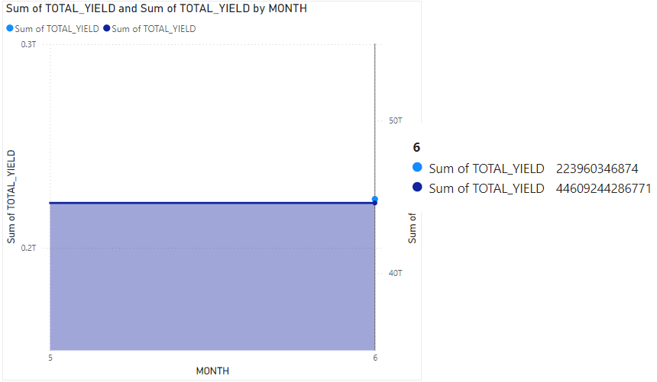
11. Compare the total yield generated by two different plants.
INFERENCE:
The total yield generated by PLANT 4135001 is much lower than that has been generated by the PLANT 4136001

Slide 17
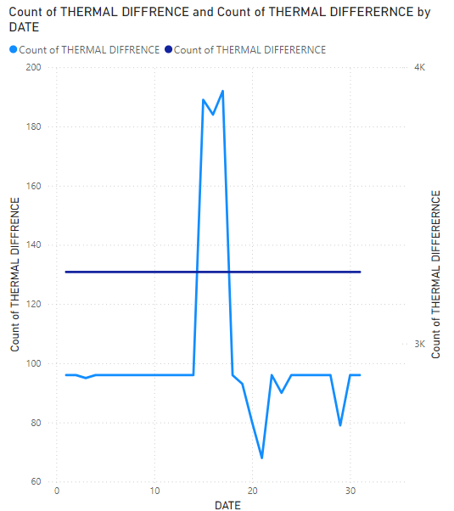
12. Compare and contrast the thermal differences between the two solar plants.
INFERENCE:
The thermal difference of PLANT ID 4135001 varies while of the other plant remains same

Slide 18
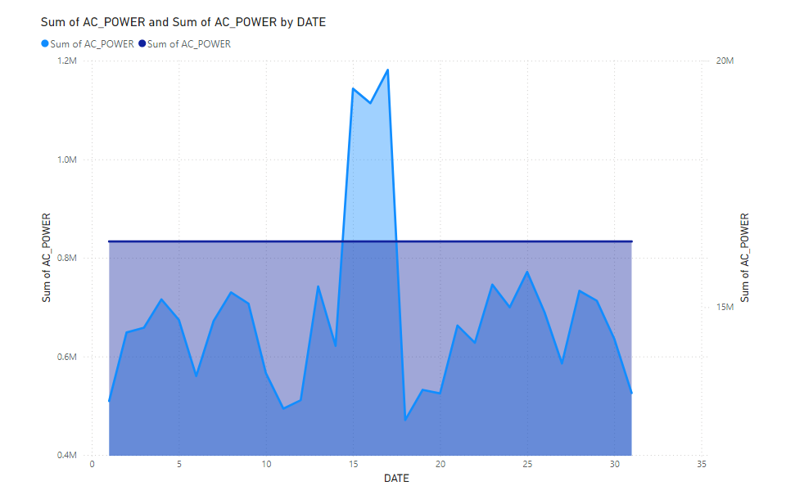
13. Compare the AC_POWER generated by two plants
INFERENCE:
The PLANT ID 4135001 generates varying AC power while
the other generates 16334048 sum of AC power all the days

Slide 19
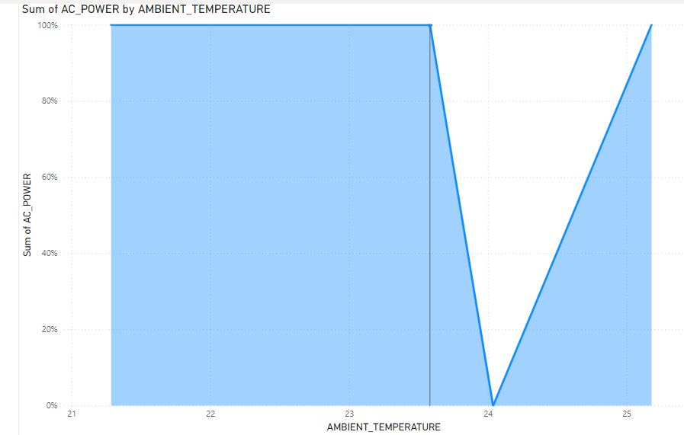
14. Finding the adverse effect of the temperature difference to the power generation
INFERENCE:
The power generated remains same until the threshold value of ambient temperature with value 23.4 and varies as the temperature increases

Slide 20
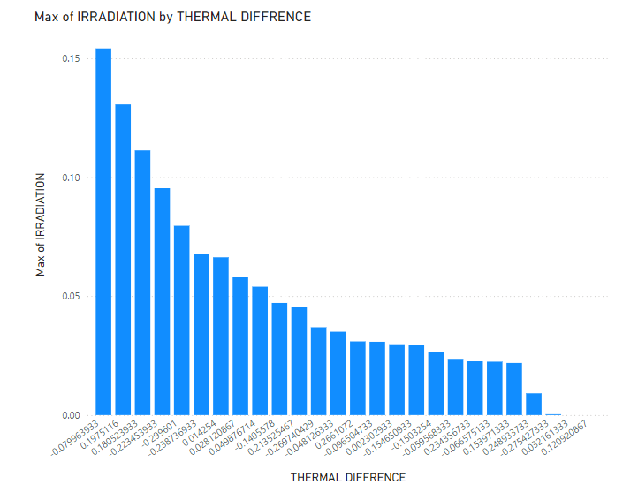
15. How does the thermal difference affects the irradiation level?
INFERENCE:
The irradiation level decreases with increase in thermal difference

Slide 21
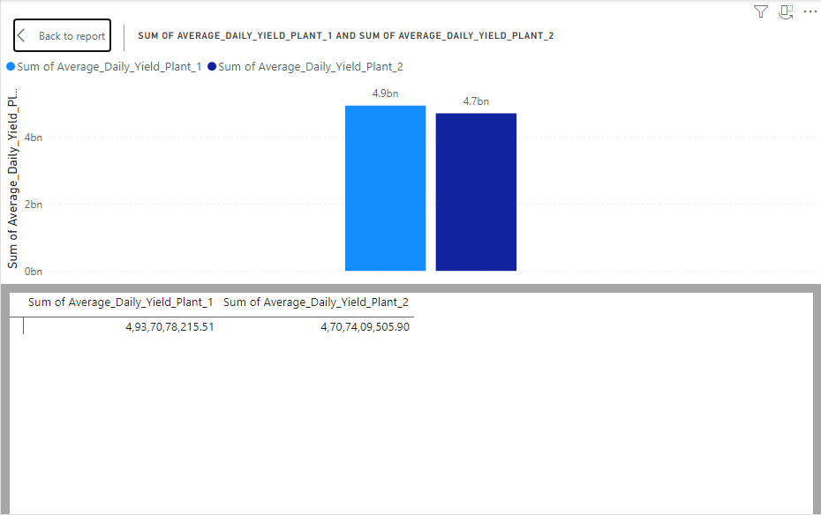
16. What is the average of the daily yield in both plants?

Slide 22
DAX QUERY :
Average_Daily_Yield_Plant_1 =
AVERAGEX(
SUMMARIZE(
'Plant_1_Generation_Data',
'Plant_1_Generation_Data'[DATE_TIME],
"Daily_Yield", SUM('Plant_1_Generation_Data'[DAILY_YIELD])
),
[Daily_Yield]
)
Average_Daily_Yield_Plant_2 =
AVERAGEX(
SUMMARIZE(
'Plant_2_Generation_Data',
'Plant_2_Generation_Data'[DATE_TIME],
"Daily_Yield", SUM('Plant_2_Generation_Data'[DAILY_YIELD])
),
[Daily_Yield]
)
INFERENCE:
The irradiation level decreases with increase in thermal difference

Slide 23
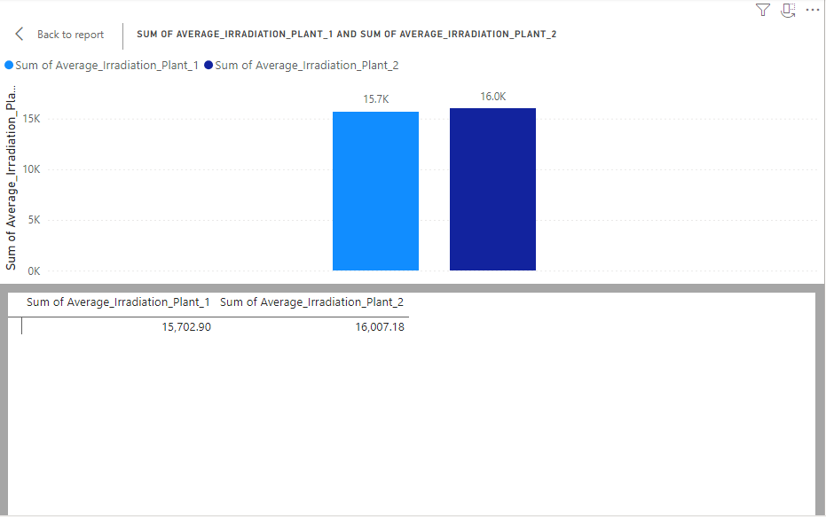
17. What is the average of the Irradiation yield in both plants?

Slide 24
DAX QUERY: Average_Irradiation_Plant1 = AVERAGE(‘Plant_1_Weather_Sensor_Data’[IRRADIATION])
Average_Irradiation_Plant_2 =
AVERAGE(‘Plant_2_Weather_Sensor_Data’[IRRADIATION])
INFERENCE:
The irradiation level decreases with increase in thermal difference

Slide 25
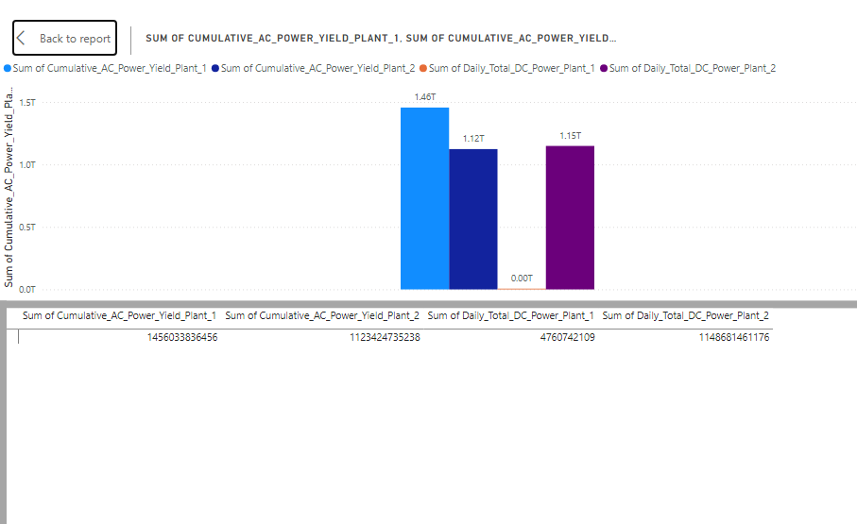
18. What is the total AC and DC Power Generated in both plants?

Slide 26
DAX QUERY:
Cumulative_AC_Power_Yield_Plant_1 =
CALCULATE(
SUM('Plant_1_Generation_Data'[AC_POWER]),
FILTER(
ALL('Plant_1_Generation_Data'),
'Plant_1_Generation_Data'[DATE_TIME] <= MAX('Plant_1_Generation_Data'[DATE_TIME])
)
)
Daily_Total_DC_Power_Plant_1 =
CALCULATE(
SUM('Plant_1_Generation_Data'[DC_POWER]),
ALLEXCEPT('Plant_1_Generation_Data', 'Plant_1_Generation_Data'[DATE_TIME])
)
Cumulative_AC_Power_Yield_Plant_2 =
CALCULATE(
SUM('Plant_2_Generation_Data'[AC_POWER]),
FILTER(
ALL('Plant_2_Generation_Data'),
'Plant_2_Generation_Data'[DATE_TIME]
<=
MAX('Plant_2_Generation_Data'[DATE_TIME])
)
)
Daily_Total_DC_Power_Plant_2 =
CALCULATE(
SUM('Plant_2_Generation_Data'[DC_POWER]),
ALLEXCEPT('Plant_2_Generation_Data', 'Plant_2_Generation_Data'[DATE_TIME])
)
INFERENCE:
Plant 2 has very low DC power generation from all the others .

Slide 27
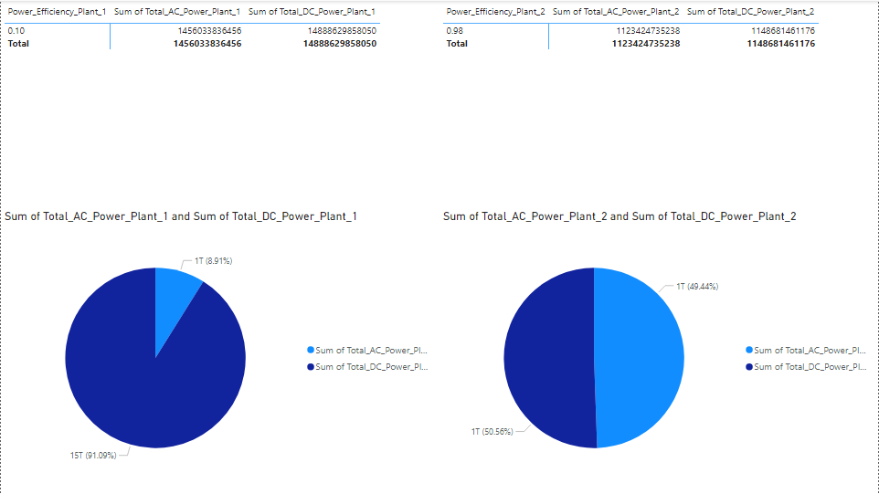
19. What is the Power Efficiency of both power plants?

Slide 28
Total_AC_Power_Plant_1 = SUM('Plant_1_Generation_Data'[AC_POWER])
Total_DC_Power_Plant_1 = SUM('Plant_1_Generation_Data'[DC_POWER])
Power_Efficiency_Plant_1 = DIVIDE([Total_AC_Power_Plant_1], [Total_DC_Power_Plant_1], 0)
Total_AC_Power_Plant_2 = SUM('Plant_2_Generation_Data'[AC_POWER])
Total_DC_Power_Plant_2 = SUM('Plant_2_Generation_Data'[DC_POWER])
Power_Efficiency_Plant_2 = DIVIDE([Total_AC_Power_Plant_2], [Total_DC_Power_Plant_2], 0)
INFERENCE:
Plant 2 has better power efficiency when compared to plant 1.

Slide 29
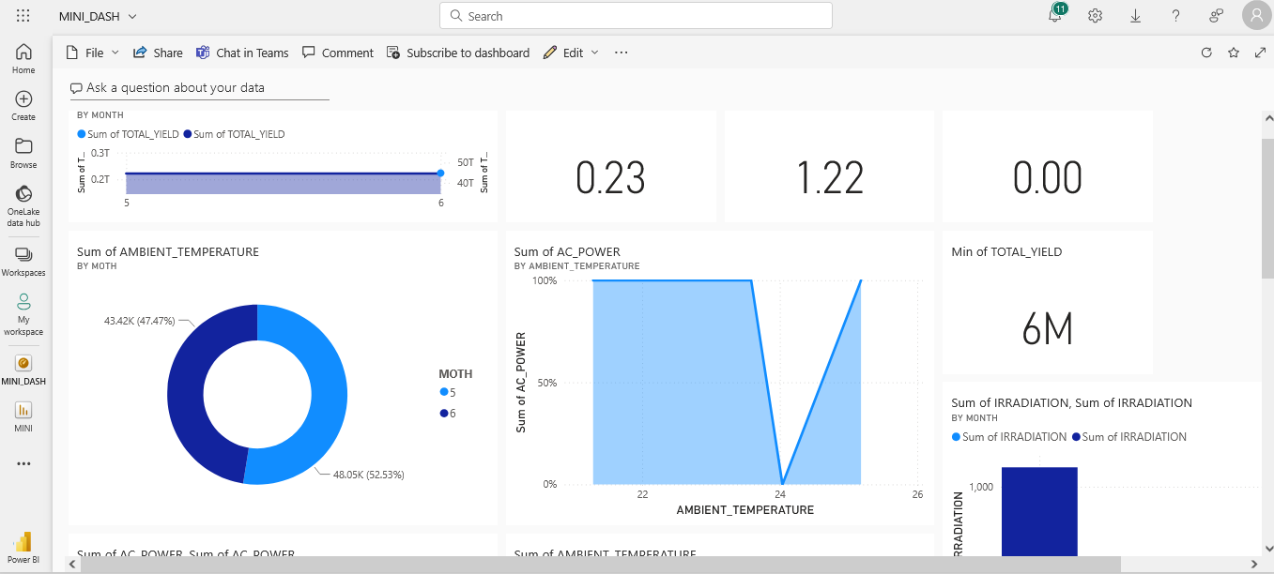
DASHBOARD

Slide 30
Github Repository Link
https://github.com/anirudhgv1805/dataAnalysisReport
Refeerences
https://data.world/gymprathap/india-solar-power-generation-dataset
Official Documentation:
https://learn.microsoft.com/en-us/power-bi/

Slide 31
THANK YOU

