Slide 1
Forward Chaining using Rete

Slide 2
We already saw two ways to improve FC
The two improvements we have seen before:
Conjunct ordering
Incremental Forward Chaining
Rete takes incremental Forward Chaining to a whole new level
Rete does not waste partial matches

Slide 3
Definite Clauses vs Production Rules
All definite clauses can be expressed as production rules. But not the reverse.
Example of a Definite clause:
Missile(x) ∧ Owns(Nono, x) ⇒ Sells(West, x, Nono)
Equivalent Production Rule:
IF missile(x) AND Owns(Nono, x) THEN
Assert(Sells(West, x, Nono) )

Slide 4
Definite Clauses vs Production Rules- Primary difference
Production rules supports multiple consequents
It supports retract and modify
Example:
IF missile(x) AND Owns(Nono, x) AND investigate (FBI, Nono) THEN
Retract(Sells(West, x, Nono))
Modify(Owns(Nono,x), Owns(Us, x))
You just need to be familiar with production rules
All definite clauses are valid production rules and in this class, we will only deal with them

Slide 5
Rete Algorithm
‘Rete’ stands for ‘Network’ (of blood vessels) in latin
Rete was designed for working on Production Systems
it operates on production rules
Invented by Charles Forgy (1978, 1979 and 1982) for OPS5 system
“A fast algorithm for many pattern/many object pattern match problem”

Slide 6
Rete complexity
P: Number of rules
C: Average number of pattern/antecedents in a rule
W: Number of facts
The algorithmic complexity is:
Best case: O(Log(P))
Average Case O(PWC) – linear in the size of working memory
Worst Case: O(PW^{c} )
Proof/analysis is left as a exercise

Slide 7
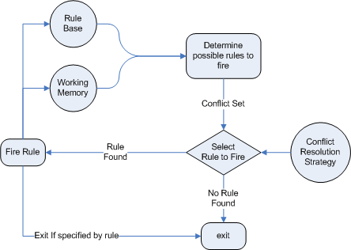
A high-level architecture of a Production Rules System
- Drools expert Guide

Slide 8
A high-level architecture of a Production Rules System
- Drools expert Guide
What RETE does

Slide 9
Root
Discriminator (Alpha Nodes)
RETE Network High level Idea
Kind-1
Kind-N
Alpha Memory 1
Alpha Memory n
Intra Element pattern 1
Intra Element pattern n
Assimilator (Beta Nodes)
Inter Element pattern 1
Inter Element pattern1
Beta Memory 1
Beta Memory n
Conflict Set Changes

Slide 10
Our Rule base and Facts
Rule 1: (has-goal ?x simplify)
(expression ?x 0 + ?y)
==> DO SOMETHING
Rule 2: (has-goal ?x simplify)
(expression ?x 0 * ?y)
==> DO SOMETHING
Fact 1: (has-goal e1 simplify)
Fact 3: (has-goal e2 simplify)
Fact 2: (expression e1 0 + 3)
Fact 4: (expression e2 0 + 5)
Fact 5: (has-goal e3 simplify)
Fact 6: (expression e3 0 * 2)
(assume that facts will be asserted one at a time)

Slide 11
Root
Rules are compiled into rete Network with associated alpha/beta storage
Has-goal
Expression
(has-goal ?x simplify)
(expression ?x 0 + ?y)
(expression ?x 0 * ?y)
?x
--
?x ?y
----------
?x ?y
----------
Has-goal/expression-+ (?x equal)
Has-goal/expression (?x – equal)
?x ?y
----------
?x ?y
----------
Rule-1 ready-to-fire
Rule-2 ready-to-fire

Slide 12
Root
Fact1: (has-goal e1 simplify)
Has-goal
Expression
(has-goal ?x simplify)
(expression ?x 0 + ?y)
(expression ?x 0 * ?y)
?x
--
E1
?x ?y
----------
?x ?y
----------
Has-goal/expression-+ (?x equal)
Has-goal/expression (?x – equal)
?x ?y
----------
?x ?y
----------
Rule-1 ready-to-fire
Rule-2 ready-to-fire

Slide 13
Root
Fact2: (has-goal e2 simplify)
Has-goal
Expression
(has-goal ?x simplify)
(expression ?x 0 + ?y)
(expression ?x 0 * ?y)
?x
--
E1
E2
?x ?y
----------
?x ?y
----------
Has-goal/expression-+ (?x equal)
Has-goal/expression (?x – equal)
?x ?y
----------
?x ?y
----------
Rule-1 ready-to-fire
Rule-2 ready-to-fire

Slide 14
Root
Fact3: (expression e1 0 + 3)
Has-goal
Expression
(has-goal ?x simplify)
(expression ?x 0 + ?y)
(expression ?x 0 * ?y)
?x
--
E1
E2
?x ?y
----------
E1 3
?x ?y
----------
Has-goal/expression-+ (?x equal)
Has-goal/expression (?x – equal)
?x ?y
----------
E1 3
Fire!
?x ?y
----------
Rule-1 ready-to-fire
Rule-2 ready-to-fire

Slide 15
Root
Fact4: (expression e2 0 + 5)
Has-goal
Expression
(has-goal ?x simplify)
(expression ?x 0 + ?y)
(expression ?x 0 * ?y)
?x
--
E1
E2
?x ?y
----------
E1 3
E2 5
?x ?y
----------
Has-goal/expression-+ (?x equal)
Has-goal/expression (?x – equal)
?x ?y
----------
E1 3
E2 5
Fire!
?x ?y
----------
Rule-1 ready-to-fire
Rule-2 ready-to-fire

Slide 16
Root
Fact5: (has-goal e3 simplify)
Has-goal
Expression
(has-goal ?x simplify)
(expression ?x 0 + ?y)
(expression ?x 0 * ?y)
?x
--
E1
E2
E3
?x ?y
----------
E1 3
E2 5
?x ?y
----------
Has-goal/expression-+ (?x equal)
Has-goal/expression (?x – equal)
?x ?y
----------
E1 3
E2 5
?x ?y
----------
Rule-1 ready-to-fire
Rule-2 ready-to-fire

Slide 17
Root
Fact6: (expression e3 0 * 2)
Has-goal
Expression
(has-goal ?x simplify)
(expression ?x 0 + ?y)
(expression ?x 0 * ?y)
?x
--
E1
E2
E3
?x ?y
----------
E1 3
E2 5
?x ?y
----------
E3 2
Has-goal/expression-+ (?x equal)
Has-goal/expression (?x – equal)
?x ?y
----------
E1 3
E2 5
?x ?y
----------
E3 2
Fire!
Rule-1 ready-to-fire
Rule-2 ready-to-fire

Slide 18
Conflict Set - Resolution
In an expert system (especially a large one with a large amount of rules), at any one moment in time there may be a series of rules that are ready to fire.
Which one should be fired first?
The rules which could fire at any moment in time are known as the conflict set.
A Conflict Resolution Strategy is required to make the decision as to which rule should be fired first.

Slide 19
Conflict Set – Resolution Strategies
Rule Ordering (First Come, First Served) - Simple. The rule fired is the first rule in the conflict set. If the set contains rules 2, 5, 7 and 9, then fire rule 2.
Recency - The rule is fired which uses the data added most recently to the working memory (a common mistake is to use the rule added most recently to the knowledge base - wrong). E.g.
Rule 1: IF A AND B THEN C
Rule 2: IF D AND E THEN F
Rule 4: IF G AND H THEN I
If the contents of working memory are B, A, H, G, E, D (added in that order with D most recent addition) then rule 2 will fire, as D and E are the most recent additions. (If you will, the 'freshest' evidence in the trail).

Slide 20
Conflict Set – Resolution Strategies
Specificity - Fire the rule with the most conditions attached. E.g.
Rule 1: IF A AND B THEN C
Rule 2: IF D AND E AND F THEN G
Rule 2 is fired because it has 3 conditions attached as opposed to the 2 conditions in rule 1.
Refractoriness - This prevents any rule rule that has already fired from firing again, which can cause an infinite loop in the system. Once fired, a rule should be permanently removed from the conflict set.

Slide 21
FOL Resolution

Slide 22
Substitutions
A substitution is a finite set {t₁ / V₁, · · · , t_{n}/ V_{n}}
V_{i} is a variable
t_{i} is a term, different from vi
No two elements in the set have the same variable after the ‘/’ symbol.
Please remember many books seem to contradict on whether its ‘t/v’ or ‘v/t’ . There is a lack of uniformity.

Slide 23
Example Substitutions
f (z)/x, y/z} is a substitution
{a/x, g(y)/y, f (g(b))/z} is a substitution
{y/x, g(b)/y} is a substitution
{a/x, g(y)/x, f (g(b))/z} is not a substitution
{g(y)/x, z/f (g(b))} is not a substitution

Slide 24
Most general unifier
A most general unifier (mgu) of a set S of expressions is a unifier of θ of S such that any other unifier σ of S can be written as σ = θα for some substitution α.
Example. Let S = {p(x, a), p(y, z)}. The unifiers of S are
{x/y, z/a} and {y/x, z/a} and {x/t, y/t, z/a} for any term t.
The unifier {x/y, z/a} is an mgu for S because
{y/x, z/a} = {x/y, z/a}{y/x} and {x/t, y/t, z/a} = {x/y, z/a}{y/t}.

Slide 25
Most general unifier
A most general unifier (mgu) of a set S of expressions is a unifier of θ of S such that any other unifier σ of S can be written as σ = θα for some substitution α.
Example. Let S = {p(x, a), p(y, z)}. The unifiers of S are
{x/y, z/a} and {y/x, z/a} and {x/t, y/t, z/a} for any term t.
The unifier {x/y, z/a} is an mgu for S because
{y/x, z/a} = {x/y, z/a}{y/x} and {x/t, y/t, z/a} = {x/y, z/a}{y/t}.

Slide 26
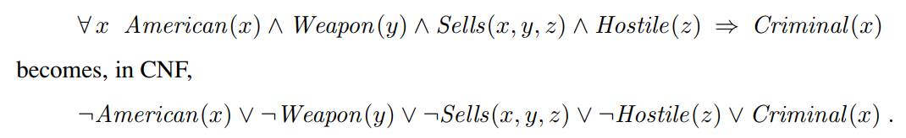
Change FOL to CNF
Change to CNF (But need to handle quantifiers)
Standardize Variables
Universal quantifiers can be left alone
Existential quantifiers need to be skolemized (examples in Book)

Slide 27
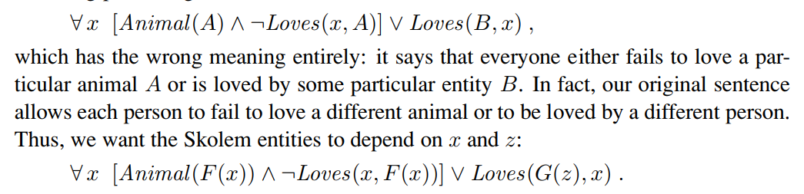
Change FOL to CNF

Slide 28
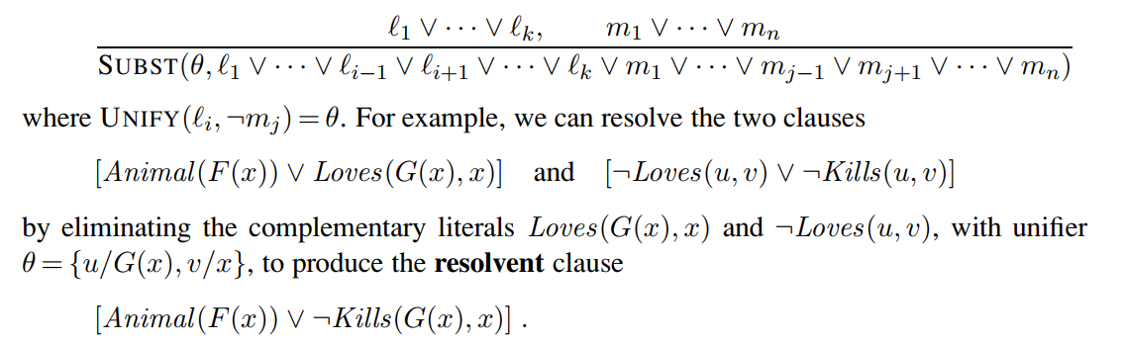
Resolution inference rule

Slide 29
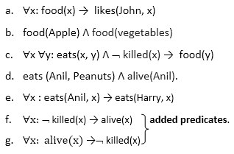
Resolution example

Slide 30
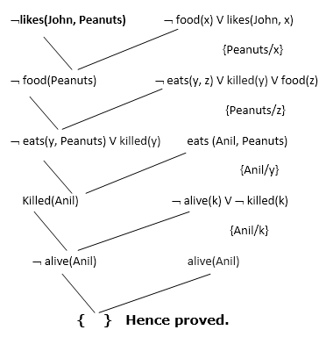
Resolution example

Slide 31
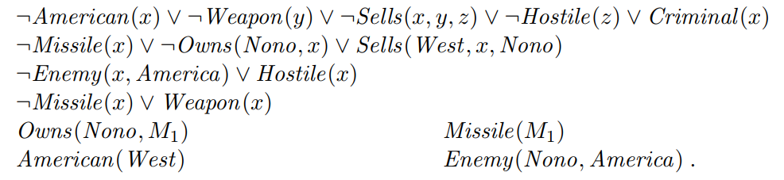
Resolution example

Slide 32
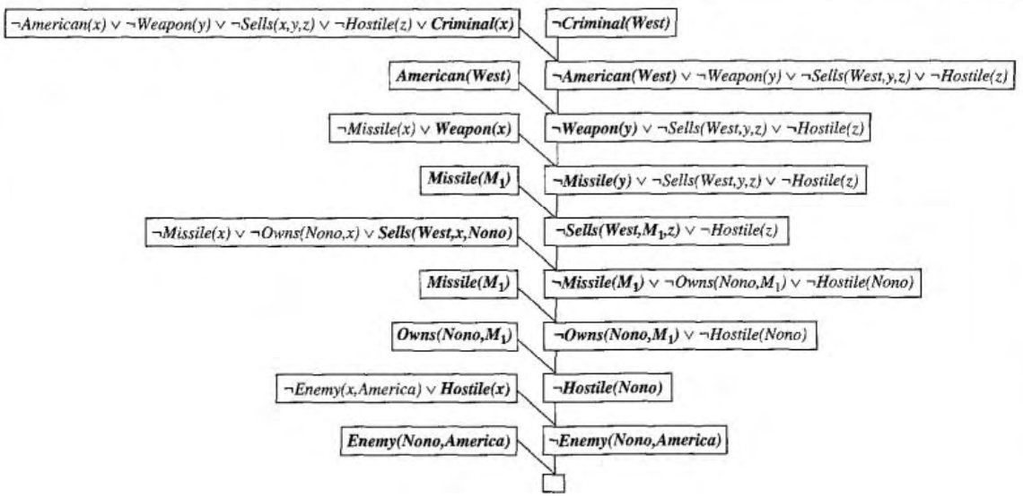
Resolution example

