Slide 1

Computer Communication Networks
Introduction, Communication link, Multiplexing
Dr. Raja Vara Prasad
Assistant Professor
IIIT Sri City

Slide 2
Content
Introduction
Communication Link
Guided
Unguided
Multiplexing
Frequency division multiplexing (FDM)
Time division multiplexing (TDM)

Slide 3
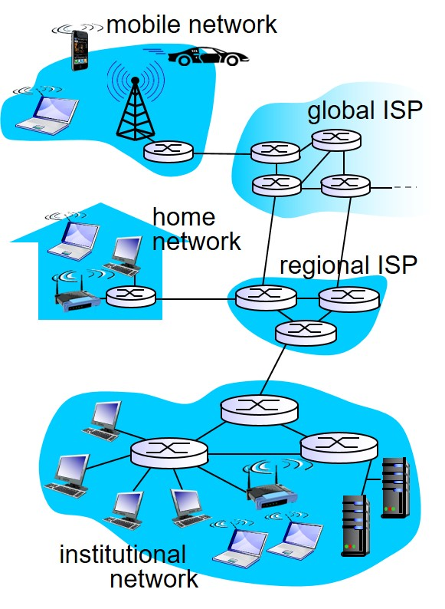
What is a Network?
A network is an interconnection of devices.
The computers/laptops connected to the network are known as end systems or hosts.
The digital data is fragmented into packets.

Slide 4
Uses of Computer network
Business applications
Resource sharing
powerful medium of communication (email and online document preparation)
Video conferencing
Doing business electronically with other companies (ex: Isuzu).
Doing business with consumer (online market).

Slide 5
Uses of Computer network
Home applications
Why do people buy computer for home use?
Earlier days it is for word processing and gaming , now for “Internet access”
Internet provides access to remote information, person- to-person communication, entertainment, e-commerce.

Slide 6
Network Essentials
Modem
“Modulator and demodulator”, is a hardware device that converts data into a format suitable for a transmission medium so that it can be transmitted from one computer to another.
Ethernet
System for connecting the number of computers to form a LAN.
Router
A router is a device that forwards data packets along networks. A router is connected to at least two networks, commonly two LANs or WANs or a LAN and its ISP's network.
Repeater
A network device used to regenerate or replicate a signal. Repeaters are used in transmission systems to regenerate analog or digital signals distorted by transmission loss. Analog repeaters frequently can only amplify the signal while digital repeaters can reconstruct a signal to near its original quality.

Slide 7
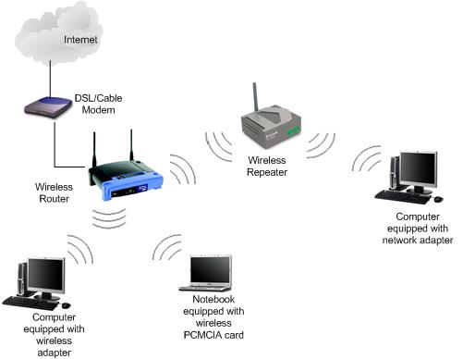
Wireless Network

Slide 8
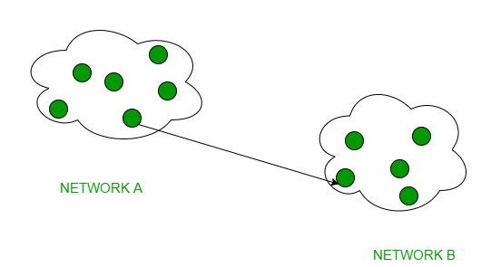
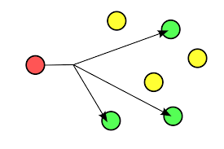
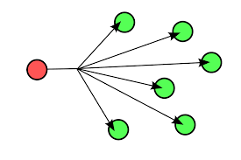
Classification of Networks
Transmission technology:
Unicasting : transmission with exactly one sender and exactly one receiver
Broadcasting : information is intended to all hosts
Multicasting : information is intended for a subset of hosts in the network

Slide 9
Network Hardware: Classification
Interprocessor Distance | Processors located in same
1 m | Square meter
10 m | Room
100 m | Building
1 km | Campus
10 km | City
100 km | Country
1000 km | Continent
10,000 km | Planet
Personal area network
Local area network
Metropolitan area network
Wide area network
The Internet

Slide 10
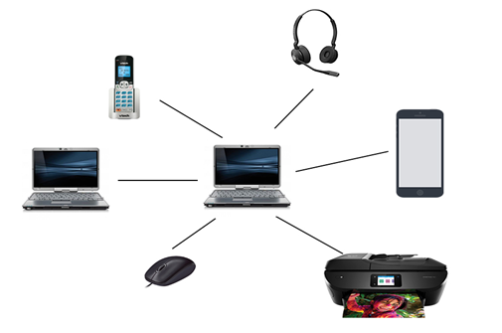
Classification of Networks:
Personal area networks (PANs)
Organized around an individual person, with in a small office or residence.
With in the range of few meters
Notable example is Bluetooth
Watching movies on online streaming service to TV
With multiple uses with in a same residence then, referred as Home Area Network (HAN).
Connecting peripherals to computer via Bluetooth

Slide 11
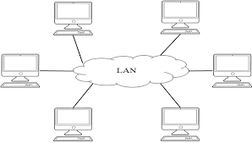
Classification of Networks:
Local area networks (LANs)
Typically an individual office building: suitable for sharing resources (data storage and printers).
Range: It can reach few hundred meters, can be increased further using wireless repeaters.
Wireless LAN: WLAN
Privately owned network: wireless/wired connections.

Slide 12
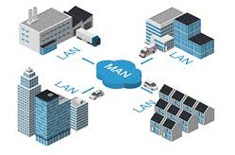
Classification of Networks:
Metropolitan area networks (MANs)
Computer network across entire city, college campus or small region.
Referred as Campus Area Network (CAN).
Range: from several miles to tens of miles.
Connect several LANs together to form a bigger network.

Slide 13
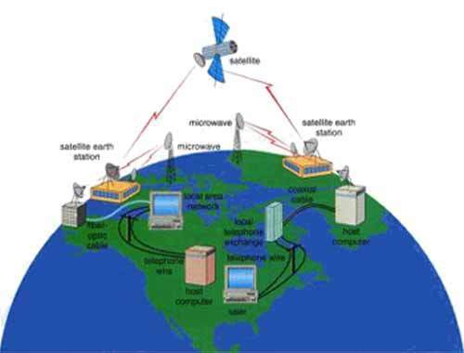
Classification of Networks:
Wide area networks (WANs)
Occupies a very large area, such as an entire country or the entire world
can contain multiple smaller networks, such as LANs or MANs
The most well-known WAN is the “Internet”

