Slide 1

Computer Communication Networks
Introduction, Communication link, Multiplexing
Dr. Raja Vara Prasad
Assistant Professor
IIIT Sri City

Slide 2
Network Software
Protocol
Is an agreement between the communicating parties on how communication is to proceed.
Violation of protocol will make communication more difficult, if not completely impossible.

Slide 3
Layers, protocols, and interfaces
Host 1
Host 2
Layer 5
Layer 5 protocol
Layer 5
Layer 4/5 interface
Layer 4
Layer 4 protocol
Layer 4
Layer 3/4 interface
Layer 3 protocol
Layer 3
Layer 3
Layer 2/3 interface
Layer 2
Layer 2 protocol
Layer 2
Layer 1/2 interface
Layer 1 protocol
Layer 1
Layer 1
Physical Medium

Slide 4
The Physical Layer
Lowest of our protocol model
Defines the electrical, timing and other interfaces by which bits are sent as signals over channels.
The properties of different kinds of physical channels determine the performance.
Kinds of transmission media: Guided and Unguided.

Slide 5
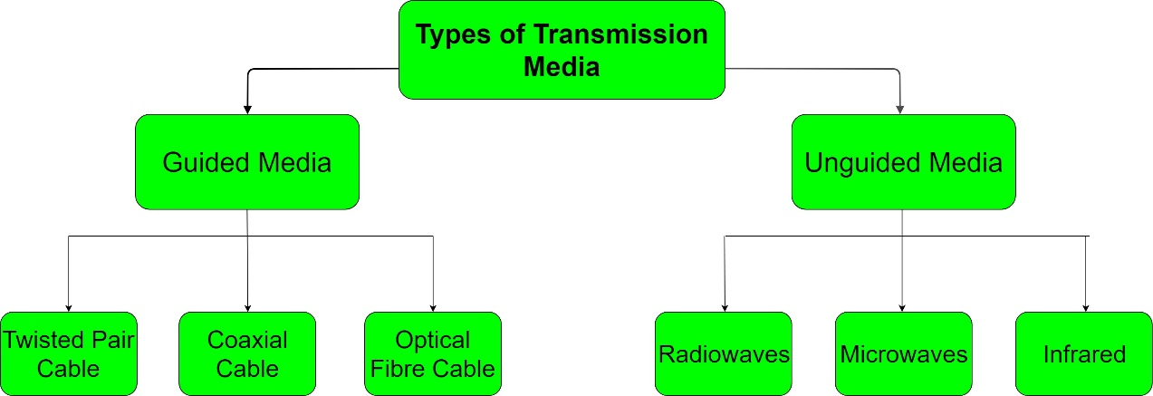
Communication Link?
Communication link : provides a way for information to move between physically separated components

Slide 6
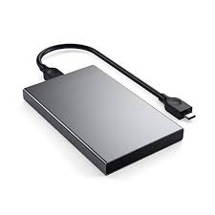
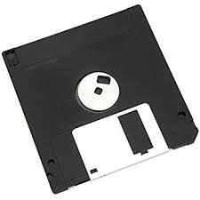
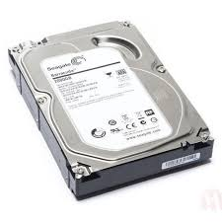
Magnetic Media
One of the most common ways to transport data from one computer to another is to write them onto magnetic tape or removable media.
It is often more cost effective, especially for applications in which high bandwidth or cost per bit transported is the key factor.
Floppy disc.
External hard Disc
Hard Disc

Slide 7
Twisted pair
Used for telephone communications and most modern Ethernet networks.
A pair of wires forms a circuit that can transmit data.
The pairs are twisted to provide protection against crosstalk, the noise generated by adjacent pairs.
When electrical current flows through a wire, it creates a small, circular magnetic field around the wire (Ampere’s Law).
When two wires in an electrical circuit are placed close together, their magnetic fields are the exact opposite of each other. Thus, the two magnetic fields cancel each other out.
Twisting the wires can enhance this cancellation effect.
Two types: Unshielded, and shielded.

Slide 8
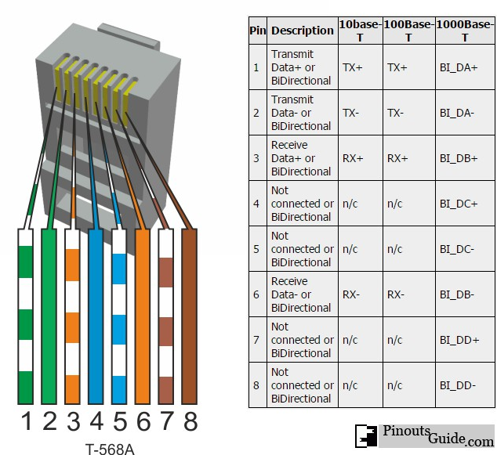
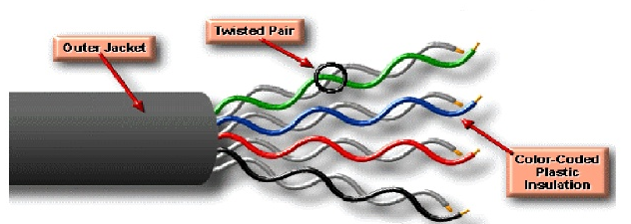
UTP (unshielded)
is a medium that is composed of pairs of wires (4 pairs for network medium)
UTP cable often is installed using a Registered Jack 45 (RJ-45) connector

Slide 9
UTP
Advantages: Smaller size (external diameter), easy to install and less expensive.
Disadvantages: UTP cable is more prone to electrical noise and interference than other types of networking media, and the distance between signal boosts is shorter for UTP .
The following summarizes the features of UTP cable:
Speed and throughput—10 to 1000 Mbps
Average cost per node—Least expensive
Media and connector size—Small
Maximum cable length—100 m (short)

Slide 10
UTP cabling
Category 1 (1 pair)—Used for telephone communications. Not suitable for transmitting data.
Category 2 (2 pairs)—Capable of transmitting data at speeds up to 4 megabits per second (Mbps).
Category 3 (4 pairs)—Used in 10BASE-T networks, Can transmit data at speeds up to 10 Mbps.
Category 4 (4 pairs)—Used in Token Ring networks, Can transmit data at speeds up to 16 Mbps.
Category 5 (4 pairs)—Can transmit data at speeds up to 100 Mbps.
Category 5e (4 pairs) —Used in networks running at speeds up to 1000 Mbps (1 gigabit per second [Gbps]).
Category 6 (4 pairs)—Typically, Category 6 cable consists of four pairs of 24 American Wire Gauge (AWG) copper wires. Category 6 cable is currently the fastest standard for UTP.

Slide 11
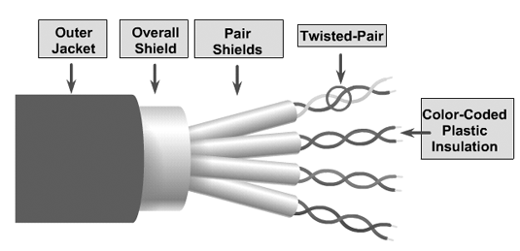
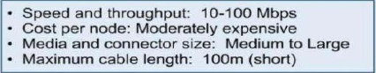
STP (Shielded Twisted Pair)
Combines the techniques of shielding, cancellation, and wire twisting.
Each pair of wires is wrapped in a metallic foil. The four pairs of wires then are wrapped in an overall metallic braid or foil.
Reduces electrical noise both within the cable (pair-to-pair coupling, or crosstalk) and from outside the cable (EMI and RFI)

Slide 12
STP comparison with UTP
Although STP prevents interference better than UTP, it is more expensive and difficult to install.
the metallic shielding must be grounded at both ends. If it is improperly grounded, the shield acts like an antenna and picks up unwanted signals.
Because of its cost and difficulty with termination, STP is rarely used in Ethernet networks.
The speed of both types of cable is usually satisfactory for local-area distances.

Slide 13
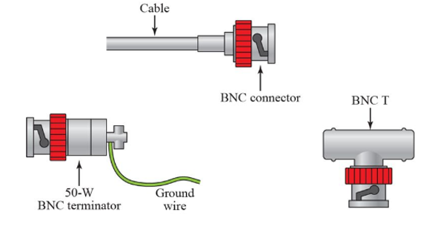
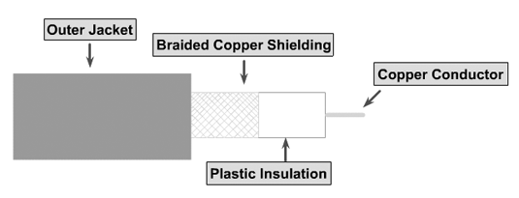
Coaxial Cable
Coaxial cabling has a single copper conductor at its center. A plastic layer provides insulation between the center conductor and a braided metal shield.
The metal shield helps to block any outside interference from fluorescent lights, motors, and other computers.
The most common type of connector used the Bayonet Neill-Concelman (BNC) connector

Slide 14
Categories of Coax.
Base band
For digital transmission, a 50 ohm (Ω) coaxial cable is used. It defines a process of transmitting a single signal at a time with a very high speed. It is generally used for LAN's.
Broadband
Analog transmission on standard cable television 75 ohm (Ω) cabling is used by this. It defines a process of transmitting multiple signals simultaneously with very high speed. It covers a large area as compared to Baseband Coaxial Cable.

Slide 15
Advantages and Disadvantages
It can be used for both analog and digital transmission.
It offers higher bandwidth as compared to twisted pair cable and can span longer distances.
Because of better shielding in coaxial cable, loss of signal or attenuation is less.
Better shielding also offers good noise immunity.
It is relatively inexpensive as compared to optical fibers.
It has lower error rates as compared to twisted pair.
It is not as easy to tap as twisted pair because copper wire is contained in plastic jacket.
It is usually more expensive than twisted pair.

Slide 16
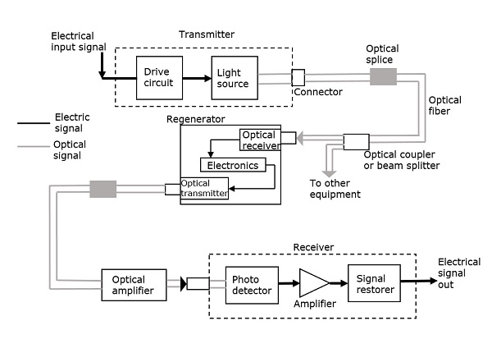
Fiber optics
An optical transmission system has three key components:
the light source,
the transmission medium, and
the detector

Slide 17
Fiber Optics: Construction
Core: The core of a fiber cable is a cylinder of plastic that runs all along the fiber cable’s length. The diameter of the core depends on the application used.
Cladding: Cladding is an outer optical material that protects the core. The main function of the cladding is that it reflects the light back into the core.
Buffer: The main function of the buffer is to protect the fiber from damage and thousands of optical fibers arranged in hundreds of optical cables.
Jacket: These bundles are protected by the cable’s outer covering that is called jacket.

Slide 18
Fiber Optics: Working Principle
A hair-thin Fiber consist of two concentric layers of high-purity silica glass the core and the cladding, which are enclosed by a protective sheath.
Core and cladding have different refractive indices, with the core having a refractive index, n1, which is slightly higher than that of the cladding, n2.
When light enters the fiber made of material with higher refractive index than the cladding surrounding it, it stays inside the material due to total internal reflection and is thus transmitted forward.
Index of refraction: Index of refraction is a measurement of speed of light in material.

Slide 19
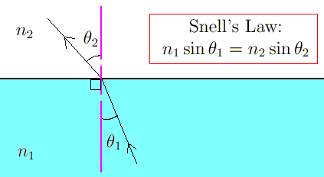
Snell’s Law: Law of Refraction, Critical Angle, total internal Reflection
Critical angle

Slide 20
Fiber Optics: Modes
Mode is the one which describes the nature of propagation of electromagnetic waves (light) in a wave guide (Fiber).
Single mode fiber: In a fiber, if only one mode is transmitted through it, then it is said to be a single mode fiber.
If more than one mode is transmitted through optical fiber, then it is said to be a multimode fiber.
The larger core radii of multimode fibers make it easier to launch optical power into the fiber and facilitate the end to end connection of similar powers.

Slide 21
Types of Fibers
Step-index fiber − The refractive index of the core is uniform throughout and undergoes an abrupt change (or step) at the cladding boundary.
Graded-index fiber − The core refractive index is made to vary as a function of the radial distance from the center of the fiber.
Further divided into:
Single-mode fiber − These are excited with laser.
Multi-mode fiber − These are excited with LED.

Slide 22
Fiber Optics: Advantages and Disadvantages
Advantages:
The transmission bandwidth of the fiber optic cables is higher than the metal cables.
The amount of data transmission is higher in fiber optic cables.
The power loss is very low and hence helpful in long-distance transmissions.
Fiber optic cables provide high security and cannot be tapped.
Fiber optic cables are the most secure way for data transmission.
Fiber optic cables are immune to electromagnetic interference.
These are not affected by electrical noise.
Disadvantages:
Though fiber optic cables last longer, the installation cost is high.
The number of repeaters are to be increased with distance.
They are fragile if not enclosed in a plastic sheath. Hence, more protection is needed than copper ones

Slide 23
Media Type | Maximum Segment Length | Speed | Cost | Advantages | Disadvantages
UTP | 100 m | 10 Mbps to 1000 Mbps | Least expensive | Easy to install; widely available and widely used | Susceptible to interference; can cover only a limited distance
STP | 100 m | 10 Mbps to 100 Mbps | More expensive than UTP | Reduced crosstalk; more resistant to EMI than Thinnet or UTP | Difficult to work with; can cover only a limited distance
Coaxial | 500 m (Thicknet) 185 m (Thinnet) | 10 Mbps to 100 Mbps | Relatively inexpensive, but more costly than UTP | Less susceptible to EMI interference than other types of copper media | Difficult to work with (Thicknet); limited bandwidth; limited application (Thinnet); damage to cable can bring down entire network
Fiber-Optic | 10 km and farther (single-mode) 2 km and farther (multimode) | 100 Mbps to 100 Gbps (single mode) 100 Mbps to 9.92 Gbps (multimode) | Expensive | Cannot be tapped, so security is better; can be used over great distances; is not susceptible to EMI; has a higher data rate than coaxial and twisted-pair cable | Difficult to terminate

Slide 24
Unguided Media: Wireless Transmission
Electromagnetic Spectrum
Radio transmission
Microwave Transmission
Infrared Transmission
Light Transmission

Slide 25
Electromagnetic Spectrum
Electromagnetic waves, can propagate through space, were predicted by J C Maxwell in 1865 and observed by Heinrich Hertz in 1887.
When an antenna of the appropriate size is attached to an electrical circuit, the electromagnetic waves can be broadcast efficiently and received by a receiver some distance away.
In vacuum, all electromagnetic waves travel at the same speed, no matter what their frequency.
In copper or fiber the speed slows to about 2/3 of this value and becomes slightly frequency dependent.

Slide 26
Electromagnetic spectrum and its uses for communication

Slide 27
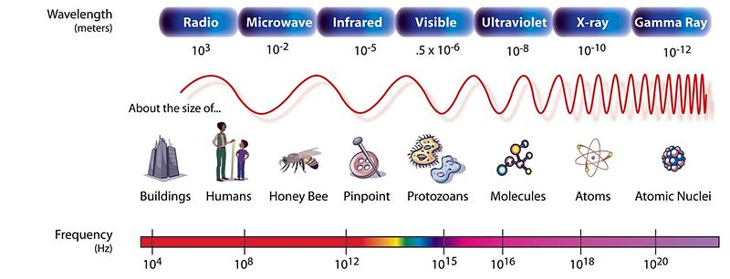
Electromagnetic spectrum and its uses for communication

Slide 28
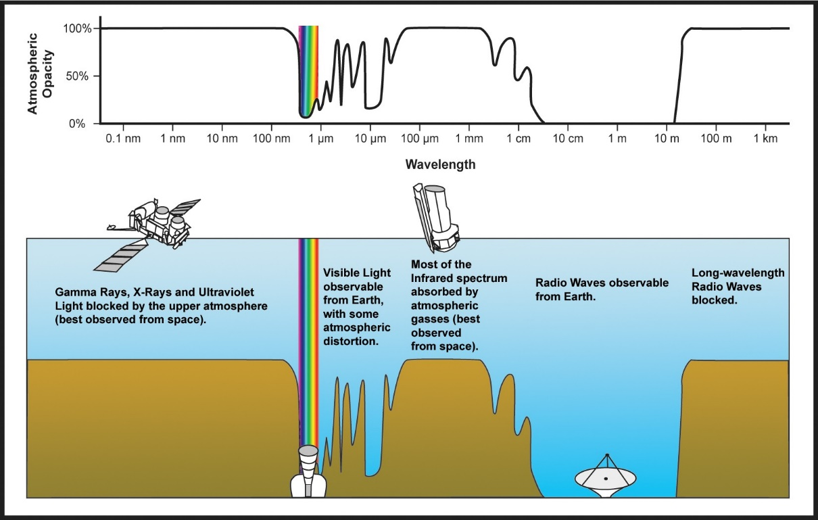
Electromagnetic spectrum and its uses for communication

Slide 29
Electromagnetic spectrum and its uses for communication
The radio, microwave, infrared, and visible light portions of the spectrum can all be used for transmitting information
by modulating the amplitude, frequency, or phase of the waves.
Ultraviolet light, X-rays, and gamma rays would be even better, due to their higher frequencies.
but they are hard to produce and modulate, do not propagate well through buildings, and are dangerous to living things.

Slide 30
Radio Transmission (10 kHz – 300 MHz)
easy to generate, can travel long distances, and can penetrate buildings easily, so they are widely used for communication, both indoors and outdoors.
Radio waves also are omnidirectional, meaning that they travel in all directions from the source, so the transmitter and receiver do not have to be carefully aligned physically.
Due to radio's ability to travel long distances, interference between users is a problem. For this reason, all governments tightly license the use of radio transmitters.
There is a wide range of subcategories contained within radio including AM and FM radio

Slide 31
Radio Transmission
AM radio waves: commercial radio signals ( 540 and 1600 kHz), information is carried by amplitude variation, while the frequency remains constant.
FM radio waves: commercial radio signals ( 88 and 108 MHz), information is carried by frequency modulation, while the signal amplitude remains constant.
TV broadcast: (174 – 216 MHz).

Slide 32
Microwave Transmission (300 MHz – 300 GHz)
Microwaves are “small” compared to waves used in typical radio broadcasting.
The microwave portion of the electromagnetic spectrum can be subdivided into:
Extremely High Frequency (30 to 300 GHz): wavelength range of 10 to 1 mm, so it is sometimes called the millimeter band.
Super High Frequency (3 to 30 GHz): ten to one centimeters, used for wireless LANs, cell phones, satellite communication, microwave radio relay links, and numerous short range terrestrial data links
Ultra-High Frequency (300 MHz to 3 GHz): 10 centimeters to 1 meter, used for television broadcasting, cordless phones, walkie-talkies, satellite communication, and numerous other applications

Slide 33
Infrared and Millimeter Wave
Unguided infrared and millimeter waves are widely used for short-range communication (The remote controls used on televisions, VCRs, and stereos all use infrared communication).
They are relatively directional, cheap, and easy to build but have a major drawback: they do not pass through solid objects.
In general, as we go from long-wave radio toward visible light, the waves behave more and more like light and less and less like radio.
On the other hand, infrared system in one room of a building will not interfere with a similar system in adjacent rooms or buildings.
Infrared communication has a limited use on the desktop, for example, connecting notebook computers and printers, it is not a major player in the communication.

Slide 34
Light Wave Transmission
A more modern application is to connect the LANs in two buildings lasers mounted on their rooftops.
Coherent optical signaling using lasers is inherently unidirectional, so each building needs its own laser and its own photodetector. This scheme offers very high bandwidth and very low cost.
It is also relatively easy to install and, unlike microwave, does not require an FCC license.

Slide 35
Multiplexing
Definition: Multiplexing is a technique which combines multiple signals into one signal, suitable for transmission over a communication channel such as coaxial cable or optical fiber.
By doing multiplexing, large amount bandwidth can be saved, cost can be reduced, circuit complexity can be reduced and multiple signals can be sent simultaneously over a single communication channel.
Analog: Frequency Division Multiplexing and Wavelength Division Multiplexing
Digital: Time Division Multiplexing

Slide 36
Frequency Division Multiplexing (FDM)
popular multiplexing technique in TV and radio.
combines multiple signals into one signal → transmitted over the communication channel.
bandwidth of the communication channel should be greater than the combined bandwidth of individual signals.
divides the bandwidth of a channel into several logical sub-channels and each logical sub-channel is separated by an unused bandwidth called Guard Band to prevent overlapping of signals.
A guard band is a narrow frequency range that separates two signal frequencies.

Slide 37
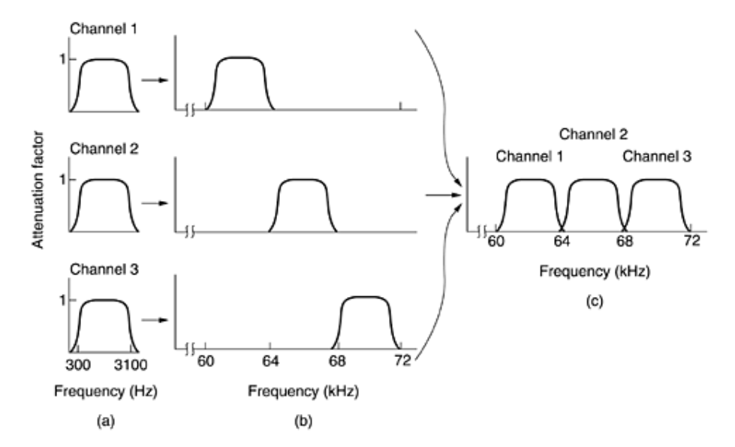
FDM Operation

Slide 38
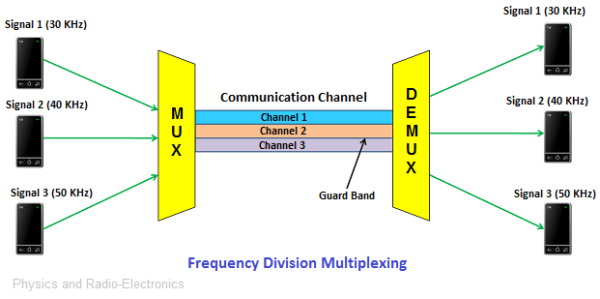
FDM Operation

Slide 39
FDM
Advantages of Frequency Division Multiplexing (FDM)
It transmits multiple signals simultaneously.
In frequency division multiplexing, the demodulation process is easy.
It does not need Synchronization between transmitter and receiver.
Disadvantages of Frequency Division Multiplexing (FDM)
It needs a large bandwidth communication channel.
Applications of Frequency Division Multiplexing (FDM)
Frequency division multiplexing is used for FM and AM radio broadcasting.
It is used in first generation cellular telephone.
It is used in television broadcasting.

Slide 40
Wavelength Division Multiplexing (WDM)
Wavelength division multiplexing is a technology that increases the bandwidth of a communication channel (optical fiber) by simultaneously allowing multiple optical signals through it.
the working principle of wavelength division multiplexing is similar to frequency division multiplexing. The only difference is in wavelength division multiplexing optical signals are used instead of electrical signals.
The main advantage of WDM system is that only need to upgrade the multiplexer and demultiplexer at each end; no need to buy more fibers which are more expensive.

Slide 41
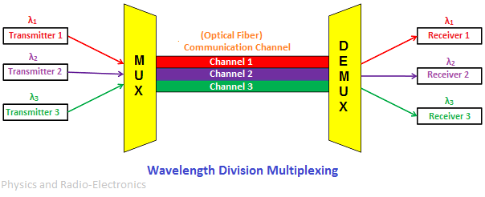
WDM

Slide 42
WDM
WDM techniques are of two types:
Dense Wavelength Division Multiplexing (longer distances)
Coarse Wavelength Division Multiplexing (Shorter distances)
Advantages of Wavelength Division Multiplexing (WDM)
WDM allows transmission of data in two directions simultaneously
Low cost
Greater transmission capacity
High security
Long distance communication with low signal loss

Slide 43
Time Division Multiplexing (digital)
multiple signals are combined and transmitted one after another on the same communication channel.
in time division multiplexing, all signals operate with the same frequency are transmitted at different times.

Slide 44
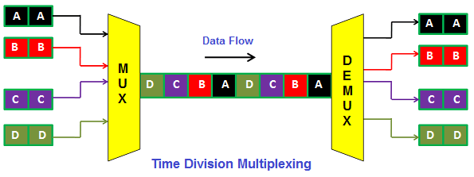
TDM

Slide 45
TDM
Time Division Multiplexing is mainly classified into two types:
Synchronous TDM (fixed time slots)
Asynchronous TDM (no fixed time slots they are flexible).
Advantages of Time Division Multiplexing (TDM)
Full bandwidth is utilized by a user at a particular time.
The time division multiplexing technique is more flexible than frequency division multiplexing.
In time division multiplexing, the problem of crosstalk is very less.
Disadvantages of Time Division Multiplexing (TDM)
In time division multiplexing, synchronization is required.

Slide 46
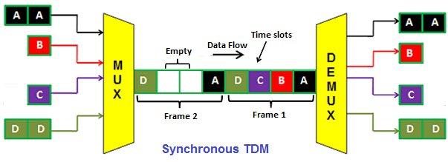
Synchronous TDM
synchronous TDM, the number of time slots is equal to the number of transmitters.

Slide 47
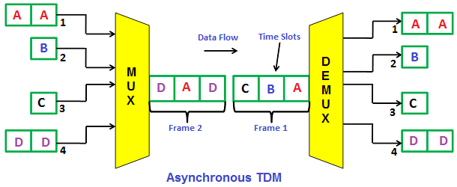
Asynchronous TDM
in Asynchronous TDM, the number of time slots is not equal to the number of devices (transmitters). The time slots in asynchronous TDM are always less than the number of devices (transmitter)

