Slide 1

Machine Learning Regression
Indian Institute of Information Technology Sri City, Chittoor

Slide 2
Today’s Agenda
Gradient Descent: Regression
Probabilistic interpretation of Regression: ML estimation

Slide 3
Gradient Descent: Regression

Slide 4
Gradient Descent: Regression
Repeat until “convergence":
Least Square cost function.
Demo: https://lukaszkujawa.github.io/gradient-descent.html
This method looks at every example in the entire training set on every step, and is called batch gradient descent.
Stochastic gradient descent: In this algorithm, we repeatedly run through the training set, and each time we encounter a training example, we update the parameters according to the gradient of the error with respect to that single training example only.

Slide 5
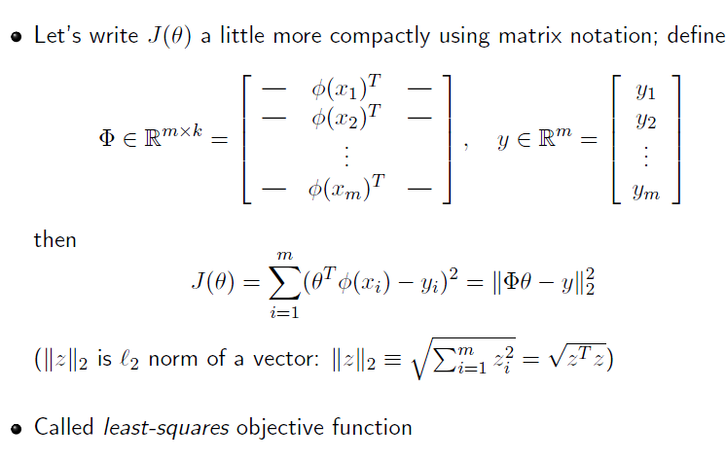
Gradient Descent: Regression

Slide 6
Probabilistic interpretation of Regression: ML estimation
Why might the least-squares cost function J, be a reasonable choice?
Let us assume that the target variables and the inputs are related via the equation
where Є^{(i)} is an error term that captures either unmodeled effects or random noise.
Let us further assume that the Є^{(i)} are distributed IID (independently and identically distributed) according to a Gaussian distribution with mean zero and some variance σ².

Slide 7
Probabilistic interpretation of Regression: ML estimation
We can write this assumption as “Є^{(i)} ∼ N(0, σ²).” I.e., the density of Є^{(i)} is given by
The notation “(p(y^{(i)}|x^{(i)}; θ)” indicates that this is the distribution of y^{(i)} given x^{(i)} and parameterized by θ.
We can also write the distribution of y^{(i)} as
y^{(i)} | x^{(i)}; θ ∼ N(θ^{T} x^{(i)}, σ²)

Slide 8
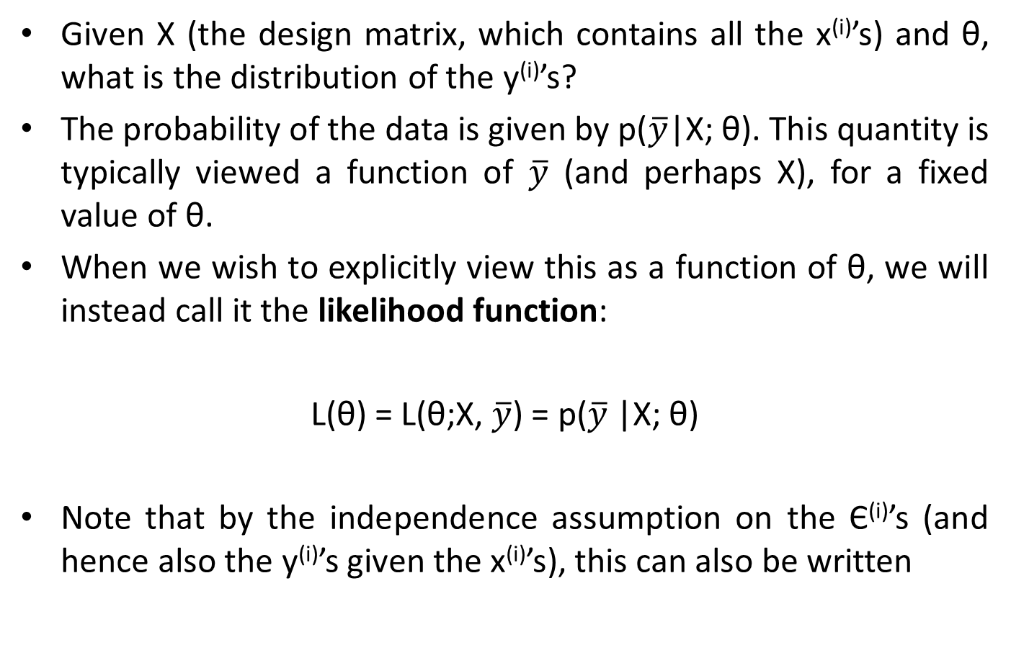
Probabilistic interpretation of Regression: ML estimation
Given X (the design matrix, which contains all the x^{(i)}’s) and θ, what is the distribution of the y^{(i)}’s?
The probability of the data is given by p($\overline{y}$|X; θ). This quantity is typically viewed a function of $\overline{y}$ (and perhaps X), for a fixed value of θ.
When we wish to explicitly view this as a function of θ, we will instead call it the likelihood function:
L(θ) = L(θ;X, $\overline{y}$) = p($\overline{y}$|X; θ)
Note that by the independence assumption on the Є^{(i)}’s (and hence also the y^{(i)}’s given the x^{(i)}’s), this can also be written

Slide 9
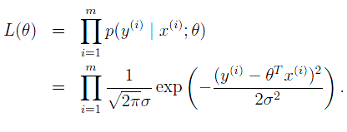
Probabilistic interpretation of Regression: ML estimation
Note that by the independence assumption on the Є^{(i)}’s (and hence also the y^{(i)}’s given the x^{(i)}’s), this can also be written
Now, given this probabilistic model relating the y(i)’s and the x(i)’s, what is a reasonable way of choosing our best guess of the parameters θ?
The principal of maximum likelihood says that we should choose θ so as to make the data as high probability as possible.

Slide 10
Probabilistic interpretation of Regression: ML estimation
In particular, the derivations will be a bit simpler if we maximize the log likelihood ℓ(θ):
Hence, maximizing ℓ(θ) gives the same answer as minimizing
which we recognize to be J(θ), our original least-squares cost function.

Slide 11
Probabilistic interpretation of Regression: ML estimation
Under the previous probabilistic assumptions on the data, least-squares regression corresponds to finding the maximum likely hood estimate of θ.
This is thus one set of assumptions under which least-squares regression can be justified as a very natural method that’s just doing maximum likelihood estimation.

Slide 12
Extending to the non-linear models
Consider the problem of predicting y from x ∈ R. The leftmost figure below shows the result of fitting a y = θ₀ + θ₁x to a dataset.
We see that the data doesn’t really lie on straight line, and so the fit is not very good.

Slide 13
Extending to the non-linear models
Instead, if we had added an extra feature x², and fit y = θ₀ +θ₁x +θ₂x², then we obtain a slightly better fit to the data.
Naively, it might seem that the more features we add, the better.
However, there is also a danger in adding too many features: The rightmost figure is the result of fitting a 5-th order polynomial

Slide 14
Extending to the non-linear models
We see that even though the fitted curve passes through the data perfectly, we would not expect this to be a very good predictor of, say, housing prices (y) for different living areas (x).
Without formally defining what these terms mean, we’ll say the figure on the left shows an instance of underfitting—in which the data clearly shows structure not captured by the model—and the figure on the right is an example of overfitting.

Slide 15
Additional Resources:
https://towardsdatascience.com/linear-regression-detailed-view-ea73175f6e86
http://www.stat.yale.edu/Courses/1997-98/101/linreg.htm

