Slide 1
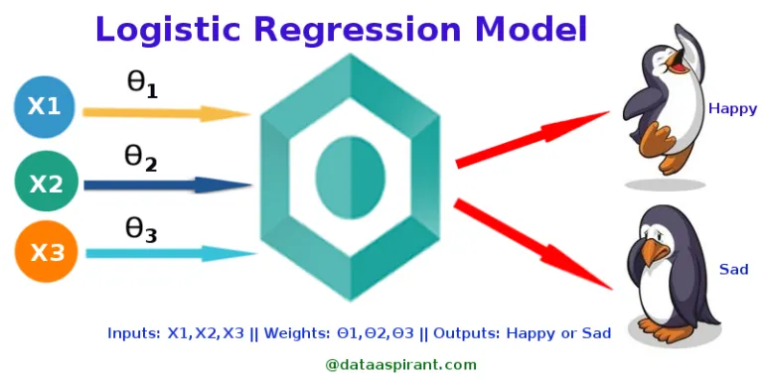
Logistic regression
Logistic regression measures the relationship between the categorical dependent variable and one or more independent variables by estimating probabilities using a logistic function.
Credits: Saishruthi S. “Logistic Regression — Detailed Overview”

Slide 2
Logistic regression
Logistic Regression was used in the biological sciences in early twentieth century. It was then used in many social science applications. Logistic Regression is used when the dependent variable(target) is categorical.
For example,
To predict whether an email is spam (1) or (0)
Whether the tumor is malignant (1) or not (0)
Credits: Saishruthi S. “Logistic Regression — Detailed Overview”

Slide 3
Sigmoid Function
The logistic function, also called the sigmoid function was developed by statisticians to describe properties of population growth in ecology, rising quickly and maxing out at the carrying capacity of the environment.
It’s an S-shaped curve that can take any real-valued number and map it into a value between 0 and 1, but never exactly at those limits.
Where e is the base of the natural logarithms (Euler’s number or the exp() function in your python) and x is the actual numerical value that you want to transform.

Slide 4
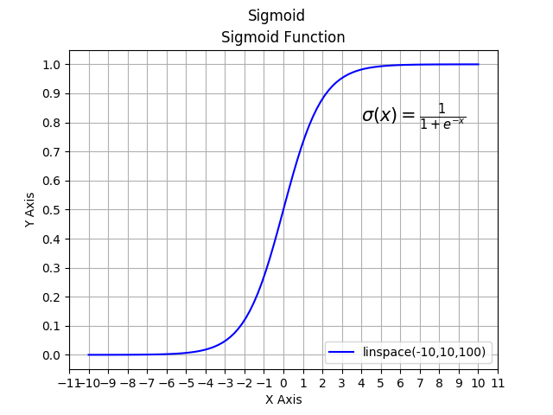
Sigmoid Function
https://hackaday.io/page/5331-sigmoid-function

Slide 5
Types of Logistic Regression
1. Binary Logistic Regression:
The categorical response has only two 2 possible outcomes. Example: Spam or Not
2. Multinomial Logistic Regression:
Three or more categories without ordering. Example: Predicting which food is preferred more (Veg, Non-Veg, Vegan)
3. Ordinal Logistic Regression:
Three or more categories with ordering. Example: Movie rating from 1 to 5

Slide 6
Decision Boundary
To predict which class a data belongs, a threshold can be set. Based upon this threshold, the obtained estimated probability is classified into classes.
Say, if predicted_value ≥ 0.5, then classify email as spam else as not spam.
Decision boundary can be linear or non-linear. Polynomial order can be increased to get complex decision boundary.

Slide 7
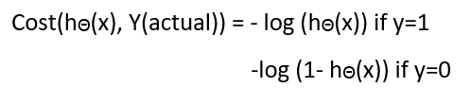
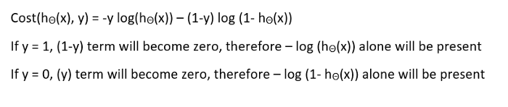
Cost Function
Cost function:
Simplified Cost Function:

Slide 8
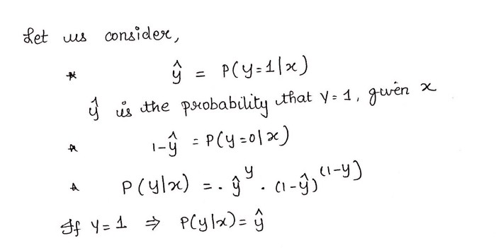
Cost Function

Slide 9
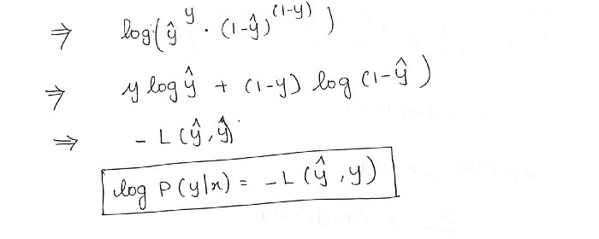
Cost Function

