Slide 1

Unsupervised methods: Clustering

Slide 2
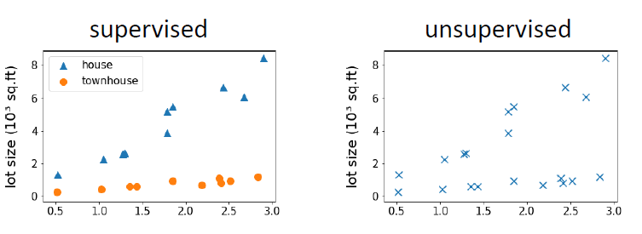
Unsupervised Learning
•Dataset contains nolabels: 𝑥₁,…𝑥_{𝑛}
•Goal(vaguely-posed):to find interesting structures in the data.

Slide 3
Unsupervised Learning
Annotating large datasets is very costly and time consuming.
Example: Speech Recognition, Medical Image Analysis, etc.
There may be cases where we don’t know how many/what classes is the data divided into.
Example: Data Mining, Sentimental Analysis.
We may want to use clustering to gain some insight into the structure of the data before designing a classifier.

Slide 4
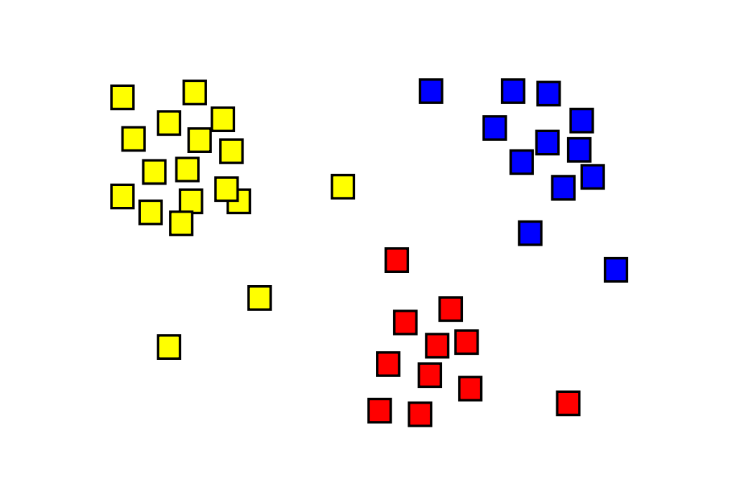
What is clustering?
Clustering: the process of grouping a set of objects into classes of similar objects.
Objects within a cluster should be similar.
Objects from different clusters should be dissimilar.

Slide 5
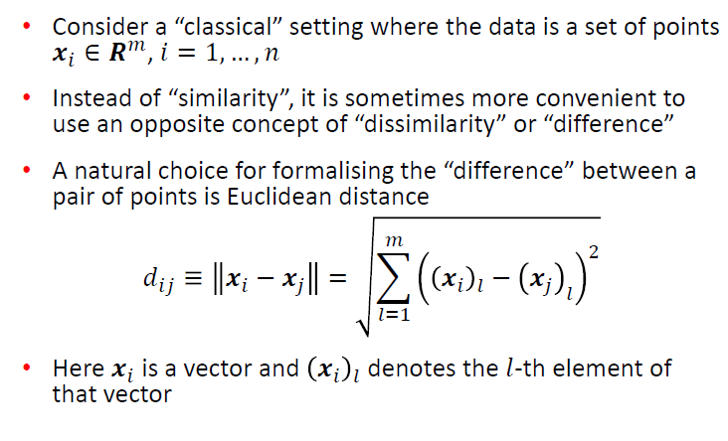
Measuring (dis)similarity

Slide 6
k-means Clustering
k-means is a partitional clustering algorithm
Let the set of data points (or instances) D be {x₁, x₂, …, x_{n}}, where x_{i} = (x_{i1}, x_{i2}, …, x_{ir}) is a vector in a real-valued space X ⊆ R^{r}, and r is the number of attributes (dimensions) in the data.
The k-means algorithm partitions the given data into k clusters.
Each cluster has a cluster centre, called centroid.
k is specified by the user

Slide 7
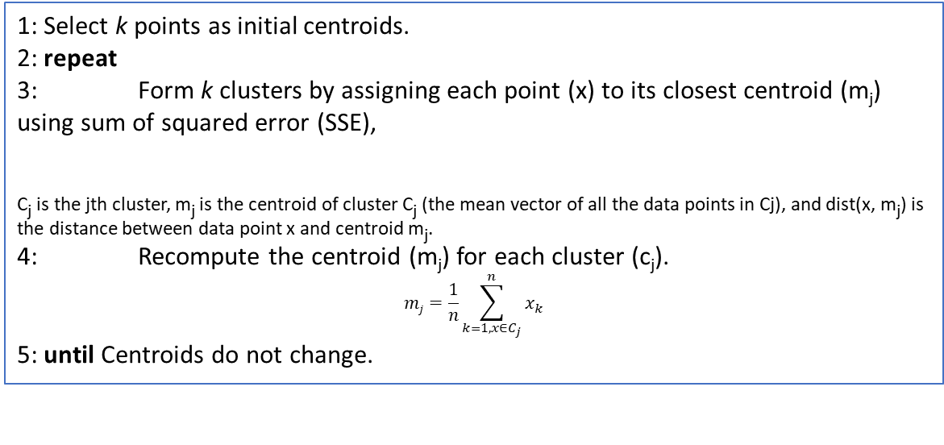
k-means algorithm
Randomly choose k data points (seeds) to be the initial centroids or cluster centers.
Assign each data point to the closest centroid
Re-compute the centroids using the current cluster memberships.
Repeat the assignment (step 2) and update the centroids (step 3) until centroids remain same or no chances in clusters.
Algorithm: k-means clustering algorithm
1: Select k points as initial centroids.
2: repeat
3: Form k clusters by assigning each point (x) to its closest centroid (m_{j}) using sum of squared error (SSE),
C_{j} is the jth cluster, m_{j} is the centroid of cluster C_{j} (the mean vector of all the data points in Cj), and dist(x, m_{j}) is the distance between data point x and centroid m_{j}.
4: Recompute the centroid (m_{j}) for each cluster (c_{j}).
$$mj=\frac{1}{n}\sum_{k=1, x∈C_{j}}^{n}{x_{k}}$$
5: until Centroids do not change.

Slide 8
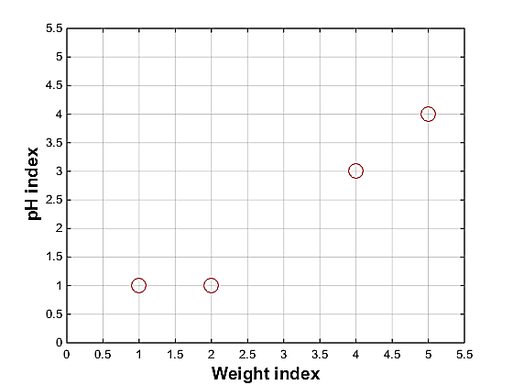
Example of k means:
Problem: Suppose we have 4 types of medicines and each has two attributes (pH and weight index). Our goal is to group these objects into k=2 group of medicine.
Medicine | Weight | pH-index
A | 1 | 1
B | 2 | 1
C | 4 | 3
D | 5 | 4

Slide 9
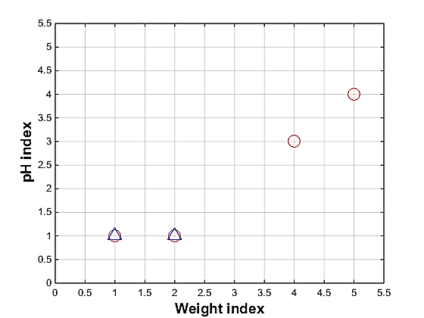








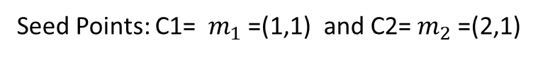


Example of k-means: iteration 1 Step 1: Use initial seed points for partitioning.
Seed Points: C1= $m_{1}$=(1,1) and C2= $m_{2}$=(2,1)
$$Euclidian dist\left(X,Y\right)=\sqrt{{\left(x_{1}−y_{1}\right)}^{2}+{\left(x_{2}−y_{2}\right)}^{2}+….+{\left(x_{n}−y_{n}\right)}^{2}}$$
A=(1,1) $m_{1}$=(1,1) $m_{2}=(2,1)$
B=(2,1) $m_{1}$=(1,1) $m_{2}=(2,1)$
C=(4,3) $m_{1}$=(1,1) $m_{2}=(2,1)$
$Euclidian dist\left(A,m_{2}\right)=\sqrt{{\left(1−2\right)}^{2}+{\left(1−1\right)}^{2}}=$ $\sqrt{1+0}=\sqrt{1}=1$
$Euclidian dist\left(C,m_{2}\right)=\sqrt{{\left(4−2\right)}^{2}+{\left(3−1\right)}^{2}}=$ $\sqrt{4+4}=\sqrt{8}=2.83$
$Euclidian dist\left(B,m_{2}\right)=\sqrt{{\left(2−2\right)}^{2}+{\left(1−1\right)}^{2}}=$ $\sqrt{0+0}=\sqrt{0}=0$
$Euclidian dist\left(B,m_{1}\right)=\sqrt{{\left(2−1\right)}^{2}+{\left(1−1\right)}^{2}}=$ $\sqrt{1+0}=\sqrt{1}=1$
$Euclidian dist\left(A,m_{1}\right)=\sqrt{{\left(1−1\right)}^{2}+{\left(1−1\right)}^{2}}=$ $\sqrt{0+0}=\sqrt{0}=0$
$Euclidian dist\left(C,m_{1}\right)=\sqrt{{\left(4−1\right)}^{2}+{\left(3−1\right)}^{2}}=$ $\sqrt{9+4}=\sqrt{13}=3.61$
$$D^{0}=\left[\begin{matrix}0 & 1 & \\ 1 & 0 & \end{matrix}\right]$$
$$D^{0}=\left[\begin{matrix}0 & & \\ & & \end{matrix}\right]$$
$$D^{0}=\left[\begin{matrix}0 & & \\ 1 & & \end{matrix}\right]$$
$$D^{0}=\left[\begin{matrix}0 & 1 & \\ 1 & & \end{matrix}\right]$$
$$D^{0}=\left[\begin{matrix}0 & 1 & 3.61 \\ 1 & 0 & \end{matrix}\right]$$
$$D^{0}=\left[\begin{matrix}0 & 1 & 3.61 \\ 1 & 0 & 2.83\end{matrix}\right]$$

Slide 10
Example of k-means: iteration 1
Step 1: Use initial seed points for partitioning.
Seed Points:
Assign each object to the cluster with the nearest seed point (mean).

Slide 11
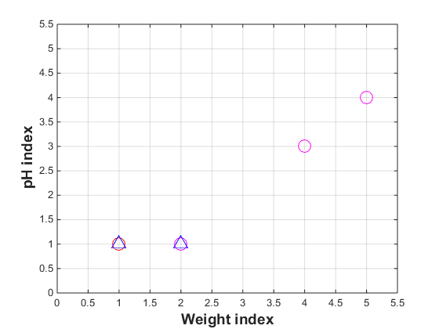
Example of k-means: iteration 1
Step 2: Renew membership based on new centroids..
Seed Points:
Assign each object to the cluster with the nearest seed point (mean).

Slide 12
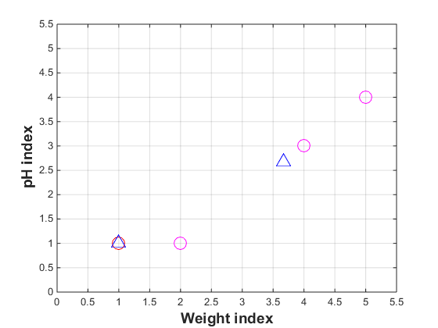
Example of k-means: iteration 1
Step 3: Compute new centroids of the current partition.
Knowing the members of each cluster, compute the new centroid for each cluster based on these new membership assignment.
=(3.66, 2.66)

Slide 13
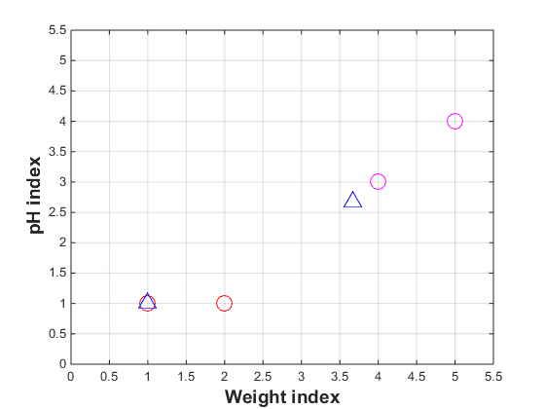
Example of k-means: iteration 2
Step 2: Renew membership based on new centroids.
Compute the distance of all objects to the new centroids.
Assign each object to the cluster with the nearest centroid.

Slide 14
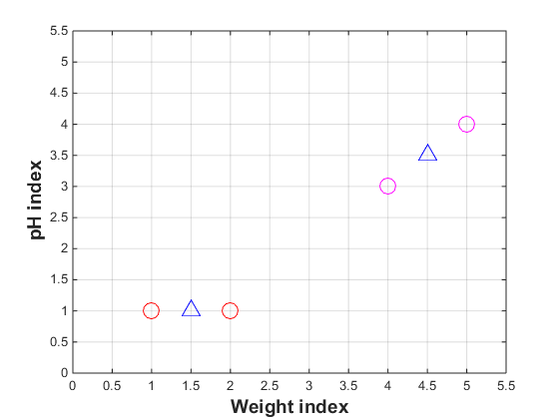
Example of k-means: iteration 2
Step 3: Compute new centroids of the current partition.
Knowing the members of each cluster, compute the new centroid for each cluster based on these new membership assignment.

Slide 15
Example of k-means: iteration 3
Step 3: Repeat the first two steps until its convergence.
Compute the distance of all objects to the new centroids.
Assign each object to the cluster with the nearest centroid.
Knowing the members of each cluster, compute the new centroid for each cluster based on these new membership assignment.
Since there is no change in cluster assignments and centroids the algorithm terminates.

Slide 16
Applications of k-means clustering
Behavioural segmentation:
Inventory categorization:
Sorting sensor measurements:
Image Segmentation

Slide 17
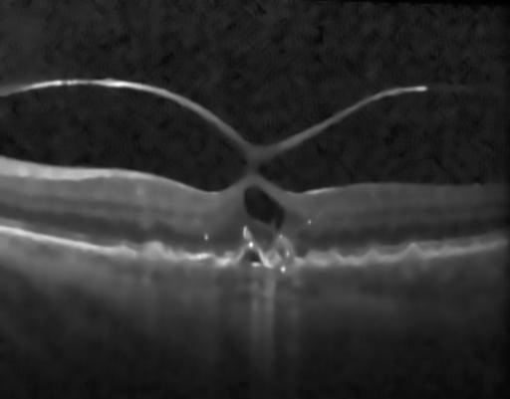

Image Segmentation using k-means Clustering: An example
Original Retinal OCT Bscan
Segmented Bscan with k=3

Slide 18
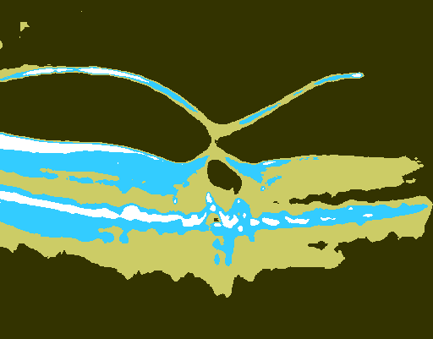
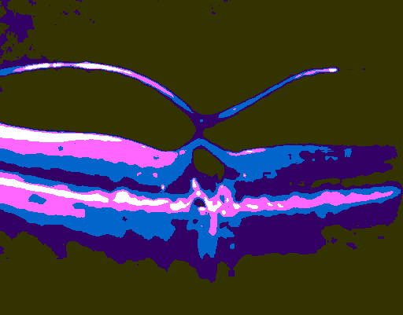
Image Segmentation using K-means Clustering: An example
Segmented Bscan with k=4
Segmented Bscan with k=5

Slide 19
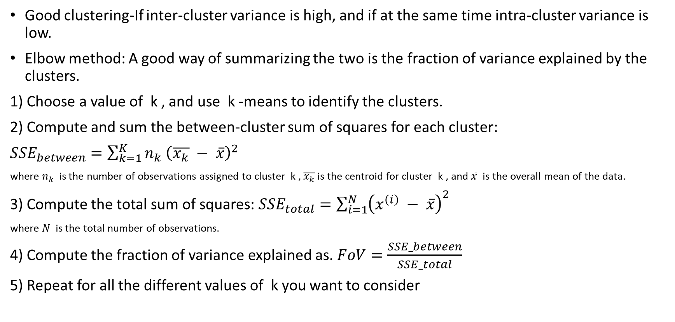
Evaluating k-means clustering algorithm
Good clustering-If inter-cluster variance is high, and if at the same time intra-cluster variance is low.
Elbow method: A good way of summarizing the two is the fraction of variance explained by the clusters.
1) Choose a value of k , and use k -means to identify the clusters.
2) Compute and sum the between-cluster sum of squares for each cluster:
${SSE}_{between}=\sum_{k=1}^{K}{n_{k}}$ ${\left(\overline{x_{k}} − \overline{x}\right)}^{2}$
where $n_{k}$ is the number of observations assigned to cluster k , $\overline{x_{k}}$is the centroid for cluster k , and $\overline{x}$ is the overall mean of the data.
3) Compute the total sum of squares: ${SSE}_{total}={\sum_{i=1}^{N}{\left(x^{\left(i\right)} − \overline{x}\right)}}^{2}$
where $N$ is the total number of observations.
4) Compute the fraction of variance explained as. $FoV=\frac{SSE_between}{SSE_total}$
5) Repeat for all the different values of k you want to consider

Slide 20
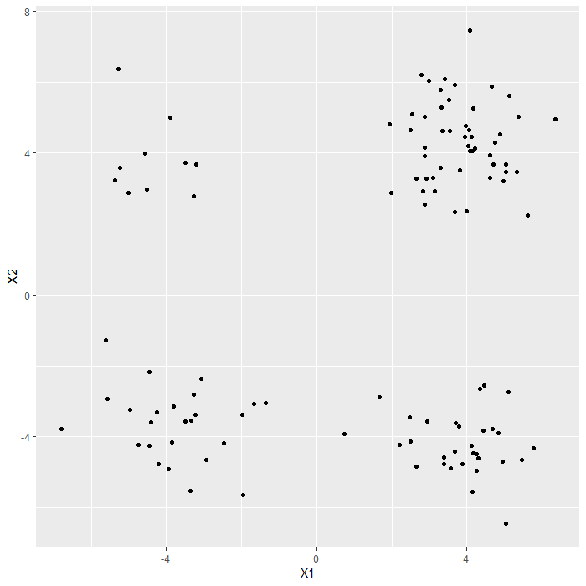
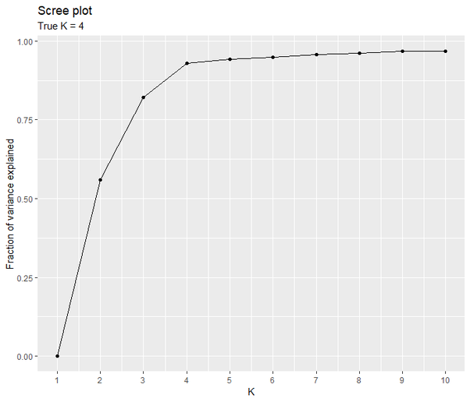
Elbow method:
Original Data
Elbow plot

Slide 21
Bottom Line:
k-means algorithm is a simple yet popular method for clustering analysis.
Need to specify k, the number of clusters, in advance.
Sensitive to initial seed points.
Converge to a local optimum: maybe an unwanted solution.
Unable to handle noisy data and outlier.
Not suitable for discovering clusters with non-linear data.

Slide 22
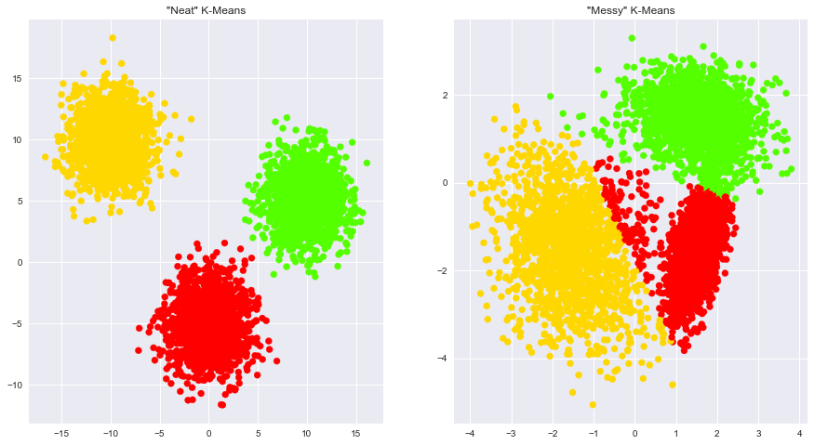
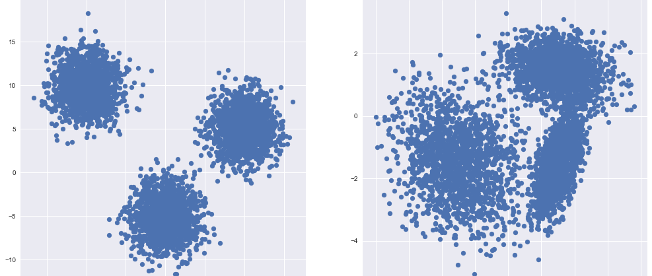

Slide 23


Thank you

