Slide 1
Theory of Computation
Spring 2021
Department of Computer Science and Engineering
Indian Institute of Information Technology Sri City

Slide 2
Why Study Theory of Computation?
A survey of Stanford grads 5 years out asked which of their courses did they use in their job.
Basics like Programming took the top spots, of course.
But among optional courses, TOC stood remarkably high.
3X the score for AI, for example.
GATE

Slide 3
Objectives
Introduce concepts in automata theory and theory of computation
Identify different formal language classes and their relationships
Design grammars and recognizers for different formal languages
Prove or disprove theorems in automata theory using its properties
Determine the decidability and intractability of computational problems

Slide 4
Course Organization
Very broadly, the course will contain three parts:
Part I) Regular languages
Part II) Context-free languages
Part III) Turing machines & decidability

Slide 5
Why Finite Automata and Regular Expressions?
Regular expressions (REs) are used in many systems.
E.g., UNIX, Linux, OS X,… a.*b.
Finite automata model protocols, electronic circuits.
Theory is used in model-checking.

Slide 6
Why Context-Free Grammars?
Context-free grammars (CFGs) are used to describe the syntax of essentially every modern programming language.
Every modern complier uses CFG concepts to parse programs

Slide 7
Why Turing Machines?
When developing solutions to real problems, we often confront the limitations of what software can do.
Undecidable things – no program can do it 100% of the time with 100% accuracy.
Intractable things – there are programs, but no fast programs.

Slide 8
Example – halting problem
Can you write a program which takes another program P as input and tell whether P will terminate or not?

Slide 9
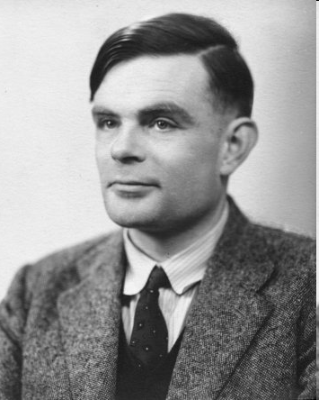
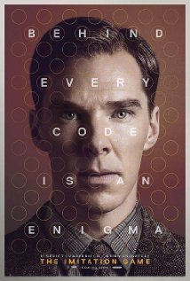
Alan Turing (1912-1954)
Father of Modern Computer Science
English mathematician
Studied abstract machines called Turing machines even before computers existed
Heard of the Turing test?

Slide 10
Required Textbook
Introduction to Automata Theory, Languages and Computation
By J.E. Hopcroft, R. Motwani, J.D. Ullman
3rd Edition
Addison Wesley/Pearson
Course book homepage: http://infolab.stanford.edu/~ullman/ialc.html
Solutions to starred exercises in the textbook & Errata

Slide 11
EVALUATION PLAN
Sl. No. | Mode of Assessment | Marks
1 | Mid Exam | 25%
2 | End Semester Exam | 35%
3 | Assignments | 30%
4 | Class Participation (Surprise Quiz) | 10%

Slide 12
References
http://www.eecs.wsu.edu/~ananth/CptS317
https://nptel.ac.in/courses/106/106/106106049/#
http://www.cs.virginia.edu/~robins/cs3102/

