Slide 1
JavaScript
An Overview

Slide 2
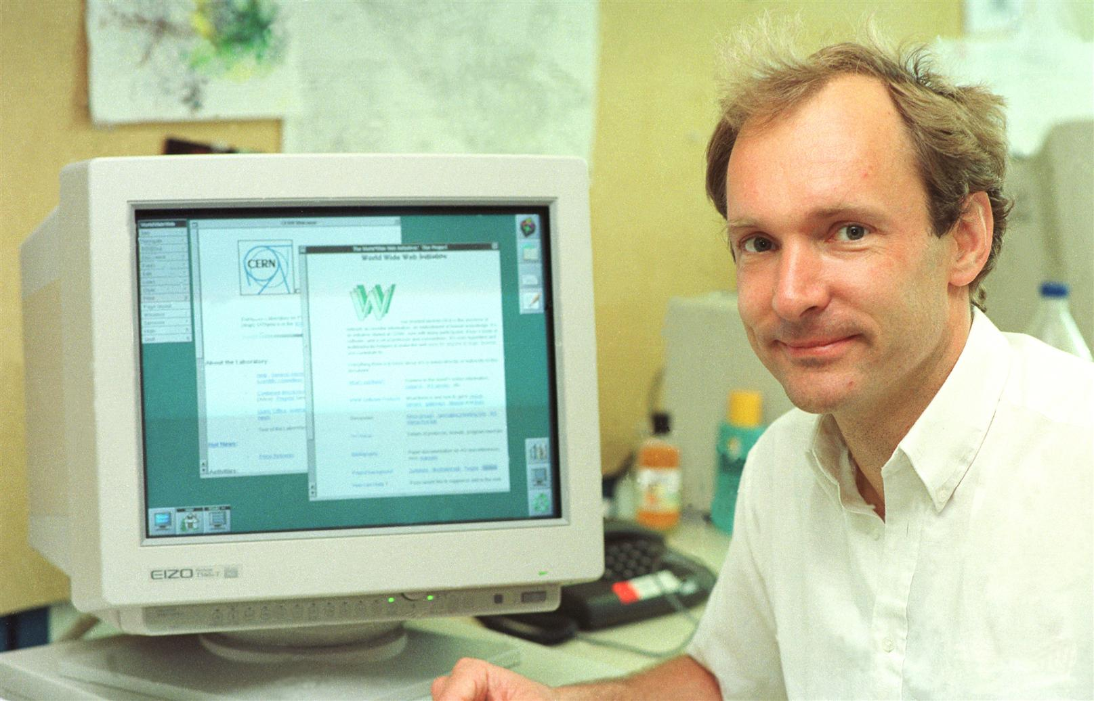
The Web Revolution
Tim Berners-Lee, a British scientist, invented the World Wide Web (WWW) in 1989, while working at CERN.
The Web was originally conceived and developed to meet the demand for automated information-sharing between scientists in universities and institutes around the world.
First web page: http://info.cern.ch/hypertext/WWW/TheProject.html
Source: https://home.cern/science/computing/birth-web/short-history-web

Slide 3

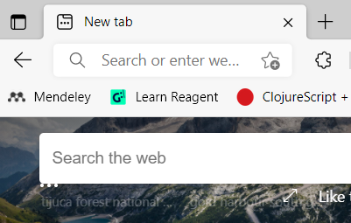
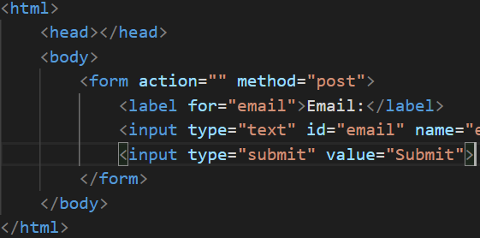
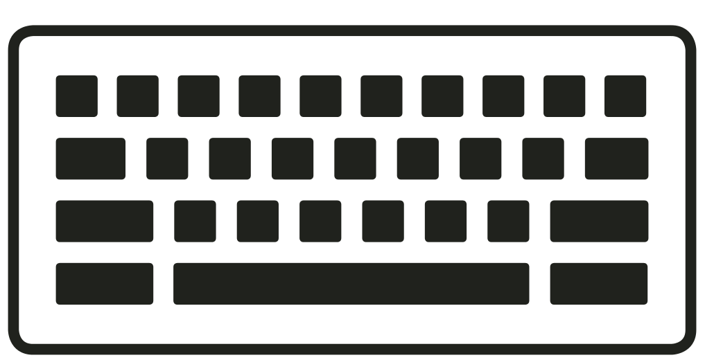
Browser
XXX
80/443
listening
Server
Parsing & Rendering
Operating System
(xwindow, keyboard driver)
Operating System
index.html
Client Machine
Server Machine

Slide 4
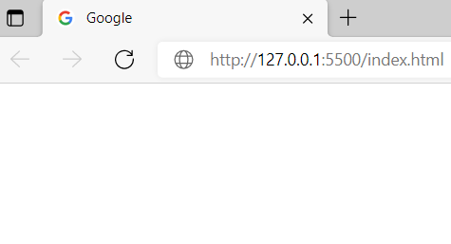
Browser
XXX
80
listening
Server
Parsing & Rendering
Operating System
(xwindow, keyboard driver)
Operating System
index.html
index.html
Client Machine
Server Machine

Slide 5
Browser
XXX
80
listening
Server
HTTP Request
Parsing & Rendering
Operating System
(xwindow, keyboard driver)
Operating System
index.html
index.html
Client Machine
Server Machine

Slide 6
Browser
XXX
80
listening
Server
HTTP Request
Parsing & Rendering
Finds in filesystem
Operating System
(xwindow, keyboard driver)
Operating System
index.html
index.html
Client Machine
Server Machine

Slide 7
Browser
XXX
80
listening
Server
HTTP Request
Parsing & Rendering
Packages as response
Operating System
(xwindow, keyboard driver)
Operating System
index.html
index.html
Client Machine
Server Machine

Slide 8
Browser
XXX
80
listening
Server
HTTP Response
Parsing & Rendering
Operating System
(xwindow, keyboard driver)
Operating System
index.html
index.html
Client Machine
Server Machine

Slide 9
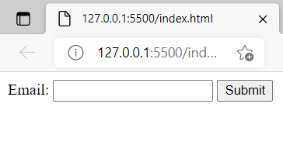
Browser
XXX
80
listening
Server
HTTP Response
Parsing & Rendering
Parses and Renders
Operating System
(xwindow, keyboard driver)
Operating System
index.html
index.html
Client Machine
Server Machine

Slide 10
Now let's ask ourselves the following question
What happens when an user types in ‘ax123’ and submits it?
The server (hopefully!) sends back an error
Is that a productive use of bandwidth (and very limited) server resources?
No
Assume we have a more complicated form
Requirement: someone who checks ‘yes’ for disability fills in a textbox, explaining the type of disability.
Is there a way to ensure that the textbox is enabled on when someone selects ‘yes’.

Slide 11
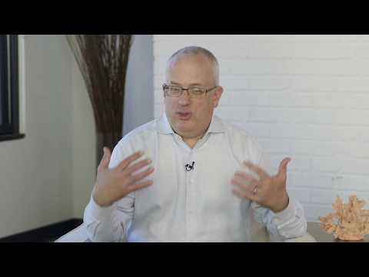

Slide 12
Browser
XXX
80
listening
Server
Parsing & Rendering
JavScript Engine
Operating System
(xwindow, keyboard driver)
index.html
Client Machine
Server Machine

Slide 13
Lets see a quick demo
VSCode Live server
HTML + JS for email validation
Directly on the browser
Just Debugging
Replit.com
Same HTML + JS for email validation

Slide 14
“Hosted” language
Never intended to work alone
Always runs with “friends”
Hosted in an environment
Like in a browser
In a C++ shell - Node - explained later
Relies on “friends” in the hosting environment for some of the features

Slide 15
Popular JavaScript Engines
Chrome has V8 Engine
So does Node.js
Firefox has Spidermonkey
Safari has JavaScriptCore (also called Nitro)
Edge has Chakra

Slide 16
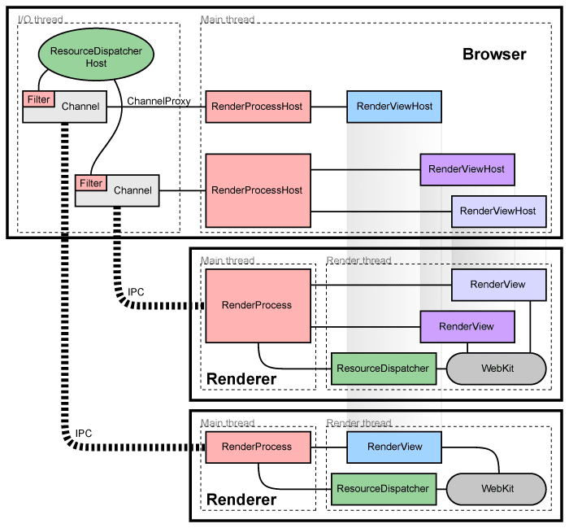
Inside WebKit there is JavaScriptCore - JavaScript Engine V8
Chrome Multi Process Architecture

Slide 17
Caution: The following slides show a heavily (unapologetically) simplified model of javascript in Browser, so as to help you understand. Use this just as a tool/mental model to understand javascript-in-browser vs javascript-in-Nodejs. DO NOT interpret the modules literally! For example, there is no such thing called ‘friend’

Slide 18
Javascript is single threaded!
But its not slow
But how does it get work done
It works similar to IIITS students
When you can’t do the assignment what do you do?
Ask your friend to do it and go to sleep/watch movie
Tell him to wake you up when he is done
The friends are threads (workers) spawned and run by the hosted environment

Slide 19
Browser
(program
written in C++)
WEB
APIS
Renderer (HTML) friend
V8 JavScript Engine
Network (xpc) friend
Webpage
Timer friend
URL
Other HTML related friend
JavaScript is executed as needed - triggered by events
Some other useful friend

Slide 20
How shall we design this??
Outcome of Code execution
JavaScript
Code

Slide 21
A program
written in C/C++
Idea: Let’s start by Copying the entire browser program and may be remove things that are not needed!
WEB
APIS
Renderer (HTML) friend
V8 JavScript Engine
Network (xpc) friend
Outcome of Code execution
JavaScript
Code
Timer friend
Other HTML related friend
Some other useful friend

Slide 22
A program
written in C/C++
This is what Ryan Dhal did for Node
APIS
We kept the Network friend around because we still want to talk to the internet
NODE
V8 JavScript Engine
Network (xpc) friend
Outcome of Code execution
JavaScript
Code
Timer friend
caution: The sheer amount of thing removed was plenty. Not just 2 components
Some other useful friend

Slide 23
Lets see a quick demo
Same simple email validation in Node
VSCode
Replit

Slide 24
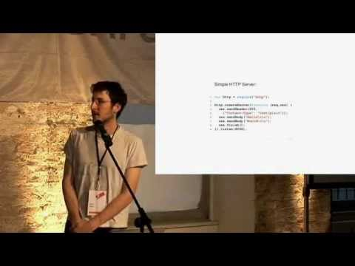

Slide 25
Node - Run JavaScript locally
It can talk to the local file system through OS
It can listen to a port for requests
Hence you can use it to create Servers
Voilà now you can write javascript for server side operations
Unlike the browser you can even increase the number of worker threads in the worker pools
Node (libuv) starts with 4 workers in the pool
You can also implement your own pools

Slide 26
Summary
Created by Brendan Eich for Netscape browser (1995ish)
In 10 days
Started as ‘Scheme in a browser’
Hosted language
Needs friends
Browser brings in all the friends
Ryan Dhal said
Don’t worry JS! No need for a browser!
I’ll give you all the friends you need! Let’s C
Node (2009)

