Slide 1
Introduction to Data Analytics
Class #12
Estimation
Dr. Sreeja S R
Assistant Professor
Indian Institute of Information Technology
IIIT Sri City

Slide 2

Quote of the day..

Slide 3
In this presentation…
POINT ESTIMATION
GENERAL CONCEPTS OF POINT ESTIMATION
Unbiased Estimators
Variance of a Point Estimator
Standard Error: Reporting a Point Estimate
Mean Squared Error of an Estimator
METHODS OF POINT ESTIMATION
Method of Moments
Method of Maximum Likelihood

Slide 4
Point Estimation
Statistical inference is always focused on drawing conclusions about one or more parameters of a population.
An important part of this process is obtaining estimates of the parameters.
Suppose that we want to obtain a point estimate (a reasonable value) of a population parameter.
Any function of the observation, or any statistic, is also a random variable. For example, the sample mean and the sample variance are statistics and they are also random variables.
Since a statistic is a random variable, it has a probability distribution. We call the probability distribution of a statistic a sampling distribution.

Slide 5
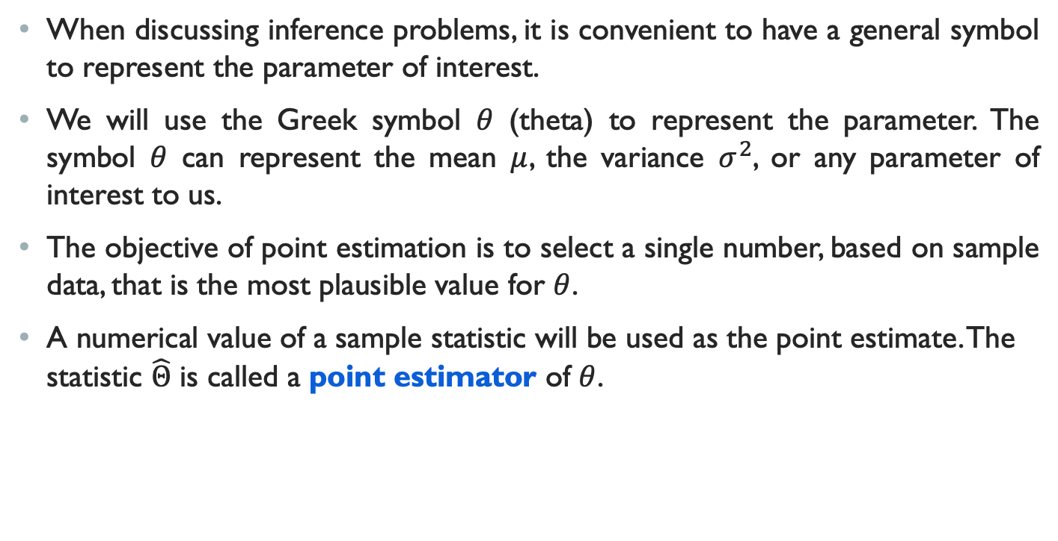
Point Estimation
When discussing inference problems, it is convenient to have a general symbol to represent the parameter of interest.
We will use the Greek symbol $θ$ (theta) to represent the parameter. The symbol $θ$ can represent the mean $μ$, the variance $σ^{2}$, or any parameter of interest to us.
The objective of point estimation is to select a single number, based on sample data, that is the most plausible value for $θ$.
A numerical value of a sample statistic will be used as the point estimate. The statistic $\hat{Θ}$ is called a point estimator of $θ$.

Slide 6
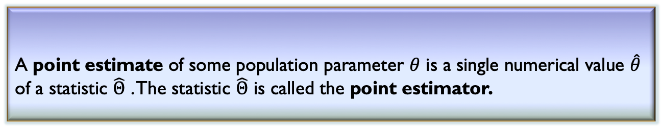

Point Estimator
A point estimate of some population parameter $θ$ is a single numerical value $\hat{θ}$ of a statistic $\hat{Θ}$ . The statistic $\hat{Θ}$ is called the point estimator.
Definition 12.1: Point Estimator
Example:
Suppose that the random variable X is normally distributed with an unknown mean $μ$. The sample mean is a point estimator of the unknown population mean $μ$. That is, $\hat{μ}=\overline{X}$.

Slide 7
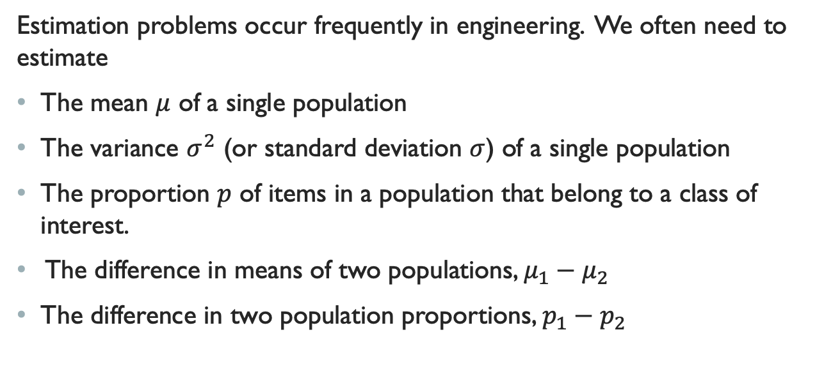
Point Estimator
Estimation problems occur frequently in engineering. We often need to estimate
The mean $μ$ of a single population
The variance $σ^{2}$ (or standard deviation $σ$) of a single population
The proportion $p$ of items in a population that belong to a class of interest.
The difference in means of two populations, $μ_{1}−μ_{2}$
The difference in two population proportions, $p_{1}−p_{2}$

Slide 8
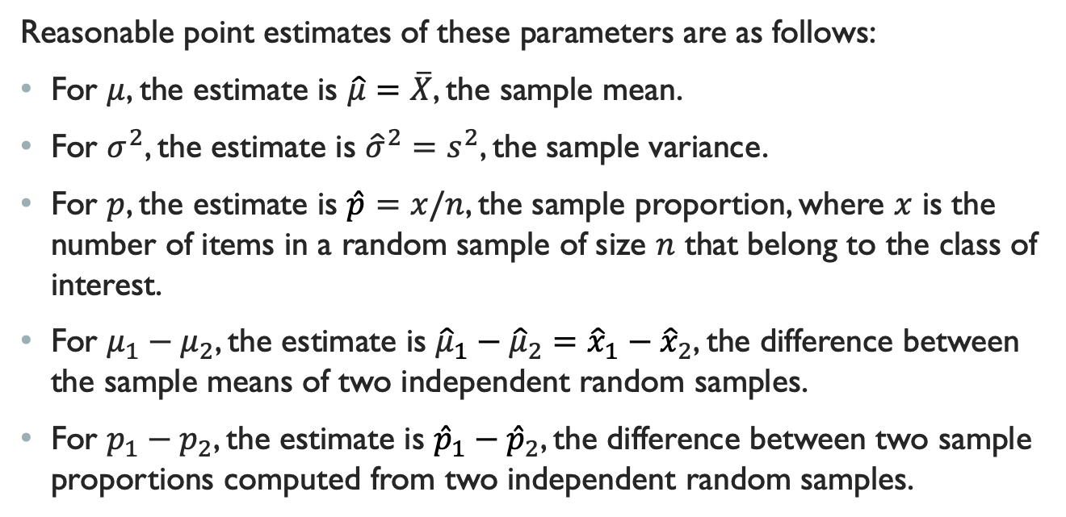
Point Estimator
Reasonable point estimates of these parameters are as follows:
For $μ$, the estimate is $\hat{μ}=\overline{X}$, the sample mean.
For $σ^{2}$, the estimate is ${\hat{σ}}^{2}=s^{2}$, the sample variance.
For $p$, the estimate is $\hat{p}=x/n$, the sample proportion, where $x$ is the number of items in a random sample of size $n$ that belong to the class of interest.
For $μ_{1}−μ_{2}$, the estimate is ${\hat{μ}}_{1}−{\hat{μ}}_{2}={\hat{x}}_{1}−{\hat{x}}_{2}$, the difference between the sample means of two independent random samples.
For $p_{1}−p_{2}$, the estimate is ${\hat{p}}_{1}−{\hat{p}}_{2}$, the difference between two sample proportions computed from two independent random samples.

Slide 9
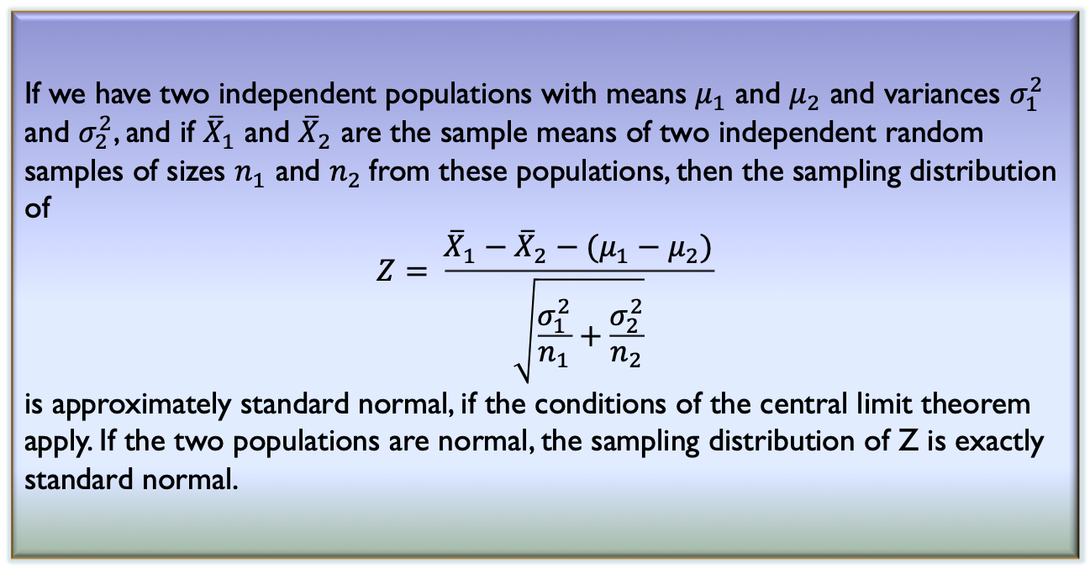
Central limit theorem
Definition 12.2: Approximate Sampling Distribution of a Difference in Sample Means
If we have two independent populations with means $μ_{1}$ and $μ_{2}$ and variances $σ_{1}^{2}$ and $σ_{2}^{2}$, and if ${\overline{X}}_{1}$ and ${\overline{X}}_{2}$ are the sample means of two independent random samples of sizes $n_{1}$ and $n_{2}$from these populations, then the sampling distribution of
$$Z= \frac{{\overline{X}}_{1}−{\overline{X}}_{2}−(μ_{1}−μ_{2})}{\sqrt{\frac{σ_{1}^{2}}{n_{1}}+\frac{σ_{2}^{2}}{n_{2}}}}$$
is approximately standard normal, if the conditions of the central limit theorem apply. If the two populations are normal, the sampling distribution of Z is exactly standard normal.

Slide 10
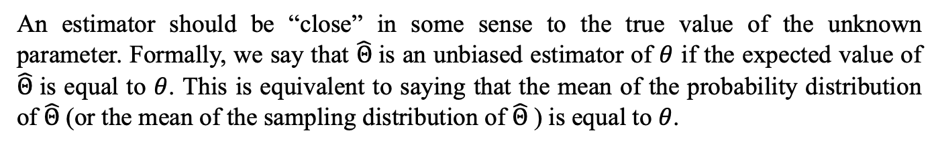
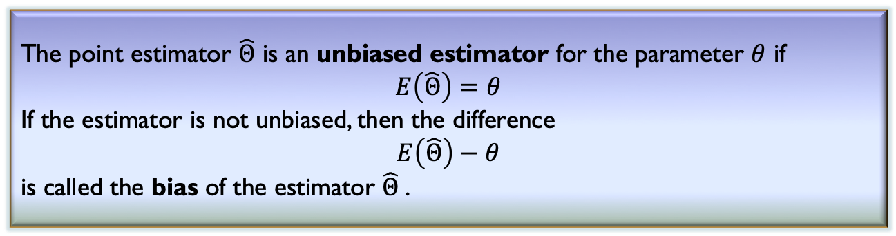
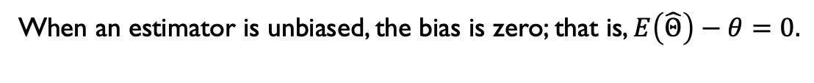
Unbiased Estimators
An estimator should be “close” in some sense to the true value of the unknown parameter. Formally, we say that $\hat{Θ}$ is an unbiased estimator of $θ$ if the expected value of $\hat{Θ}$ is equal to $θ$. This is equivalent to saying that the mean of the probability distribution of $\hat{Θ}$ (or the mean of the sampling distribution of $\hat{Θ}$ ) is equal to $θ$.
Definition 12.3: Bias of an Estimator
The point estimator $\hat{Θ}$ is an unbiased estimator for the parameter $θ$ if $$E\left(\hat{Θ}\right)=θ$$
If the estimator is not unbiased, then the difference $$E\left(\hat{Θ}\right)−θ$$
is called the bias of the estimator $\hat{Θ}$.
When an estimator is unbiased, the bias is zero; that is, $E\left(\hat{Θ}\right)−θ=0.$

Slide 11
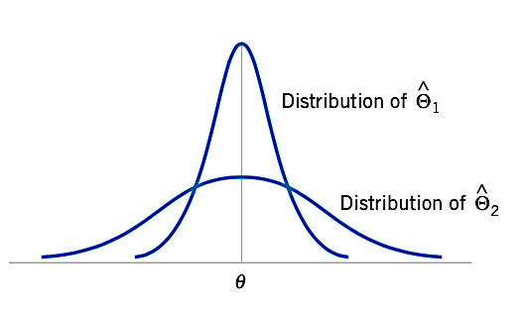
Variance of a Point Estimator
A logical principle of estimation, when selecting among several estimators, is to choose the estimator that has minimum variance.
If we consider all unbiased estimators of 𝜃, the one with the smallest variance is called the minimum variance unbiased estimator (MVUE).

Slide 12
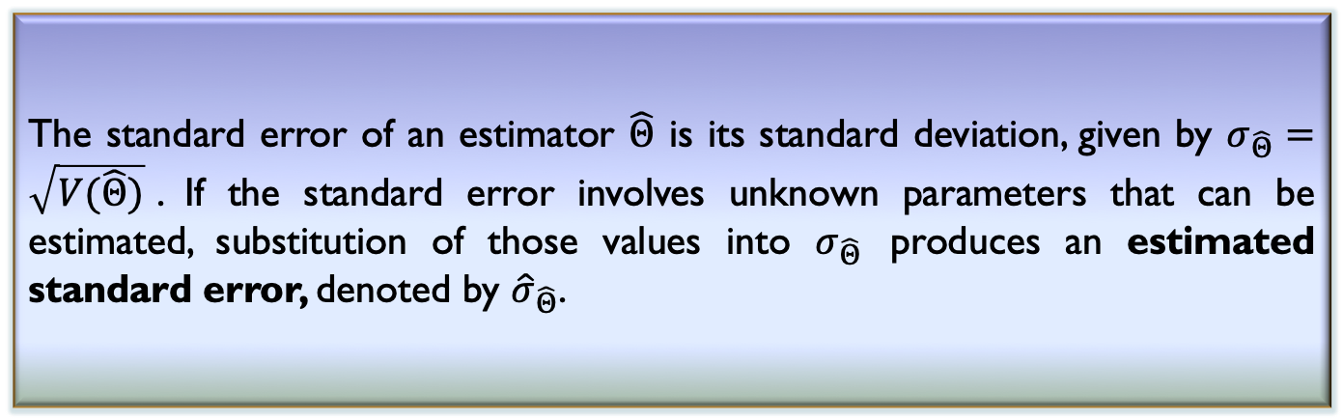
Standard Error
When the numerical value or point estimate of a parameter is reported, it is usually desirable to give some idea of the precision of estimation. The measure of precision usually employed is the standard error of the estimator that has been used.
The standard error of an estimator $\hat{Θ}$ is its standard deviation, given by $σ_{\hat{Θ}}=\sqrt{V(\hat{Θ})}$. If the standard error involves unknown parameters that can be estimated, substitution of those values into $σ_{\hat{Θ}}$ produces an estimated standard error, denoted by ${\hat{σ}}_{\hat{Θ}}$.
Sometimes the estimated standard error is denoted by $s_{\hat{Θ}}$or $se\left(\hat{Θ}\right).$

Slide 13

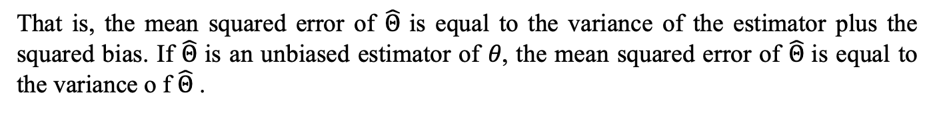
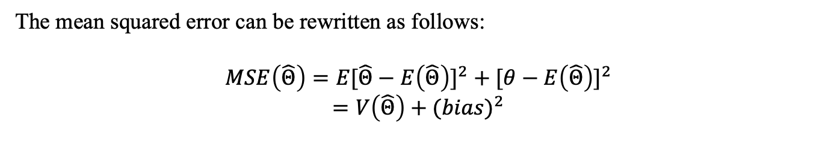
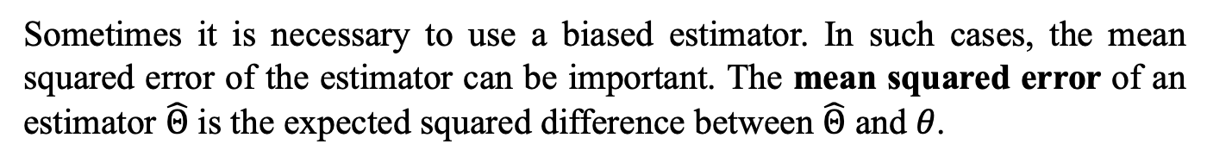
Mean Squared Error of an Estimator
Sometimes it is necessary to use a biased estimator. In such cases, the mean squared error of the estimator can be important. The mean squared error of an estimator $\hat{Θ}$ is the expected squared difference between $\hat{Θ}$ and 𝜃.
The mean squared error of an estimator $\hat{Θ}$ of the parameter 𝜃 is defined as
$$MSE\left(\hat{Θ}\right)=E{\left(\hat{Θ}−\text{θ}\right)}^{2}$$
The mean squared error can be rewritten as follows:
$$MSE\left(\hat{Θ}\right)=E{[\hat{Θ}−E\left(\hat{Θ}\right)]}^{2} +{ [\text{θ}−E\left(\hat{Θ}\right)]}^{2}$$
$$=V\left(\hat{Θ}\right)+{(bias)}^{2}$$
That is, the mean squared error of $\hat{Θ}$ is equal to the variance of the estimator plus the squared bias. If $\hat{Θ}$ is an unbiased estimator of 𝜃, the mean squared error of $\hat{Θ}$ is equal to the variance o f $\hat{Θ}$ .

Slide 14
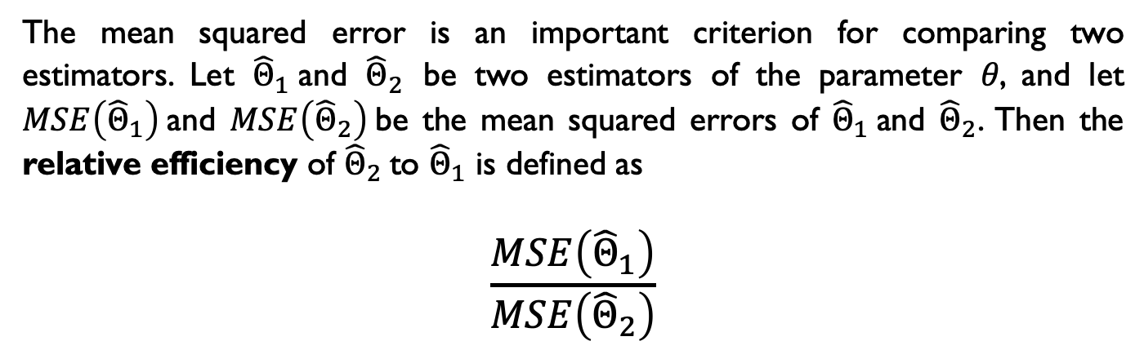
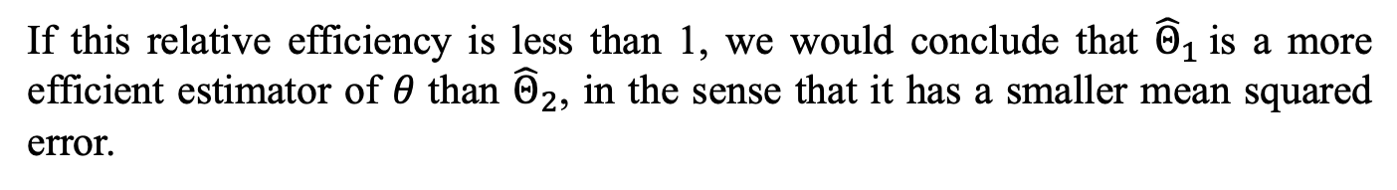
Mean Squared Error of an Estimator
The mean squared error is an important criterion for comparing two estimators. Let ${\hat{Θ}}_{1}$and ${\hat{Θ}}_{2}$ be two estimators of the parameter 𝜃, and let $MSE\left({\hat{Θ}}_{1}\right)$and $MSE\left({\hat{Θ}}_{2}\right)$be the mean squared errors of ${\hat{Θ}}_{1}$and ${\hat{Θ}}_{2}$. Then the relative efficiency of ${\hat{Θ}}_{2}$to ${\hat{Θ}}_{1}$ is defined as
$$\frac{MSE\left({\hat{Θ}}_{1}\right)}{MSE\left({\hat{Θ}}_{2}\right)}$$
If this relative efficiency is less than 1, we would conclude that ${\hat{Θ}}_{1}$is a more efficient estimator of 𝜃 than ${\hat{Θ}}_{2}$, in the sense that it has a smaller mean squared error.

Slide 15
METHODS OF POINT ESTIMATION
The definitions of unbiasedness and other properties of estimators do not provide any guidance about how good estimators can be obtained.
Methods for obtaining point estimators:
The method of moments
The method of maximum likelihood.

Slide 16
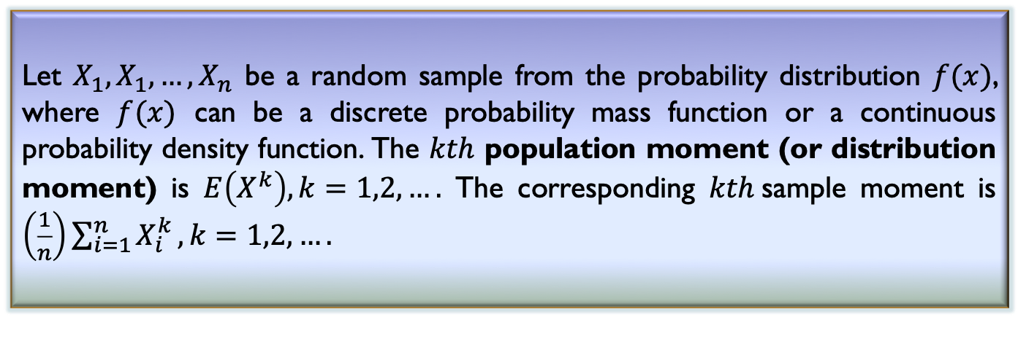
Method of Moments
The general idea behind the method of moments is to equate population moments, which are defined in terms of expected values, to the corresponding sample moments. The population moments will be functions of the unknown parameters. Then these equations are solved to yield estimators of the unknown parameters.
Definition 12.4: Moments
Let $X_{1},X_{1},…,X_{n}$ be a random sample from the probability distribution $f(x)$, where $f(x)$ can be a discrete probability mass function or a continuous probability density function. The $kth$ population moment (or distribution moment) is $E\left(X^{k}\right), k=1,2,….$ The corresponding $kth$sample moment is $\left(\frac{1}{n}\right)\sum_{i=1}^{n}{X_{i}^{k}},k=1,2,….$

Slide 17
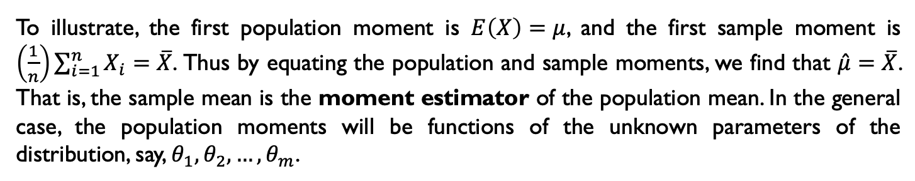
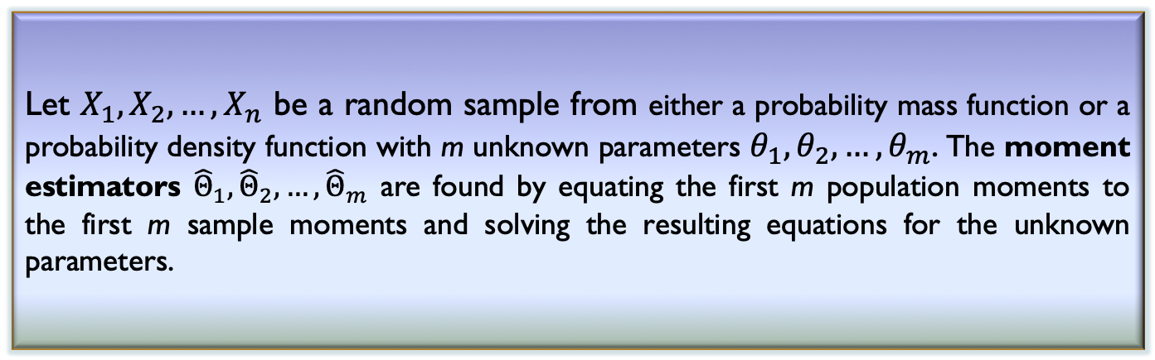
Method of Moments
To illustrate, the first population moment is $E\left(X\right)=μ$, and the first sample moment is $\left(\frac{1}{n}\right)\sum_{i=1}^{n}{X_{i}}=\overline{X}$. Thus by equating the population and sample moments, we find that $\hat{μ}=\overline{X}$. That is, the sample mean is the moment estimator of the population mean. In the general case, the population moments will be functions of the unknown parameters of the distribution, say, ${\text{θ}}_{1},{\text{θ}}_{2},…,{\text{θ}}_{m}$.
Definition 12.5: Moment Estimators
Let $X_{1},X_{2},…,X_{n}$ be a random sample from either a probability mass function or a probability density function with m unknown parameters ${\text{θ}}_{1},{\text{θ}}_{2},…,{\text{θ}}_{m}$. The moment estimators ${\hat{Θ}}_{1},{\hat{Θ}}_{2},…,{\hat{Θ}}_{m}$ are found by equating the first m population moments to the first m sample moments and solving the resulting equations for the unknown parameters.

Slide 18
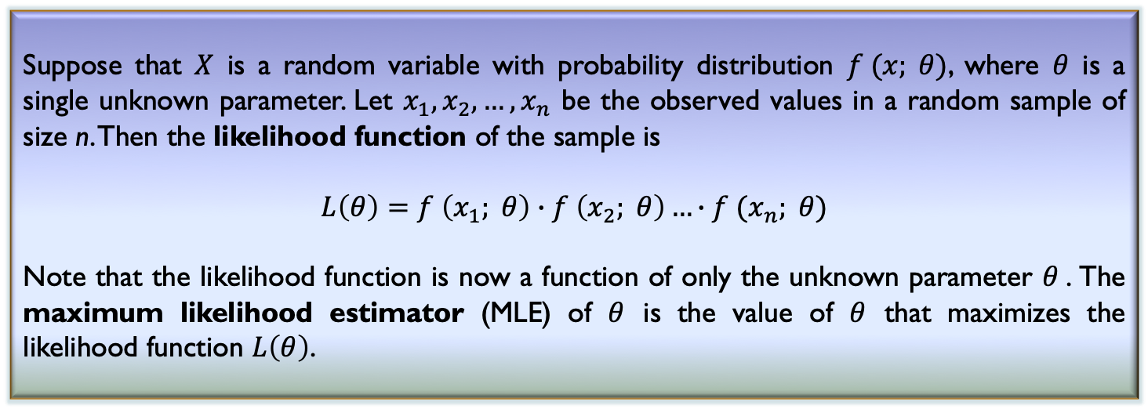
Method of Maximum Likelihood
One of the best methods of obtaining a point estimator of a parameter is the method of maximum likelihood. This technique was developed in the 1920s by a famous British statistician, Sir R. A. Fisher. As the name implies, the estimator will be the value of the parameter that maximizes the likelihood function.
Definition 12.6: Maximum Likelihood Estimator
Suppose that $X$ is a random variable with probability distribution $f (x; θ)$, where $θ$ is a single unknown parameter. Let $x_{1},x_{2},…,x_{n}$ be the observed values in a random sample of size n. Then the likelihood function of the sample is
$$L\left(θ\right)=f \left(x_{1}; θ\right)∙f \left(x_{2}; θ\right)…∙f (x_{n}; θ)$$
Note that the likelihood function is now a function of only the unknown parameter $θ$. The maximum likelihood estimator (MLE) of $θ$ is the value of $θ$ that maximizes the likelihood function $L\left(θ\right)$.

Slide 19
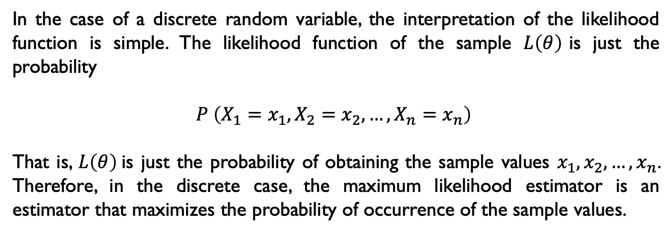
Method of Maximum Likelihood
In the case of a discrete random variable, the interpretation of the likelihood function is simple. The likelihood function of the sample $L\left(θ\right)$is just the probability
$$P \left(X_{1}=x_{1},X_{2}=x_{2},…,X_{n}=x_{n}\right)$$
That is, $L\left(θ\right)$is just the probability of obtaining the sample values $x_{1},x_{2},…,x_{n}$. Therefore, in the discrete case, the maximum likelihood estimator is an estimator that maximizes the probability of occurrence of the sample values.

Slide 20
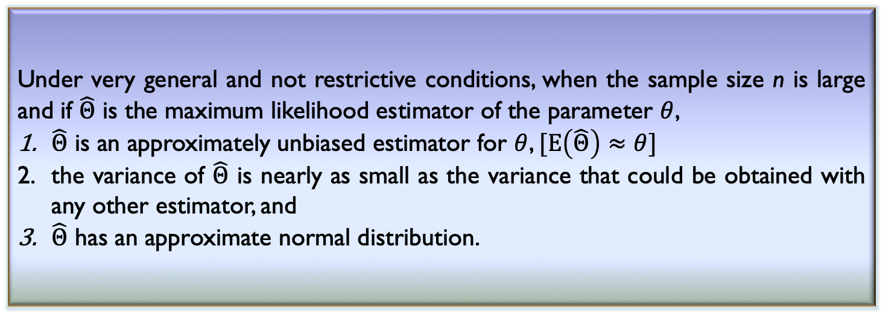
Properties of the Maximum Likelihood Estimator
The method of maximum likelihood is often the estimation method that mathematical statisticians prefer, because it produces estimators with good statistical properties.
Under very general and not restrictive conditions, when the sample size n is large and if $\hat{Θ}$ is the maximum likelihood estimator of the parameter $θ$,
$\hat{Θ}$ is an approximately unbiased estimator for $θ$, $[E\left(\hat{Θ}\right)≈θ]$
the variance of $\hat{Θ}$ is nearly as small as the variance that could be obtained with any other estimator, and
$\hat{Θ}$ has an approximate normal distribution.

Slide 21
Any question?

