Slide 1
Introduction to Data Analytics
Class # 16
Relation Analysis
Dr. Sreeja S R
Assistant Professor
Indian Institute of Information Technology
IIIT Sri City

Slide 2
This TOPIC includes…
Regression Analysis
Simple Linear Regression
Multiple Linear Regression
Non-Linear Regression Analysis
Auto-Regression Analysis

Slide 3
Regression Analysis

Slide 4
Regression Analysis
The regression analysis is a statistical method to deal with the formulation of mathematical model depicting relationship amongst variables, which can be used for the purpose of prediction of the values of dependent variable, given the values of independent variables.
Classification of Regression Analysis Models
Linear regression models
Simple linear regression
Multiple linear regression
Non-linear regression models

Slide 5
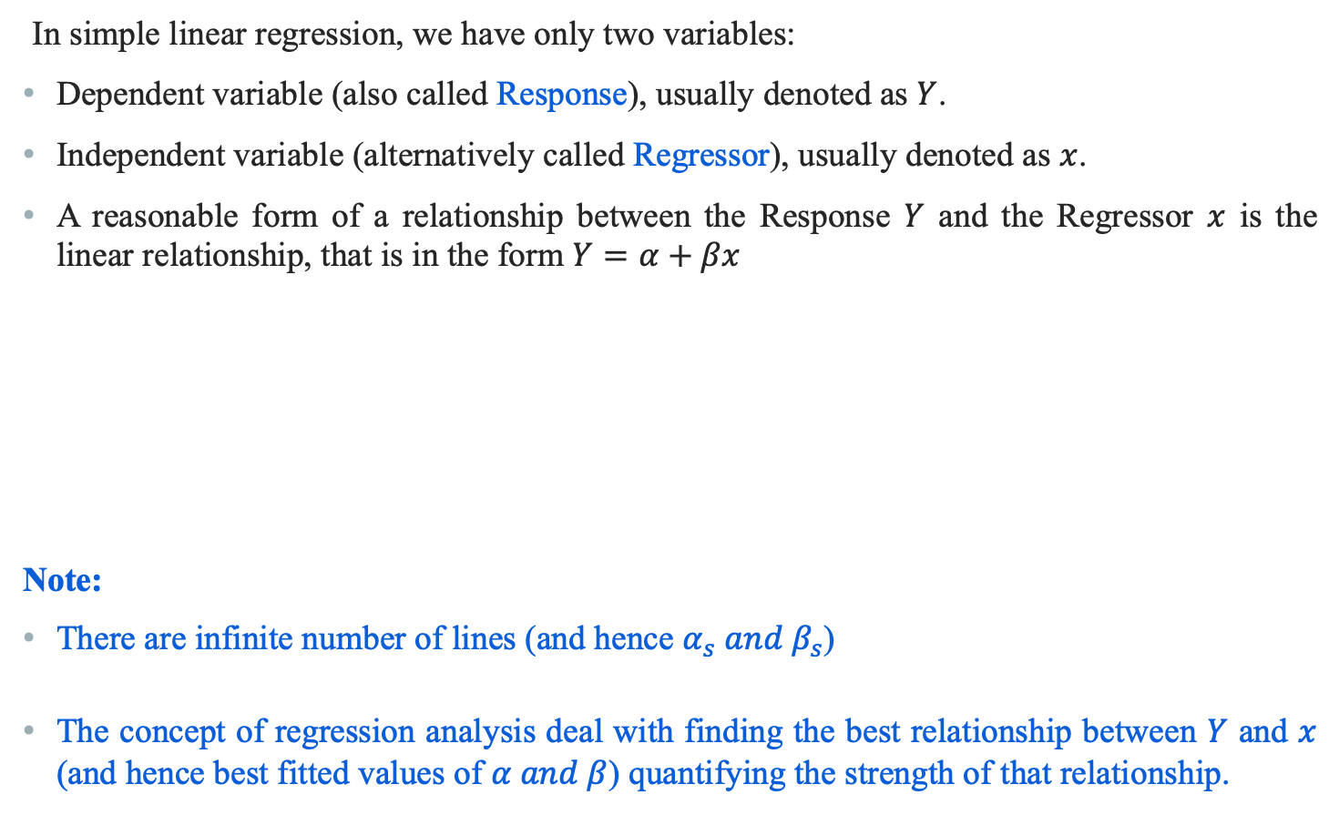
Simple Linear Regression Model
In simple linear regression, we have only two variables:
Dependent variable (also called Response), usually denoted as $Y$.
Independent variable (alternatively called Regressor), usually denoted as $x$.
A reasonable form of a relationship between the Response $Y$ and the Regressor $x$ is the linear relationship, that is in the form $Y=α+βx$
Note:
There are infinite number of lines (and hence $α_{s} and β_{s}$)
The concept of regression analysis deal with finding the best relationship between $Y$ and $x$ (and hence best fitted values of $α and β$) quantifying the strength of that relationship.

Slide 6
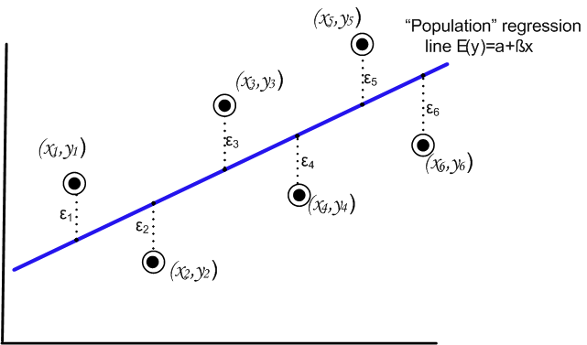
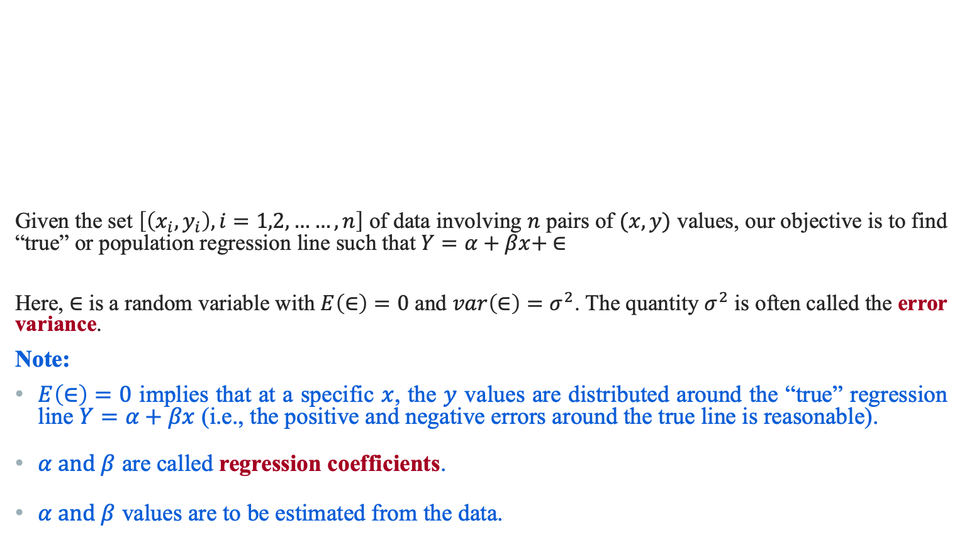
Regression Analysis
Given the set $\left[\left(x_{i},y_{i}\right), i=1,2,……,n\right]$ of data involving $n$ pairs of $(x,y)$ values, our objective is to find “true” or population regression line such that $Y=α+βx+ ∈$
Here, $∈$ is a random variable with $E\left(∈\right)=0$ and $var\left(∈\right)=σ^{2}$. The quantity $σ^{2}$ is often called the error variance.
Note:
$E\left(∈\right)=0$ implies that at a specific $x$, the $y$ values are distributed around the “true” regression line $Y=α+βx$ (i.e., the positive and negative errors around the true line is reasonable).
$α and β$ are called regression coefficients.
$α and β$ values are to be estimated from the data.

Slide 7

True versus Fitted Regression Line
The task in regression analysis is to estimate the regression coefficients $α and β$.
Suppose, we denote the estimates a for $α$ and b for $β$. Then the fitted regression line is
$\hat{Y}=a+bx$
where $\hat{Y}$is the predicted or fitted value.

Slide 8

Least Square Method to estimate $α and β$
This method uses the concept of residual. A residual is essentially an error in the fit of the model $\hat{Y}=a+bx$. Thus, $i^{th}$ residual is
$e_{i}=Y_{i}−{\hat{Y}}_{i}$, $i=1,2,3,……,n$

Slide 9
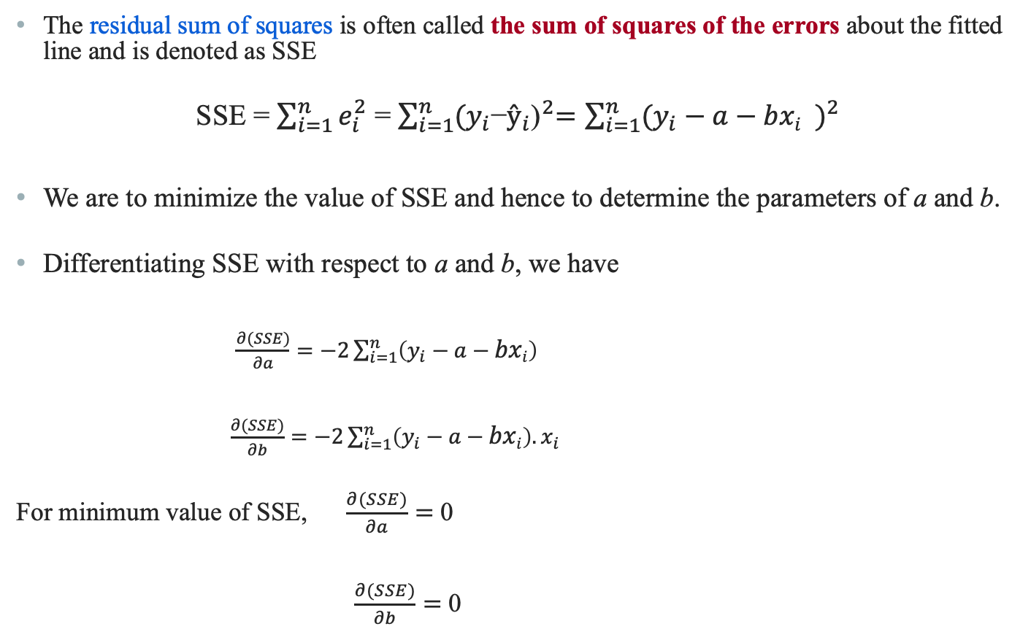
Least Square method
The residual sum of squares is often called the sum of squares of the errors about the fitted line and is denoted as SSE
SSE = $\sum_{i=1}^{n}{e_{i}^{2}}$ = $\sum_{i=1}^{n}{{(y_{i}\text{−}ŷ_{i}\text{)}}^{2}=\sum_{i=1}^{n}{{(y_{i}−a−{bxi}_{})}^{2}}}$
We are to minimize the value of SSE and hence to determine the parameters of a and b.
Differentiating SSE with respect to a and b, we have
$\frac{∂(SSE)}{∂a}=−2\sum_{i=1}^{n}{{\left(y_{i}−a−bxi\right)}^{}}$
$\frac{∂(SSE)}{∂b}=−2\sum_{i=1}^{n}{\left(y_{i}−a−bxi\right).x_{i}}$
For minimum value of SSE, $\frac{∂(SSE)}{∂a}=$ 0
$\frac{∂(SSE)}{∂b}=$ 0

Slide 10
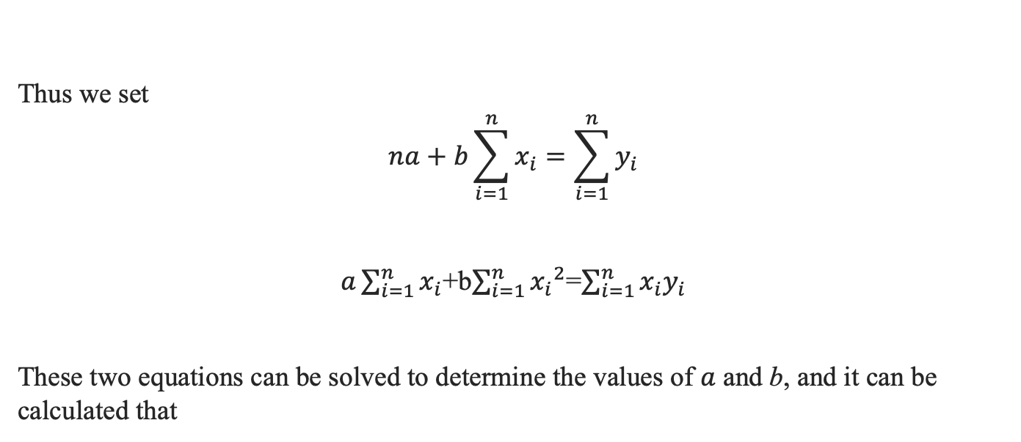
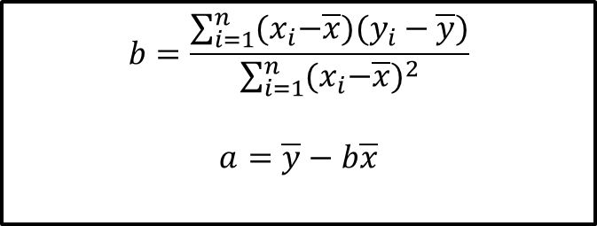
Least Square method to estimate $α and β$
Thus we set
$$na+b\sum_{i=1}^{n}{x_{i}}=\sum_{i=1}^{n}{y_{i}}$$
$a\sum_{i=1}^{n}{x_{i}}$+b$\sum_{i=1}^{n}{{x_{i}}^{2}}$=$\sum_{i=1}^{n}{x_{i}y_{i}}$
These two equations can be solved to determine the values of $a$ and b, and it can be calculated that
$$b=\frac{\sum_{i=1}^{n}{{(x}_{i}−\overline{x}{)(y}_{i}−\overline{y})}}{\sum_{i=1}^{n}{{{(x}_{i}−\overline{x})}^{2}}}$$
$$a=\overline{y}−b\overline{x}$$

Slide 11
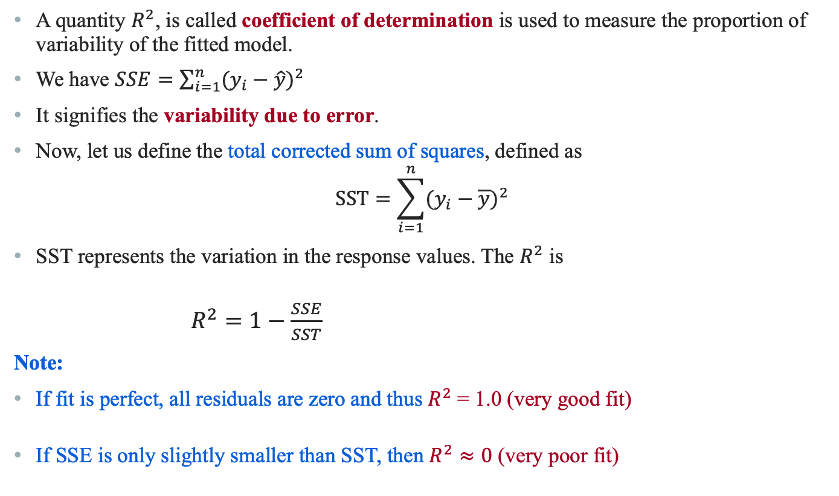

$R^{2}$: Measure of Quality of Fit
A quantity $R^{2}$, is called coefficient of determination is used to measure the proportion of variability of the fitted model.
We have $SSE=\sum_{i=1}^{n}{{(y_{i}−\hat{y})}^{2}}$
It signifies the variability due to error.
Now, let us define the total corrected sum of squares, defined as
$$SST=\sum_{i=1}^{n}{{(y_{i}−\overline{y})}^{2}}$$
SST represents the variation in the response values. The $R^{2}$ is
$R^{2}=1−\frac{SSE}{SST}$
Note:
If fit is perfect, all residuals are zero and thus $R^{2}$ = 1.0 (very good fit)
If SSE is only slightly smaller than SST, then $R^{2}≈0$ (very poor fit)

Slide 12

$R^{2}$: Measure of Quality of Fit
$$R^{2}≈0$$

Slide 13
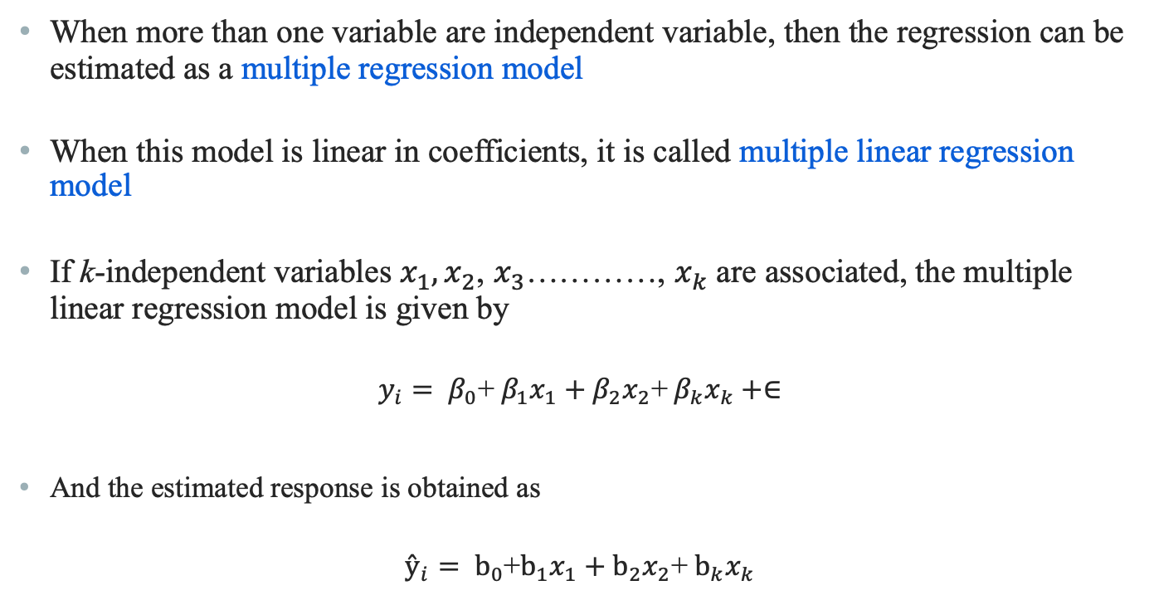
Multiple Linear Regression
When more than one variable are independent variable, then the regression can be estimated as a multiple regression model
When this model is linear in coefficients, it is called multiple linear regression model
If k-independent variables $x_{1},x_{2}$, $x_{3}$…………, $x_{k}$ are associated, the multiple linear regression model is given by
$y_{i}= β_{0}$+${ β}_{1}x_{1}+β_{2}x_{2}$+${ β}_{k}x_{k}+∈$
And the estimated response is obtained as
$ŷ_{i}= b_{0}$+$b_{1}x_{1}+b_{2}x_{2}$+${ b}_{k}x_{k}$

Slide 14
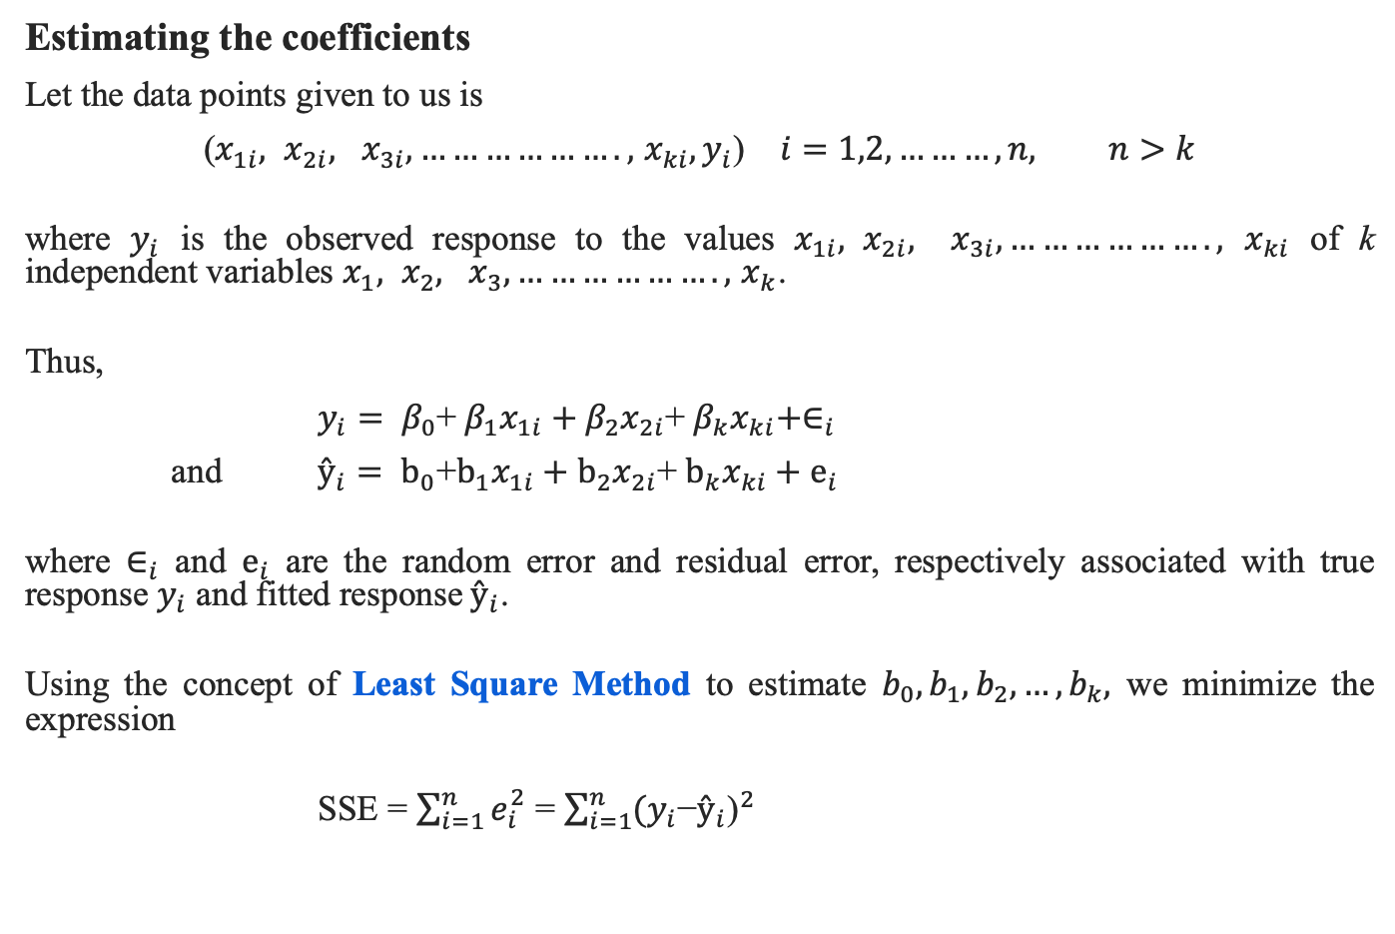
Multiple Linear Regression
Estimating the coefficients
Let the data points given to us is
($x_{1i}, x_{2i},$ $x_{3i}, ……………….,$ $x_{ki}, y_{i}$) $i=1,2,………,n, n>k$
where $y_{i}$ is the observed response to the values $x_{1i}, x_{2i},$ $x_{3i}, ……………….,$ $x_{ki}$ of k independent variables $x_{1}, x_{2},$ $x_{3}, ……………….,$ $x_{k}$.
Thus,
$y_{i}= β_{0}$+${ β}_{1}x_{1i}+β_{2}x_{2i}$+${ β}_{k}x_{ki}+∈_{i}$
and $ŷ_{i}= b_{0}$+$b_{1}x_{1i}+b_{2}x_{2i}$+${ b}_{k}x_{ki}+e_{i}$
where $∈_{i}$ and $e_{i}$ are the random error and residual error, respectively associated with true response $y_{i}$ and fitted response${ ŷ}_{i}$.
Using the concept of Least Square Method to estimate $b_{0},b_{1},b_{2},…,b_{k},$ we minimize the expression
SSE = $\sum_{i=1}^{n}{e_{i}^{2}}$ = $\sum_{i=1}^{n}{{(y_{i}\text{−}ŷ_{i}\text{)}}^{2}}$

Slide 15
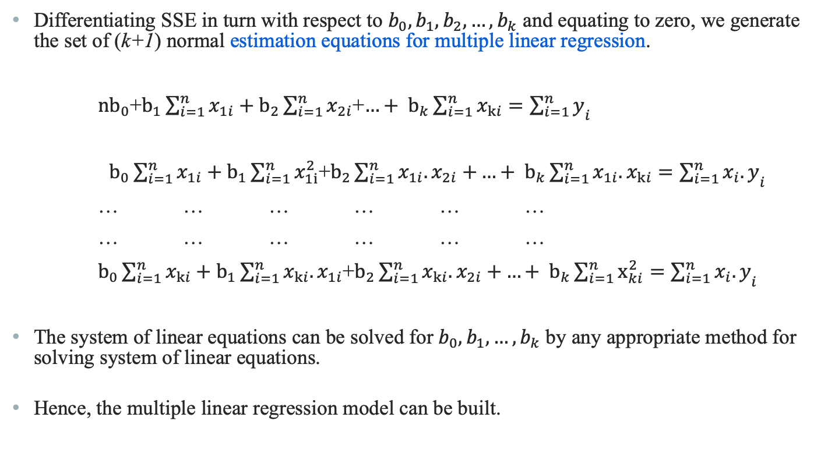
Multiple Linear Regression
Differentiating SSE in turn with respect to $b_{0},b_{1},b_{2},…,b_{k}$ and equating to zero, we generate the set of (k+1) normal estimation equations for multiple linear regression.
${nb}_{0}$+$b_{1}\sum_{i=1}^{n}{x_{1i}}+b_{2}\sum_{i=1}^{n}{x_{2i}}$+${…+ b}_{k}\sum_{i=1}^{n}{x_{ki}}={\sum_{i=1}^{n}{y}}_{i}$
$b_{0}\sum_{i=1}^{n}{x_{1i}}+b_{1}\sum_{i=1}^{n}{x_{1i}^{2}}$+$b_{2}\sum_{i=1}^{n}{x_{1i}.x_{2i}+}{…+ b}_{k}\sum_{i=1}^{n}{{x_{1i}.x}_{ki}}={\sum_{i=1}^{n}{x_{i}.y}}_{i}$
… … … … … …
… … … … … …
$b_{0}\sum_{i=1}^{n}{x_{ki}}+b_{1}\sum_{i=1}^{n}{x_{ki}.x_{1i}}$+$b_{2}\sum_{i=1}^{n}{x_{ki}.x_{2i}+}{…+ b}_{k}\sum_{i=1}^{n}{x_{ki}^{2}}={\sum_{i=1}^{n}{x_{i}.y}}_{i}$
The system of linear equations can be solved for $b_{0},b_{1}, …,b_{k}$ by any appropriate method for solving system of linear equations.
Hence, the multiple linear regression model can be built.

Slide 16
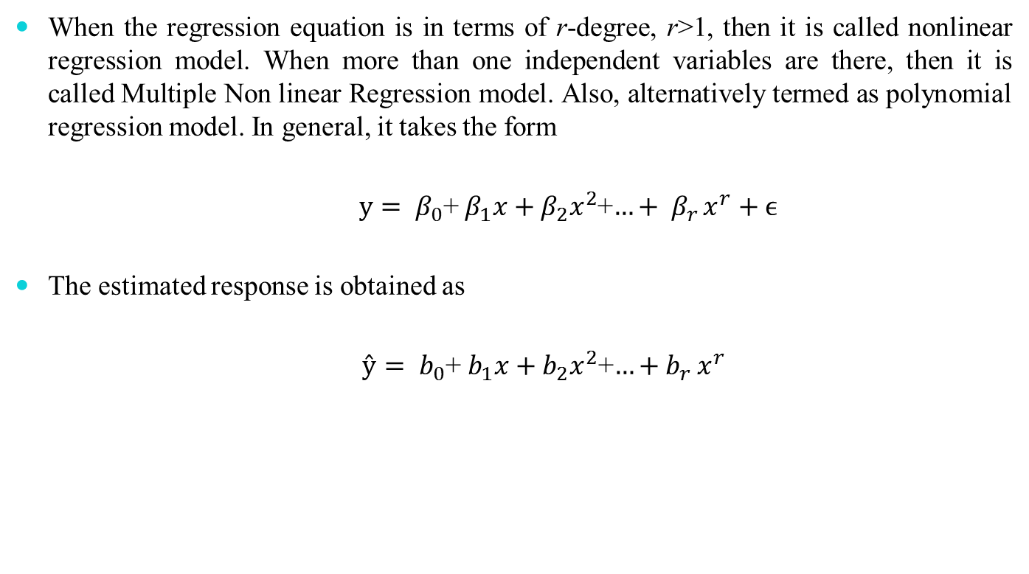
Non Linear Regression Model
When the regression equation is in terms of r-degree, r>1, then it is called nonlinear regression model. When more than one independent variables are there, then it is called Multiple Non linear Regression model. Also, alternatively termed as polynomial regression model. In general, it takes the form
$y= β_{0}$+${ β}_{1}x+β_{2}x^{2}$+${…+ β}_{r}x^{r}+ϵ$
The estimated response is obtained as
$ŷ= b_{0}$+${ b}_{1}x+b_{2}x^{2}$+${…+b}_{r}x^{r}$

Slide 17
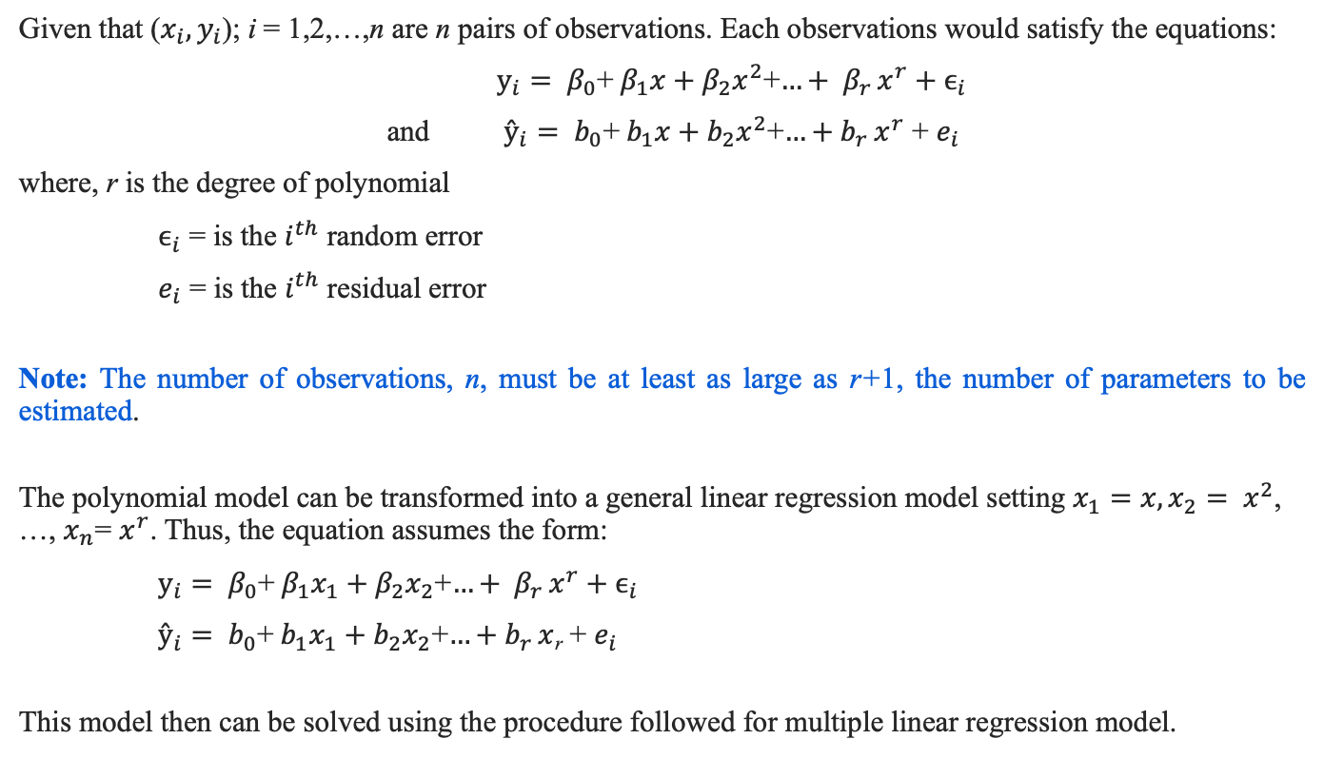
Solving for Polynomial Regression Model
Given that ($x_{i},y_{i}$); i = 1,2,…,n are n pairs of observations. Each observations would satisfy the equations:
$y_{i}= β_{0}$+${ β}_{1}x+β_{2}x^{2}$+${…+ β}_{r}x^{r}+ϵ_{i}$
and $ŷ_{i}= b_{0}$+${ b}_{1}x+b_{2}x^{2}$+${…+b}_{r}x^{r}$ + $e_{i}$
where, r is the degree of polynomial
$ϵ_{i}$ = is the $i^{th}$ random error
$e_{i}$ = is the $i^{th}$ residual error
Note: The number of observations, n, must be at least as large as r+1, the number of parameters to be estimated.
The polynomial model can be transformed into a general linear regression model setting $x_{1}=x, x_{2}= x^{2}$, …, $x_{n}$= $x^{r}$. Thus, the equation assumes the form:
$y_{i}= β_{0}$+${ β}_{1}x_{1}+β_{2}x_{2}$+${…+ β}_{r}x^{r}+ϵ_{i}$
$ŷ_{i}= b_{0}$+${ b}_{1}x_{1}+b_{2}x_{2}$+${…+b}_{r}x$_{r} + $e_{i}$
This model then can be solved using the procedure followed for multiple linear regression model.

Slide 18
Auto-Regression Analysis

Slide 19
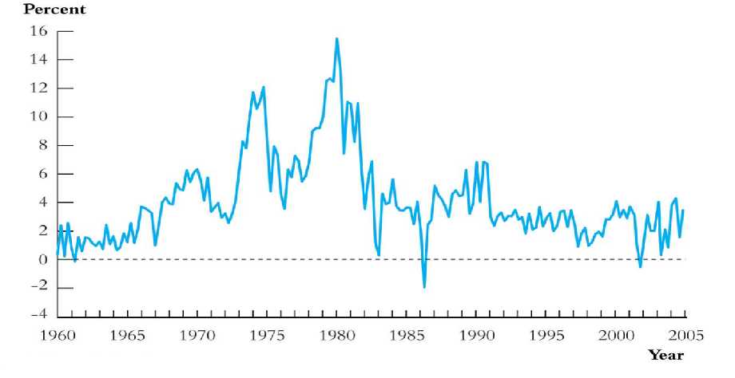
Auto Regression Analysis
Regression analysis for time-ordered data is known as Auto-Regression Analysis
Time series data are data collected on the same observational unit at multiple time periods
Example: Indian rate of price inflation

Slide 20
Auto Regression Analysis
Examples: Which of the following is a time-series data?
Aggregate consumption and GDP for a country (for example, 20 years of quarterly observations = 80 observations)
Yen/$, pound/$ and Euro/$ exchange rates (daily data for 1 year = 365 observations)
Cigarette consumption per capita in a state, by years
Rainfall data over a year
Sales of tea from a tea shop in a season

Slide 21
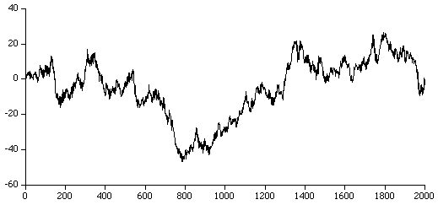
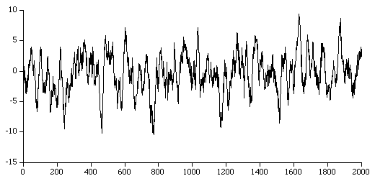
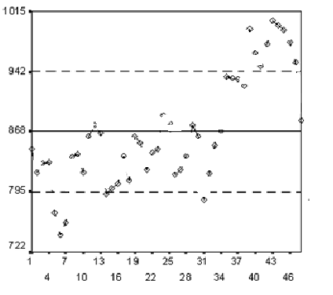
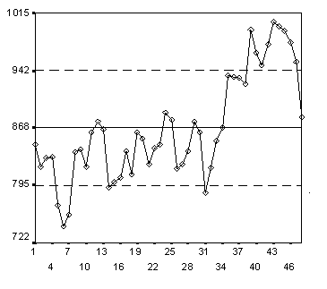
Auto Regression Analysis
Examples: Which of the following graph is due to time-series data?

Slide 22
Use of Time Series Data
To develop forecast model
What will the rate of inflation by next year?
To estimate dynamic causal effects
If the rate of interest increases the interest rate now, what will be the effect on the rates of inflation and unemployment in 3 months? in 12 months?
What is the effect over time on electronics good consumption of a hike in the excise duty?
Time dependent analysis
Rates of inflation and unemployment in the country can be observed only over time!

Slide 23
Modeling with Time Series Data
Correlation over time
Serial correlation, also called autocorrelation
Calculating standard error
To estimate dynamic causal effects
Under which dynamic effects can be estimated?
How to estimate?
Forecasting model
Forecasting model build on regression model

Slide 24
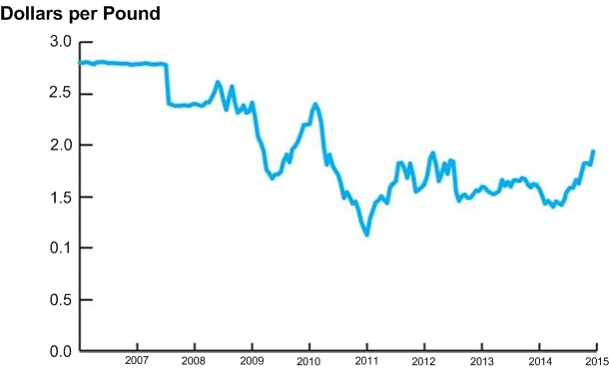
Auto-Regression Model for Forecasting
Can we predict the trend at a time say 2022?

Slide 25
Some Notations and Concepts
Y_{t} = Value of Y in a period t
Data set [Y₁, Y₂, … Y_{T-1}, Y_{T}]: T observations on the time series random variable Y
Assumptions
We consider only consecutive, evenly spaced observations
For example, monthly, 2000-2015, no missing months
A time series Y_{t} is stationary if its probability distribution does not change over time, that is, if the joint distribution of (Y_{i+1}, Y_{i+2}, …, Y_{i+T}) does not depend on i.
Stationary property implies that history is relevant. In other words, Stationary requires the future to be like the past (in a probabilistic sense).
Auto Regression analysis assumes that Y_{t} is stationary.

Slide 26
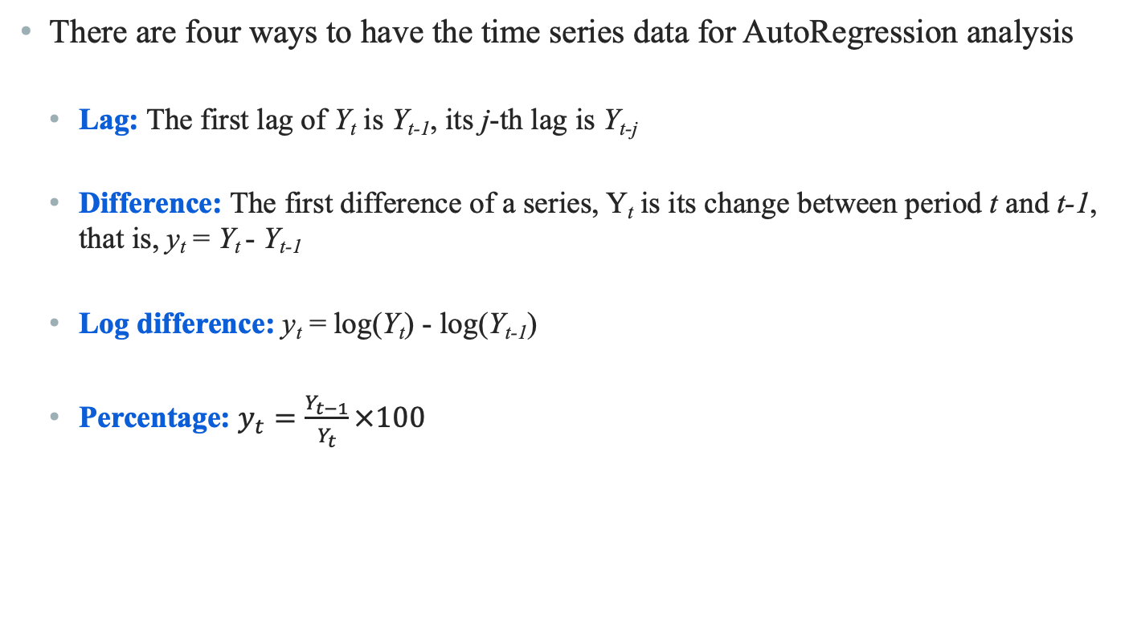
Some Notations and Concepts
There are four ways to have the time series data for AutoRegression analysis
Lag: The first lag of Y_{t} is Y_{t-1}, its j-th lag is Y_{t-j}
Difference: The first difference of a series, Y_{t} is its change between period t and t-1, that is, y_{t} = Y_{t} - Y_{t-1}
Log difference: y_{t} = log(Y_{t}) - log(Y_{t-1})
Percentage: $y_{t}=\frac{Y_{t−1}}{Y_{t}}×100$

Slide 27
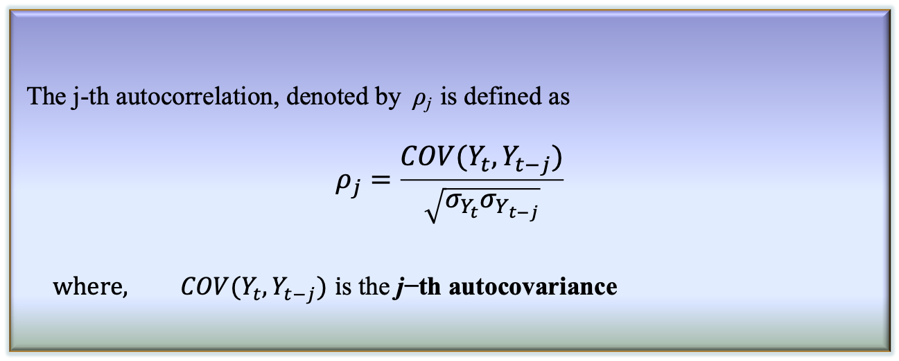
Some Notations and Concepts
Autocorrelation
The correlation of a series with its own lagged values is called autocorrelation (also called serial correlation)
The j-th autocorrelation, denoted by ρ_{j} is defined as
$$ρ_{j}=\frac{COV(Y_{t},Y_{t−j})}{\sqrt{σ_{Y_{t}}σ_{Y_{t−j}}}}$$
$$where, COV(Y_{t},Y_{t−j}) \text{i}\text{s} \text{the} \text{j}\text{−}\text{th} \text{autocovariance}$$
Definition: j-th Autocorrelation

Slide 28
Some Notations and Concepts
For the given data, say ρ₁ = 0.84
This implies that the Dollars per Pound is highly serially correlated
Similarly, we can determine ρ_{2 ,} ρ_{3 ….} etc., and hence different regression analyses

Slide 29
Auto-Regression Model for Forecasting
A natural starting point for forecasting model is to use past values of Y, that is, Y_{t-1}, Y_{t-2}, … to predict Y_{t}
An autoregression is a regression model in which Y_{t} is regressed against its own lagged values.
The number of lags used as regressors is called the order of autoregression
In first order autoregression (denoted as AR(1)), Y_{t} is regressed against Y_{t-1}
In p-th order autoregression (denoted as AR(p)), Y_{t} is regressed against, Y_{t-1}, Y_{t-2}, …,Y_{t-p}

Slide 30
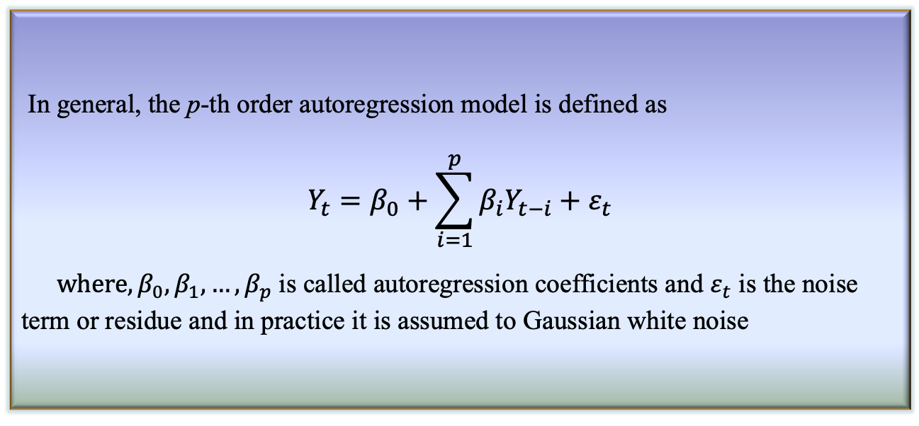
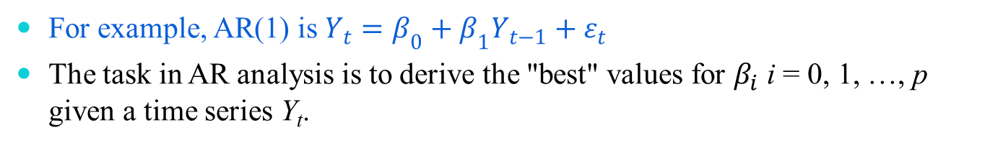
p-th Order Auto-Regression Model
In general, the p-th order autoregression model is defined as
$$Y_{t}=β_{0}+\sum_{i=1}^{p}{β_{i}Y_{t−i}}+ε_{t}$$
$where,{β_{0}, β}_{1}, …,β_{p}$ is called autoregression coefficients and $ε_{t}$ is the noise term or residue and in practice it is assumed to Gaussian white noise
Definition: p-th AutoRegression Model
For example, AR(1) is $Y_{t}=β_{0}+β_{1}Y_{t−1}+ε_{t}$
The task in AR analysis is to derive the "best" values for $β_{i}$ i = 0, 1, …, p given a time series Y_{t}.

Slide 31
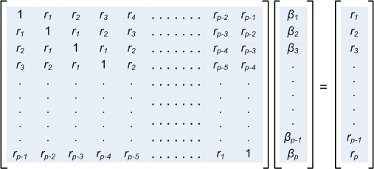
Computing AR Coefficients
A number of techniques known for computing the AR coefficients
The most common method is called Least Squares Method (LSM)
The LSM is based upon the Yule-Walker equations
Here, r_{i} (i = 1, 2 , 3, …, p-1) denotes the i-th auto correlation coefficient.
β₀ can be chosen empirically, usually taken as zero.

Slide 32
Reference
The detail material related to this lecture can be found in
The Elements of Statistical Learning, Data Mining, Inference, and Prediction (2nd Edn.), Trevor Hastie, Robert Tibshirani, Jerome Friedman, Springer, 2014.

Slide 33
Any question?

