Slide 1
Introduction to Data Analytics
Class # 18
Naïve Bayes’ Classifier: Example
Dr. Sreeja S R
Assistant Professor
Indian Institute of Information Technology
IIIT Sri City

Slide 2
Bayesian Classifier

Slide 3
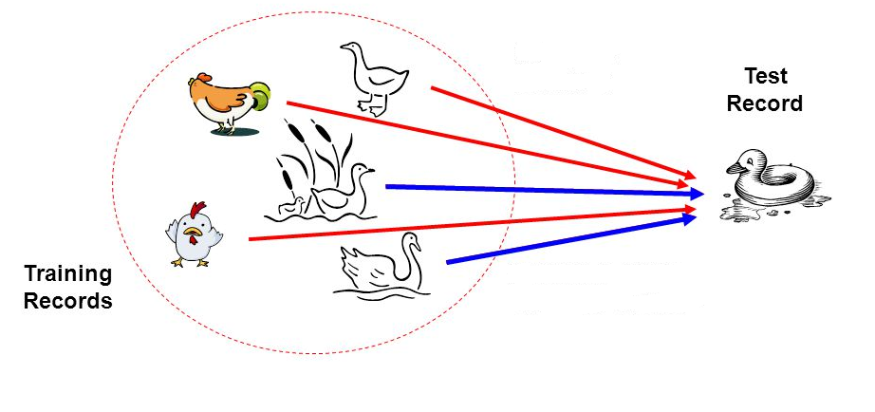
Bayesian Classifier
Principle
If it walks like a duck, quacks like a duck, then it is probably a duck

Slide 4
Bayesian Classifier
A statistical classifier
Performs probabilistic prediction, i.e., predicts class membership probabilities
Foundation
Based on Bayes’ Theorem.
Assumptions
The classes are mutually exclusive and exhaustive.
The attributes are independent given the class.
Called “Naïve” classifier because of these assumptions.
Empirically proven to be useful.
Scales very well.

Slide 5
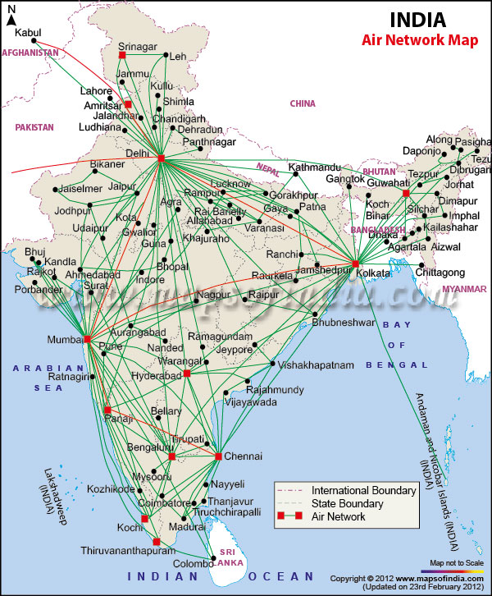
Example: Bayesian Classification
Example 8.2: Air Traffic Data
Let us consider a set observation recorded in a database
Regarding the arrival of airplanes in the routes from any airport to New Delhi under certain conditions.

Slide 6
Air-Traffic Data
Days | Season | Fog | Rain | Class
Weekday | Spring | None | None | On Time
Weekday | Winter | None | Slight | On Time
Weekday | Winter | None | None | On Time
Holiday | Winter | High | Slight | Late
Saturday | Summer | Normal | None | On Time
Weekday | Autumn | Normal | None | Very Late
Holiday | Summer | High | Slight | On Time
Sunday | Summer | Normal | None | On Time
Weekday | Winter | High | Heavy | Very Late
Weekday | Summer | None | Slight | On Time
Cond. to next slide…

Slide 7
Air-Traffic Data
Cond. from previous slide…
Days | Season | Fog | Rain | Class
Saturday | Spring | High | Heavy | Cancelled
Weekday | Summer | High | Slight | On Time
Weekday | Winter | Normal | None | Late
Weekday | Summer | High | None | On Time
Weekday | Winter | Normal | Heavy | Very Late
Saturday | Autumn | High | Slight | On Time
Weekday | Autumn | None | Heavy | On Time
Holiday | Spring | Normal | Slight | On Time
Weekday | Spring | Normal | None | On Time
Weekday | Spring | Normal | Heavy | On Time

Slide 8
Air-Traffic Data
In this database, there are four attributes
A = [ Day, Season, Fog, Rain]
with 20 tuples.
The categories of classes are:
C= [On Time, Late, Very Late, Cancelled]
Given this is the knowledge of data and classes, we are to find most likely classification for any other unseen instance, for example:
Classification technique eventually to map this tuple into an accurate class.
Week Day | Winter | High | None | ???

Slide 9
Bayes’ Theorem of Probability

Slide 10
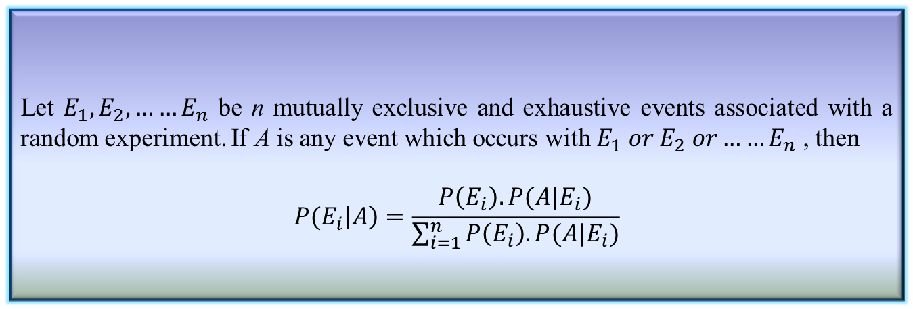
Bayes’ Theorem
Theorem 8.4: Bayes’ Theorem
Let $E_{1},E_{2},……E_{n}$ be n mutually exclusive and exhaustive events associated with a random experiment. If A is any event which occurs with $E_{1} or E_{2} or……E_{n}$ , then
$$P(E_{i}\left|A\right)=\frac{P\left(E_{i}\right).P(A|E_{i})}{\sum_{i=1}^{n}{P\left(E_{i}\right).P(A|E_{i})}}$$

Slide 11
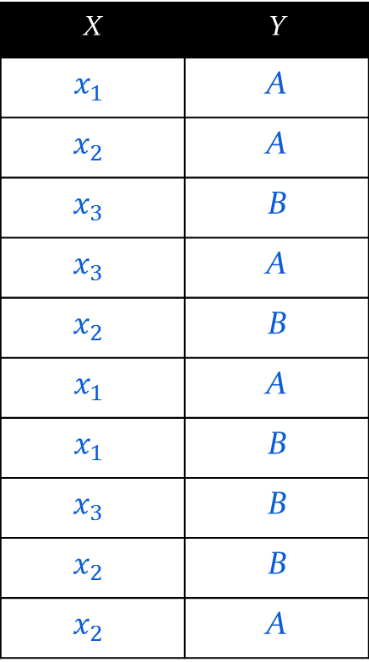
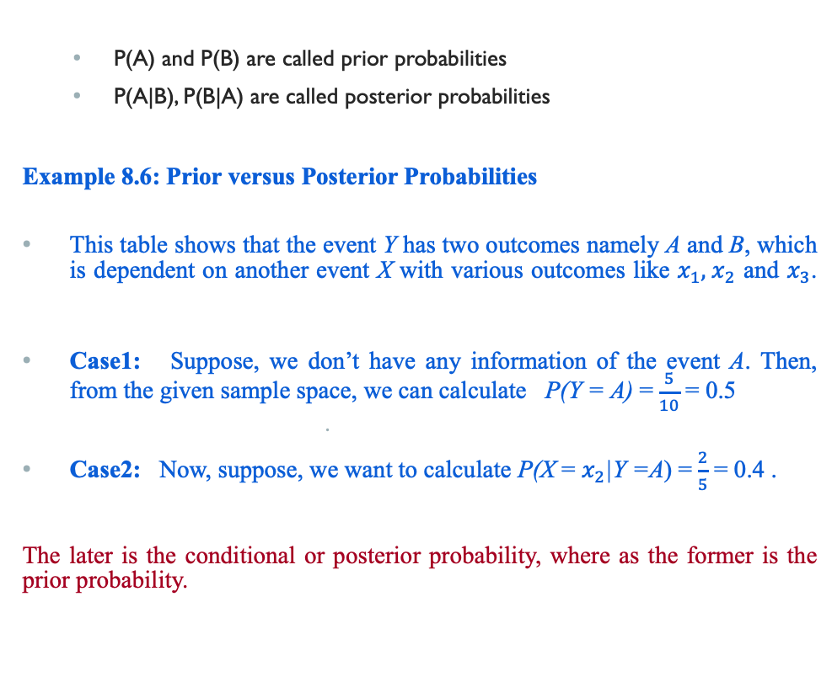
Prior and Posterior Probabilities
P(A) and P(B) are called prior probabilities
P(A|B), P(B|A) are called posterior probabilities
Example 8.6: Prior versus Posterior Probabilities
This table shows that the event Y has two outcomes namely A and B, which is dependent on another event X with various outcomes like $x_{1},{ x}_{2}$ and $x_{3}$.
Case1: Suppose, we don’t have any information of the event A. Then, from the given sample space, we can calculate P(Y = A) =$\frac{5}{10}$ = 0.5
Case2: Now, suppose, we want to calculate P(X = $x_{2}$|Y =A) =$\frac{2}{5}$ = 0.4 .
The later is the conditional or posterior probability, where as the former is the prior probability.
X | Y
$$x_{1}$$ | A
$$x_{2}$$ | A
$$x_{3}$$ | B
$$x_{3}$$ | A
$$x_{2}$$ | B
$$x_{1}$$ | A
$$x_{1}$$ | B
$$x_{3}$$ | B
$$x_{2}$$ | B
$$x_{2}$$ | A

Slide 12
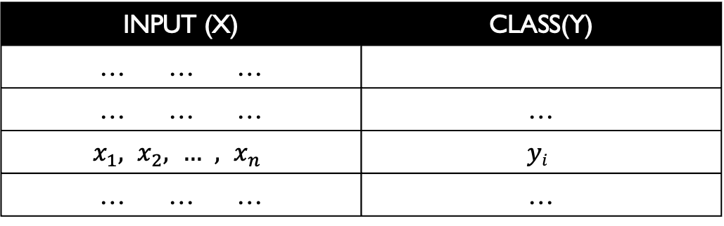

Naïve Bayesian Classifier
Suppose, Y is a class variable and X = $\left\{X1,X_{2},…..,X_{n}\right\}$ is a set of attributes,
with instance of Y.
The classification problem, then can be expressed as the class-conditional probability
$$P\left(Y=yi|\left(X_{1}=x_{1}\right) AND \left(X_{2}=x_{2}\right) AND …..\left(X_{n}=x_{n}\right)\right)$$
INPUT (X) | CLASS(Y)
… … …
… … … | …
$$x_{1},x_{2},…,x_{n}$$ | $$yi$$
… … … | …

Slide 13
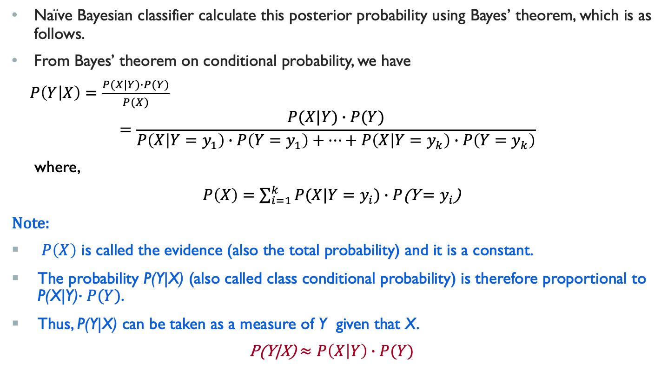
Naïve Bayesian Classifier
Naïve Bayesian classifier calculate this posterior probability using Bayes’ theorem, which is as follows.
From Bayes’ theorem on conditional probability, we have
$P\left(Y | X\right)=\frac{P(X|Y)∙P(Y)}{P(X)}$
$$=\frac{P(X|Y)∙P(Y)}{P\left(X | Y=y_{1}\right)∙P\left(Y=y_{1}\right)+…+P\left(X | Y=y_{k}\right)∙P\left(Y=y_{k}\right)}$$
where,
$P\left(X\right)=\sum_{i=1}^{k}{P(X|Y=y_{i}})∙P$(Y$=y_{i}$)
Note:
$P\left(X\right)$ is called the evidence (also the total probability) and it is a constant.
The probability P(Y|X) (also called class conditional probability) is therefore proportional to P(X|Y)$∙P(Y)$.
Thus, P(Y|X) can be taken as a measure of Y given that X.
P(Y|X) $≈P\left(X | Y\right)∙P(Y)$

Slide 14
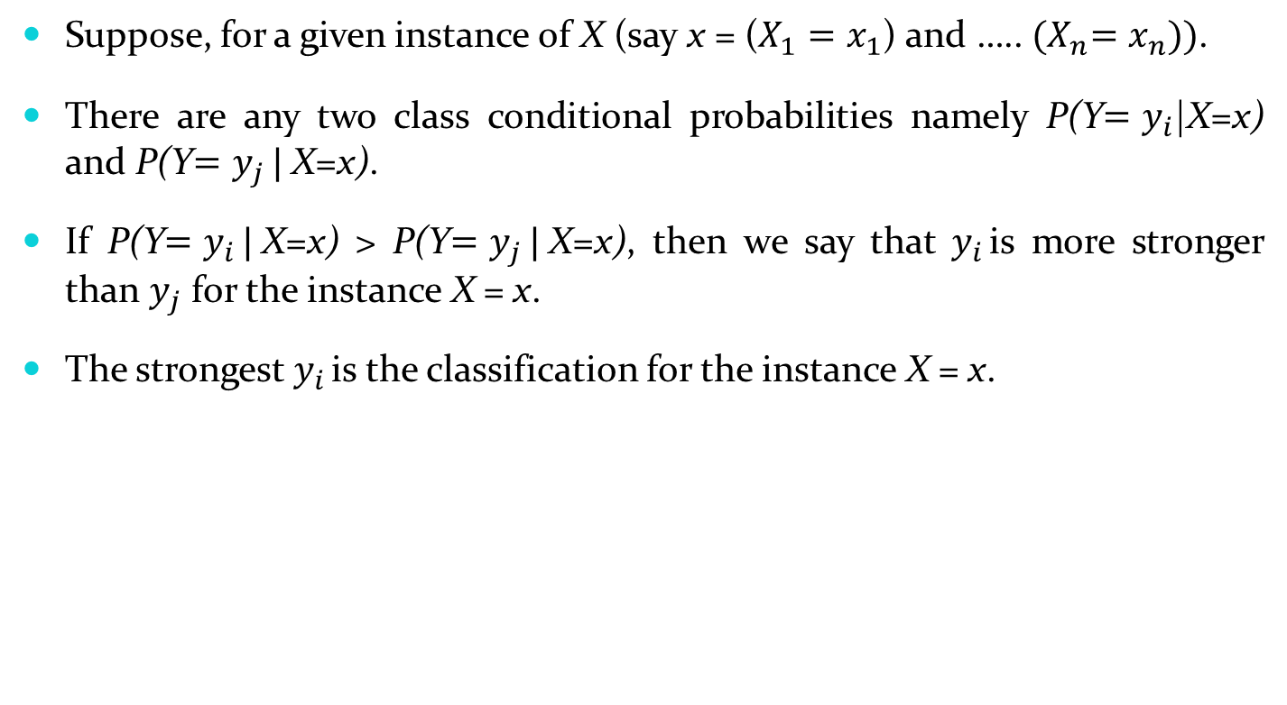
Naïve Bayesian Classifier
Suppose, for a given instance of X (say x = ($X_{1}=x_{1}$) and ….. ${(X}_{n}=x_{n}))$.
There are any two class conditional probabilities namely P(Y$=y_{i}$|X=x) and P(Y$=y_{j }|$X=x).
If P(Y$=y_{i }|$X=x) > P(Y$=y_{j }|$X=x), then we say that $y_{i }$is more stronger than $y_{j}$ for the instance X = x.
The strongest $y_{i }$is the classification for the instance X = x.

Slide 15


Naïve Bayesian Classifier
Input: Given a set of k mutually exclusive and exhaustive classes C = $\left\{c_{1},c_{2},…..,c_{k}\right\}$, which have prior probabilities P(C₁), P(C₂),….. P(C_{k}).
There are n-attribute set A = $\left\{A_{1},A_{2},…..,A_{n}\right\},$ which for a given instance have values $A_{1}$ = $a_{1}$, $A_{2}$ = $a_{2}$,….., $A_{n}$ = $a_{n}$
Step: For each $c_{i} ∈C$, calculate the class condition probabilities, i = 1,2,…..,k
$p_{i}=P\left(C_{i}\right)\text{×}\prod_{j=1}^{n}{P(A_{j}= a_{j}|C_{i}})$
$$p_{x}=\max\left\{p_{1},p_{2},…..,p_{k}\right\}$$
Output: $C_{x}$ is the classification
Algorithm: Naïve Bayesian Classification
Note: $\sum{p_{i}}$ $≠1$, because they are not probabilities rather proportion values (to posterior probabilities)

Slide 16

Naïve Bayesian Classifier
Example: With reference to the Air Traffic Dataset mentioned earlier, let us tabulate all the posterior and prior probabilities as shown below.
$P\left(A_{j}= a_{j} | C_{i}\right)$is the likelihood. Here, for the given example, $P(Day=weekday|C_{1}=On time)$
 |  | Class
Attribute |  | On Time | Late | Very Late | Cancelled
Day | Weekday | 9/14 = 0.64 | ½ = 0.5 | 3/3 = 1 | 0/1 = 0
 | Saturday | 2/14 = 0.14 | ½ = 0.5 | 0/3 = 0 | 1/1 = 1
 | Sunday | 1/14 = 0.07 | 0/2 = 0 | 0/3 = 0 | 0/1 = 0
 | Holiday | 2/14 = 0.14 | 0/2 = 0 | 0/3 = 0 | 0/1 = 0
Season | Spring | 4/14 = 0.29 | 0/2 = 0 | 0/3 = 0 | 0/1 = 0
 | Summer | 6/14 = 0.43 | 0/2 = 0 | 0/3 = 0 | 0/1 = 0
 | Autumn | 2/14 = 0.14 | 0/2 = 0 | 1/3= 0.33 | 0/1 = 0
 | Winter | 2/14 = 0.14 | 2/2 = 1 | 2/3 = 0.67 | 0/1 = 0

Slide 17
Naïve Bayesian Classifier
 |  | Class
Attribute |  | On Time | Late | Very Late | Cancelled
Fog | None | 5/14 = 0.36 | 0/2 = 0 | 0/3 = 0 | 0/1 = 0
 | High | 4/14 = 0.29 | 1/2 = 0.5 | 1/3 = 0.33 | 1/1 = 1
 | Normal | 5/14 = 0.36 | 1/2 = 0.5 | 2/3 = 0.67 | 0/1 = 0
Rain | None | 5/14 = 0.36 | 1/2 = 0.5 | 1/3 = 0.33 | 0/1 = 0
 | Slight | 8/14 = 0.57 | 0/2 = 0 | 0/3 = 0 | 0/1 = 0
 | Heavy | 1/14 = 0.07 | 1/2 = 0.5 | 2/3 = 0.67 | 1/1 = 1
Prior Probability |  | 14/20 = 0.70 | 2/20 = 0.10 | 3/20 = 0.15 | 1/20 = 0.05

Slide 18
Naïve Bayesian Classifier
Instance:
Case1: Class = On Time : 0.70 × 0.64 × 0.14 × 0.29 × 0.07 = 0.0013
Case2: Class = Late : 0.10 × 0.50 × 1.0 × 0.50 × 0.50 = 0.0125
Case3: Class = Very Late : 0.15 × 1.0 × 0.67 × 0.33 × 0.67 = 0.0222
Case4: Class = Cancelled : 0.05 × 0.0 × 0.0 × 1.0 × 1.0 = 0.0000
Case3 is the strongest; Hence correct classification is Very Late
Week Day | Winter | High | Heavy | ???

Slide 19
Naïve Bayesian Classifier
Pros and Cons
The Naïve Bayes’ approach is a very popular one, which often works well.
However, it has a number of potential problems
It relies on all attributes being categorical.
If the data is less, then it estimates poorly.

Slide 20
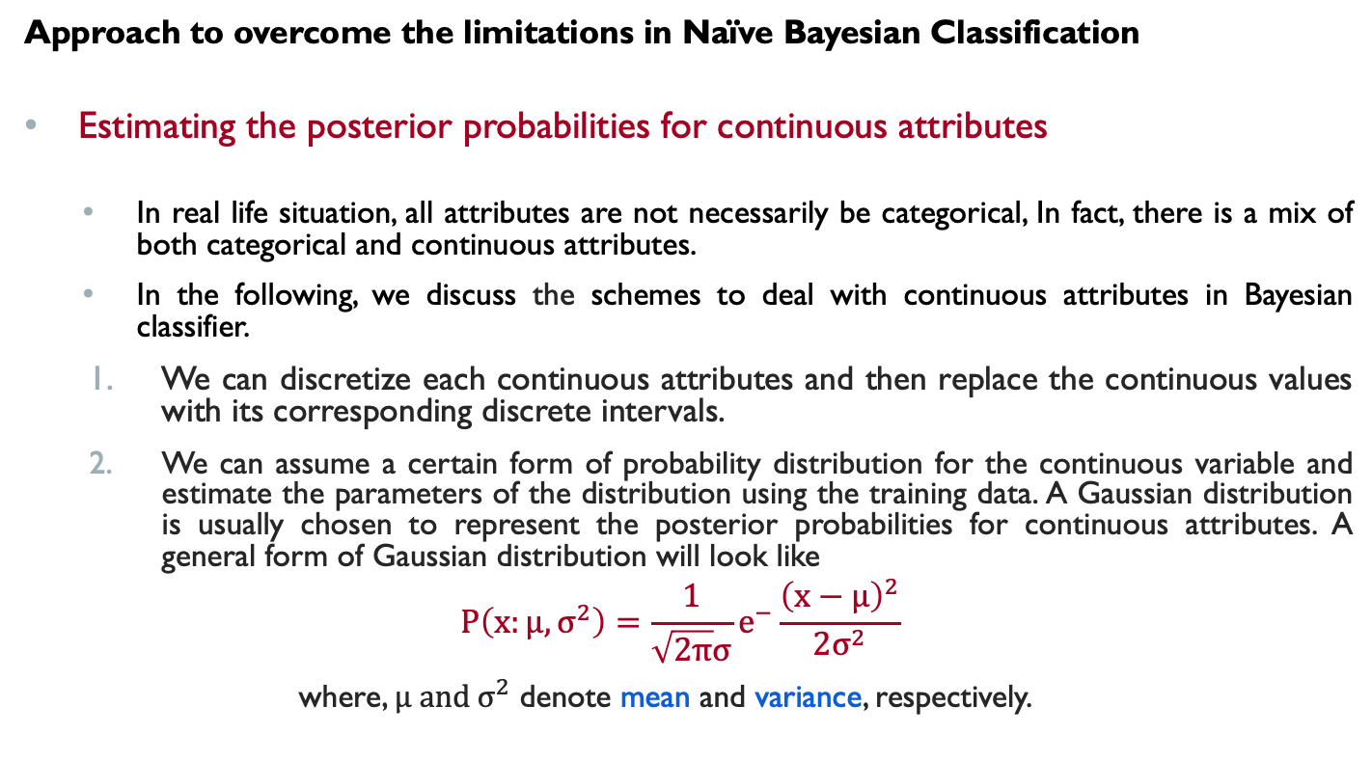
Naïve Bayesian Classifier
Approach to overcome the limitations in Naïve Bayesian Classification
Estimating the posterior probabilities for continuous attributes
In real life situation, all attributes are not necessarily be categorical, In fact, there is a mix of both categorical and continuous attributes.
In the following, we discuss the schemes to deal with continuous attributes in Bayesian classifier.
We can discretize each continuous attributes and then replace the continuous values with its corresponding discrete intervals.
We can assume a certain form of probability distribution for the continuous variable and estimate the parameters of the distribution using the training data. A Gaussian distribution is usually chosen to represent the posterior probabilities for continuous attributes. A general form of Gaussian distribution will look like
$$P\left(x:μ,σ^{2}\right)=\frac{1}{\sqrt{2π}σ}e^{−}\frac{{\left(x−μ\right)}^{2}}{2σ^{2}}$$
where, $μ and σ^{2}$ denote mean and variance, respectively.

Slide 21
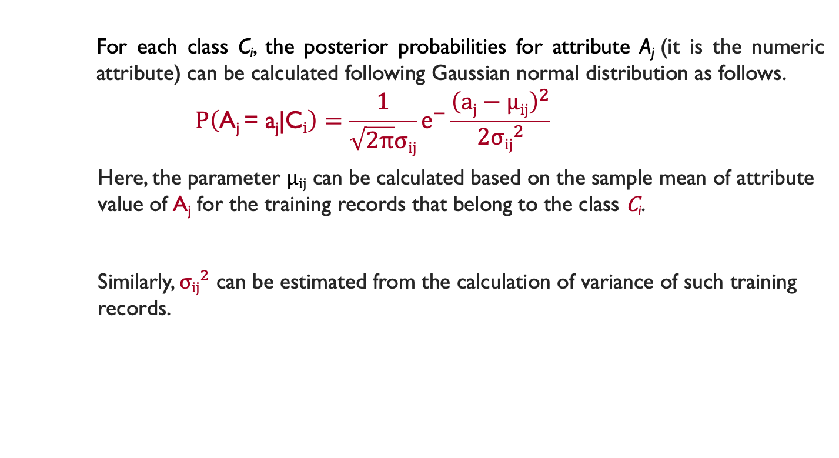
Naïve Bayesian Classifier
For each class C_{i}, the posterior probabilities for attribute A_{j} (it is the numeric attribute) can be calculated following Gaussian normal distribution as follows.
$$P\left(\text{A}\text{j} \text{=} \text{a}\text{j}\text{|}\text{C}i\right)=\frac{1}{\sqrt{2π}σij}e^{−}\frac{{\left(aj−μij\right)}^{2}}{2{σij}^{2}}$$
Here, the parameter $μij$ can be calculated based on the sample mean of attribute value of $\text{A}\text{j}$ for the training records that belong to the class $\text{C}\text{i}$.
Similarly, ${σij}^{2}$ can be estimated from the calculation of variance of such training records.

Slide 22
Naïve Bayesian Classifier
M-estimate of Conditional Probability
The M-estimation is to deal with the potential problem of Naïve Bayesian Classifier when training data size is too poor.
If the posterior probability for one of the attribute is zero, then the overall class-conditional probability for the class vanishes.
In other words, if training data do not cover many of the attribute values, then we may not be able to classify some of the test records.
This problem can be addressed by using the M-estimate approach.

Slide 23
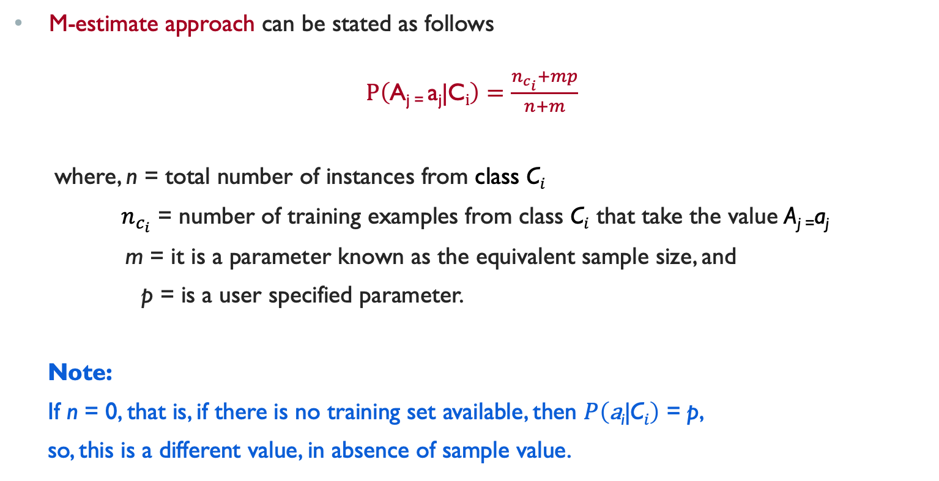
M-estimate Approach
M-estimate approach can be stated as follows
$P\left(\text{A}\text{j}\text{ = }\text{a}\text{j}\text{|}\text{C}i\right)=\frac{n_{c_{i}}+mp}{n+m}$
where, n = total number of instances from class $\text{C}i$
$n_{c_{i}}$ = number of training examples from class $\text{C}i$ that take the value $\text{A}\text{j}\text{ =}\text{a}\text{j}$
m = it is a parameter known as the equivalent sample size, and
p = is a user specified parameter.
Note:
If n = 0, that is, if there is no training set available, then $P\left(\text{a}\text{i}\text{|}\text{C}i\right)$ = p,
so, this is a different value, in absence of sample value.

Slide 24
A Practice Example
Example 17.4
Class:
C1:buys_computer = ‘yes’
C2:buys_computer = ‘no’
Data instance
X = (age <=30,
Income = medium,
Student = yes
Credit_rating = fair)

Slide 25
A Practice Example
Example 17.4

Slide 26
A Practice Example
P(C_{i}): P(buys_computer = “yes”) = 9/14 = 0.643
P(buys_computer = “no”) = 5/14= 0.357
Compute P(X|C_{i}) for each class
P(age = “<=30” | buys_computer = “yes”) = 2/9 = 0.222
P(age = “<= 30” | buys_computer = “no”) = 3/5 = 0.6
P(income = “medium” | buys_computer = “yes”) = 4/9 = 0.444
P(income = “medium” | buys_computer = “no”) = 2/5 = 0.4
P(student = “yes” | buys_computer = “yes) = 6/9 = 0.667
P(student = “yes” | buys_computer = “no”) = 1/5 = 0.2
P(credit_rating = “fair” | buys_computer = “yes”) = 6/9 = 0.667
P(credit_rating = “fair” | buys_computer = “no”) = 2/5 = 0.4
X = (age <= 30 , income = medium, student = yes, credit_rating = fair)
P(X|C_{i}) : P(X|buys_computer = “yes”) = 0.222 × 0.444 × 0.667 × 0.667 = 0.044
P(X|buys_computer = “no”) = 0.6 × 0.4 × 0.2 × 0.4 = 0.019
P(X|C_{i})*P(C_{i}) : P(X|buys_computer = “yes”) * P(buys_computer = “yes”) = 0.028
P(X|buys_computer = “no”) * P(buys_computer = “no”) = 0.007
Therefore, X belongs to class (“buys_computer = yes”)

Slide 27
Reference
The detail material related to this lecture can be found in
Data Mining: Concepts and Techniques, (3rd Edn.), Jiawei Han, Micheline Kamber, Morgan Kaufmann, 2015.
Introduction to Data Mining, Pang-Ning Tan, Michael Steinbach, and Vipin Kumar, Addison-Wesley, 2014

Slide 28
Any question?

