Slide 1
Introduction to Data Analytics
Class # 19
Classification: Decision Tree Induction
Dr. Sreeja S R
Assistant Professor
Indian Institute of Information Technology
IIIT Sri City

Slide 2

An interesting fact..
Thanks to 3D printing, NASA can basically “email” tools to astronauts.
Getting new equipment to the Space Station used to take months or years, but the new technology means the tools are ready within hours.

Slide 3
This presentation slides includes…
Concept of Decision Tree
Use of Decision Tree to classify data
Basic algorithm to build Decision Tree
Some illustrations
Concept of Entropy
Basic concept of entropy in information theory
Mathematical formulation of entropy
Calculation of entropy of a training set
Decision Tree induction algorithms
ID3
CART
C4.5

Slide 4
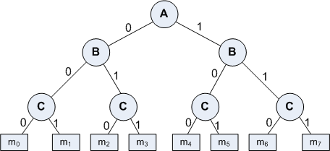
Basic Concept
A Decision Tree is an important data structure known to solve many computational problems
Example 19.1: Binary Decision Tree

Slide 5
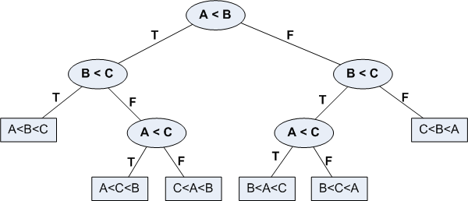
Basic Concept
In Example 19.1, we have considered a decision tree where values of any attribute if binary only. Decision tree is also possible where attributes are of continuous data type
Example 19.2: Decision Tree with numeric data

Slide 6
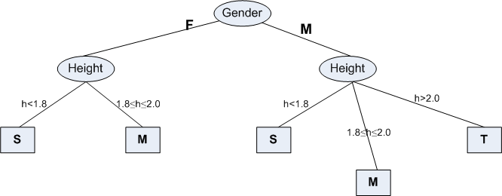
Some Characteristics
Decision tree may be n-ary, n ≥ 2.
There is a special node called root node.
All nodes drawn with circle (ellipse) are called internal nodes.
All nodes drawn with rectangle boxes are called terminal nodes or leaf nodes.
Edges of a node represent the outcome for a value of the node.
In a path, a node with same label is never repeated.
Decision tree is not unique, as different ordering of internal nodes can give different decision tree.

Slide 7
Decision Tree and Classification Task
Decision tree helps us to classify data.
Internal nodes are some attribute
Edges are the values of attributes
External nodes are the outcome of classification
Such a classification is, in fact, made by posing questions starting from the root node to each terminal node.

Slide 8
Decision Tree and Classification Task
Example 19.3 : Vertebrate Classification
What are the class label of Dragon and Shark?
Name | Body Temperature | Skin Cover | Gives Birth | Aquatic Creature | Aerial Creature | Has Legs | Hibernates | Class
Human | Warm | hair | yes | no | no | yes | no | Mammal
Python | Cold | scales | no | no | no | no | yes | Reptile
Salmon | Cold | scales | no | yes | no | no | no | Fish
Whale | Warm | hair | yes | yes | no | no | no | Mammal
Frog | Cold | none | no | semi | no | yes | yes | Amphibian
Komodo | Cold | scales | no | no | no | yes | no | Reptile
Bat | Warm | hair | yes | no | yes | yes | yes | Mammal
Pigeon | Warm | feathers | no | no | yes | yes | no | Bird
Cat | Warm | fur | yes | no | no | yes | no | Mammal
Leopard | Cold | scales | yes | yes | no | no | no | Fish
Turtle | Cold | scales | no | semi | no | yes | no | Reptile
Penguin | Warm | feathers | no | semi | no | yes | no | Bird
Porcupine | Warm | quills | yes | no | no | yes | yes | Mammal
Eel | Cold | scales | no | yes | no | no | no | Fish
Salamander | Cold | none | no | semi | no | yes | yes | Amphibian

Slide 9
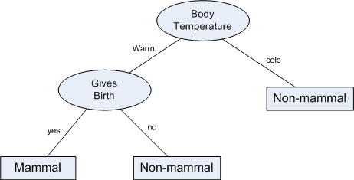
Decision Tree and Classification Task
Example 19.3 : Vertebrate Classification
Suppose, a new species is discovered as follows.
Decision Tree that can be inducted based on the data (in Example 19.3) is as follows.
Name | Body Temperature | Skin Cover | Gives Birth | Aquatic Creature | Aerial Creature | Has Legs | Hibernates | Class
Gila Monster | cold | scale | no | no | no | yes | yes | ?

Slide 10
Decision Tree and Classification Task
Example 19.3 illustrates how we can solve a classification problem by asking a series of question about the attributes.
Each time we receive an answer, a follow-up question is asked until we reach a conclusion about the class-label of the test.
The series of questions and their answers can be organized in the form of a decision tree
As a hierarchical structure consisting of nodes and edges
Once a decision tree is built, it is applied to any test to classify it.

Slide 11
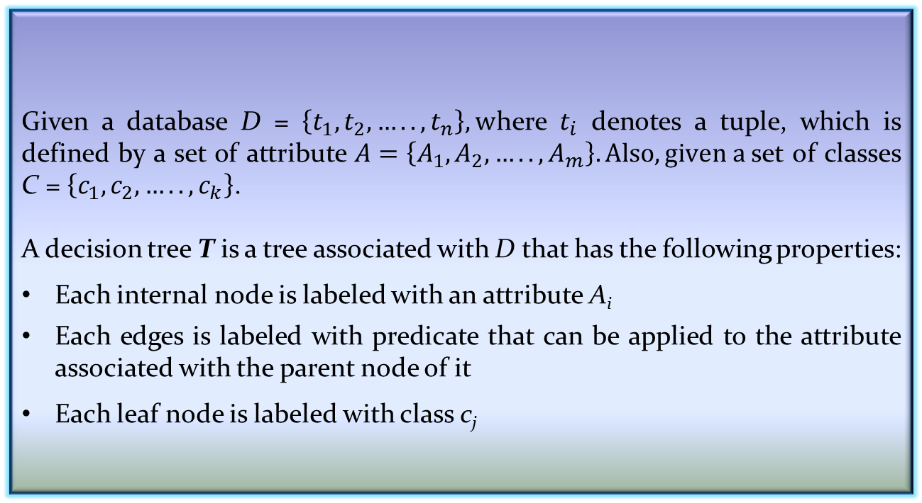
Definition of Decision Tree
Given a database D = $\left\{t_{1},t_{2},…..,t_{n}\right\}, w$here $t_{i}$ denotes a tuple, which is defined by a set of attribute $A=\left\{A_{1},A_{2},…..,A_{m}\right\}. Also, given a$set of classes C = $\left\{c_{1},c_{2},…..,c_{k}\right\}$.
A decision tree T is a tree associated with D that has the following properties:
Each internal node is labeled with an attribute A_{i}
Each edges is labeled with predicate that can be applied to the attribute associated with the parent node of it
Each leaf node is labeled with class c_{j}
Definition: Decision Tree

Slide 12
Building Decision Tree
In principle, there are exponentially many decision tree that can be constructed from a given database (also called training data).
Some of the tree may not be optimum
Some of them may give inaccurate result
Two approaches are known
Greedy strategy
A top-down recursive divide-and-conquer
Modification of greedy strategy
ID3
C4.5
CART, etc.

Slide 13
Built Decision Tree Algorithm
Algorithm BuiltDT
Input: D : Training data set
Output: T : Decision tree
Steps
If all tuples in D belongs to the same class C_{j}
Add a leaf node labeled as C_{j}
Return // Termination condition
Select an attribute A_{i} (so that it is not selected twice in the same branch)
Partition D = { D₁, D₂, …, D_{p}} based on p different values of A_{i} in D
For each D_{k} ϵ D
Create a node and add an edge between D and D_{k} with label as the A_{i}’s attribute value in D_{k}
For each D_{k} ϵ D
BuildDT(D_{k}) // Recursive call
Stop

Slide 14


Node Splitting in BuildDT Algorithm
BuildDT algorithm must provides a method for expressing an attribute test condition and corresponding outcome for different attribute type
Case: Binary attribute
This is the simplest case of node splitting
The test condition for a binary attribute generates only two outcomes

Slide 15
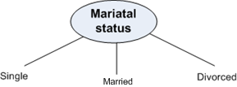

Node Splitting in BuildDT Algorithm
Case: Nominal attribute
Since a nominal attribute can have many values, its test condition can be expressed in two ways:
A multi-way split
A binary split
Muti-way split: Outcome depends on the number of distinct values for the corresponding attribute
Binary splitting by grouping attribute values

Slide 16
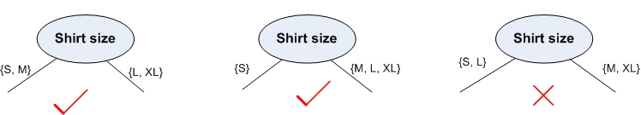
Node Splitting in BuildDT Algorithm
Case: Ordinal attribute
It also can be expressed in two ways:
A multi-way split
A binary split
Multi-way split: It is same as in the case of nominal attribute
Binary splitting attribute values should be grouped maintaining the order property of the attribute values

Slide 17

Node Splitting in BuildDT Algorithm
Case: Numerical attribute
For numeric attribute (with discrete or continuous values), a test condition can be expressed as a comparison set
Binary outcome: A > v or A ≤ v
In this case, decision tree induction must consider all possible split positions
Range query : v_{i} ≤ A < v_{i+1} for i = 1, 2, …, q (if q number of ranges are chosen)
Here, q should be decided a priori
For a numeric attribute, decision tree induction is a combinatorial optimization problem

Slide 18
Illustration : BuildDT Algorithm
Example 19.4: Illustration of BuildDT Algorithm
Consider a training data set as shown.
Attributes:
Gender = {Male(M), Female (F)} // Binary attribute
Height = {1.5, …, 2.5} // Continuous attribute
Class = {Short (S), Medium (M), Tall (T)}
Given a person, we are to test in which class s/he belongs

Slide 19
Illustration : BuildDT Algorithm
To built a decision tree, we can select an attribute in two different orderings: <Gender, Height> or <Height, Gender>
Further, for each ordering, we can choose different ways of splitting
Different instances are shown in the following.
Approach 1 : <Gender, Height>

Slide 20
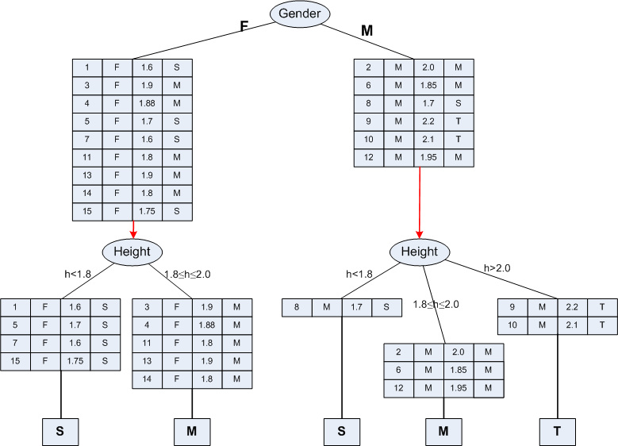
Illustration : BuildDT Algorithm

Slide 21
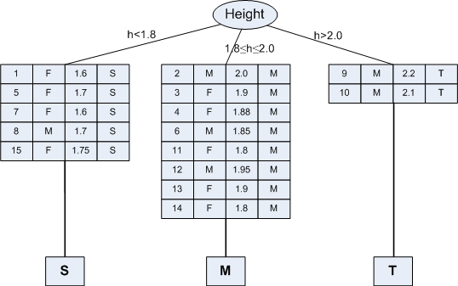
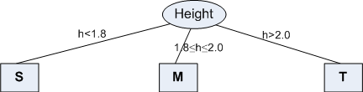
Illustration : BuildDT Algorithm
Approach 2 : <Height, Gender>

Slide 22
Illustration : BuildDT Algorithm
Example 19.5: Illustration of BuildDT Algorithm
Consider an anonymous database as shown.
Is there any “clue” that enables to select the “best” attribute first?
Suppose, following are two attempts:
A1→A2→A3→A4 [naïve]
A3→A2→A4→A1 [Random]
Draw the decision trees in the above-mentioned two cases.
Are the trees different to classify any test data?
If any other sample data is added into the database, is that likely to alter the decision tree already obtained?

Slide 23
Concept of Entropy

Slide 24
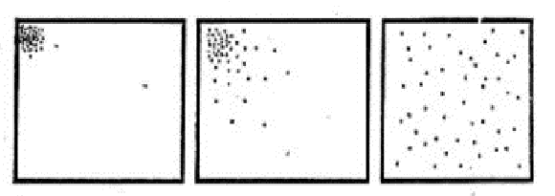
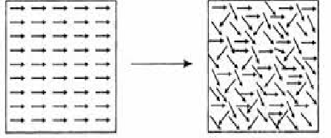


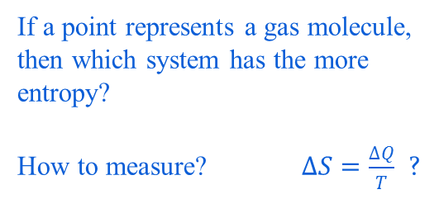
Concept of Entropy
If a point represents a gas molecule,
then which system has the more
entropy?
How to measure? $∆S=\frac{∆Q}{T}$ ?
More ordered Less ordered
less entropy higher entropy
More organized or Less organized or
ordered (less probable) disordered (more probable)

Slide 25
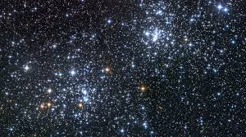
Concept of Entropy
Universe!
What was its entropy value at its starting point?

Slide 26
Entropy and its Meaning
Entropy is an important concept used in Physics in the context of heat and thereby uncertainty of the states of a matter.
At a later stage, with the growth of Information Technology, entropy becomes an important concept in Information Theory.
To deal with the classification job, entropy is an important concept, which is considered as
an information-theoretic measure of the “uncertainty” contained in a training data
due to the presence of more than one classes.

Slide 27
Entropy in Information Theory
The entropy concept in information theory first time coined by Claude Shannon (1850).
The first time it was used to measure the “information content” in messages.
According to his concept of entropy, presently entropy is widely being used as a way of representing messages for efficient transmission by Telecommunication Systems.

Slide 28
Measure of Information Content
People, in general, are information hungry!
Everybody wants to acquire information (from newspaper, library, nature, fellows, etc.)
Think how a crime detector do it to know about the crime from crime spot and criminal(s).
Kids annoyed their parents asking questions.
In fact, fundamental thing is that we gather information asking questions (and decision tree induction is no exception).
We may note that information gathering may be with certainty or uncertainty.

Slide 29
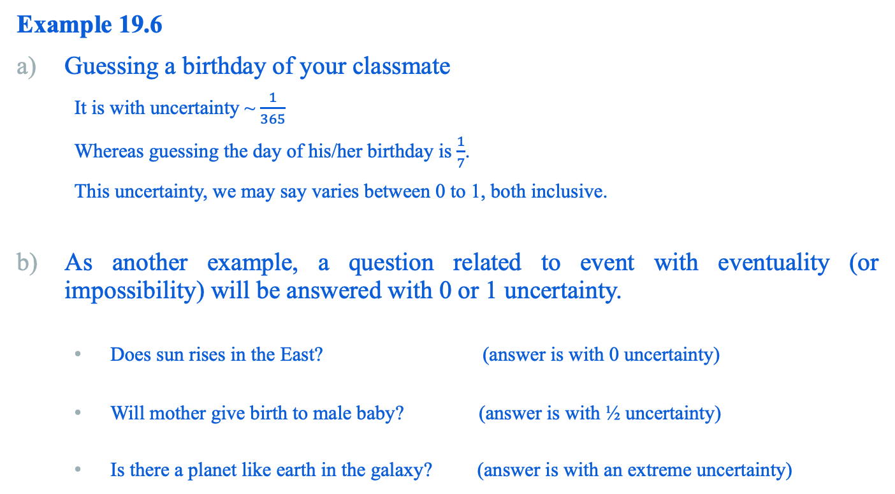
Measure of Information Content
Example 19.6
Guessing a birthday of your classmate
It is with uncertainty ~ $\frac{1}{365}$
Whereas guessing the day of his/her birthday is $\frac{1}{7}$.
This uncertainty, we may say varies between 0 to 1, both inclusive.
As another example, a question related to event with eventuality (or impossibility) will be answered with 0 or 1 uncertainty.
Does sun rises in the East? (answer is with 0 uncertainty)
Will mother give birth to male baby? (answer is with ½ uncertainty)
Is there a planet like earth in the galaxy? (answer is with an extreme uncertainty)

Slide 30

Definition of Entropy
Suppose there are m distinct objects, which we want to identify by asking a series of Yes/No questions. Further, we assume that m is an exact power of 2, say $m=2^{n}$, where $n≥1$.
Definition: Entropy
The entropy of a set of m distinct values is the minimum number of yes/no questions needed to determine an unknown values from these m possibilities.

Slide 31
Entropy Calculation
How can we calculate the minimum number of questions, that is, entropy?
There are two approaches:
Brute –force approach
Clever approach.
Example 19.7: City quiz
Suppose, Thee is a quiz relating to guess a city out of 8 cities, which are as follows:
Bangalore, Bhopal, Bhubaneshwar, Delhi, Hyderabad, Kolkata, Madras, Mumbai
The question is, “Which city is called city of joy”?

Slide 32
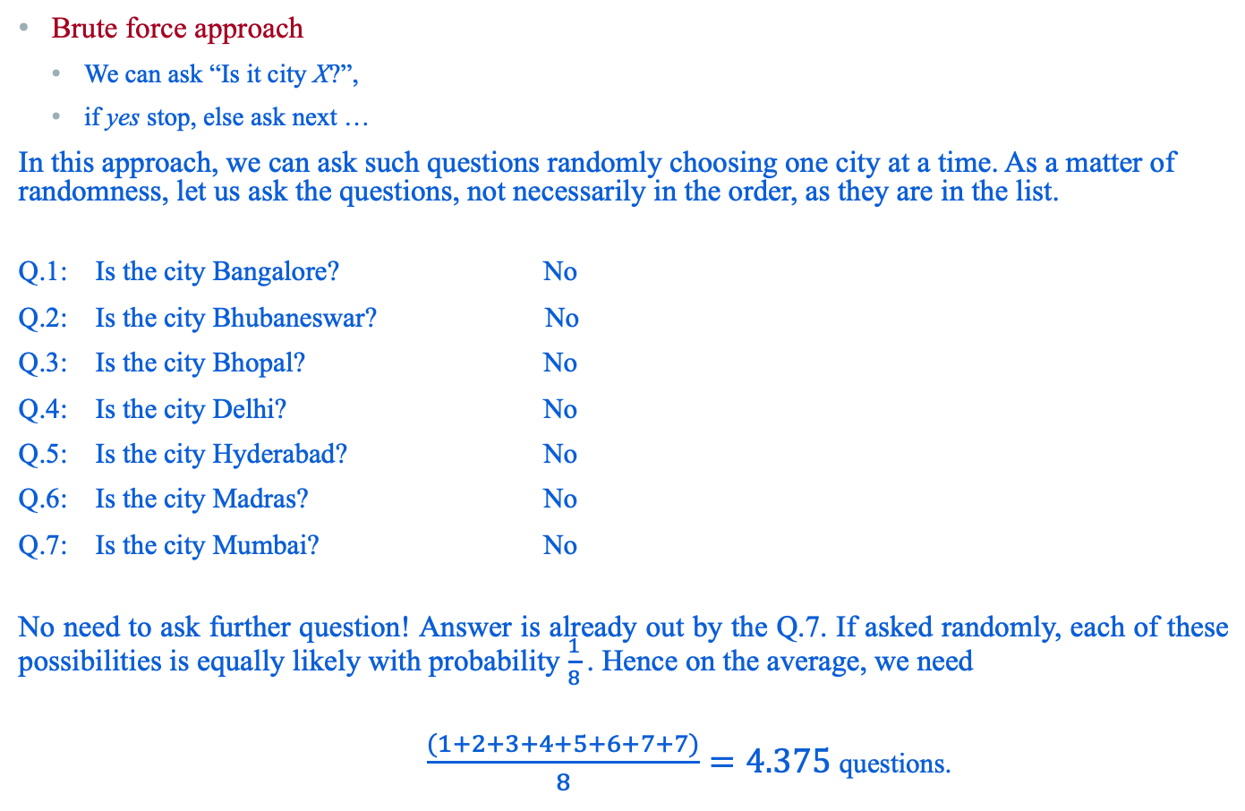
Approach 1: Brute-force search
Brute force approach
We can ask “Is it city X?”,
if yes stop, else ask next …
In this approach, we can ask such questions randomly choosing one city at a time. As a matter of randomness, let us ask the questions, not necessarily in the order, as they are in the list.
Q.1: Is the city Bangalore? No
Q.2: Is the city Bhubaneswar? No
Q.3: Is the city Bhopal? No
Q.4: Is the city Delhi? No
Q.5: Is the city Hyderabad? No
Q.6: Is the city Madras? No
Q.7: Is the city Mumbai? No
No need to ask further question! Answer is already out by the Q.7. If asked randomly, each of these possibilities is equally likely with probability $\frac{1}{8}$. Hence on the average, we need
$\frac{(1+2+3+4+5+6+7+7)}{8}=4.375$questions.

Slide 33
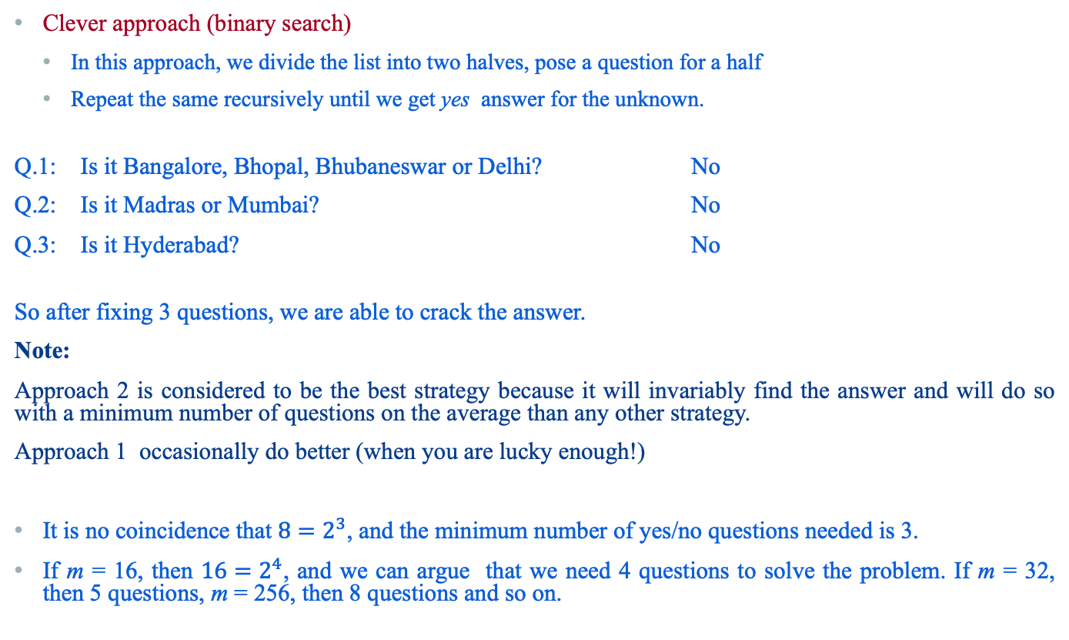
Approach 2: Clever approach
Clever approach (binary search)
In this approach, we divide the list into two halves, pose a question for a half
Repeat the same recursively until we get yes answer for the unknown.
Q.1: Is it Bangalore, Bhopal, Bhubaneswar or Delhi? No
Q.2: Is it Madras or Mumbai? No
Q.3: Is it Hyderabad? No
So after fixing 3 questions, we are able to crack the answer.
Note:
Approach 2 is considered to be the best strategy because it will invariably find the answer and will do so with a minimum number of questions on the average than any other strategy.
Approach 1 occasionally do better (when you are lucky enough!)
It is no coincidence that $8=2^{3}$, and the minimum number of yes/no questions needed is 3.
If m = 16, then $16=2^{4}$, and we can argue that we need 4 questions to solve the problem. If m = 32, then 5 questions, m = 256, then 8 questions and so on.

Slide 34
Reference
The detail material related to this lecture can be found in
Data Mining: Concepts and Techniques, (3rd Edn.), Jiawei Han, Micheline Kamber, Morgan Kaufmann, 2015.
Introduction to Data Mining, Pang-Ning Tan, Michael Steinbach, and Vipin Kumar, Addison-Wesley, 2014

Slide 35
Any question?

