Slide 1
Introduction to Data Analytics
Class # 22
Sensitivity Analysis
Dr. Sreeja S R
Assistant Professor
Indian Institute of Information Technology
IIIT Sri City

Slide 2
Topics Covered in this Presentation
Introduction
Estimation Strategies
Accuracy Estimation
Error Estimation
Statistical Estimation
Performance Estimation
ROC Curve

Slide 3
Introduction
A classifier is used to predict an outcome of a test data
Such a prediction is useful in many applications
Business forecasting, cause-and-effect analysis, etc.
A number of classifiers have been evolved to support the activities.
Each has their own merits and demerits
There is a need to estimate the accuracy and performance of the classifier with respect to few controlling parameters in data sensitivity
As a task of sensitivity analysis, we have to focus on
Estimation strategy
Metrics for measuring accuracy
Metrics for measuring performance

Slide 4
Estimation Strategy

Slide 5
Planning for Estimation
Using some “training data”, building a classifier based on certain principle is called “learning a classifier”.
After building a classifier and before using it for classification of unseen instance, we have to validate it using some “test data”.
Usually training data and test data are outsourced from a large pool of data already available.
split
Data set Estimation
Learning technique
Training data
Test data
CLASSIFIER

Slide 6
Estimation Strategies
Accuracy and performance measurement should follow a strategy. As the topic is important, many strategies have been advocated so far. Most widely used strategies are
Holdout method
Random subsampling
Cross-validation
Bootstrap approach

Slide 7
Holdout Method
This is a basic concept of estimating a prediction.
Given a dataset, it is partitioned into two disjoint sets called training set and testing set.
Classifier is learned based on the training set and get evaluated with testing set.
Proportion of training and testing sets is at the discretion of analyst; typically 1:1 or 2:1, and there is a trade-off between these sizes of these two sets.
If the training set is too large, then model may be good enough, but estimation may be less reliable due to small testing set and vice-versa.

Slide 8
Random Subsampling
It is a variation of Holdout method to overcome the drawback of over-presenting a class in one set thus under-presenting it in the other set and vice-versa.
In this method, Holdout method is repeated k times, and in each time, two disjoint sets are chosen at random with a predefined sizes.
Overall estimation is taken as the average of estimations obtained from each iteration.

Slide 9
Cross-Validation
The main drawback of Random subsampling is, it does not have control over the number of times each tuple is used for training and testing.
Cross-validation is proposed to overcome this problem.
There are two variations in the cross-validation method.
k-fold cross-validation
N-fold cross-validation

Slide 10
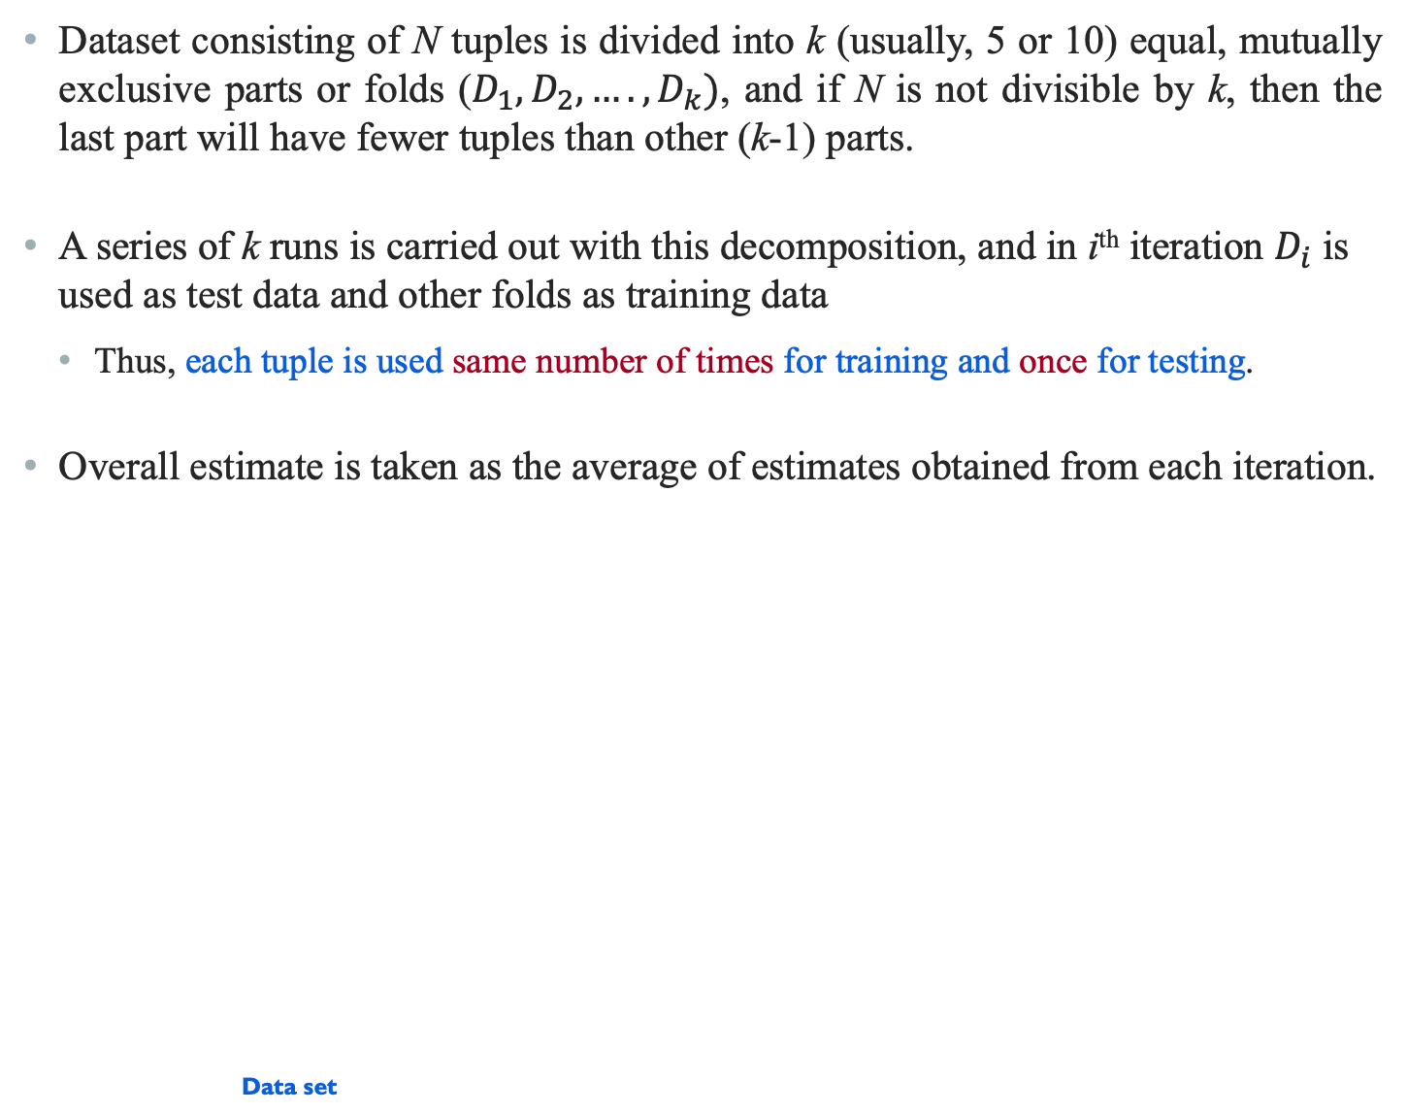
k-fold Cross-Validation
Dataset consisting of N tuples is divided into k (usually, 5 or 10) equal, mutually exclusive parts or folds ($D_{1},D_{2},….,D_{k})$, and if N is not divisible by k, then the last part will have fewer tuples than other (k-1) parts.
A series of k runs is carried out with this decomposition, and in i^{th} iteration $D_{i}$ is used as test data and other folds as training data
Thus, each tuple is used same number of times for training and once for testing.
Overall estimate is taken as the average of estimates obtained from each iteration.
Data set
D¹
Fold 1
Learning technique
D^{i}
Fold i
Data set
D^{k}
CLASSIFIER
Fold k
Accuracy
Performance

Slide 11
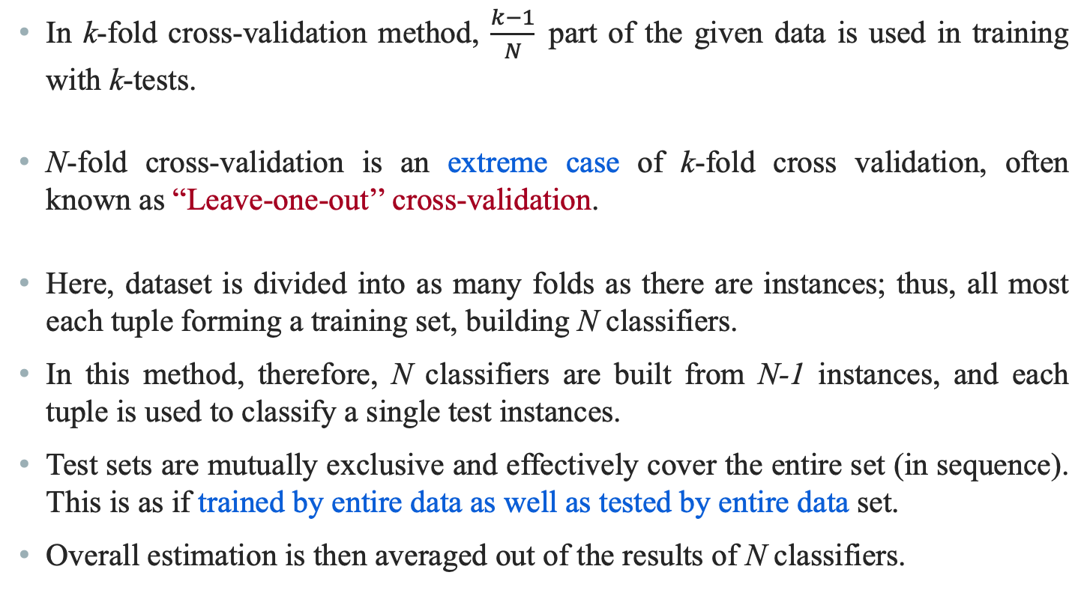
N-fold Cross-Validation
In k-fold cross-validation method, $\frac{k−1}{N}$part of the given data is used in training with k-tests.
N-fold cross-validation is an extreme case of k-fold cross validation, often known as “Leave-one-out’’ cross-validation.
Here, dataset is divided into as many folds as there are instances; thus, all most each tuple forming a training set, building N classifiers.
In this method, therefore, N classifiers are built from N-1 instances, and each tuple is used to classify a single test instances.
Test sets are mutually exclusive and effectively cover the entire set (in sequence). This is as if trained by entire data as well as tested by entire data set.
Overall estimation is then averaged out of the results of N classifiers.

Slide 12
N-fold Cross-Validation : Issue
So far the estimation of accuracy and performance of a classifier model is concerned, the N-fold cross-validation is comparable to the others we have just discussed.
The drawback of N-fold cross validation strategy is that it is computationally expensive, as here we have to repeat the run N times; this is particularly true when data set is large.
In practice, the method is extremely beneficial with very small data set only, where as much data as possible to need to be used to train a classifier.

Slide 13
Bootstrap Method
The Bootstrap method is a variation of repeated version of Random sampling method.
The method suggests the sampling of training records with replacement.
Each time a record is selected for training set, is put back into the original pool of records, so that it is equally likely to be redrawn in the next run.
In other words, the Bootstrap method samples the given data set uniformly with replacement.
The rational of having this strategy is that let some records be occur more than once in the samples of both training as well as testing.
What is the probability that a record will be selected more than once?

Slide 14
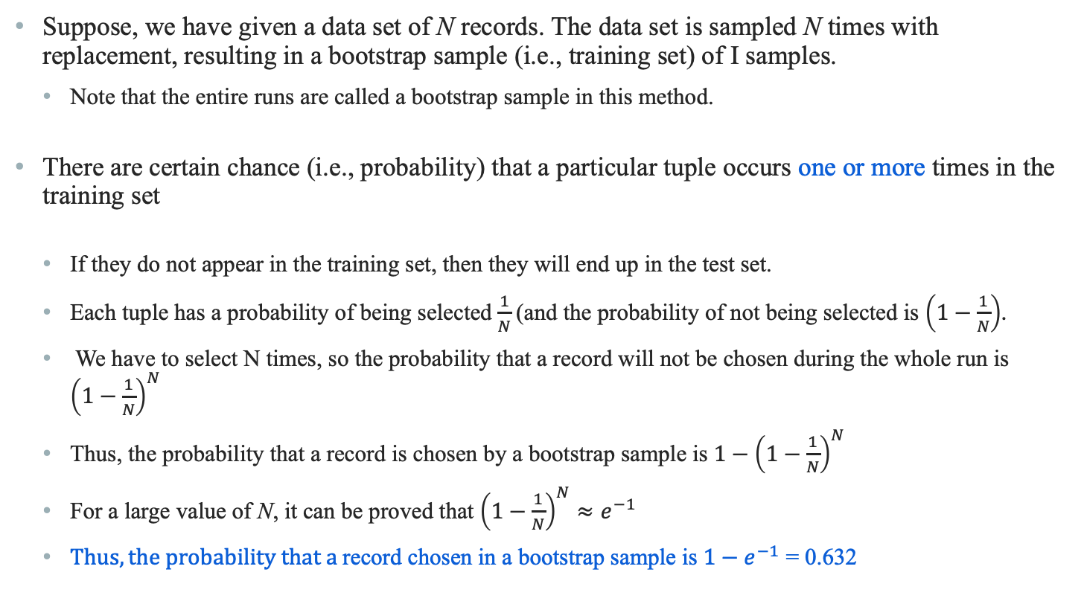
Bootstrap Method
Suppose, we have given a data set of N records. The data set is sampled N times with replacement, resulting in a bootstrap sample (i.e., training set) of I samples.
Note that the entire runs are called a bootstrap sample in this method.
There are certain chance (i.e., probability) that a particular tuple occurs one or more times in the training set
If they do not appear in the training set, then they will end up in the test set.
Each tuple has a probability of being selected $\frac{1}{N}$(and the probability of not being selected is $\left(1−\frac{1}{N}\right)$.
We have to select N times, so the probability that a record will not be chosen during the whole run is ${\left(1−\frac{1}{N}\right)}^{N}$
Thus, the probability that a record is chosen by a bootstrap sample is ${1−\left(1−\frac{1}{N}\right)}^{N}$
For a large value of N, it can be proved that ${\left(1−\frac{1}{N}\right)}^{N}≈e^{−1}$
$Thus, the probability that a$record chosen in a bootstrap sample is ${1−e}^{−1}$ = 0.632

Slide 15
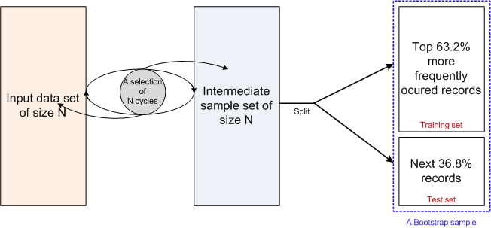
Bootstrap Method : Implication
This is why, the Bootstrap method is also known as 0.632 bootstrap method

Slide 16
Accuracy Estimation

Slide 17
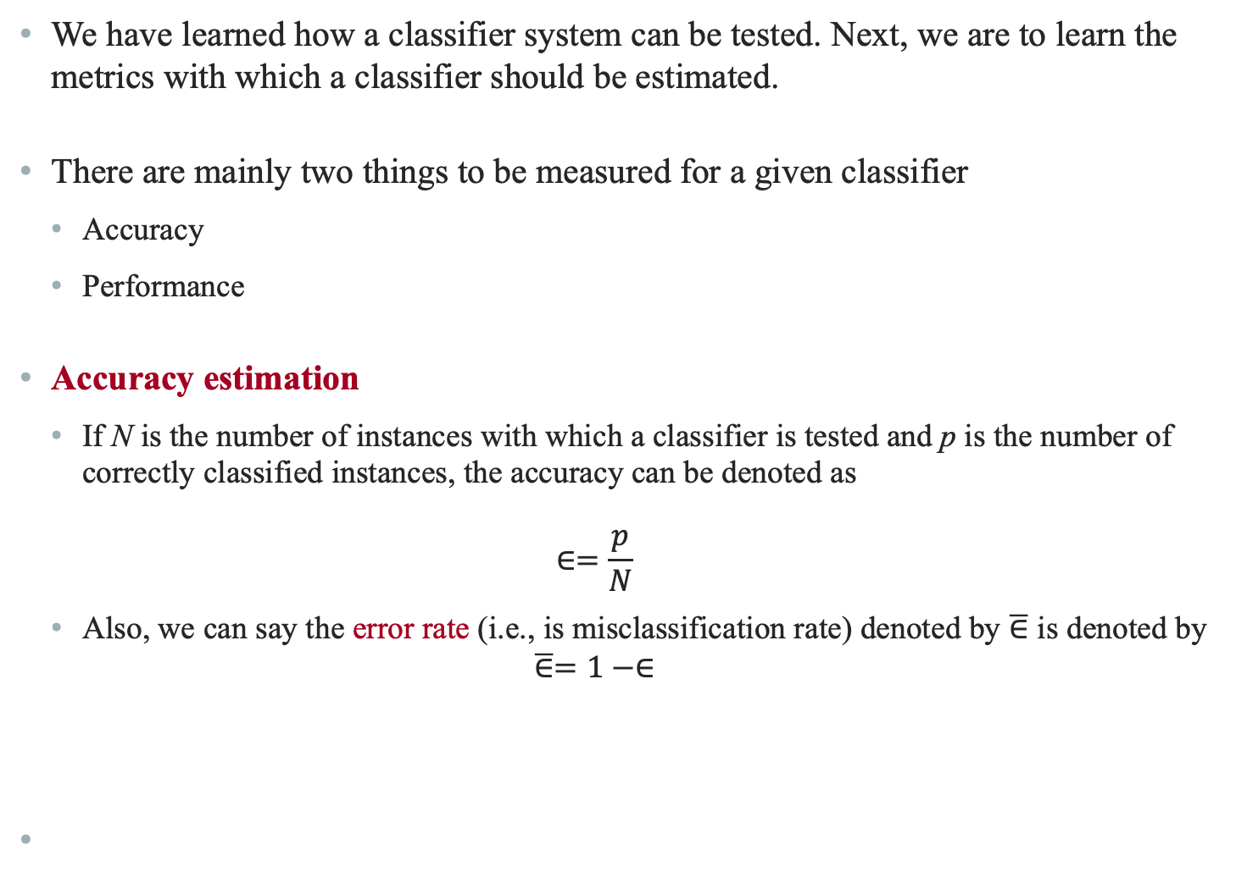
Accuracy Estimation
We have learned how a classifier system can be tested. Next, we are to learn the metrics with which a classifier should be estimated.
There are mainly two things to be measured for a given classifier
Accuracy
Performance
Accuracy estimation
If N is the number of instances with which a classifier is tested and p is the number of correctly classified instances, the accuracy can be denoted as
$$∈=\frac{p}{N}$$
Also, we can say the error rate (i.e., is misclassification rate) denoted by $\overline{∈}$ is denoted by
$$\overline{∈}=1−∈$$

Slide 18
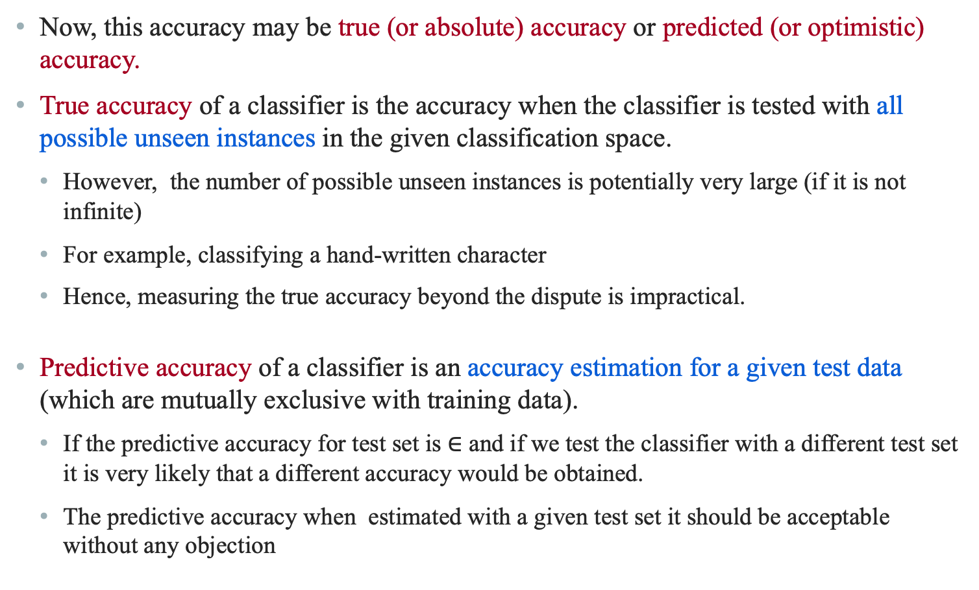
Accuracy : True and Predictive
Now, this accuracy may be true (or absolute) accuracy or predicted (or optimistic) accuracy.
True accuracy of a classifier is the accuracy when the classifier is tested with all possible unseen instances in the given classification space.
However, the number of possible unseen instances is potentially very large (if it is not infinite)
For example, classifying a hand-written character
Hence, measuring the true accuracy beyond the dispute is impractical.
Predictive accuracy of a classifier is an accuracy estimation for a given test data (which are mutually exclusive with training data).
If the predictive accuracy for test set is $∈$ and if we test the classifier with a different test set it is very likely that a different accuracy would be obtained.
The predictive accuracy when estimated with a given test set it should be acceptable without any objection

Slide 19
Predictive Accuracy
Example 21.1 : Universality of predictive accuracy
Consider a classifier model M^{D} developed with a training set D using an algorithm M.
Two predictive accuracies when M^{D} is estimated with two different training sets T₁ and T₂ are
(M^{D})_{T1} = 95%
(M^{D})_{T2} = 70%
Further, assume the size of T₁ and T₂ are
|T₁| = 100 records
|T₂| = 5000 records.
Based on the above mentioned estimations, neither estimation is acceptable beyond doubt.

Slide 20
Predictive Accuracy
With the above-mentioned issue in mind, researchers have proposed two heuristic measures
Error estimation using Loss Functions
Statistical Estimation using Confidence Level
In the next few slides, we will discus about the two estimations

Slide 21
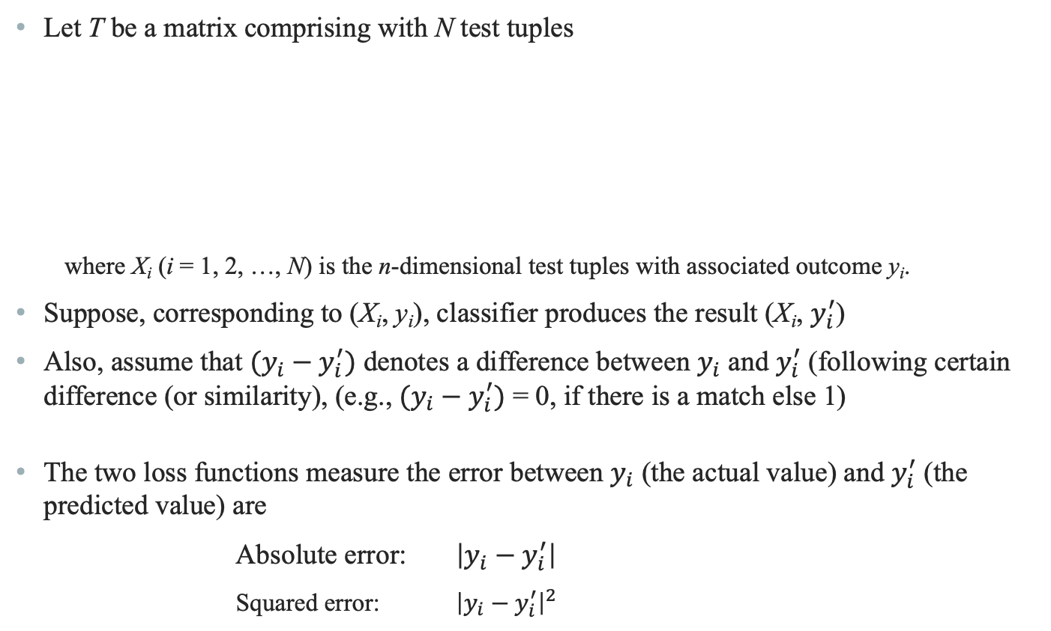
Error Estimation using Loss Functions
Let T be a matrix comprising with N test tuples
where X_{i} (i = 1, 2, …, N) is the n-dimensional test tuples with associated outcome y_{i}.
Suppose, corresponding to (X_{i}, y_{i}), classifier produces the result (X_{i}, $y_{i}^{′}$)
Also, assume that $(y_{i}−y_{i}^{′})$ denotes a difference between $y_{i}$ and $y_{i}^{′}$ (following certain difference (or similarity), (e.g., $(y_{i}−y_{i}^{′})$ = 0, if there is a match else 1)
The two loss functions measure the error between $y_{i}$ (the actual value) and $y_{i}^{′}$ (the predicted value) are
Absolute error: $\left|y_{i}−y_{i}^{′}\right|$
Squared error: ${\left|y_{i}−y_{i}^{′}\right|}^{2}$
N×(n+1)

Slide 22
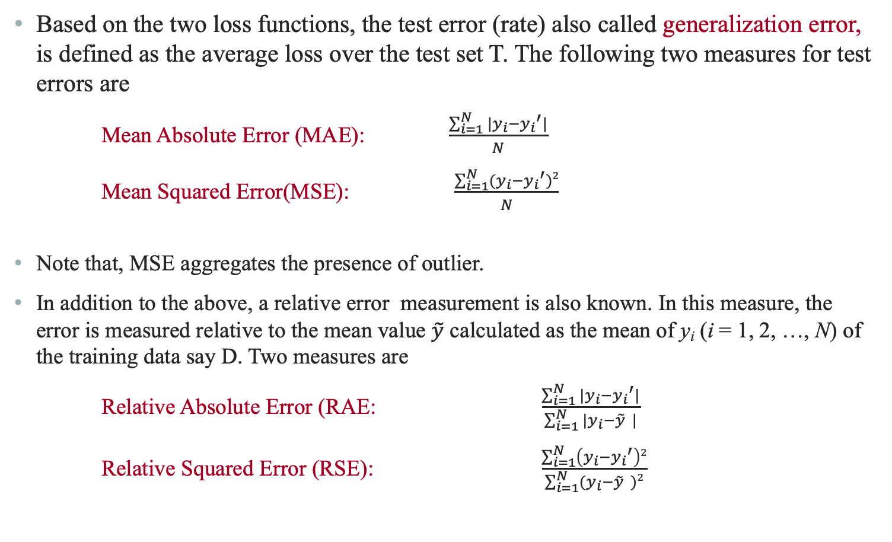
Error Estimation using Loss Functions
Based on the two loss functions, the test error (rate) also called generalization error, is defined as the average loss over the test set T. The following two measures for test errors are
Mean Absolute Error (MAE): $\frac{\sum_{i=1}^{N}{|y_{i}−{y_{i}}^{′}|}}{N}$
Mean Squared Error(MSE): $\frac{\sum_{i=1}^{N}{(y_{i}−{y_{i}}^{′})2}}{N}$
Note that, MSE aggregates the presence of outlier.
In addition to the above, a relative error measurement is also known. In this measure, the error is measured relative to the mean value $\tilde{y}$ calculated as the mean of y_{i} (i = 1, 2, …, N) of the training data say D. Two measures are
Relative Absolute Error (RAE: $\frac{\sum_{i=1}^{N}{|y_{i}−{y_{i}}^{′}|}}{\sum_{i=1}^{N}{|y_{i}−\tilde{y} |}}$
Relative Squared Error (RSE): $\frac{\sum_{i=1}^{N}{\left(y_{i}−{y_{i}}^{′}\right)2}}{\sum_{i=1}^{N}{(y_{i}−\tilde{y} )}2}$

Slide 23
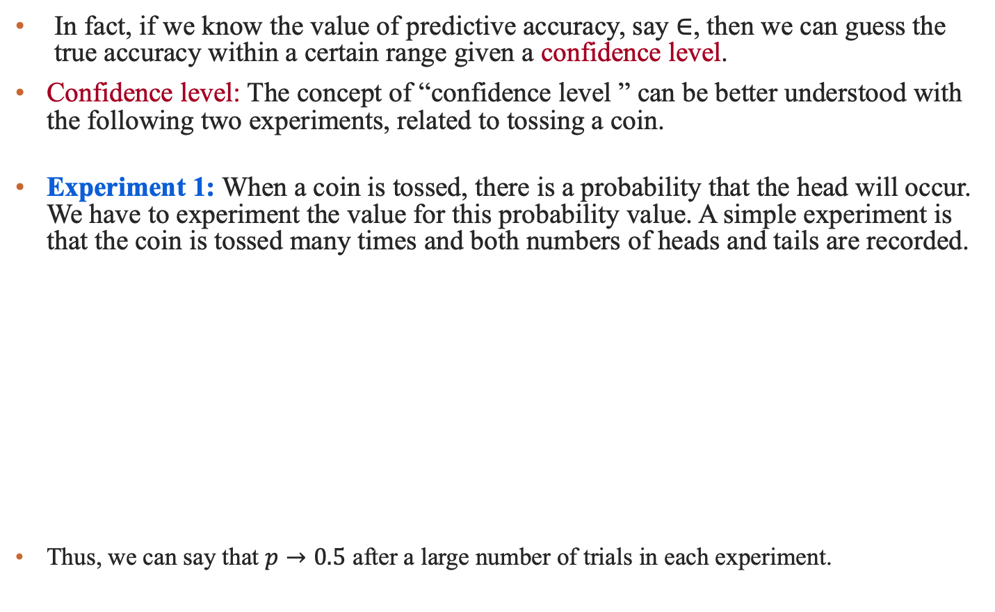
Statistical Estimation using Confidence Level
In fact, if we know the value of predictive accuracy, say $∈$, then we can guess the true accuracy within a certain range given a confidence level.
Confidence level: The concept of “confidence level ” can be better understood with the following two experiments, related to tossing a coin.
Experiment 1: When a coin is tossed, there is a probability that the head will occur. We have to experiment the value for this probability value. A simple experiment is that the coin is tossed many times and both numbers of heads and tails are recorded.
Thus, we can say that $p→0.5$ after a large number of trials in each experiment.
N=10 |  | N=50 |  | N=100 |  | N=250 |  | N=500 |  | N=1000
H | T | H | T | H | T | H | T | H | T | H | T
3 | 7 | 29 | 21 | 54 | 46 | 135 | 115 | 241 | 259 | 490 | 510
0.30 | 0.70 | 0.58 | 0.42 | 0.54 | 0.46 | 0.54 | 0.46 | 0.48 | 0.42 | 0.49 | 0.51

Slide 24
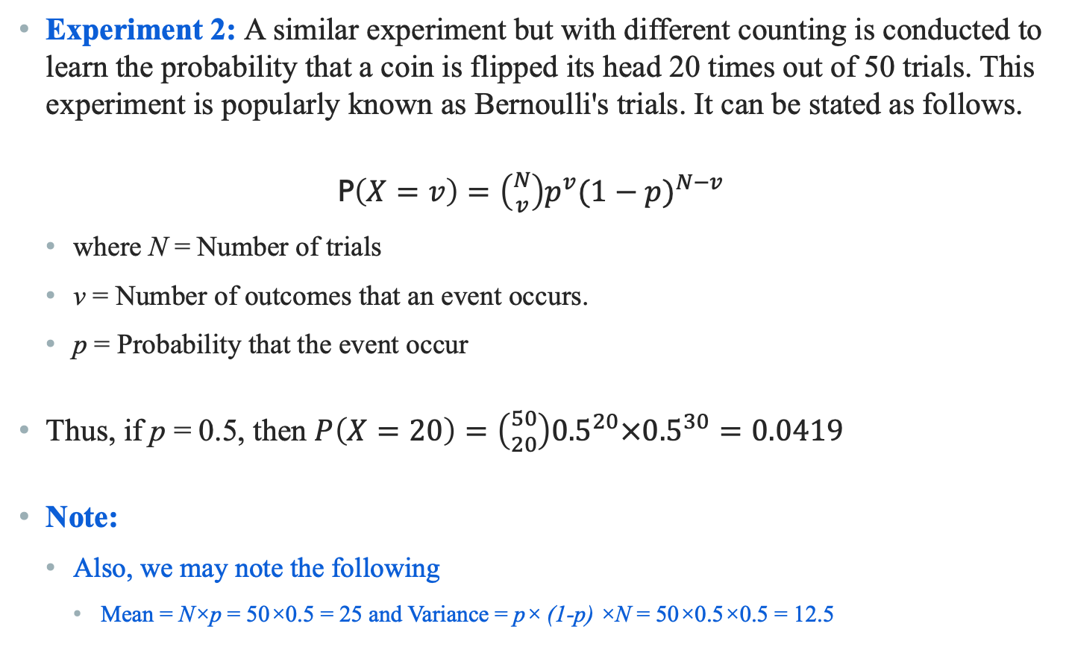
Statistical Estimation using Confidence Level
Experiment 2: A similar experiment but with different counting is conducted to learn the probability that a coin is flipped its head 20 times out of 50 trials. This experiment is popularly known as Bernoulli's trials. It can be stated as follows.
P$\left(X=v\right)=\left({N \atop v}\right)p^{v}{(1−p)}^{N−v}$
where N = Number of trials
v = Number of outcomes that an event occurs.
p = Probability that the event occur
Thus, if p = 0.5, then $P\left(X=20\right)=\left({50 \atop 20}\right){0.5}^{20}×{0.5}^{30}=0.0419$
Note:
Also, we may note the following
Mean = N×p = 50×0.5 = 25 and Variance = p× (1-p) ×N = 50×0.5×0.5 = 12.5

Slide 25
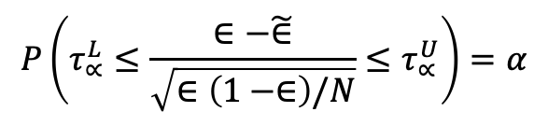
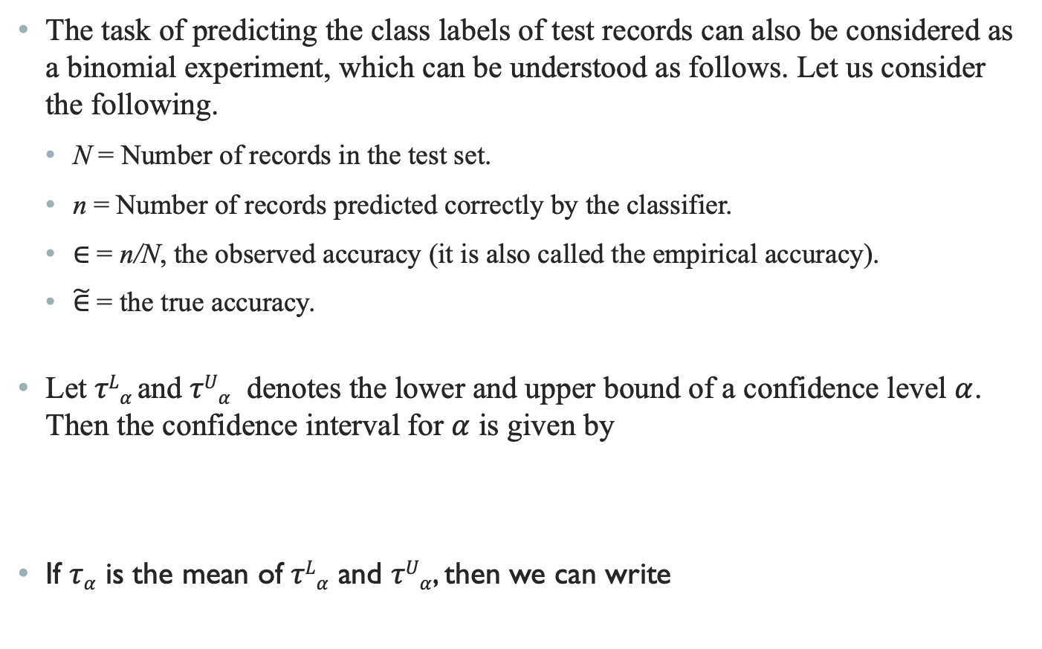
Statistical Estimation using Confidence Level
The task of predicting the class labels of test records can also be considered as a binomial experiment, which can be understood as follows. Let us consider the following.
N = Number of records in the test set.
n = Number of records predicted correctly by the classifier.
$∈$ = n/N, the observed accuracy (it is also called the empirical accuracy).
$\tilde{∈}$ = the true accuracy.
Let $τLα$and $τUα$ denotes the lower and upper bound of a confidence level $α$. Then the confidence interval for $α$ is given by
If $τα$ is the mean of $τLα$ and $τUα$, then we can write
$$P\left(τ_{∝}^{L}≤\frac{∈−\tilde{∈}}{\sqrt{∈\left(1−∈\right)/N}}≤τ_{∝}^{U}\right)=α$$
$$\tilde{∈} = ∈±τ_{α}×\sqrt{∈(1−∈)/N}$$

Slide 26
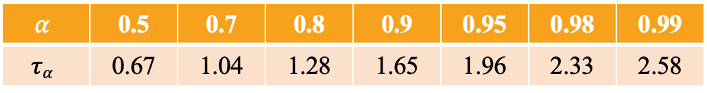
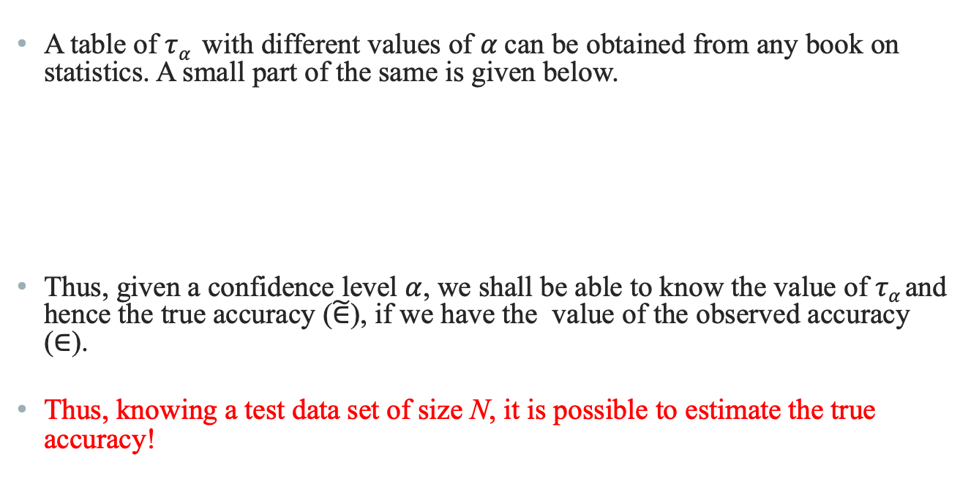
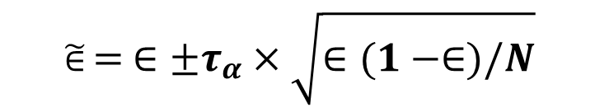
Statistical Estimation using Confidence Level
$$\tilde{∈} = ∈±τ_{α}×\sqrt{∈(1−∈)/N}$$
A table of $τα$ with different values of $α$can be obtained from any book on statistics. A small part of the same is given below.
Thus, given a confidence level $α$, we shall be able to know the value of $τα$and hence the true accuracy ($\tilde{∈}$), if we have the value of the observed accuracy ($∈$).
Thus, knowing a test data set of size N, it is possible to estimate the true accuracy!
$$α$$ | 0.5 | 0.7 | 0.8 | 0.9 | 0.95 | 0.98 | 0.99
$$τα$$ | 0.67 | 1.04 | 1.28 | 1.65 | 1.96 | 2.33 | 2.58

Slide 27
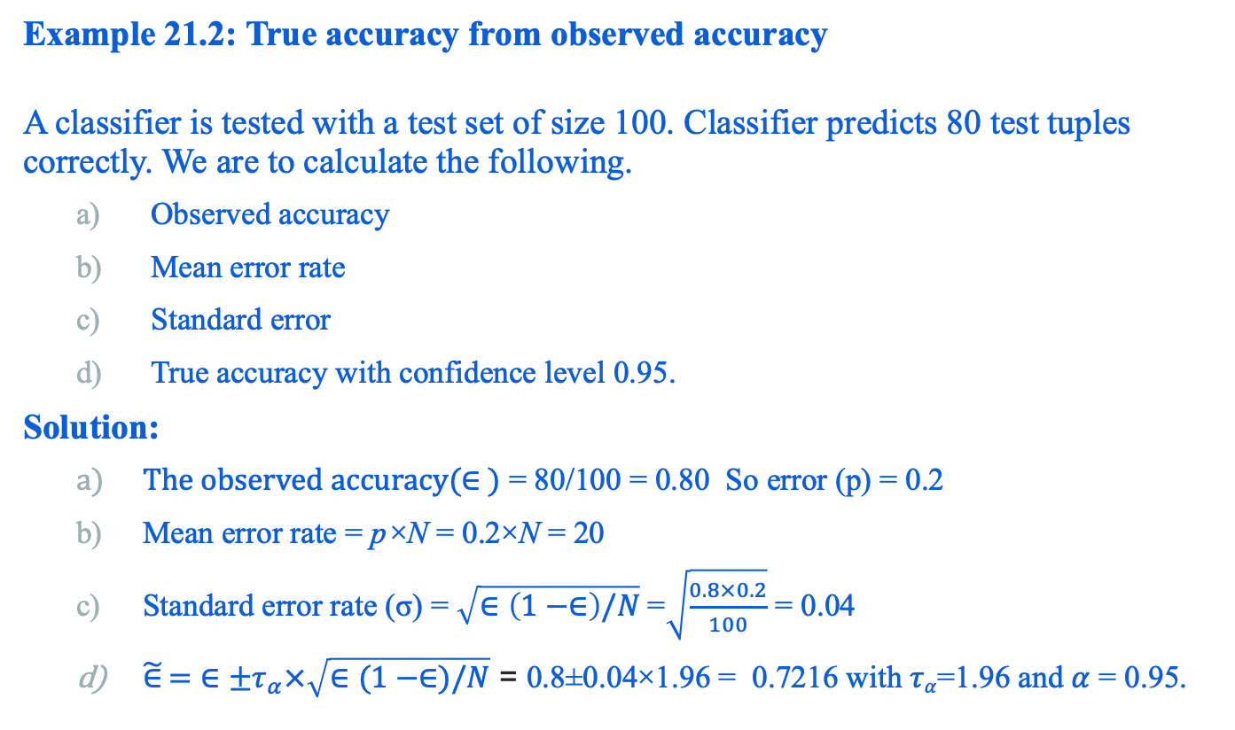
Statistical Estimation using Confidence Level
Example 21.2: True accuracy from observed accuracy
A classifier is tested with a test set of size 100. Classifier predicts 80 test tuples correctly. We are to calculate the following.
Observed accuracy
Mean error rate
Standard error
True accuracy with confidence level 0.95.
Solution:
$The observed accuracy(∈ )$ = 80/100 = 0.80 So error (p) = 0.2
Mean error rate = p×N = 0.2×N = 20
Standard error rate (σ) = $\sqrt{∈\left(1−∈\right)/N}$=$\sqrt{\frac{0.8×0.2}{100}}$ = 0.04
$\tilde{∈} =$ $∈±τ_{α}×\sqrt{∈(1−∈)/N}$ = 0.8±0.04×1.96 = 0.7216 with $τα$=1.96 and $α$ = 0.95.

Slide 28
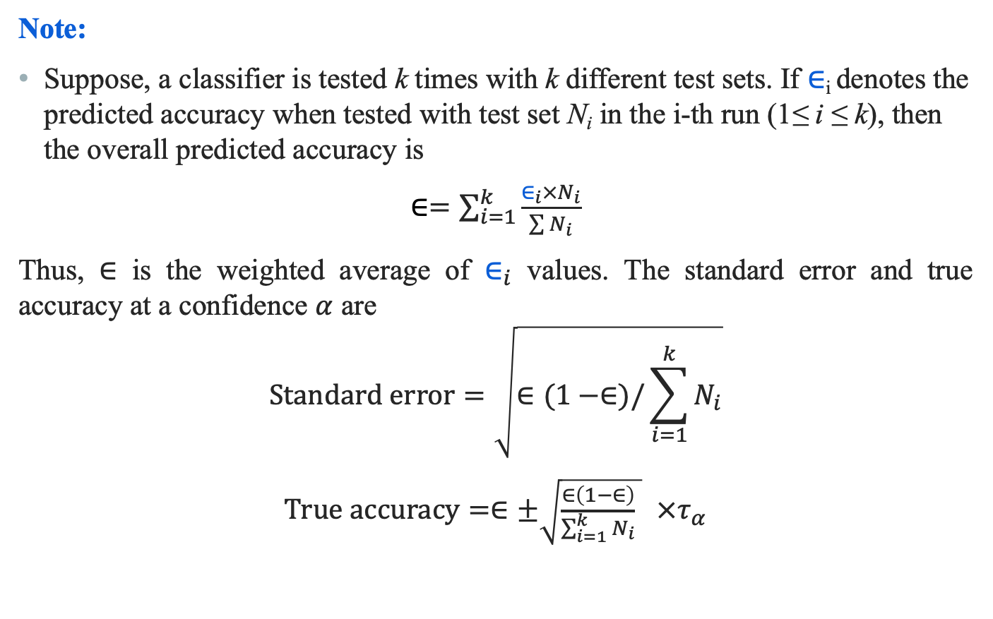
Statistical Estimation using Confidence Level
Note:
Suppose, a classifier is tested k times with k different test sets. If $∈$_{i} denotes the predicted accuracy when tested with test set N_{i} in the i-th run (1≤ i ≤ k), then the overall predicted accuracy is
$∈=\sum_{i=1}^{k}{\frac{∈_{i}×N_{i}}{\sum{N_{i}}}}$
Thus, $∈$ is the weighted average of $∈_{i}$ values. The standard error and true accuracy at a confidence $α$ are
$$Standard error=\sqrt{∈(1−∈)/\sum_{i=1}^{k}{N_{i}}}$$
$True accuracy=∈±\sqrt{\frac{∈\left(1−∈\right)}{\sum_{i=1}^{k}{N_{i}}} }$ $×τ_{α}$

Slide 29
Reference
The detail material related to this lecture can be found in
Data Mining: Concepts and Techniques, (3rd Edn.), Jiawei Han, Micheline Kamber, Morgan Kaufmann, 2015.
Introduction to Data Mining, Pang-Ning Tan, Michael Steinbach, and Vipin Kumar, Addison-Wesley, 2014

Slide 30
Any question?

