Slide 1
Introduction to Data Analytics
Class # 23
Sensitivity Analysis – Performance Estimation
Dr. Sreeja S R
Assistant Professor
Indian Institute of Information Technology
IIIT Sri City

Slide 2
Performance Estimation

Slide 3
Performance Estimation of a Classifier
Predictive accuracy works fine, when the classes are balanced
That is, every class in the data set are equally important
In fact, data sets with imbalanced class distributions are quite common in many real life applications
When the classifier classified a test data set with imbalanced class distributions then, predictive accuracy on its own is not a reliable indicator of a classifier’s effectiveness.
Example 22.1: Effectiveness of Predictive Accuracy
Given a data set of stock markets, we are to classify them as “good” and “worst”. Suppose, in the data set, out of 100 entries, 98 belong to “good” class and only 2 are in “worst” class.
With this data set, if classifier’s predictive accuracy is 0.98, a very high value!
Here, there is a high chance that 2 “worst” stock markets may incorrectly be classified as “good”
On the other hand, if the predictive accuracy is 0.02, then none of the stock markets may be classified as “good”

Slide 4
Performance Estimation of a Classifier
Thus, when the classifier classified a test data set with imbalanced class distributions, then predictive accuracy on its own is not a reliable indicator of a classifier’s effectiveness.
This necessitates an alternative metrics to judge the classifier.
Before exploring them, we introduce the concept of Confusion matrix.

Slide 5
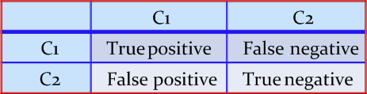
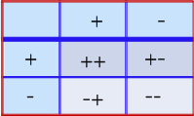
Confusion Matrix
A confusion matrix for a two classes (+, -) is shown below.
There are four quadrants in the confusion matrix, which are symbolized as below.
True Positive (TP: f₊₊) : The number of instances that were positive (+) and correctly classified as positive (+v).
False Negative (FN: f₊₋): The number of instances that were positive (+) and incorrectly classified as negative (-). It is also known as Type 2 Error.
False Positive (FP: f₋₊): The number of instances that were negative (-) and incorrectly classified as (+). This also known as Type 1 Error.
True Negative (TN: f₋₋): The number of instances that were negative (-) and correctly classified as (-).

Slide 6
Confusion Matrix
Note:
N_{p} = TP (f₊₊) + FN (f₊₋)
= is the total number of positive instances.
N_{n} = FP(f₋₊) + TN(f₋₋)
= is the total number of negative instances.
N = N_{p} + N_{n}
= is the total number of instances.
(TP + TN) denotes the number of correct classification
(FP + FN) denotes the number of errors in classification.
For a perfect classifier FP = FN = 0, that is, there would be no Type 1 or Type 2 errors.

Slide 7
Confusion Matrix
Example 22.2: Confusion matrix
A classifier is built on a dataset regarding Good and Worst classes of stock markets. The model is then tested with a test set of 10000 unseen instances. The result is shown in the form of a confusion matrix. The result is self explanatory.
Class | Good | Worst | Total
Good | 6954 | 46 | 7000
Worst | 412 | 2588 | 3000
Total | 7366 | 2634 | 10000
Predictive accuracy?

Slide 8
Confusion Matrix for Multiclass Classifier
Having m classes, confusion matrix is a table of size m×m , where, element at (i, j) indicates the number of instances of class i but classified as class j.
To have good accuracy for a classifier, ideally most diagonal entries should have large values with the rest of entries being close to zero.
Confusion matrix may have additional rows or columns to provide total or recognition rates per class.

Slide 9
Confusion Matrix for Multiclass Classifier
Example 22.3: Confusion matrix with multiple class
Following table shows the confusion matrix of a classification problem with six classes labeled as C₁, C₂, C₃, C₄, C₅ and C₆.
Class | C1 | C2 | C3 | C4 | C5 | C₆
C1 | 52 | 10 | 7 | 0 | 0 | 1
C2 | 15 | 50 | 6 | 2 | 1 | 2
C3 | 5 | 6 | 6 | 0 | 0 | 0
C4 | 0 | 2 | 0 | 10 | 0 | 1
C5 | 0 | 1 | 0 | 0 | 7 | 1
C₆ | 1 | 3 | 0 | 1 | 0 | 24
Predictive accuracy?

Slide 10
Confusion Matrix for Multiclass Classifier
In case of multiclass classification, sometimes one class is important enough to be regarded as positive with all other classes combined together as negative.
Thus a large confusion matrix of m*m can be concised into 2*2 matrix.
Example 22.4: m×m CM to 2×2 CM
For example, the CM shown in the above Example is transformed into a CM of size 2×2 considering the class C₁ as the positive class and classes C₂, C₃, C₄, C₅ and C₆ combined together as negative.
How we can calculate the predictive accuracy of the classifier model in this case?
Are the predictive accuracy same in both Example 22.3 and Example 22.4?
Class | + | -
+ | 52 | 18
- | 21 | 123

Slide 11
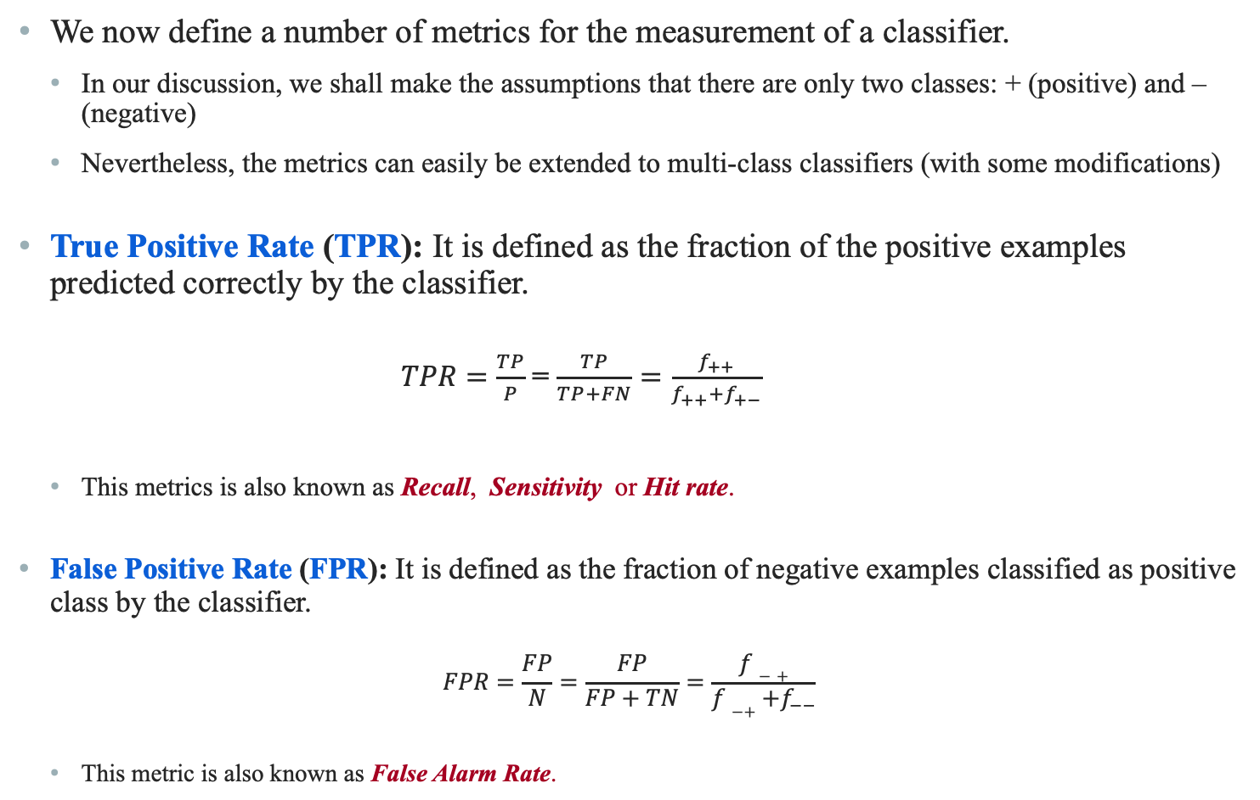
Performance Evaluation Metrics
We now define a number of metrics for the measurement of a classifier.
In our discussion, we shall make the assumptions that there are only two classes: + (positive) and – (negative)
Nevertheless, the metrics can easily be extended to multi-class classifiers (with some modifications)
True Positive Rate (TPR): It is defined as the fraction of the positive examples predicted correctly by the classifier.
$TPR=\frac{TP}{P}$ = $\frac{TP}{TP+FN}=\frac{f_{++}}{f_{++}+f_{+−}}$
This metrics is also known as Recall, Sensitivity or Hit rate.
False Positive Rate (FPR): It is defined as the fraction of negative examples classified as positive class by the classifier.
$$FPR=\frac{FP}{N}=\frac{FP}{FP+TN}=\frac{f−+}{f−++f_{−−}}$$
This metric is also known as False Alarm Rate.

Slide 12
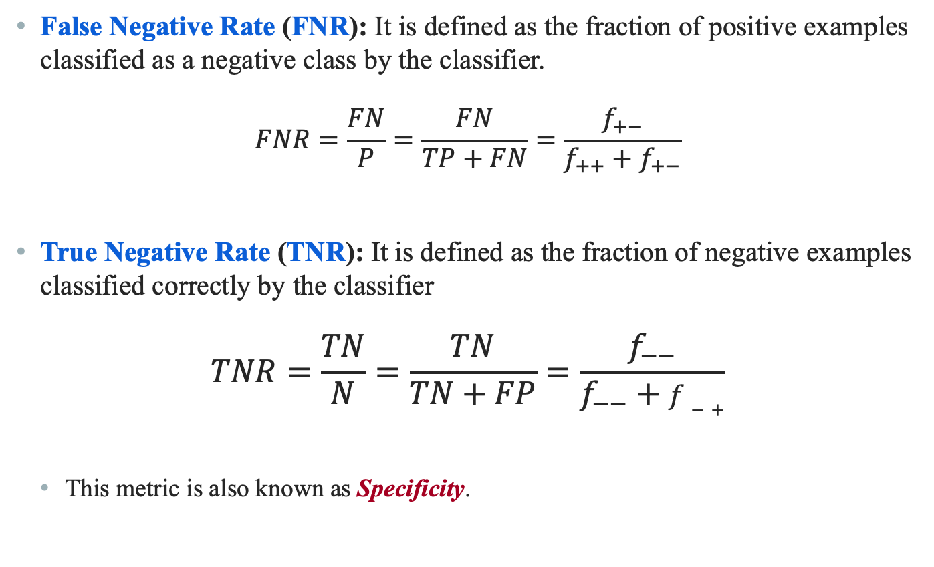
Performance Evaluation Metrics
False Negative Rate (FNR): It is defined as the fraction of positive examples classified as a negative class by the classifier.
$$FNR=\frac{FN}{P}=\frac{FN}{TP+FN}=\frac{f_{+−}}{f_{++}+f_{+−}}$$
True Negative Rate (TNR): It is defined as the fraction of negative examples classified correctly by the classifier
$$TNR=\frac{TN}{N}=\frac{TN}{TN+FP}=\frac{f_{−−}}{f_{−−}+f−+}$$
This metric is also known as Specificity.

Slide 13
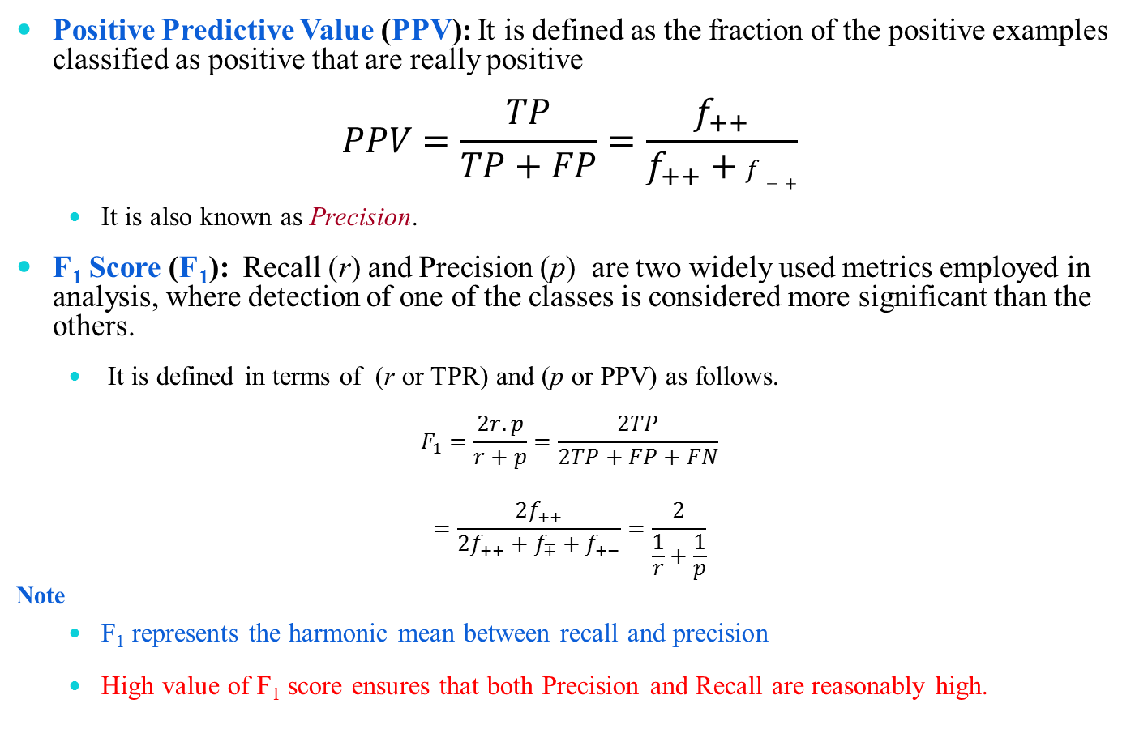
Performance Evaluation Metrics
Positive Predictive Value (PPV): It is defined as the fraction of the positive examples classified as positive that are really positive
$$PPV=\frac{TP}{TP+FP}=\frac{f_{++}}{f_{++}+f−+}$$
It is also known as Precision.
F₁ Score (F₁): Recall (r) and Precision (p) are two widely used metrics employed in analysis, where detection of one of the classes is considered more significant than the others.
It is defined in terms of (r or TPR) and (p or PPV) as follows.
$$F_{1}=\frac{2r.p}{r+p}=\frac{2TP}{2TP+FP+FN}$$
$$=\frac{{2f}_{++}}{{2f}_{++}+f_{∓}+f_{+−}}=\frac{2}{\frac{1}{r}+\frac{1}{p}}$$
Note
F₁ represents the harmonic mean between recall and precision
High value of F₁ score ensures that both Precision and Recall are reasonably high.

Slide 14
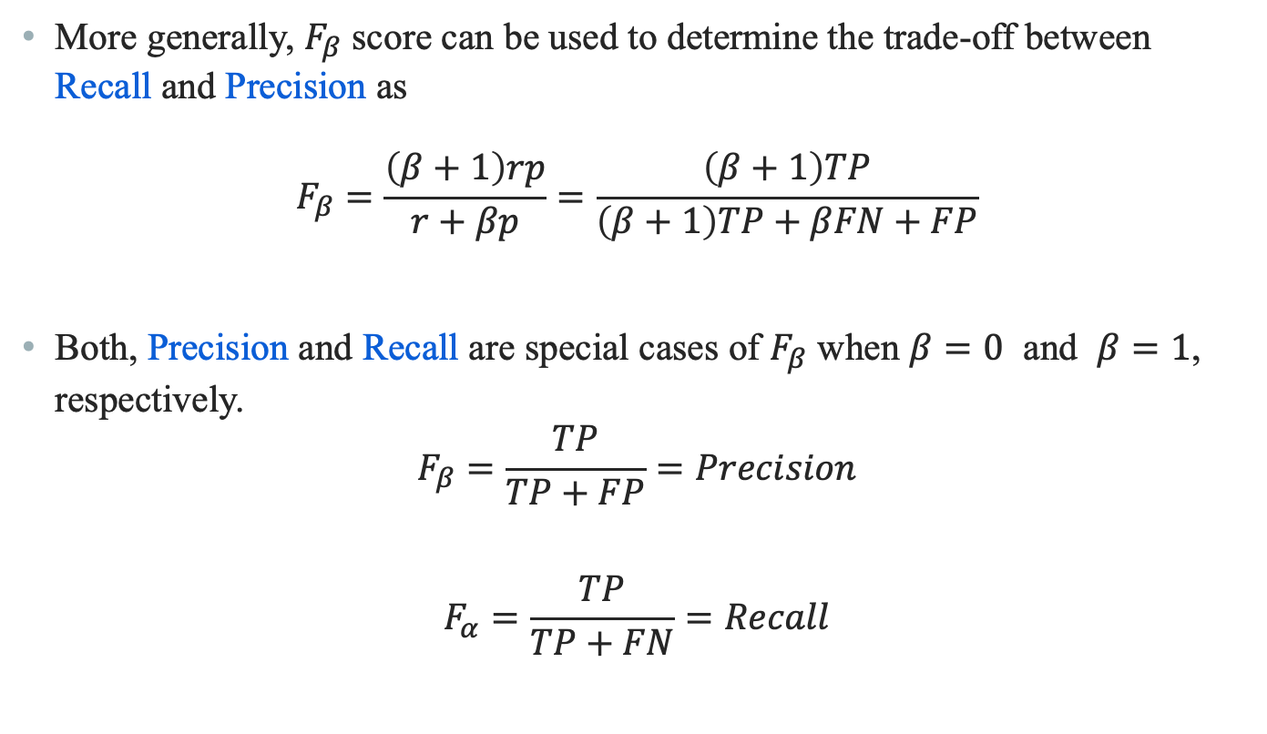
Performance Evaluation Metrics
More generally, $F_{β}$ score can be used to determine the trade-off between Recall and Precision as
$$F_{β}=\frac{\left(β+1\right)rp}{r+βp}=\frac{\left(β+1\right)TP}{\left(β+1\right)TP+βFN+FP}$$
Both, Precision and Recall are special cases of $F_{β}$ when $β=0$ and $β=1$, respectively.
$$F_{β}=\frac{TP}{TP+FP}=Precision$$
$$F_{α}=\frac{TP}{TP+FN}=Recall$$

Slide 15
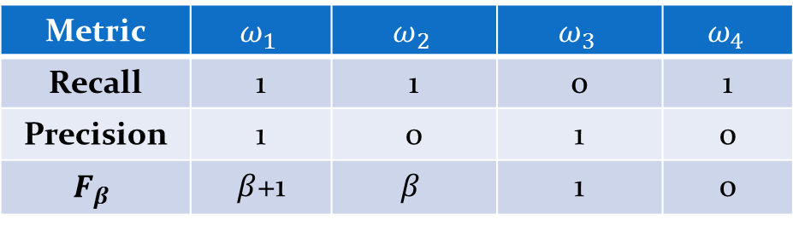

Performance Evaluation Metrics
A more general metric that captures Recall, Precision is defined in the following.
$$F_{ω}=\frac{ω_{1}TP+ω_{4}TN}{ω_{1}TP+ω_{2}FP+ω_{3}FN+ω_{4}TN}$$
Note
In fact, given TPR, FPR, p and r, we can derive all others measures.
That is, these are the universal metrics.
Metric | $$ω_{1}$$ | $$ω_{2}$$ | $$ω_{3}$$ | $$ω_{4}$$
Recall | 1 | 1 | 0 | 1
Precision | 1 | 0 | 1 | 0
$$F_{β}$$ | $β$+1 | $$β$$ | 1 | 0

Slide 16
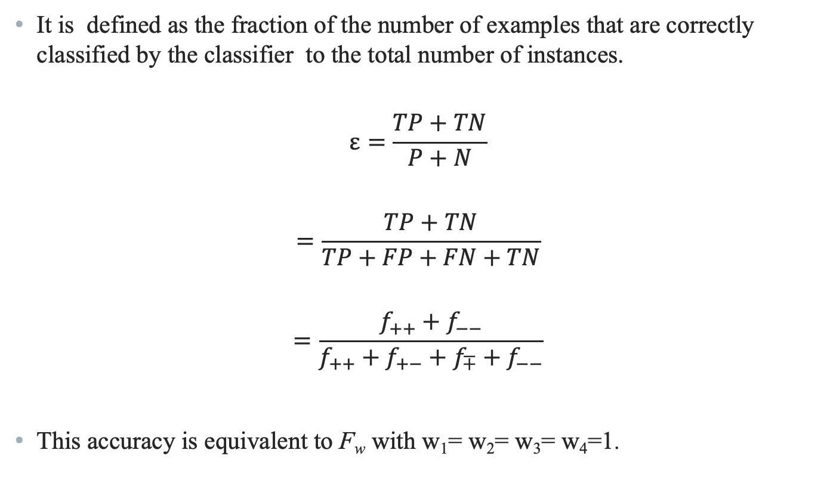
Predictive Accuracy (ε)
It is defined as the fraction of the number of examples that are correctly classified by the classifier to the total number of instances.
$$ε=\frac{TP+TN}{P+N}$$
$$=\frac{TP+TN}{TP+FP+FN+TN}$$
$$=\frac{f_{++}+f_{−−}}{f_{++}+f_{+−}+f_{∓}+f_{−−}}$$
This accuracy is equivalent to F_{w} with w₁= w₂= w₃= w₄=1.

Slide 17


Error Rate ($\overline{\text{ε}}$)
The error rate $\overline{\text{ε}}$ is defined as the fraction of the examples that are incorrectly classified.
$$\overline{\text{ε}}=\frac{FP+FN}{P+N}$$
$$=\frac{FP+FN}{TP+TN+FP+FN}$$
$$=\frac{f_{+−}+f−+}{f_{++}+f_{+−}+f− ++f_{−−}}$$
Note
$\overline{\overline{\text{ε}}}=1−ε$.

Slide 18

Accuracy, Sensitivity and Specificity
Predictive accuracy ($ε$) can be expressed in terms of sensitivity and specificity.
We can write
$$ε =\frac{TP+TN}{TP+FP+FN+TN}$$
$$=\frac{TP+TN}{P+N}$$
$$ε= \frac{TP}{P}×\frac{P}{P+N}+\frac{TN}{N}×\frac{N}{P+N}$$
Thus, $ε=Sensitivity×\frac{P}{P+N}+Specificity×\frac{N}{P+N}$

Slide 19
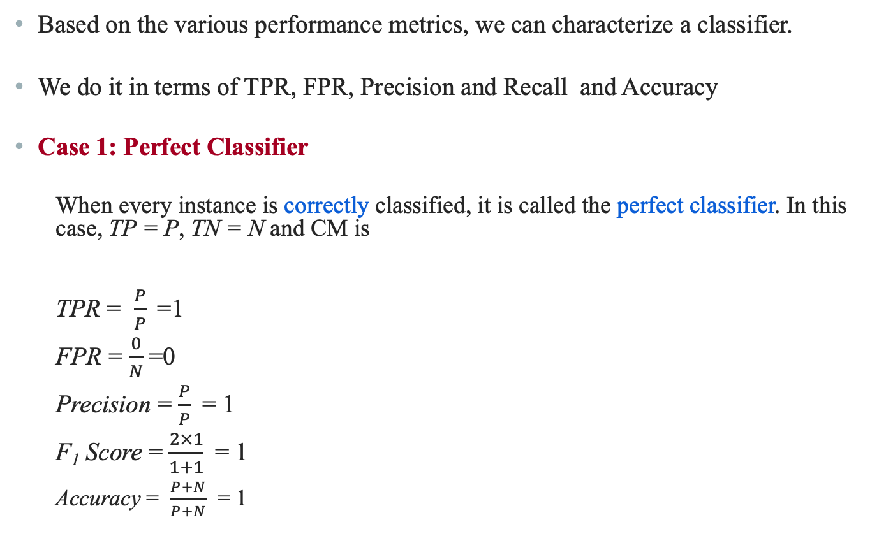
Analysis with Performance Measurement Metrics
Based on the various performance metrics, we can characterize a classifier.
We do it in terms of TPR, FPR, Precision and Recall and Accuracy
Case 1: Perfect Classifier
When every instance is correctly classified, it is called the perfect classifier. In this case, TP = P, TN = N and CM is
TPR = $\frac{P}{P}$=1
FPR = $\frac{0}{N}$=0
Precision = $\frac{P}{P}$ = 1
F₁ Score = $\frac{2×1}{1+1}$= 1
Accuracy = $\frac{P+N}{P+N}$ = 1
 |  | Predicted Class
 |  | + | -
Actual class | + | P | 0
 | - | 0 | N

Slide 20

Analysis with Performance Measurement Metrics
Case 2: Worst Classifier
When every instance is wrongly classified, it is called the worst classifier. In this case, TP = 0, TN = 0 and the CM is
TPR = $\frac{0}{P}$=0
FPR = $\frac{N}{N}$ = 1
Precision = $\frac{0}{N}$ = 0
F₁ Score = Not applicable
as Recall + Precision = 0
Accuracy = $\frac{0}{P+N}$ = 0
 |  | Predicted Class
 |  | + | -
Actual class | + | 0 | P
 | - | N | 0

Slide 21
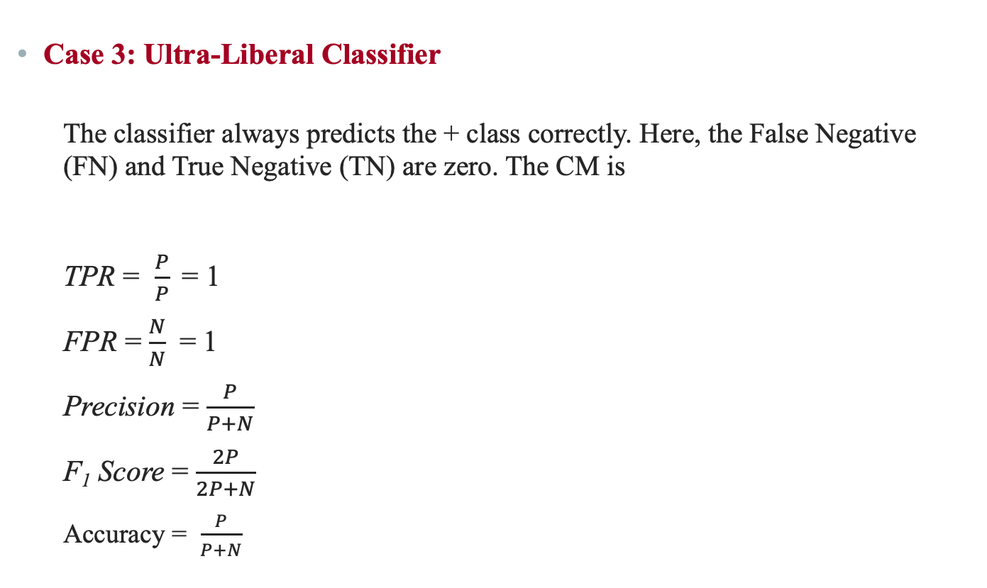
Analysis with Performance Measurement Metrics
Case 3: Ultra-Liberal Classifier
The classifier always predicts the + class correctly. Here, the False Negative (FN) and True Negative (TN) are zero. The CM is
TPR = $\frac{P}{P}$= 1
FPR = $\frac{N}{N}$ = 1
Precision = $\frac{P}{P+N}$
F₁ Score = $\frac{2P}{2P+N}$
Accuracy = $\frac{P}{P+N}$
 |  | Predicted Class
 |  | + | -
Actual class | + | P | 0
 | - | N | 0

Slide 22
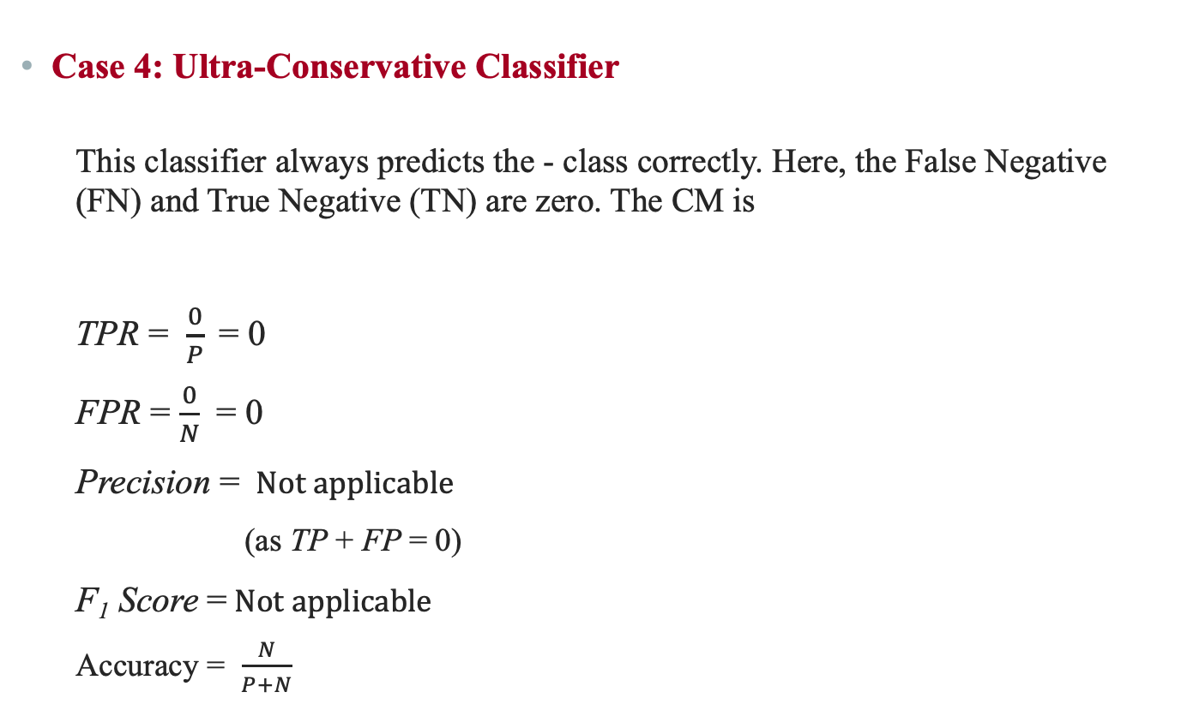
Analysis with Performance Measurement Metrics
Case 4: Ultra-Conservative Classifier
This classifier always predicts the - class correctly. Here, the False Negative (FN) and True Negative (TN) are zero. The CM is
TPR = $\frac{0}{P}$= 0
FPR = $\frac{0}{N}$ = 0
Precision = $Not applicable$
(as TP + FP = 0)
F₁ Score =$Not applicable$
Accuracy = $\frac{N}{P+N}$
 |  | Predicted Class
 |  | + | -
Actual class | + | 0 | p
 | - | 0 | N

Slide 23
Predictive Accuracy versus TPR and FPR
One strength of characterizing a classifier by its TPR and FPR is that they do not depend on the relative size of P and N.
The same is also applicable for FNR and TNR and others measures from CM.
In contrast, the Predictive Accuracy, Precision, Error Rate, F₁ Score, etc. are affected by the relative size of P and N.
FPR, TPR, FNR and TNR are calculated from the different rows of the CM.
On the other hand Predictive Accuracy, etc. are derived from the values in both rows.
This suggests that FPR, TPR, FNR and TNR are more effective than Predictive Accuracy, etc.

Slide 24
ROC Curves

Slide 25
ROC Curves
ROC is an abbreviation of Receiver Operating Characteristic come from the signal detection theory, developed during World War 2 for analysis of radar images.
In the context of classifier, ROC plot is a useful tool to study the behaviour of a classifier or comparing two or more classifiers.
A ROC plot is a two-dimensional graph, where, X-axis represents FP rate (FPR) and Y-axis represents TP rate (TPR).
Since, the values of FPR and TPR varies from 0 to 1 both inclusive, the two axes thus from 0 to 1 only.
Each point (x, y) on the plot indicating that the FPR has value x and the TPR value y.

Slide 26
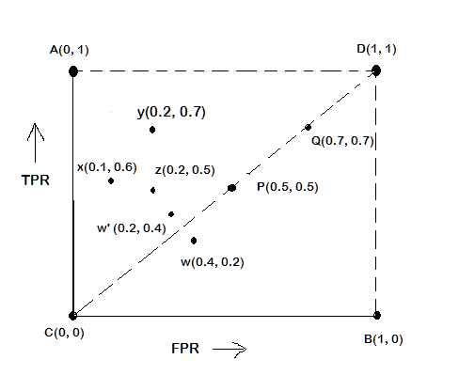
ROC Plot
A typical look of ROC plot with few points in it is shown in the following figure.
Note the four cornered points are the four extreme cases of classifiers
Identify the four extreme classifiers.

Slide 27
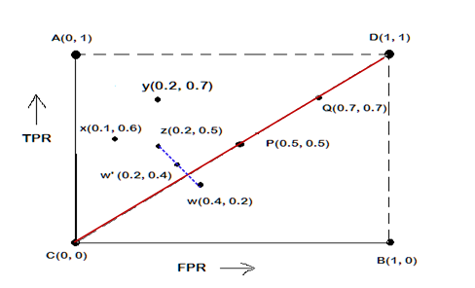
Interpretation of Different Points in ROC Plot
Le us interpret the different points in the ROC plot.
The four points (A, B, C, and D)
A: TPR = 1, FPR = 0, the ideal model, i.e., the perfect classifier, no false results
B: TPR = 0, FPR = 1, the worst classifier, not able to predict a single instance
C: TPR = 0, FPR = 0, the model predicts every instance to be a Negative class, i.e., it is an ultra-conservative classifier
D: TPR = 1, FPR = 1, the model predicts every instance to be a Positive class, i.e., it is an ultra-liberal classifier

Slide 28
Interpretation of Different Points in ROC Plot
Let us interpret the different points in the ROC plot.
The points on diagonals
The diagonal line joining point C(0,0) and D(1,1) corresponds to random guessing
Random guessing means that a record is classified as positive (or negative) with a certain probability
Suppose, a test set contacting N₊ positive and N₋ negative instances. Suppose, the classifier guesses any instances with probability p
Thus, the random classifier is expected to correctly classify p.N₊ of the positive instances and p.N₋ of the negative instances
Hence, TPR = FPR = p
Since TPR = FPR, the random classifier results reside on the main diagonals

Slide 29
Interpretation of Different Points in ROC Plot
Let us interpret the different points in the ROC plot.
The points on the upper diagonal region
All points, which reside on upper-diagonal region are corresponding to classifiers “good” as their TPR is as good as FPR (i.e., FPRs are lower than TPRs)
Here, X is better than Z as X has higher TPR and lower FPR than Z.
If we compare X and Y, neither classifier is superior to the other

Slide 30
Interpretation of Different Points in ROC Plot
Let us interpret the different points in the ROC plot.
The points on the lower diagonal region
The Lower-diagonal triangle corresponds to the classifiers that are worst than random classifiers
Note: A classifier that is worst than random guessing, simply by reversing its prediction, we can get good results.
W’(0.2, 0.4) is the better version than W(0.4, 0.2), W’ is a mirror reflection of W

Slide 31
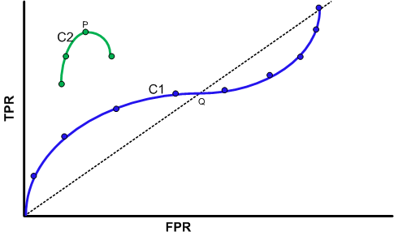
Tuning a Classifier through ROC Plot
Using ROC plot, we can compare two or more classifiers by their TPR and FPR values and this plot also depicts the trade-off between TPR and FPR of a classifier.
Examining ROC curves can give insights into the best way of tuning parameters of classifier.
For example, in the curve C2, the result is degraded after the point P. Similarly for the observation C1, beyond Q the settings are not acceptable.

Slide 32
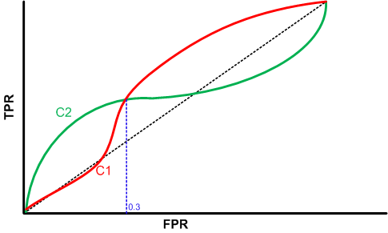
Comparing Classifiers trough ROC Plot
Two curves C1 and C2 are corresponding to the experiments to choose two classifiers with their parameters.
Here, C2 is better than C1 when FPR is less than 0.3.
However, C1 is better, when FPR is greater than 0.3.
Clearly, neither of these two classifiers dominates the other.

Slide 33
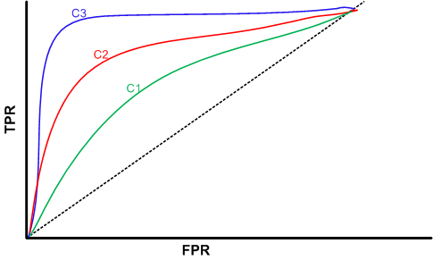
Comparing Classifiers trough ROC Plot
We can use the concept of “area under curve” (AUC) as a better method to compare two or more classifiers.
If a model is perfect, then its AUC = 1.
If a model simply performs random guessing, then its AUC = 0.5
A model that is strictly better than other, would have a larger value of AUC than the other.
Here, C3 is best, and C2 is better than C1 as AUC(C3)>AUC(C2)>AUC(C1).

Slide 34
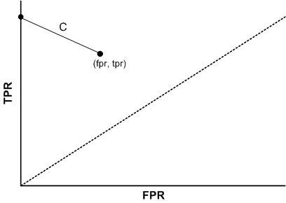
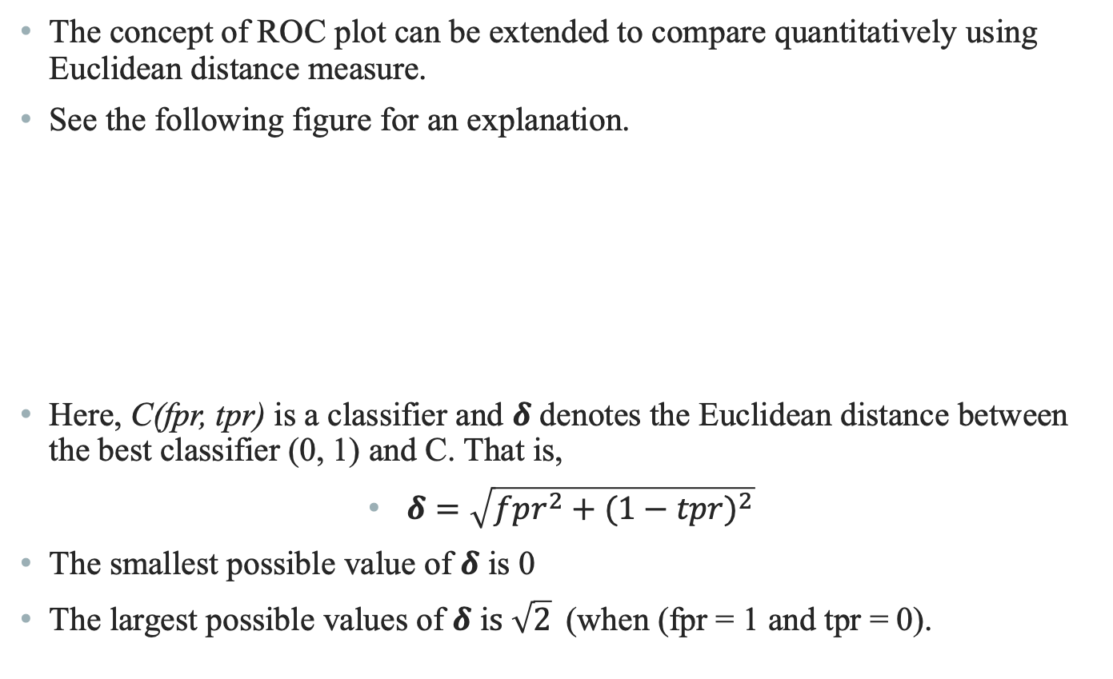
A Quantitative Measure of a Classifier
The concept of ROC plot can be extended to compare quantitatively using Euclidean distance measure.
See the following figure for an explanation.
Here, C(fpr, tpr) is a classifier and $δ$ denotes the Euclidean distance between the best classifier (0, 1) and C. That is,
$δ=\sqrt{{fpr}^{2}+{(1−tpr)}^{2}}$
The smallest possible value of $δ$ is 0
The largest possible values of $δ$ i$s \sqrt{2}$(when (fpr = 1 and tpr = 0).

Slide 35
Reference
The detail material related to this lecture can be found in
Data Mining: Concepts and Techniques, (3rd Edn.), Jiawei Han, Micheline Kamber, Morgan Kaufmann, 2015.
Introduction to Data Mining, Pang-Ning Tan, Michael Steinbach, and Vipin Kumar, Addison-Wesley, 2014

Slide 36
Any question?

