Slide 1
Introduction to Data Analytics
Class # 27
ANOVA
Dr. Sreeja S R
Assistant Professor
Indian Institute of Information Technology
IIIT Sri City

Slide 2

This presentation includes…
What is “Analysis of variance”?
Why ANOVA?
How ANOVA?
$One−way ANOVA$
Two$−way ANOVA$

Slide 3
What is Analysis of Variance?

Slide 4
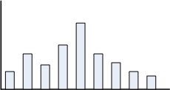
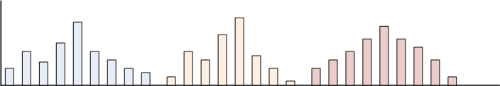
What is analysis of variation?

Slide 5
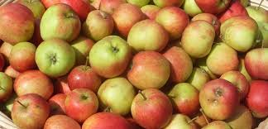

Example : Single vs. Multiple population

Slide 6
What is the issue?
Are the statistical inference valid?
µ
σ

Slide 7
Example 1: The issue in Statistical Testing
A recent study claims that using music in a class enhances the concentration and consequently helps students absorb more information.
What if it affected the results of the students in a negative way?
or
What kind of music would be a good choice for this?
We should have some proof that it actually works or not.

Slide 8
Design of Experiment
The teacher decided to implement it on a smaller group of randomly selected students from three different classes.
Three different groups of ten randomly selected students from three different classrooms were taken.
Each classroom was provided with three different environments for students to study.
Classroom A had constant music being played in the background
Classroom B had variable music being played in the background
Classroom C was a regular class with no music playing
A test was conducted after one month for all the three groups and their test scores were collected.

Slide 9
Test Result
 | Test scores of students (out of 10) |  |  |  |  |  |  |  |  |  | Mean
Class A (constant music) | 7 | 9 | 5 | 8 | 6 | 8 | 6 | 10 | 7 | 4 | 7
Class B (variable music) | 4 | 3 | 6 | 2 | 7 | 5 | 5 | 4 | 1 | 3 | 4
Class C (no music) | 6 | 1 | 3 | 5 | 3 | 4 | 6 | 5 | 7 | 3 | 4.3
 |  |  |  |  |  |  |  | Grand Mean -> |  |  | 5.1

Slide 10
Observations from the results
It is noticed that the mean score of students from Group A is definitely greater than the other two groups, so the treatment must be helpful.
Maybe it’s true, but there is also a slight chance that we happened to select the best students from class A, which resulted in better test scores (remember, the selection was done at random).
This leads to a few questions:
How do we decide that these three groups performed differently because of the different situations and not merely by chance?
In a statistical sense, how different are these three samples from each other?

Slide 11
Analysis of Variance (ANOVA)
Definition 16.1
Analysis of Variance (ANOVA) is derived from a partitioning of total variability into its component parts.
ANOVA is a statistical technique that is used to check if the means of two or more groups are significantly different from each other.
ANOVA checks the impact of one or more factors by comparing the means of different samples.
This technique was invented by Sir Ronald Aylmer Fisher (1921), and is often referred to as Fisher’s ANOVA.

Slide 12
Why ANOVA?

Slide 13

Statistical Inferences
ANOVA is a statistical technique
It is similar in application to techniques such as t-test, z-test and χ²-test in that it is used to compare means and the relative variance between them.
Why not use t-test, z-test and χ²-test ?
Why analysis of variance for comparing means?

Slide 14
Using t-test
t-test is used to:
To infer mean of a single population
T-test can be used to compare two populations
However, t-test is not useful to compare mean of more than two populations

Slide 15
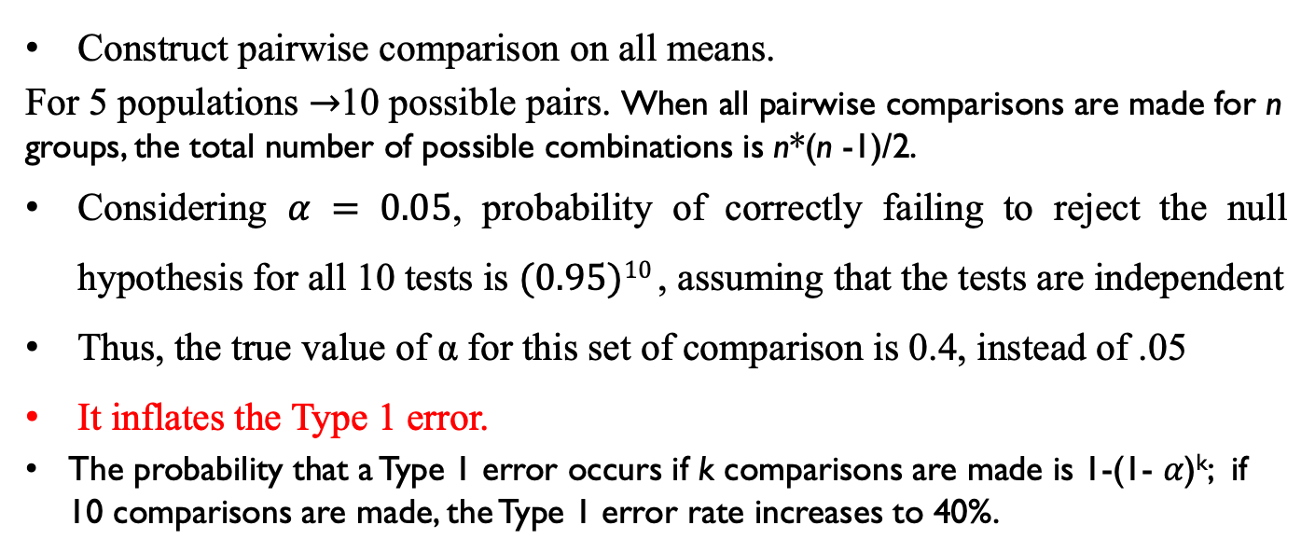
Extending the two population procedure
Construct pairwise comparison on all means.
For 5 populations $→$10 possible pairs. When all pairwise comparisons are made for n groups, the total number of possible combinations is n*(n -1)/2.
Considering $α = 0.05$, probability of correctly failing to reject the null hypothesis for all 10 tests is $(0.95)10$, assuming that the tests are independent
Thus, the true value of α for this set of comparison is 0.4, instead of .05
It inflates the Type 1 error.
The probability that a Type 1 error occurs if k comparisons are made is 1-(1- $α$)^{k}; if 10 comparisons are made, the Type 1 error rate increases to 40%.
Kao, Lillian S. et al., “Analysis of Variance: Is There a Difference in Means and What Does It Mean?”, Journal of Surgical Research, Volume 144, Issue 1, 158 – 170,2007

Slide 16
Extending the two population procedure
Statistical Inference I
A car magazine wishes to compare the average petrol consumption of THREE models for car and has available SIX vehicles of each model.
There are THREE populations
There are samples each of size six from each population
Model 1 | Model 2 | Model 3

Slide 17
Extending the two population procedure
Statistical Inference II
A teacher is interested in a comparison of the average percentage marks obtained in the examinations of five different subjects and has available the marks of eight students who all completed each examination.
What is the number of populations?
How many samples? What are their sizes?? Are each sample independent to each other?
Subject 1 | Subject 2 | Subject 3 | Subject 4 | Subject 5

Slide 18
Example 2 : Why ANOVA?
Consider the two sets of contrived data as shown below:
Observations:
Looking only at the means, we can see that they are identical for the three populations in both the sets.
Using the means alone, we would state that there is no difference between the two sets.
Set 1 (Benz) |  |  | Set 2 (Toyota)
Sample 1 | Sample 2 | Sample 3 | Sample 1 | Sample 2 | Sample 3
5.7 | 9.4 | 14.2 | 3.0 | 5.0 | 11.0
5.9 | 9.8 | 14.4 | 4.0 | 7.0 | 13.0
6.0 | 10.0 | 15.0 | 6.0 | 10.0 | 16.0
6.1 | 10.2 | 15.6 | 8.0 | 13.0 | 17.0
6.3 | 10.6 | 15.8 | 9.0 | 15.0 | 18.0
y¯ = 6.0 | y¯ = 10.0 | y¯ = 15.0 | y¯ = 6.0 | y¯ = 10.0 | y¯ = 15.0

Slide 19
Box plots of the two experiments
Observation from Box plots
It appears that there is stronger evidence of differences among means in Set 1 than among means in Set 2.
The observations within the samples are more closely bunched in Set 1 than they are in Set 2.
We know that sample means from populations with smaller variances will also be less variable.
(Central Limit Theorem)
Thus, although the variances among the means for the two sets are identical, the variance among the observations within the individual samples is smaller for Set 1 and is the reason for the apparently stronger evidence of different means.
This observation is the basis for using the analysis of variance for making inferences about differences among means.
The analysis of variance is based on the comparison of the variance among the means of the populations to the variance among sample observations within the individual populations.

Slide 20
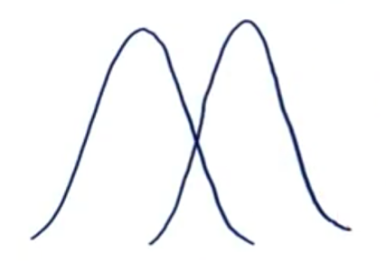
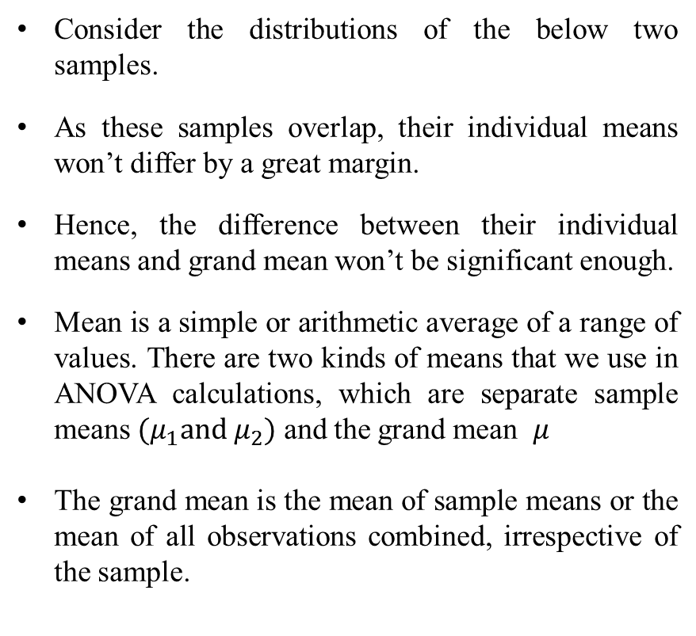
Between Group Variability
Variance among the means of the populations
Consider the distributions of the below two samples.
As these samples overlap, their individual means won’t differ by a great margin.
Hence, the difference between their individual means and grand mean won’t be significant enough.
Mean is a simple or arithmetic average of a range of values. There are two kinds of means that we use in ANOVA calculations, which are separate sample means $(μ_{1}and μ_{2})$ and the grand mean $μ$
The grand mean is the mean of sample means or the mean of all observations combined, irrespective of the sample.

Slide 21
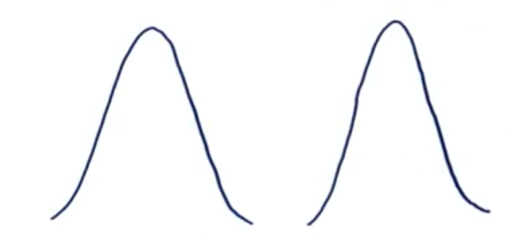
Between Group Variability
Now consider these two sample distributions. As the samples differ from each other by a big margin, their individual means would also differ. The difference between the individual means and grand mean would therefore also be significant.
Such variability between the distributions called Between-group variability or variance among the means of the populations.
Each sample is looked at and the difference between its mean and grand mean is calculated to calculate the variability.
If the distributions overlap or are close, the grand mean will be similar to the individual means, whereas if the distributions are far apart, difference between means and grand mean would be large.

Slide 22
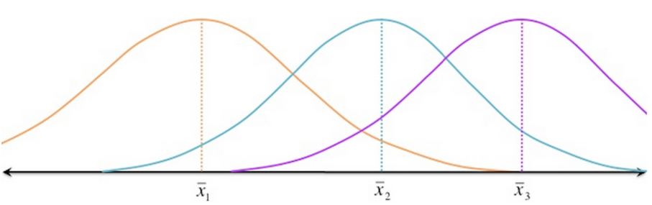
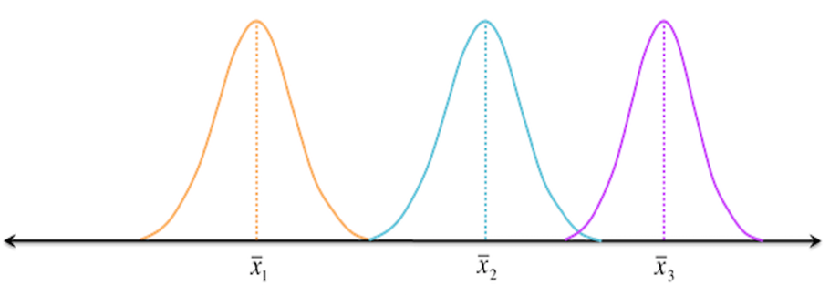
Within Group Variability
Variance among sample observations
Consider the given distributions of three samples. As the spread (variability) of each sample is increased, their distributions overlap and they become part of a big population.
Now consider another distribution of the same three samples but with less variability. Although the means of samples are similar to the samples in the given image, they seem to belong to different populations.

Slide 23
Reference
The detail material related to this lecture can be found in
Design and Analysis of Experiments (8th Edition), Douglas C. Montgomery, John Wiley & Sons, 2013.

Slide 24
Any question?

