Slide 1
Churn Analysis
Done by: Anirudh Reddy Jillela

Slide 2
Understanding and Overview of Business
We will employ exploratory data analysis to obtain actionable insights, transform them into relevant tales, and present them so that the organization can take the required measures to decrease customer churn by keeping them.

Slide 3
Data Understanding

Slide 4
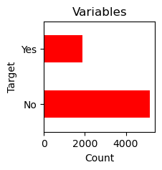
Target Variable
Customers that have churned: 1869
Customers who are active: 5174
As a result, 26.5% of all clients were lost.
To gain some insight into who are high churners, we must study all of the variables in relation to churn rate.

Slide 5
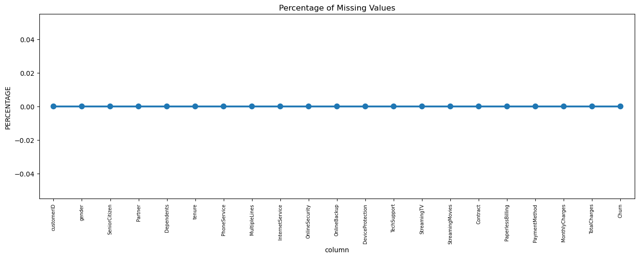
Initial Intuition and Missing Data
For features with fewer missing values, regression can be used to forecast missing values or the mean of the values present, depending on the feature.
Columns having a significant number of missing values should be removed since they provide little insight into the analysis

Slide 6
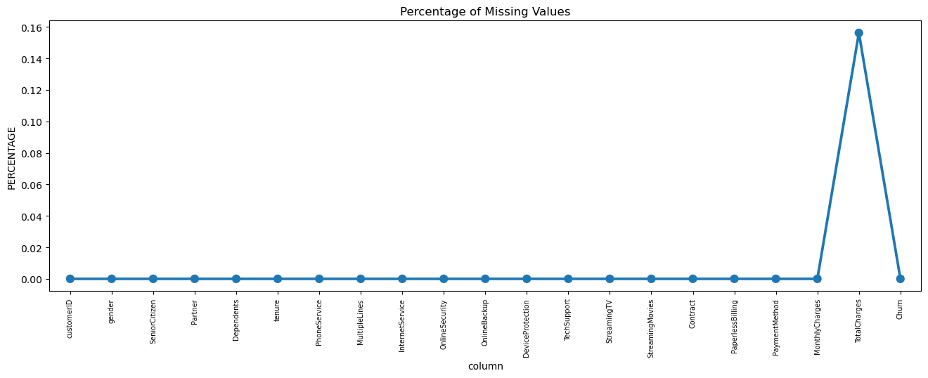
We discovered 11 rows of missing data after converting the column total charges to numerical values.
We divided the customers into bins depending on tenure, for example, for tenure of 12 months, assign a tenure group of 1-12, for tenure of 1 to 2 years, assign a tenure group of 13-24, and so on.

Slide 7
Categorical Analysis

Slide 8
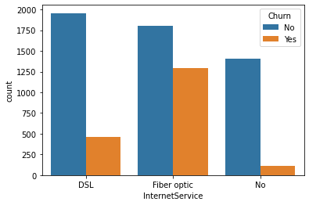
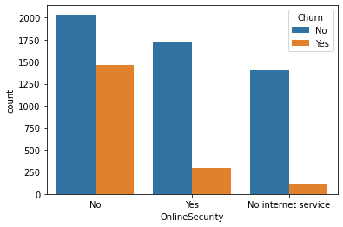
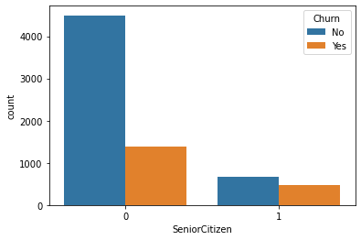
Univariate Analysis
We studied each feature individually in terms of turnover rate and created 17 charts. Some preliminary findings include:
Senior Citizens are more prone to churn, with a 41% turnover rate.
Customers who do not have a partner are more likely to churn, with a 33% turnover rate.
Customers without dependents are more likely to churn, with a 31% turnover rate.
Customers with fiber optic internet connection are more likely to churn (42%).
Customers that do not have online security are more likely to churn, with a 42% turnover rate.
Customers that do not have online backup are more likely to churn, with a 40% turnover rate.
Customers who do not have device protection are 39% more likely to churn.
Customers that do not have access to technical help are more likely to churn, with a 41% turnover rate.
Customers on month-to-month contracts are more likely to churn, with a 43% turnover rate.
Customers that receive paperless invoicing are 33% more likely to churn.
Customers that pay using electronic cheques are more likely to churn, with a 42% turnover rate.
Customers with a tenure of 1 to 12 months are more likely to churn, with a turnover rate of 48%.

Slide 9
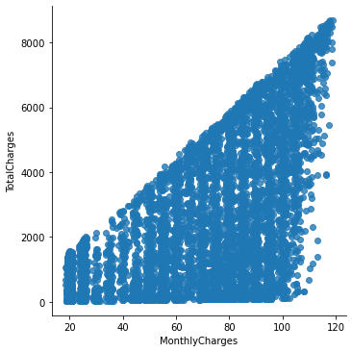
Monthly charges vs Total charges
Finding
1: Total charges and monthly charges have a positive association.
2. As monthly charges rise, total charges rise as well.

Slide 10
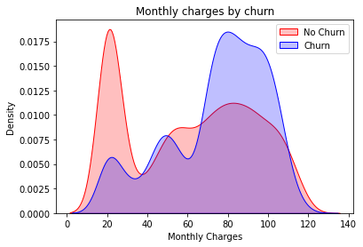
Monthly charges vs Churn
Findings:
When monthly charges are high, churn is high.

Slide 11
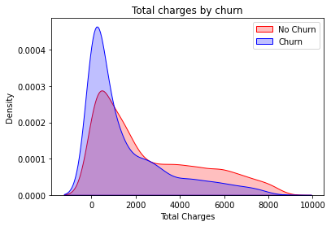
Total Charges vs churn
Findings:
Increasing Churn at Decreased Total Charges

Slide 12
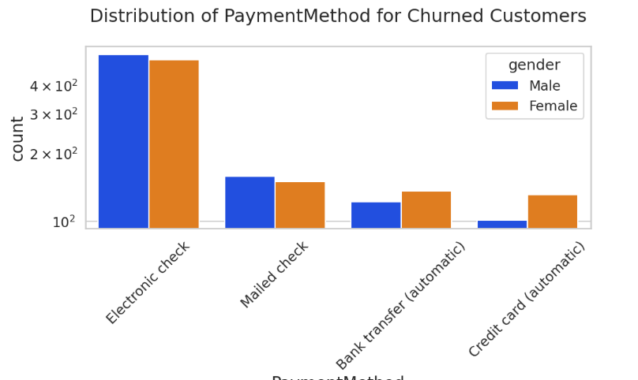
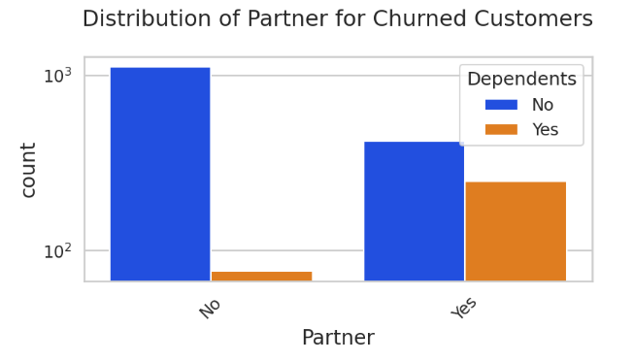
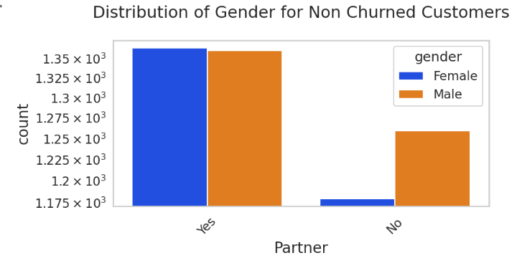
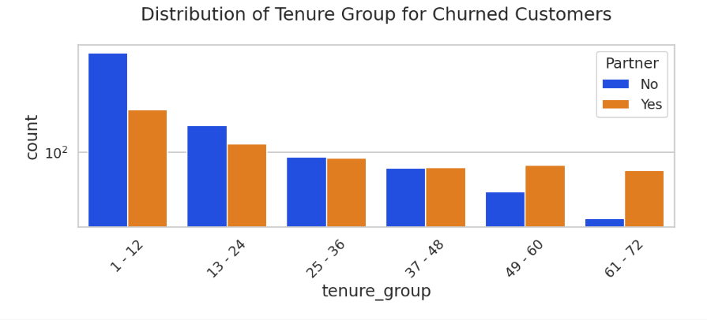
Bivariate Analysis

Slide 13
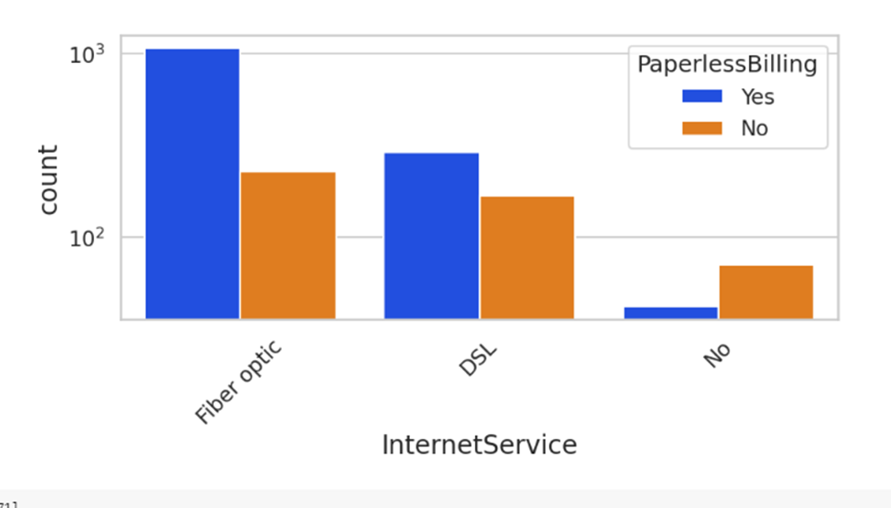
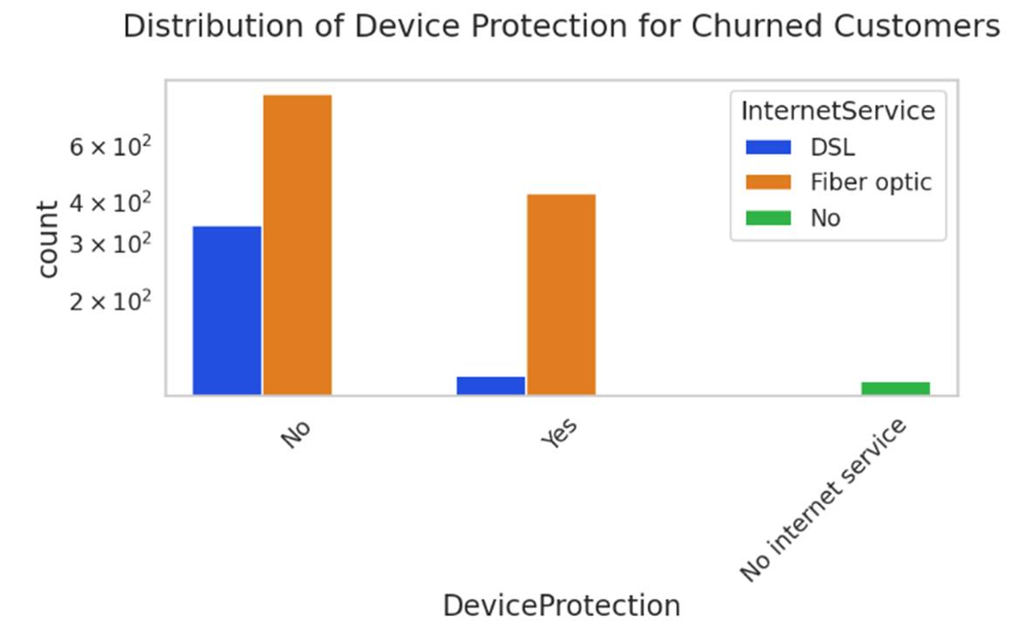
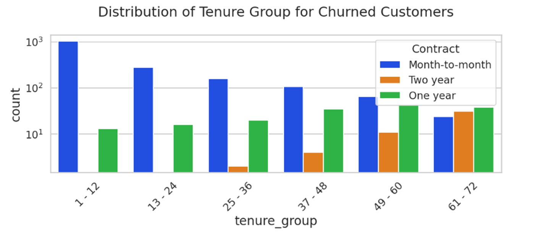

Slide 14
Conclusion
Senior citizens have a higher turnover rate of roughly 42%.
People on monthly contracts are the most likely to leave.
Fiberoptic service users have a high turnover rate.
Electronic check payments are the most popular.
People on two-year contracts are less likely to leave.
Males who do not have partners are more likely to churn (33%).
Females who use credit cards for payment are more likely to churn than males.

Slide 15

THANK YOU

